Slide 1
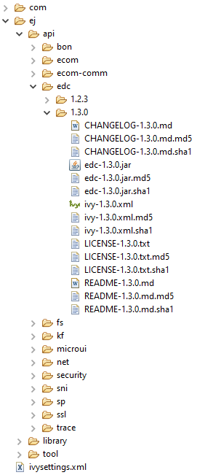
Modules Tree
Local (offline) settings file

