Slide 1

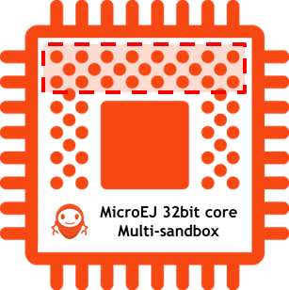
Source BSP
Firmware Build Flow
bin
src
bin
src
bin
MicroEJ Platform
Java Application
Java Libraries
Add-on Libraries
C Code BSP code
Adaptation Layer
+ MicroEJ Startup
C Libraries
Legacy C Libraries
(.java, .list, resources)
(.c, .h)
1
Java Compiler
C Compiler
(.a, .jar)
(.jar)
(.jar)
2
MicroEJ SDK (App Builder)
(microejruntime.a, microejapp.o)
(.o)
(.a)
ELF Linker
(.out, .hex, …)
bin
Firmware
MEJ32 Core
Java Application
BSP code C code
3

