Slide 1
font
*.ttf
font
*.ejf
image
*.png
*.class
*.class
*.class
*.class
*.class
*.class
Font
Designer
Java class file
*.class
Java class files
*.jar
resource
*.*
font
*.ejf
image
*.png
image
*.jpg
image
*.bmp
*.class
*.class
*.class
*.class
*.class
*.class
*.class
*.class
*.class
*.class
*.class
*.class
*.class
*.class
SOAR
(smart linker)
Font Generator
Image Generator
MicroEJ Application executable file
MicroEJ platform
(runtime)
UI engines (C modules)
Display / Input / LED

Slide 2
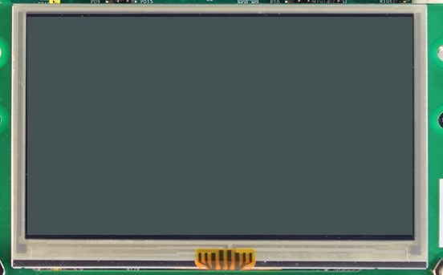
Memory
Width * Height * BPP / 8
Drawings

Slide 3
MCU
Display module
Memory
Memory
SPI
LCDC

Slide 4
MCU
Display module
Memory
LCDC
LCDC

Slide 5
MCU
Display module
Memory
Memory
Drawings
SPI
LCDC
Flush

Slide 6
MCU
Display module
Memory
Drawings
LCDC
LCDC

Slide 7
MCU
Display module
Back buffer
Frame buffer
Drawings
LCDC
LCDC
Flush

Slide 8
MCU
Display module
Back buffer 3
Back buffer 1
Drawings
LCDC
LCDC
Flush
Back buffer 2

Slide 9
MCU
Display module
Memory
Memory
SPI
LCDC
Memory
Drawings
Flush

Slide 10
MCU
Display module
Back buffer
Frame buffer
Drawings
LCDC
LCDC
Flush

Slide 11
MCU
Display module
Back buffer
Drawings
Frame buffer
LCDC
LCDC
Flush
Back buffer

Slide 12

A
C
A
D
A
A
C
B
B
A
B
A
B

Slide 13
drawing
drawing
drawing
flush
drawing
drawing
flush
new region
drawing
drawing
new region
drawing
refresh
flush
post-flush
new region
drawing
drawing
refresh
flush
post-flush
new region
drawing
drawing
new region
drawing
refresh
flush
post-flush
…
new region
drawing
drawing
drawing(s)
flush
post-flush
new region
drawing(s)
drawing(s)
refresh
new region
flush
post-flush

Slide 14
Connection : Serial
no
Available RAM
for 1 buffer
yes
Available RAM
for 2 buffers
yes
no
Direct
Partial
Single
Copy & Swap
Swap Double
Swap Triple
Available RAM
for a partial buffer
Available RAM
for 3 buffers
Available RAM
for 3 buffers
no
yes
no
yes
no
yes
Display can
change its source
buffer address
no
yes
Available RAM
for 2 buffers
no
yes
Connection : Parallel

Slide 15
Connection : Serial
Connection : Parallel
Direct
no
Available RAM
for a partial buffer
Partial
yes
no
Available RAM
for 1 buffer
no
Single
Available RAM
for 2 buffers
no
no
yes
Available RAM
for 2 buffers
Available RAM
for 3 buffers
yes
Copy & Swap
yes
yes
no
Display can
change its source
buffer address
Swap Double
no
yes
Available RAM
for 3 buffers
Swap Triple
yes

Slide 16
0 buffer
Available RAM
for n buffer(s)
2 buffers
1 buffer
Direct
Partial
Single
Copy & Swap
Swap Double
Swap Triple

Slide 17
Available RAM
for 2 buffers
no
yes
Display can
change its source
buffer address
no
yes
Available RAM
for a partial buffer
Available RAM
for 3 buffers
Available RAM
for 3 buffers
no
yes
no
yes
no
yes
Direct
Partial
Single
Copy & Swap
Swap Double
Swap Triple

