Slide 1
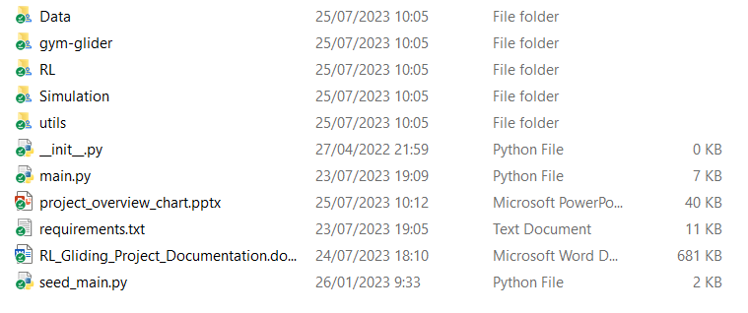
Simulation
glider_simulation.py
gym-glider
cluster_utils
Data
glider_env_learning.py
wind_simulation.py
RL
main.py
seed_main.py
hyperparameters
wandb_training.py

