Slide 1
OData Tips and Tricks
SaaS TAM
07 10 2023
|
Thanh Phan

Slide 2
Agenda
Prerequisites for OData
Accessing OData using Power BI
Accessing OData using Postman

Slide 3
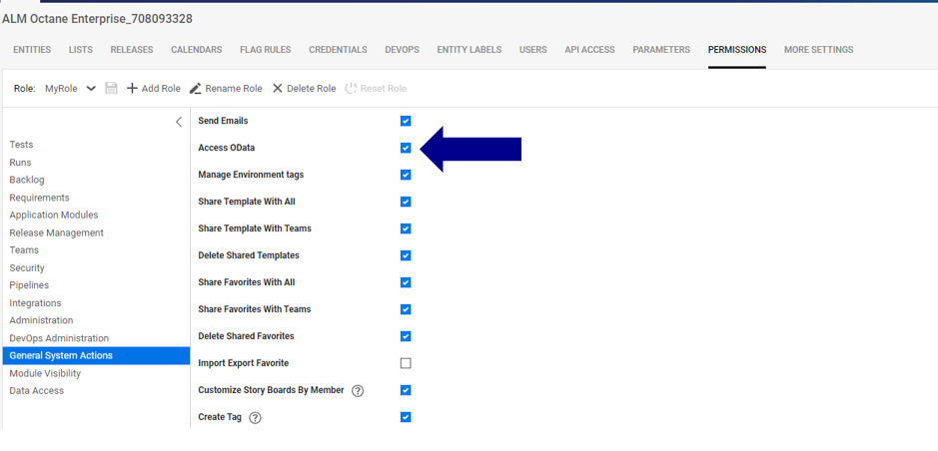
Enable Access OData

Slide 4
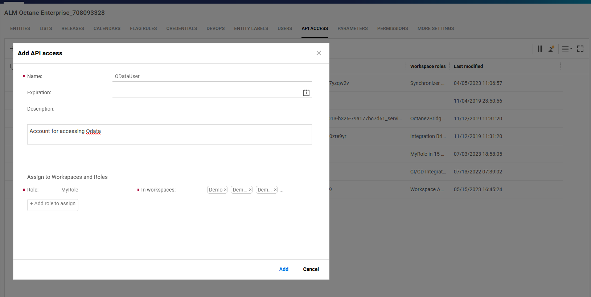
Create API Key And Grant Access to Workspace
Create an APIKey and provide access to the appropriate workspaces

Slide 5
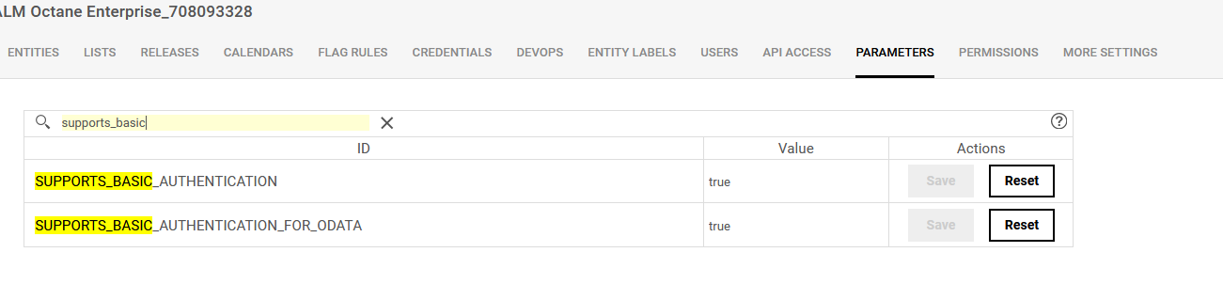
Enable SUPPORTS_BASIC_AUTHENTICATION

Slide 6
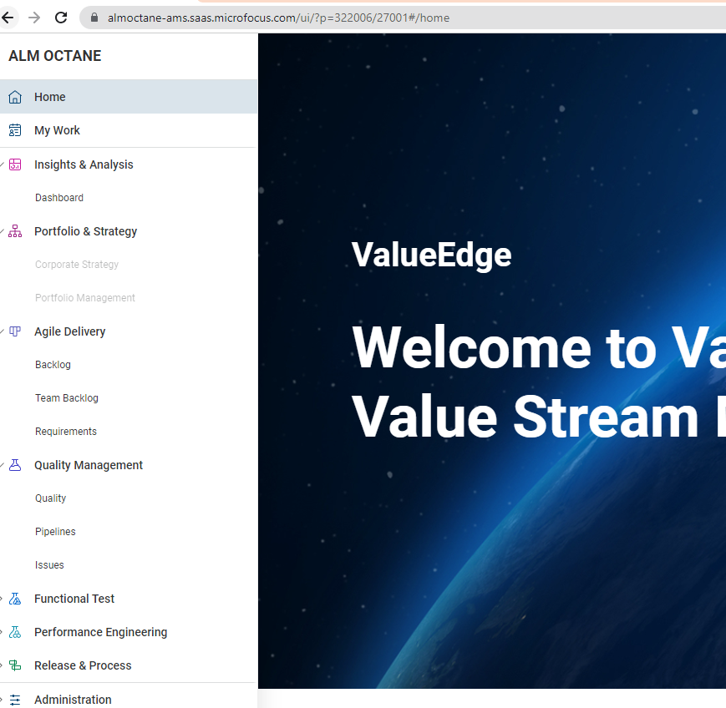
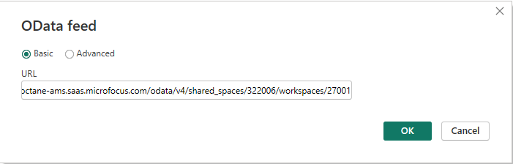
PowerBI Connection
<https://server> :<port> /odata/v4/shared_spaces/<space_ID>/workspaces/<workspace_ID>/
Example:
https://almoctane-ams.saas.microfocus.com/odata/v4/shared_spaces/322006/workspaces/27001

Slide 7
Cross Workspaces
Single workspace:
<https://server> :<port> /odata/v4/shared_spaces/<space_ID>/workspaces/<workspace_ID>/
Multiple workspaces:
<https://server> :<port> /odata/v4/shared_spaces/<space_ID>/workspaces/<workspace_ID>/cross_workspace/<1002>,<1003>
All workspaces:
<https://server> :<port> /odata/v4/shared_spaces/<space_ID>/workspaces/<workspace_ID>/cross_workspace/*

Slide 8
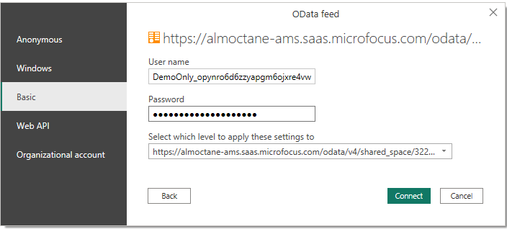
Use Basic Authentication
Use Basic authentication and enter API Key for “User name” and Secret for “Password”

Slide 9
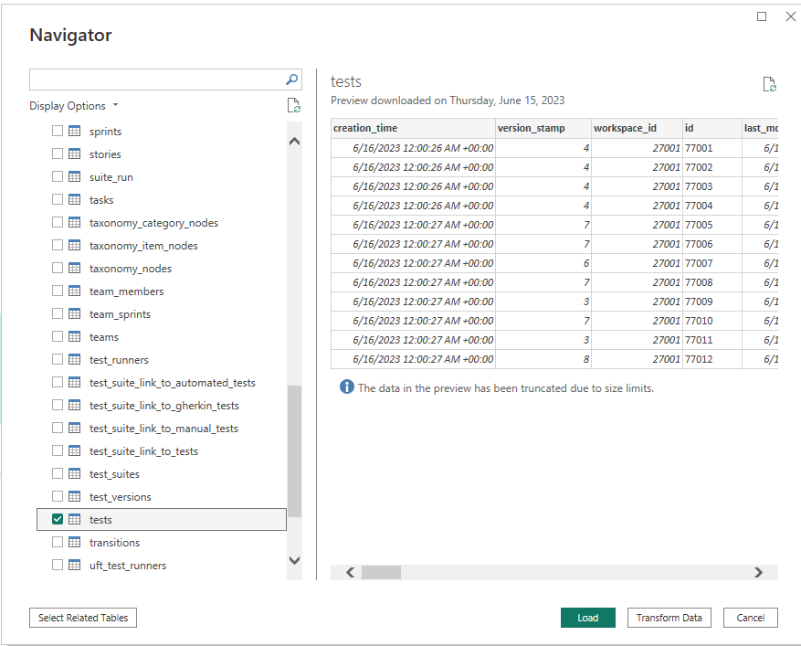
Select VE Collection to load
Select the collection from the connection. There are 59 collections available.

Slide 10
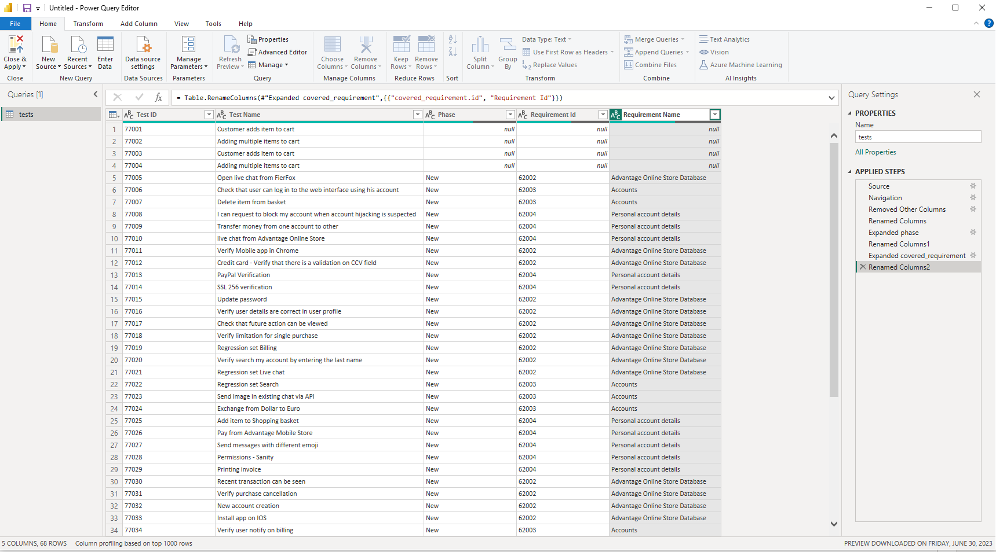
Transform Data
Transform data by applying column selection, filter, rename and etc.

Slide 11
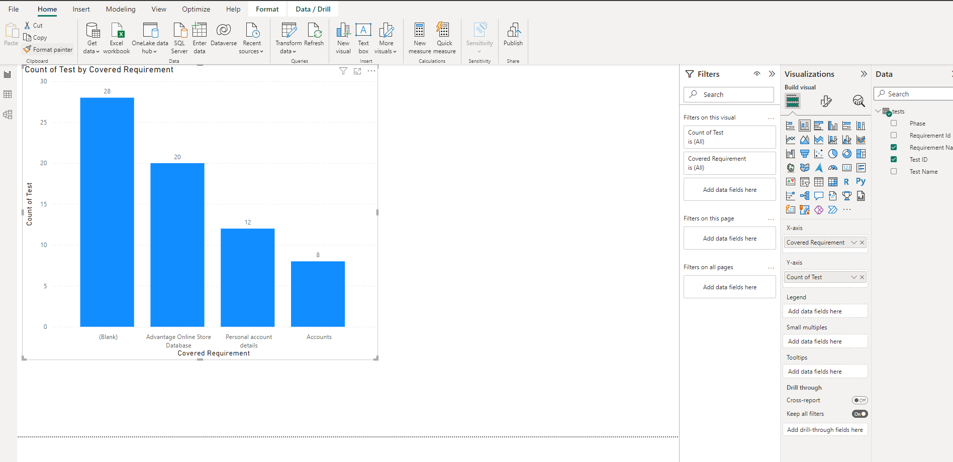
Graph Data
Graph data using the data load in PowerBI

Slide 12
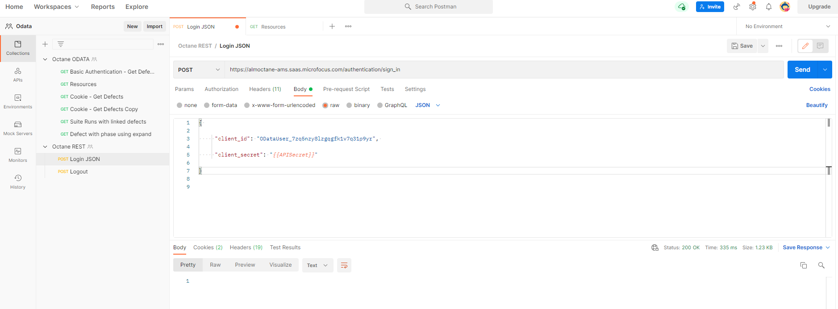
Odata for Developers – Authentication using JSON
Add JSON string containing API and Secret or username and Password.

Slide 13
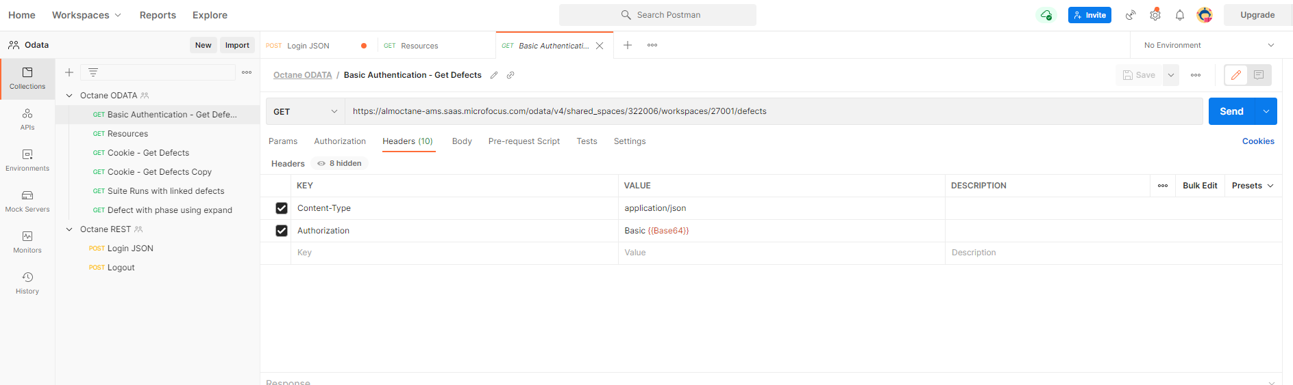
Odata for Developers – Authentication using Basic Authentication
Add Authorization Header with Base64 encrypted username:password or apikey:secret prefixed by Basic string

Slide 14
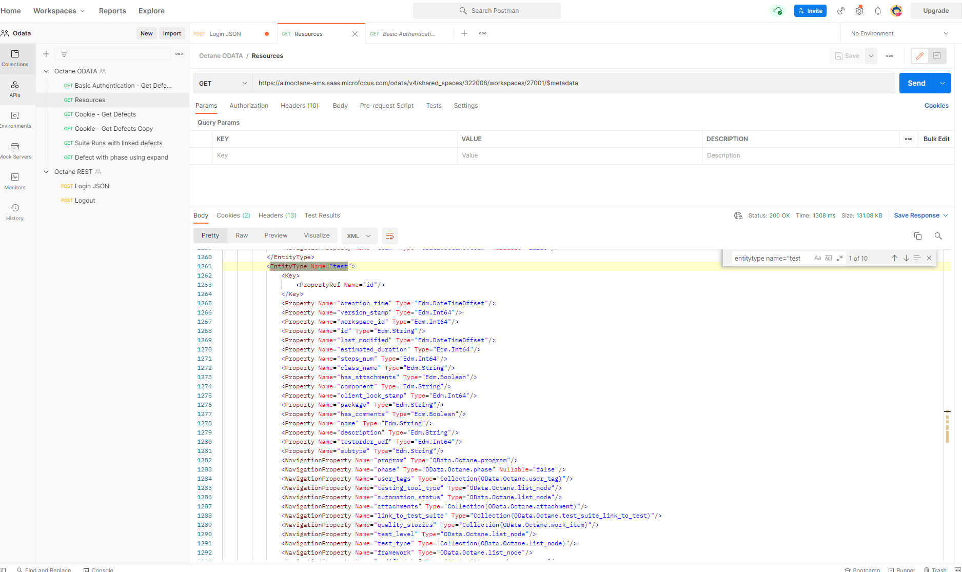
Odata for Developers: metadata
GET: <https://server> :<port> /odata/v4/shared_spaces/<space_ID>/workspaces/<workspace_ID>/metadata
Query metadata to get the odata REST resources

Slide 15
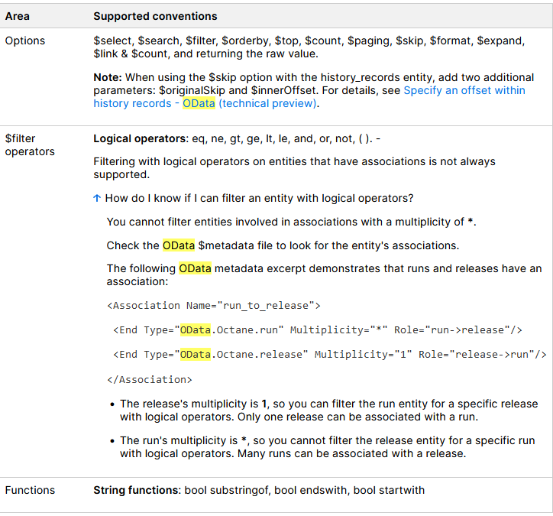
Odata for Developers: Options and Operators

Slide 16
THANK YOU

