Slide 1
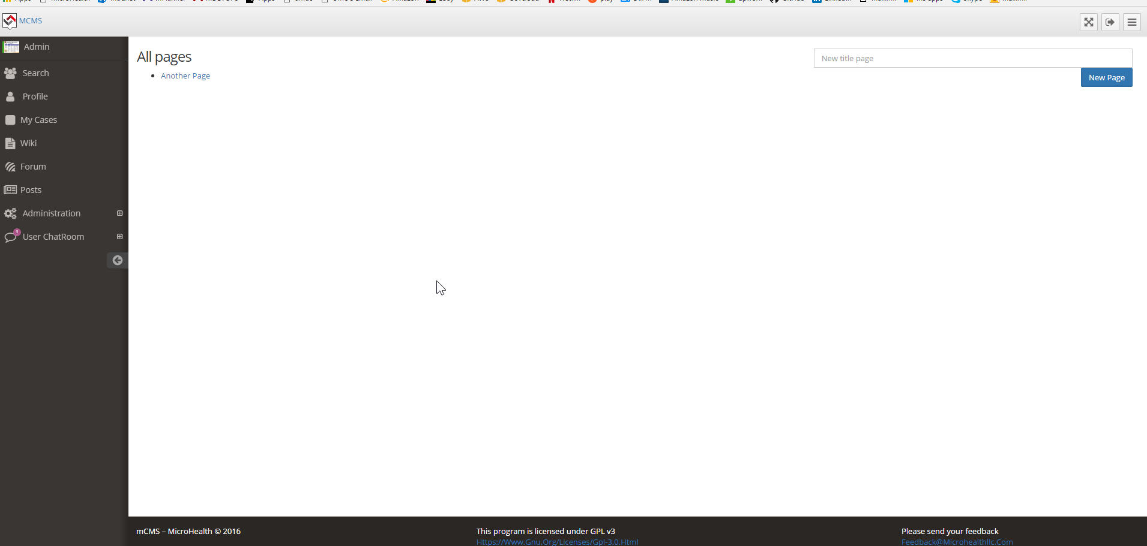
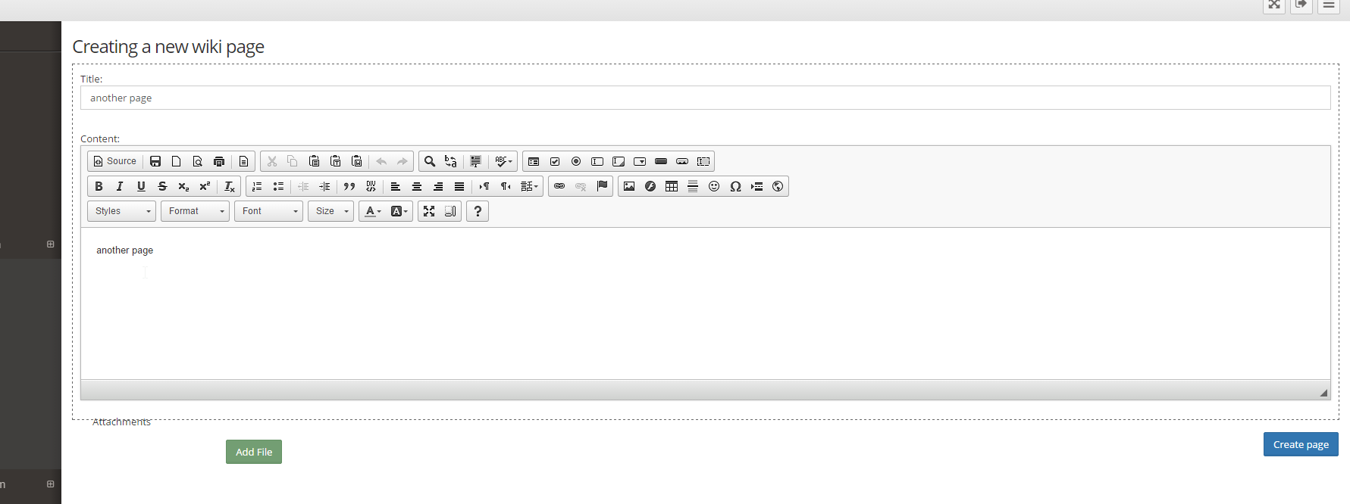
Clicking new page edits the page
Rather than creates a new one
Need to be able to create a new one
AND make it a sub page to a parent page
Just like redmine

Slide 2
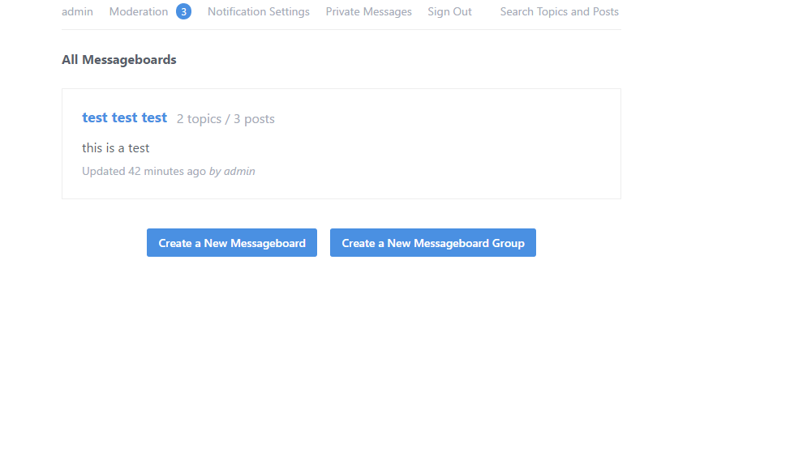
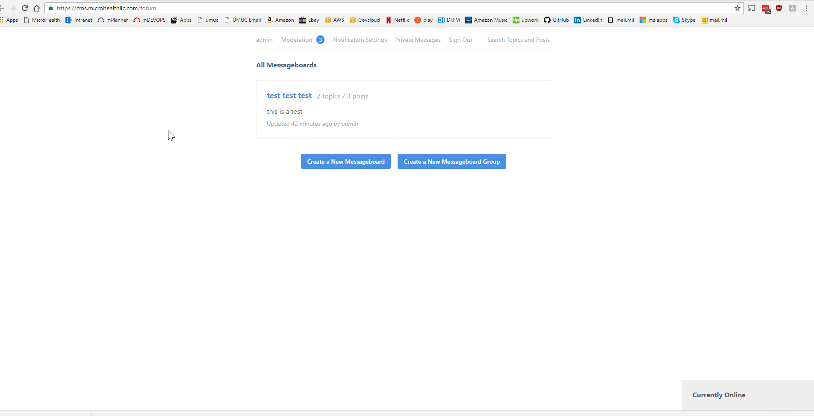
The forum should run
Within the container

Slide 3
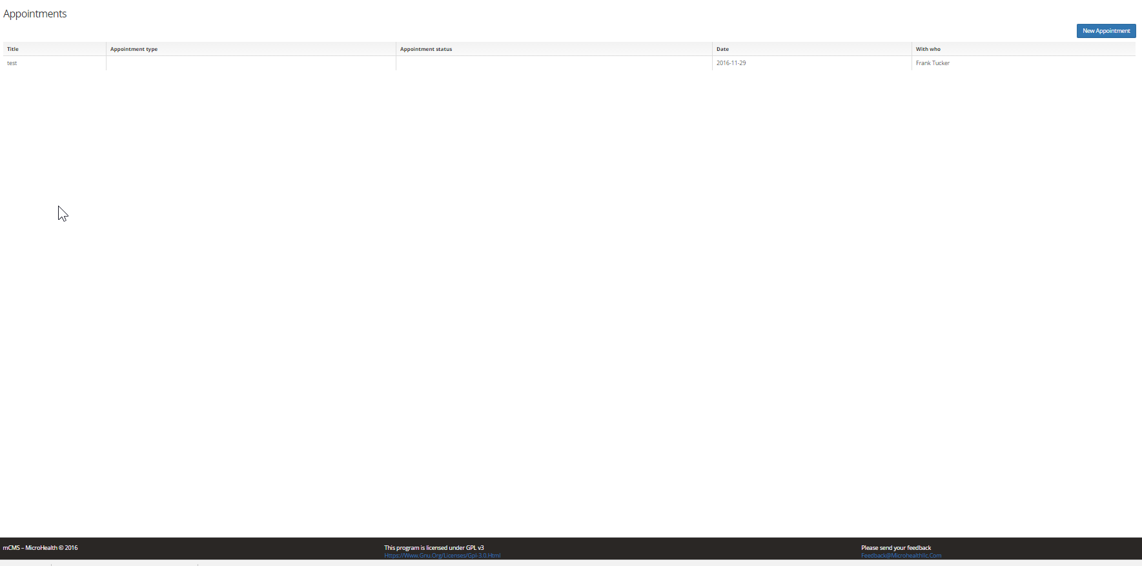
My appointments should show all appointments assigned to this person

Slide 4
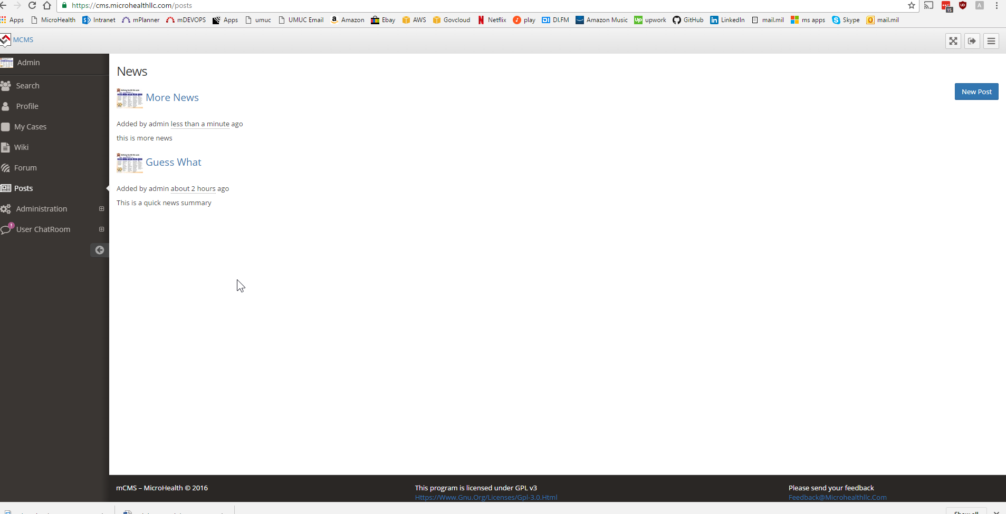
This is called news

Slide 5
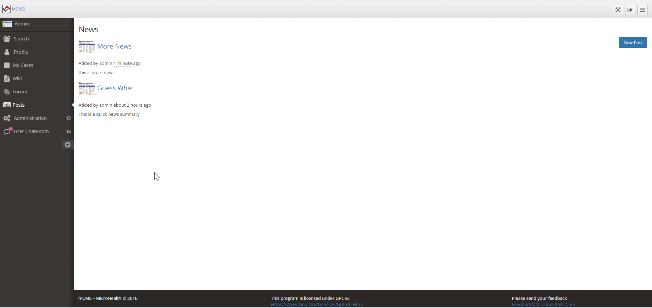
This should show above administration

Slide 6
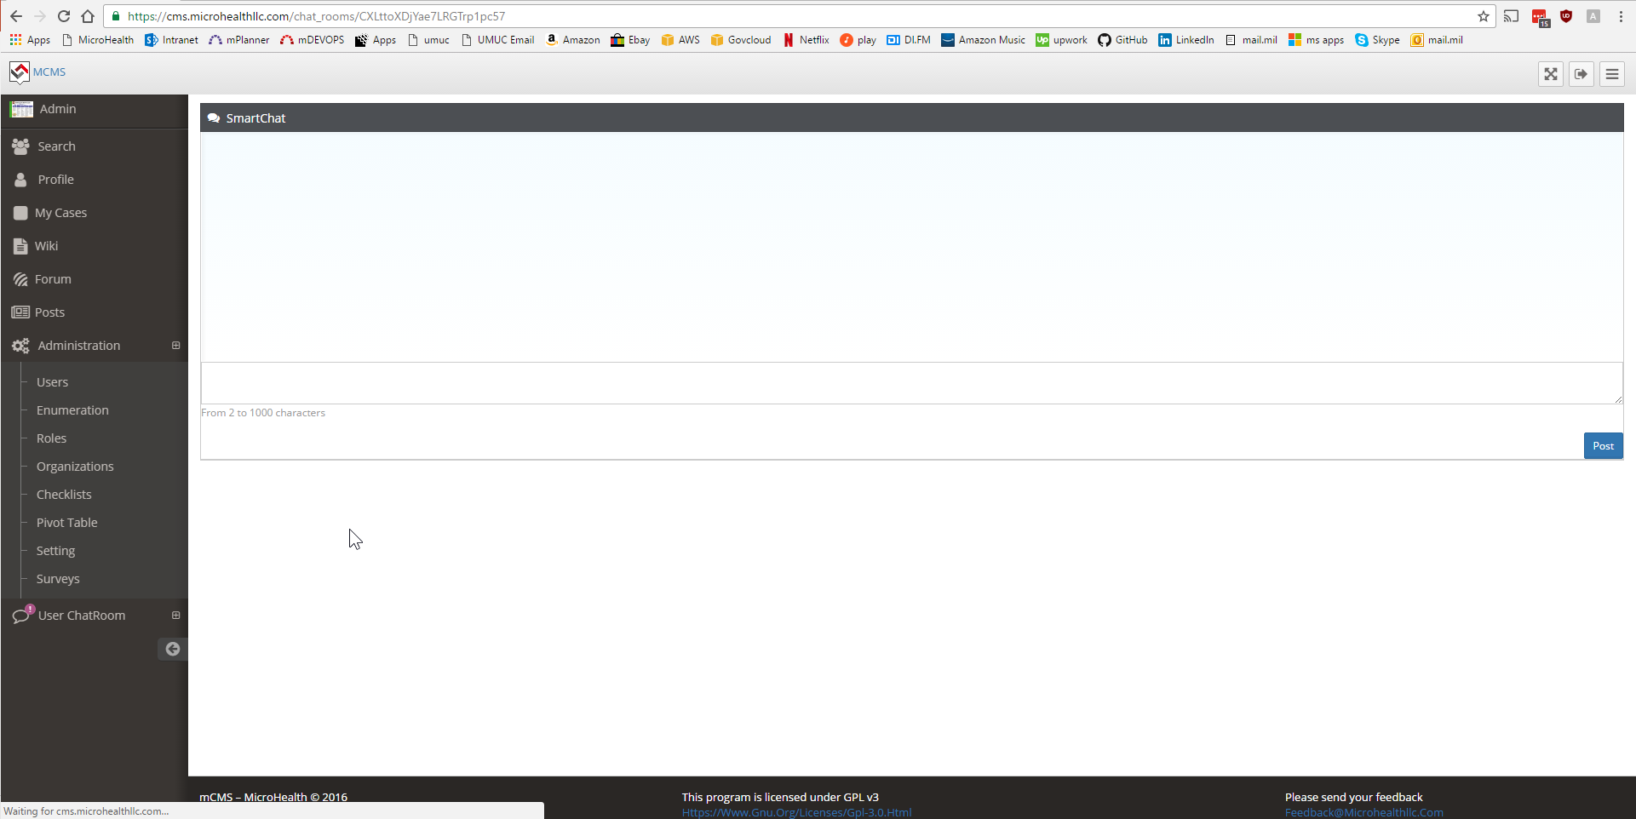
When I type…nothing shows up
I also don’t have an indicator with who I’m talking to
I’m hoping it would be more like other chats where
You can see the post and the replies and who you sent
A message to and who sent you a message back
This should show above administration

Slide 7
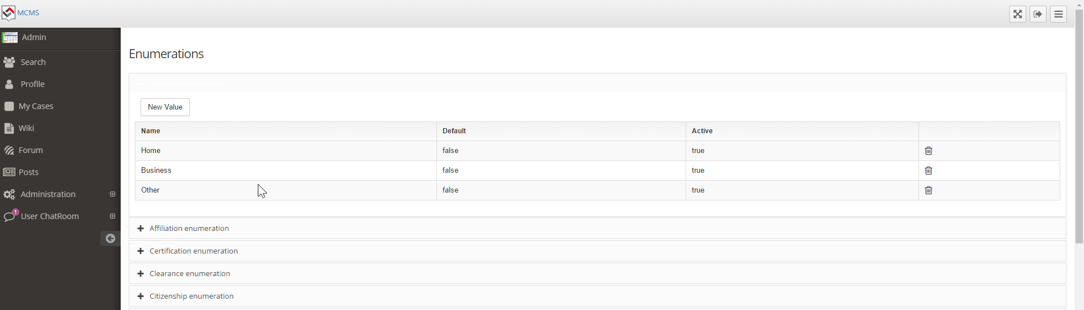
When you activate an enumeration…the text is white
So you can’t see it anymore against the white background

Slide 8
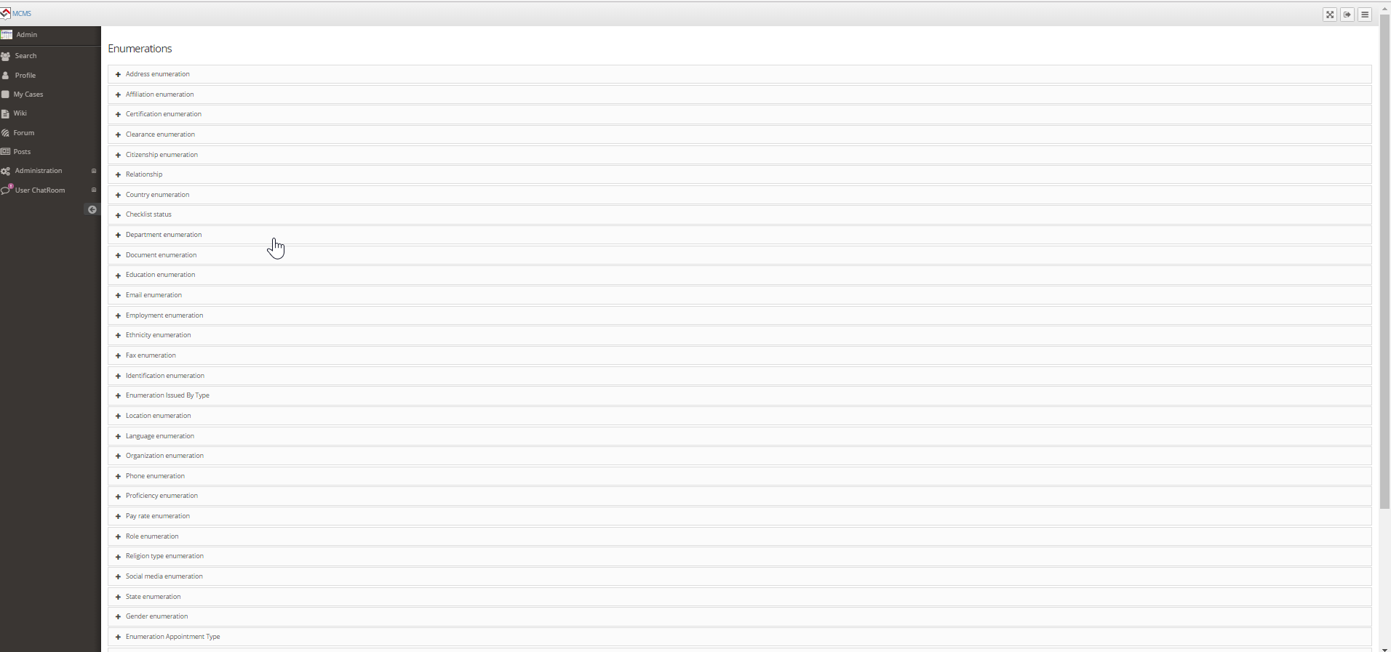
Can you remove the word
Enumeration so it just has the name
Of the field?

Slide 9
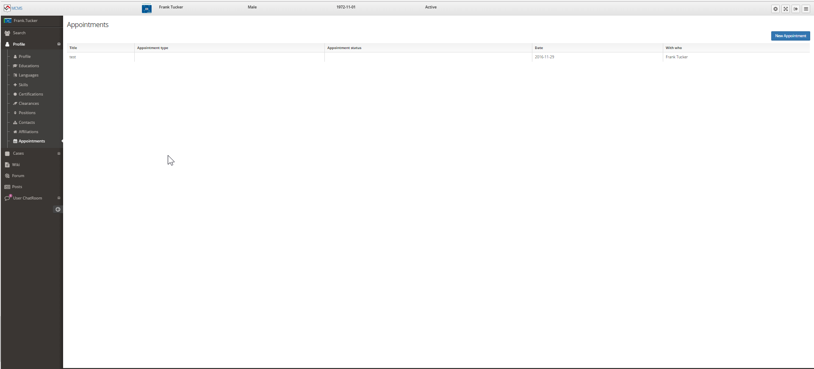
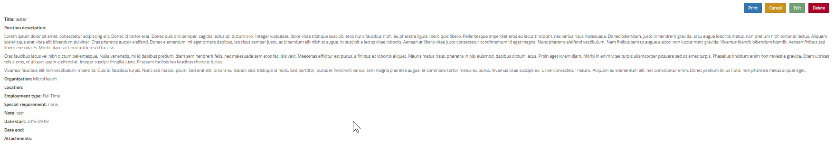
Can’t click this to edit it which should have the same view as all the rest like
This----→
This should be removed from profile

Slide 10
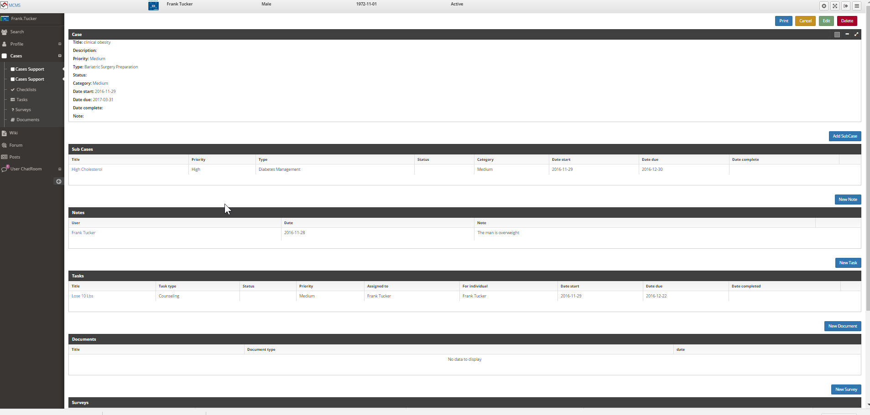
Missing appointments related to just this case

Slide 11
This link should just say Cases

Slide 12
This link should just say Case Support and have people assigned to the case like
Watchers but with a role. If they person cannot be found on search within the system
Then they should be able to add a contact like the other contact screens

Slide 13
This should have all the elements below in the same order so its missing
Sub Cases, Notes, and appointments for this person loaded

Slide 14
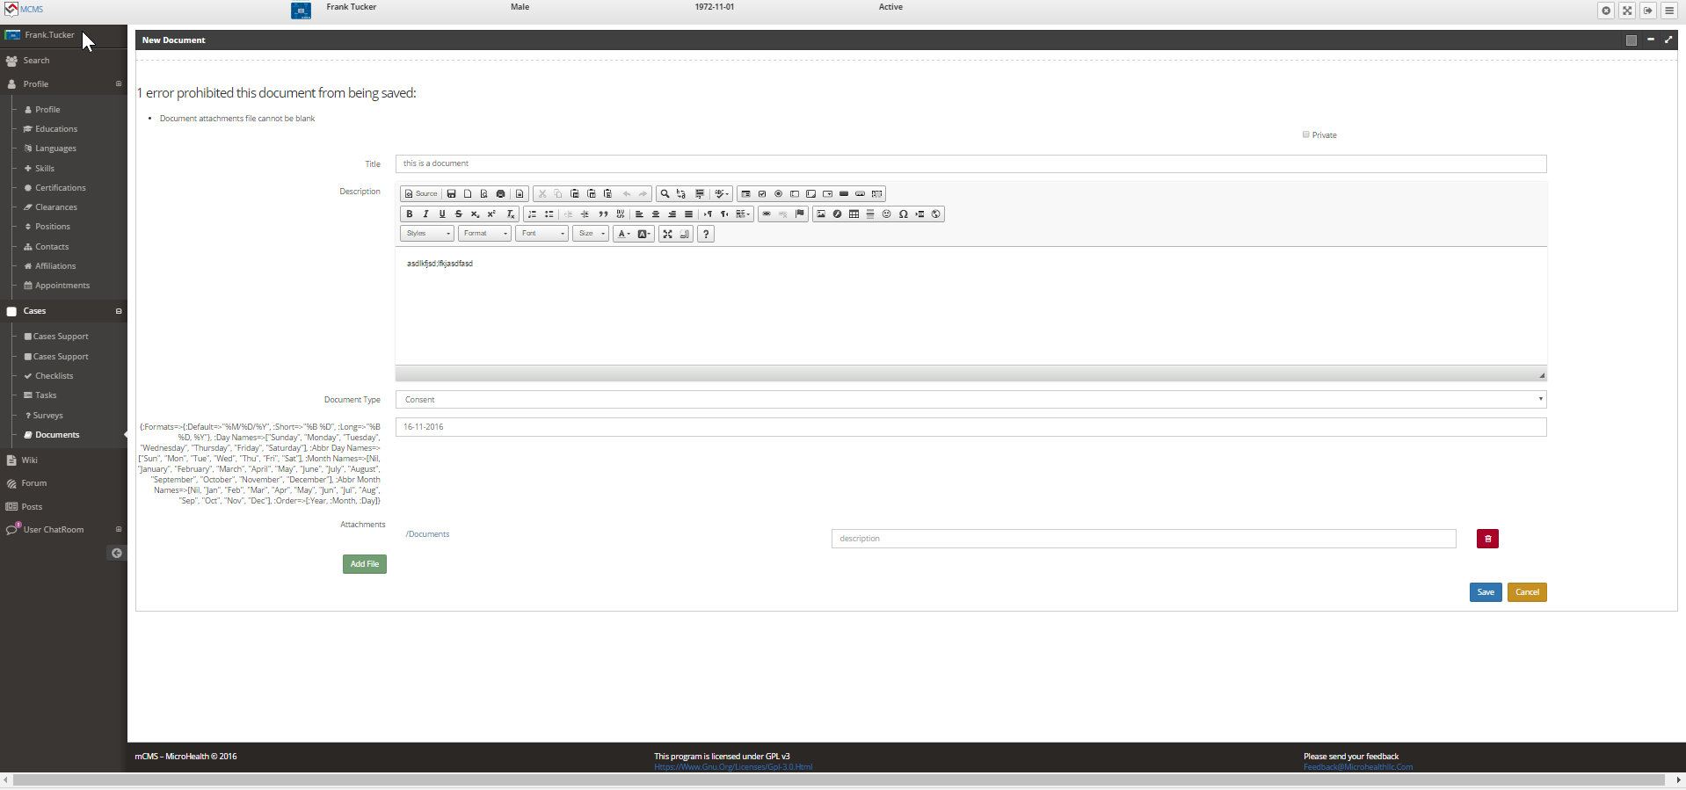
Wont save even though I attached an open office file
Weird

Slide 15
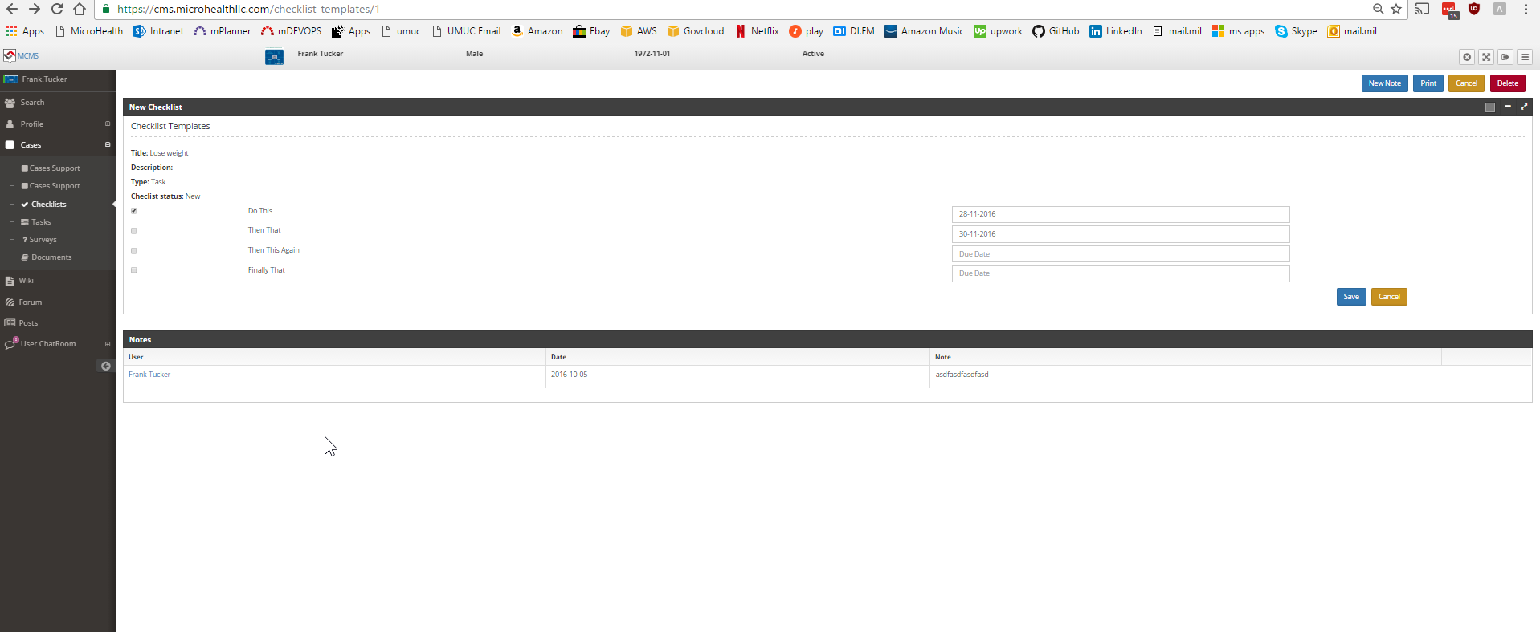
There is no way to change the status of this checklist from new to in progress or done
Not sure where this note came from but it showed up
After adding this new checklist

Slide 16
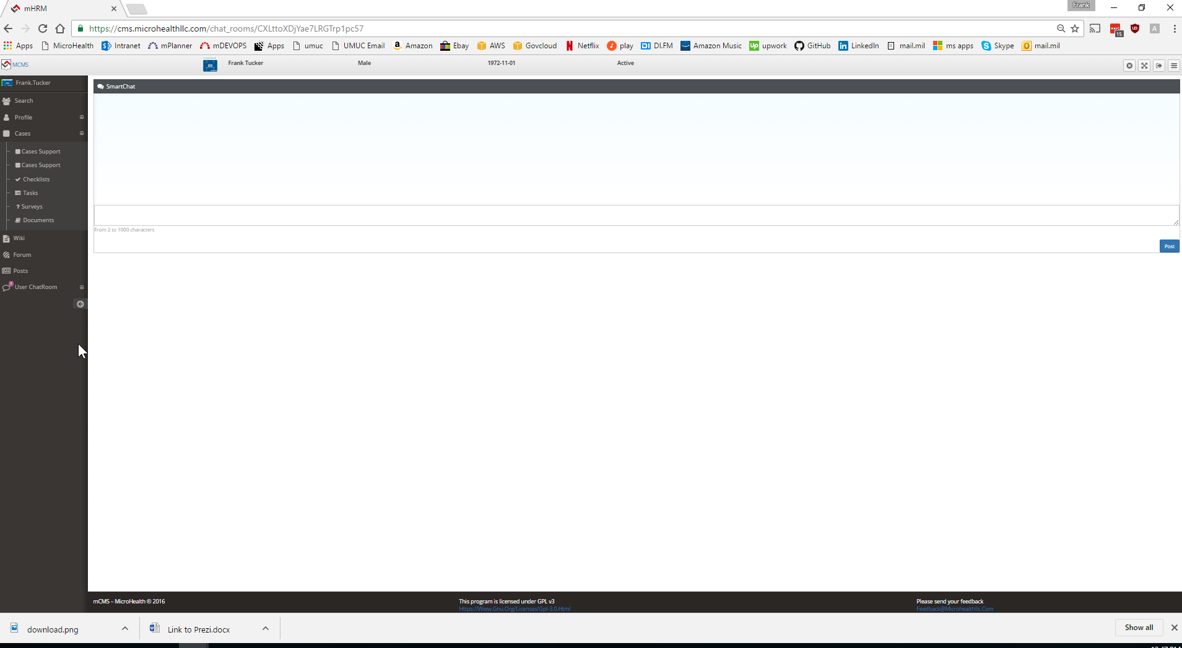
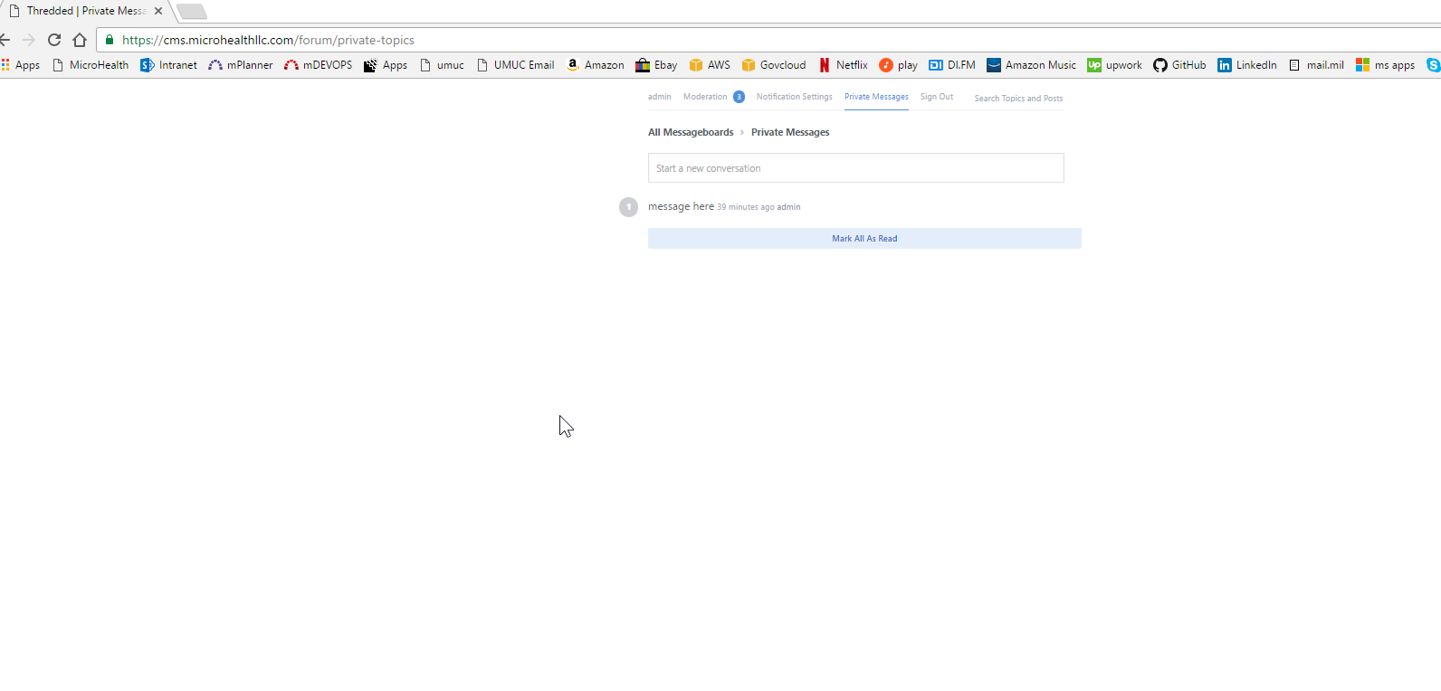
Maybe we want to use the private message feature from the forum or disable
Private messages from the forum so there isn’t 2 places for private messages
As it can be confusing
Also, private messages are part of cases so the chat and chat logs should be under cases
The chat can only occur between the person logged in and the patient loaded so they should
Not be able to select anyone else. Its always between the person logged in and the
Patient loaded

Slide 17
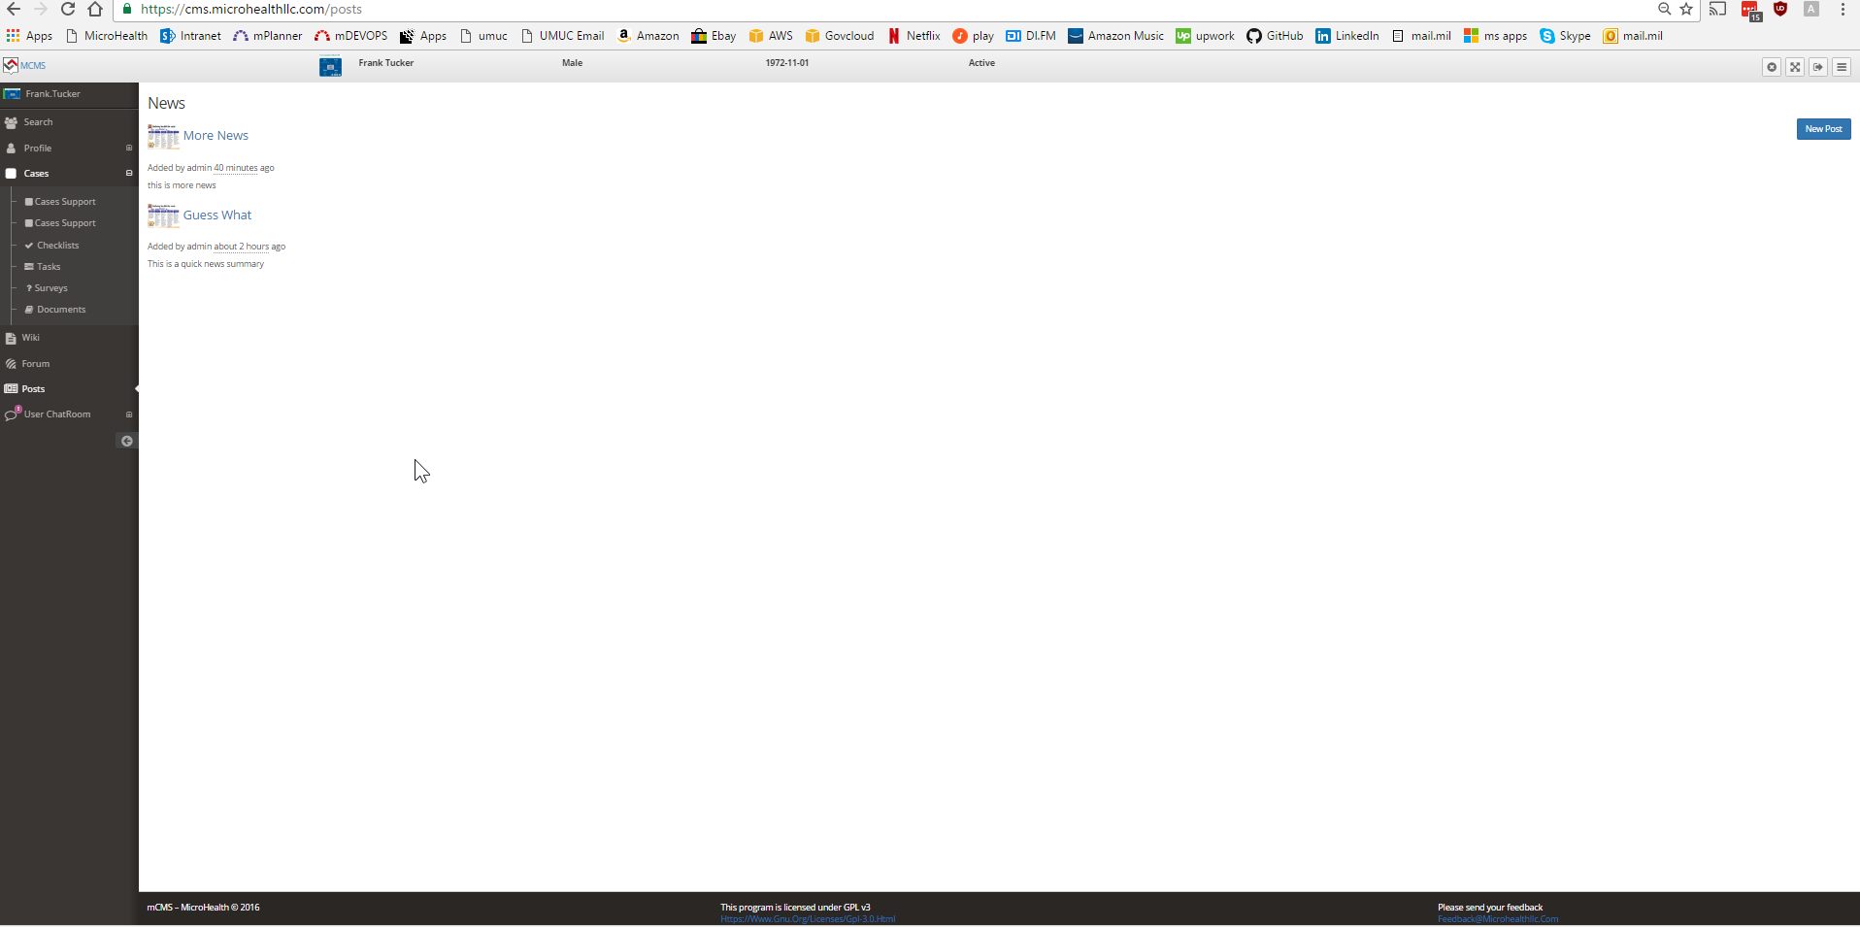
Remove these 3 as this page is specific to cases and cases only

Slide 18
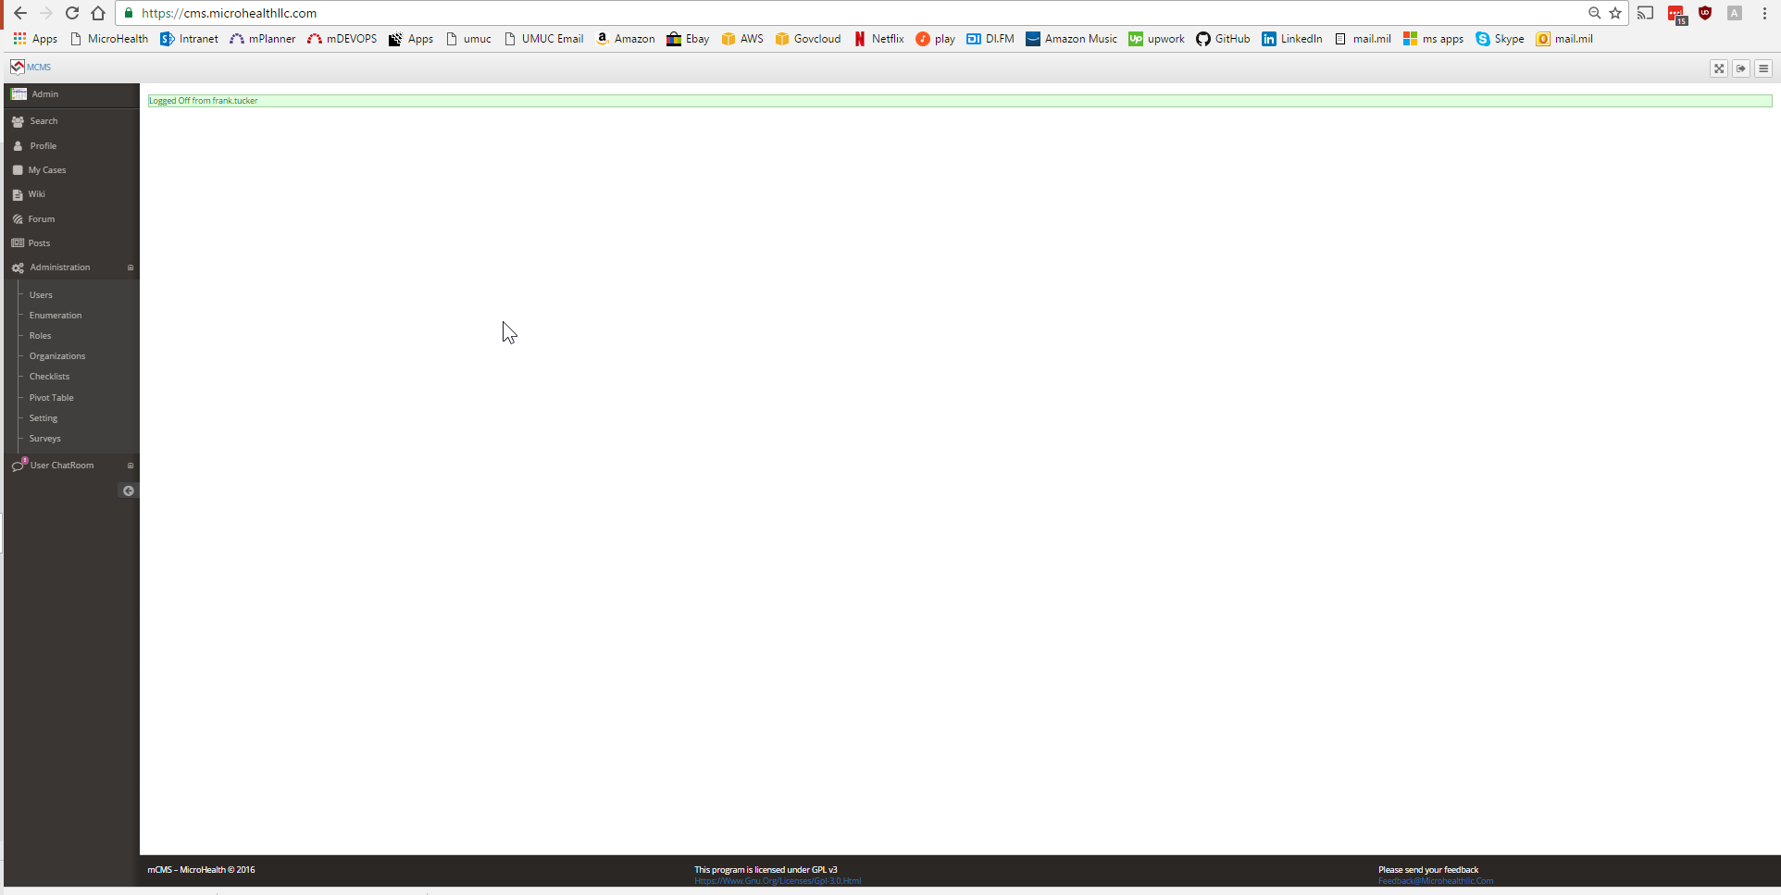
Missing the documents module
https://github.com/danmunn/redmine_dmsf

