Slide 1
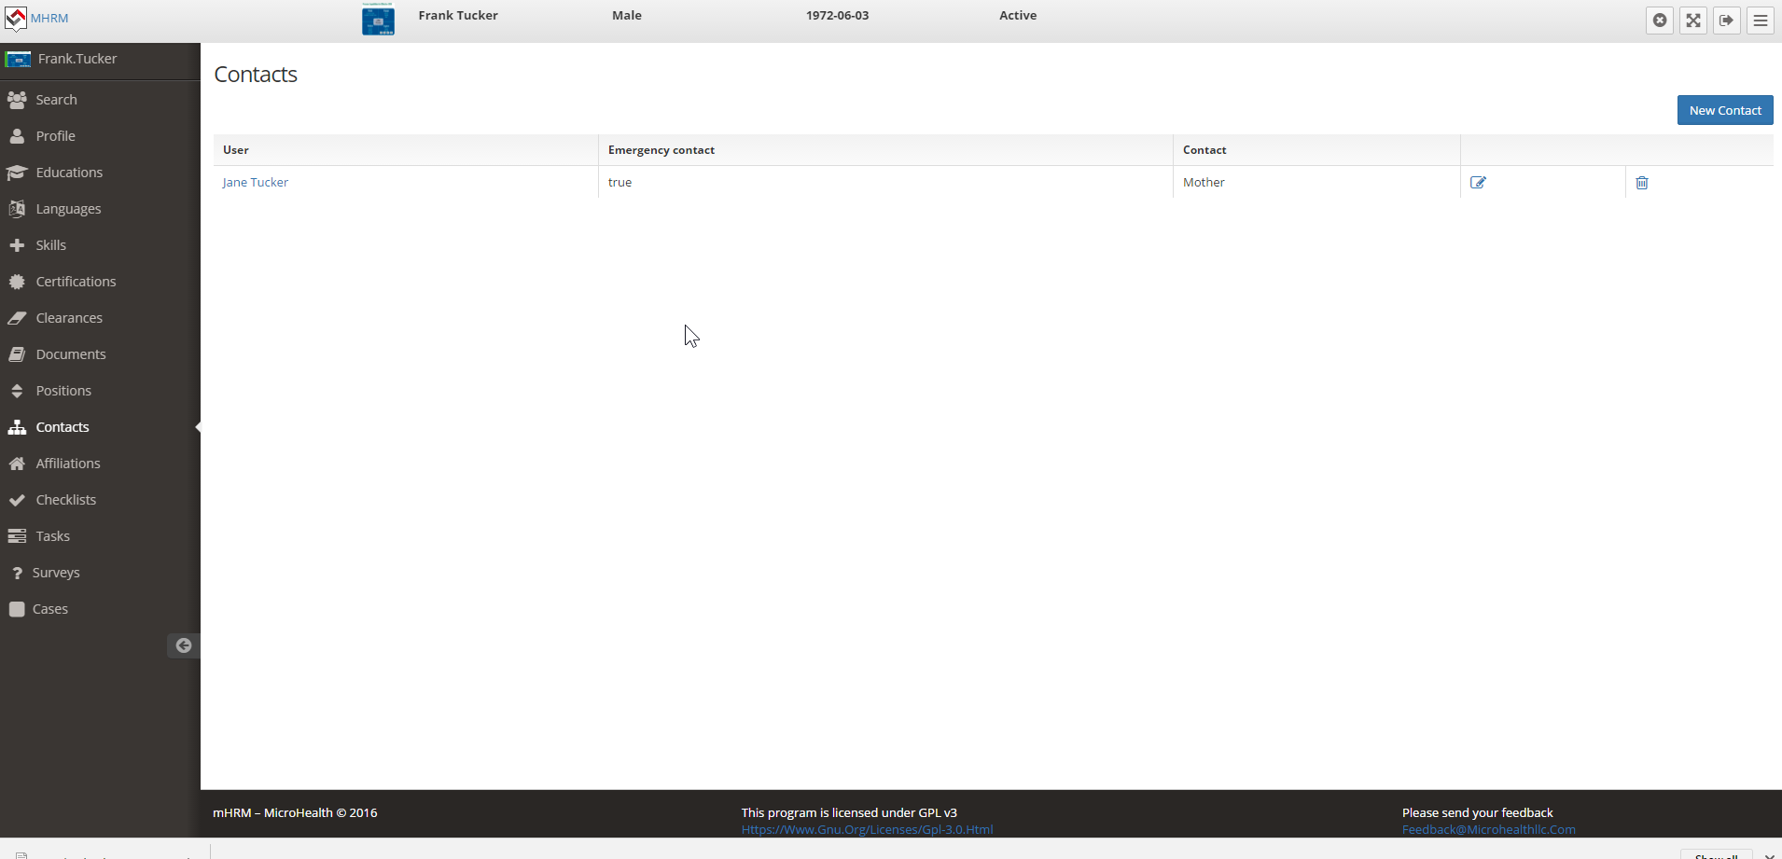
Add a button to search contact
This will allow them to select
Someone already in the system
Vs adding a new person if the
Person already exists

Slide 2
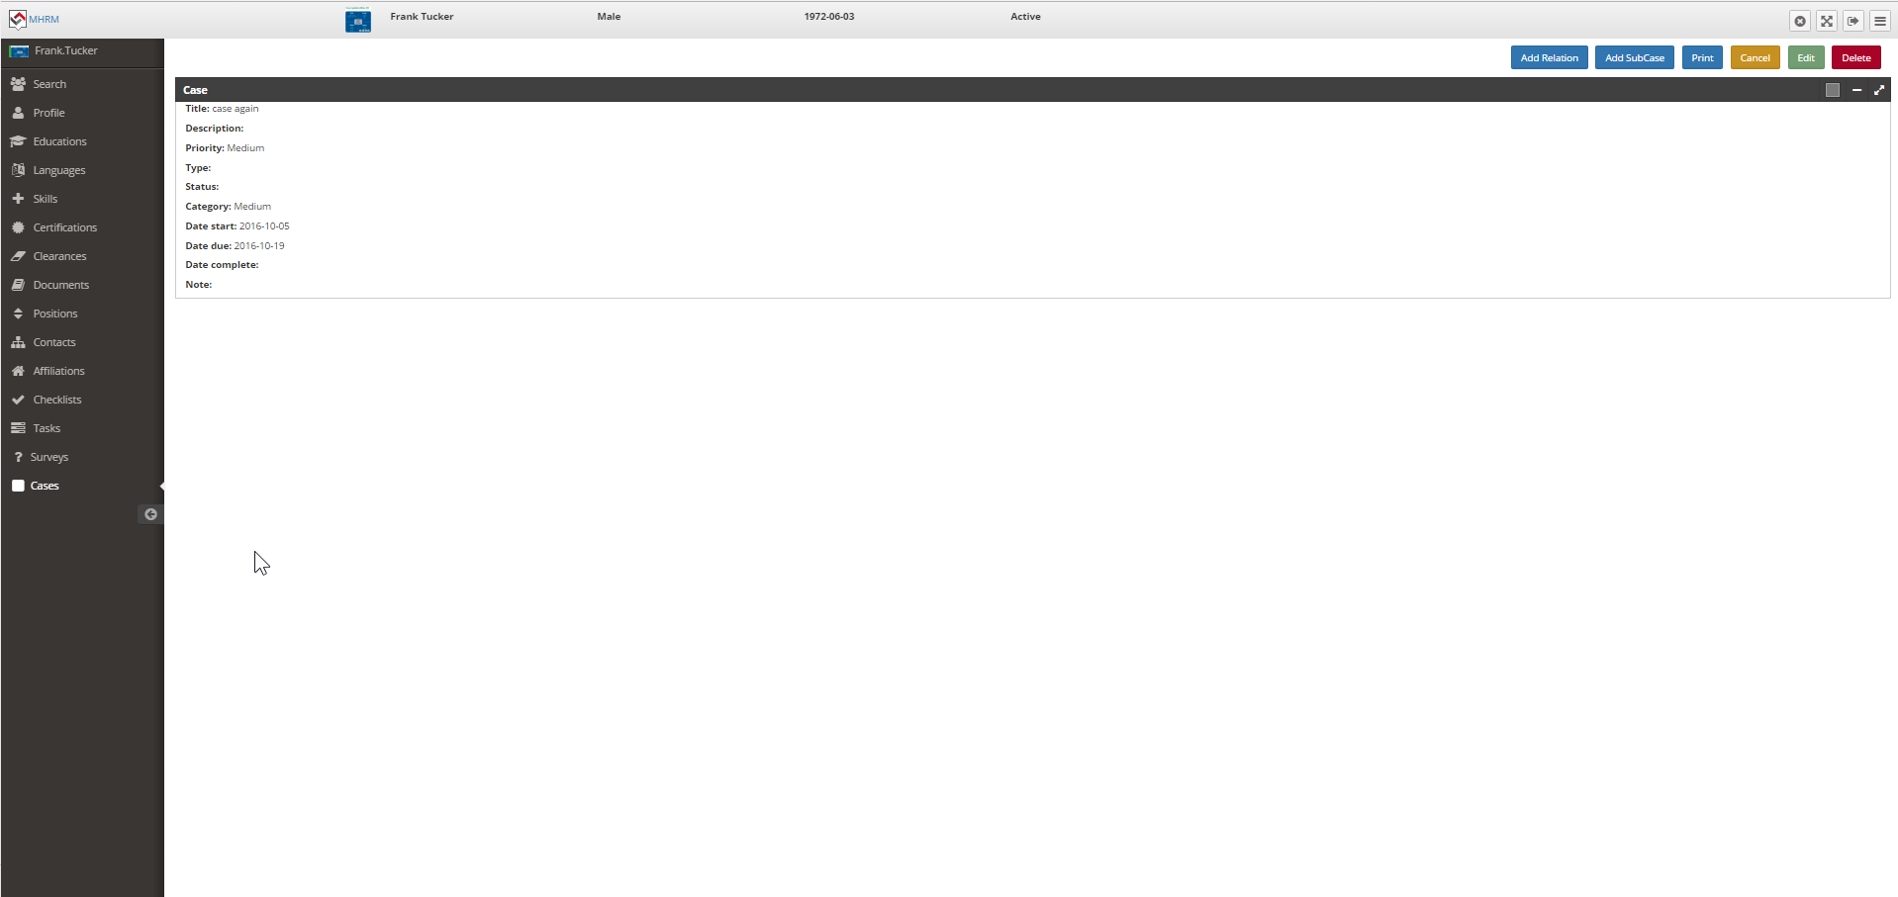
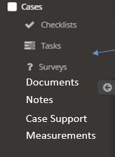
This adds a module that allows webrtc real time chat, video, audio, whiteboard
https://github.com/assaf416/conference
They can set one up here, send the invite to the person and have a conference
That conference can be recorded and saved using the product
Add Virtual Visit

Slide 3
This adds a module that allows discussion based on a topic for this individual ONLY
https://github.com/thredded/thredded
Person can post and ask questions or enter journal entries and they can have a secure
Discussion related to only this person related to case
Add Secure Messaging

Slide 4
Basically need to record
Appointment Title, Description, type (enumeration), date, time, status (enumeration),
Appointment with who (user in the system OR from the contacts table) and, any attachment
Need the ability for the Person who is opening their own record to schedule an appointment
And have the manager approve it
Notifications back and forth on this
Add Appointments

Slide 5
Add Export to Excel for every table/grid as an option

Slide 6
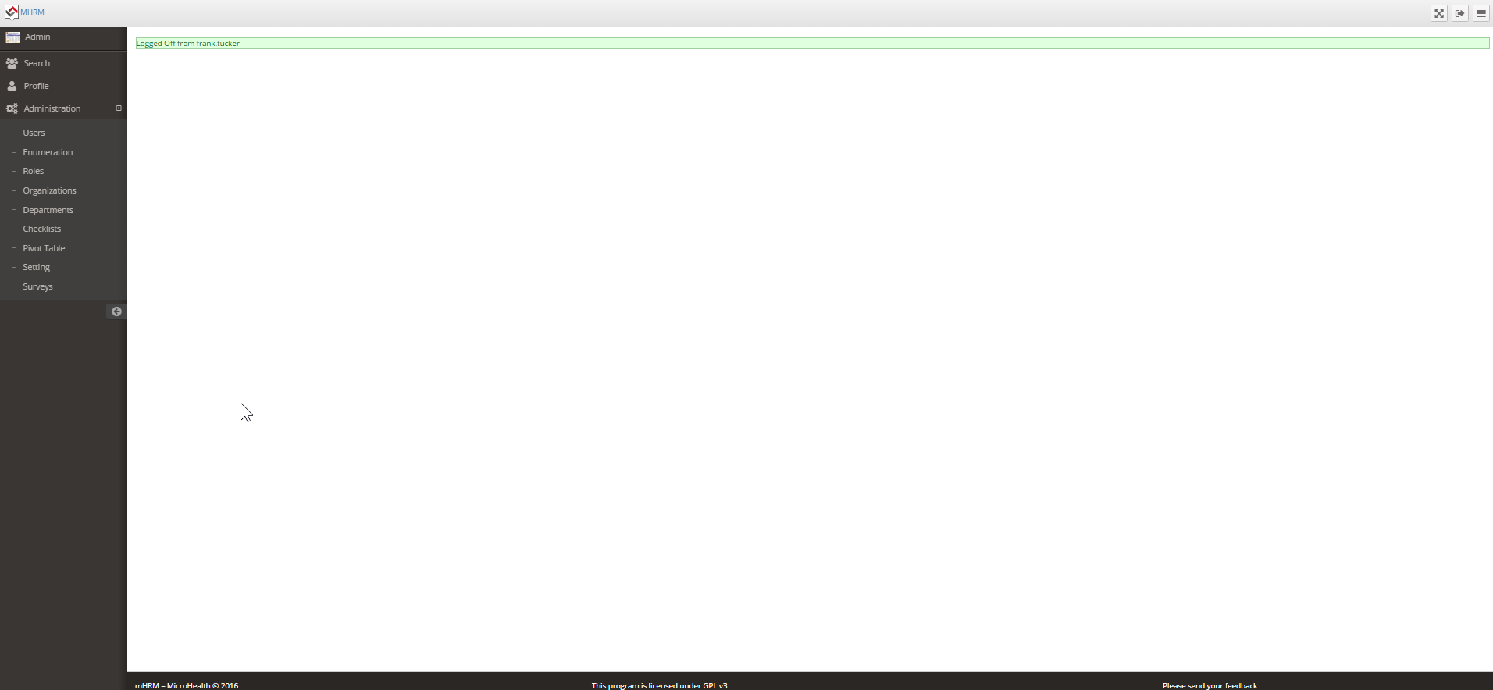
Add ldap authentication option

Slide 7
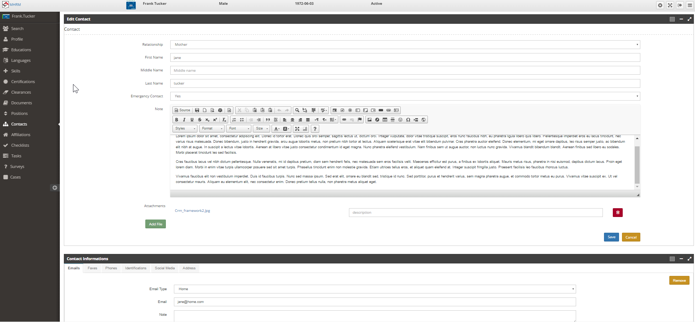
This is new case support module for cases to identify
Who supports this case and the type of support they are
Just like contacts, there should be the
Search function to find an existing
Contact from the user base and the contact
Base and have the ability to add a new contact
In the contact table NOT user table
Case Support
Remove relationship
Remove emergency
contact
Add Case Support Type enumeration

Slide 8
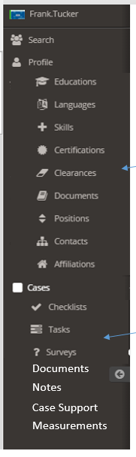
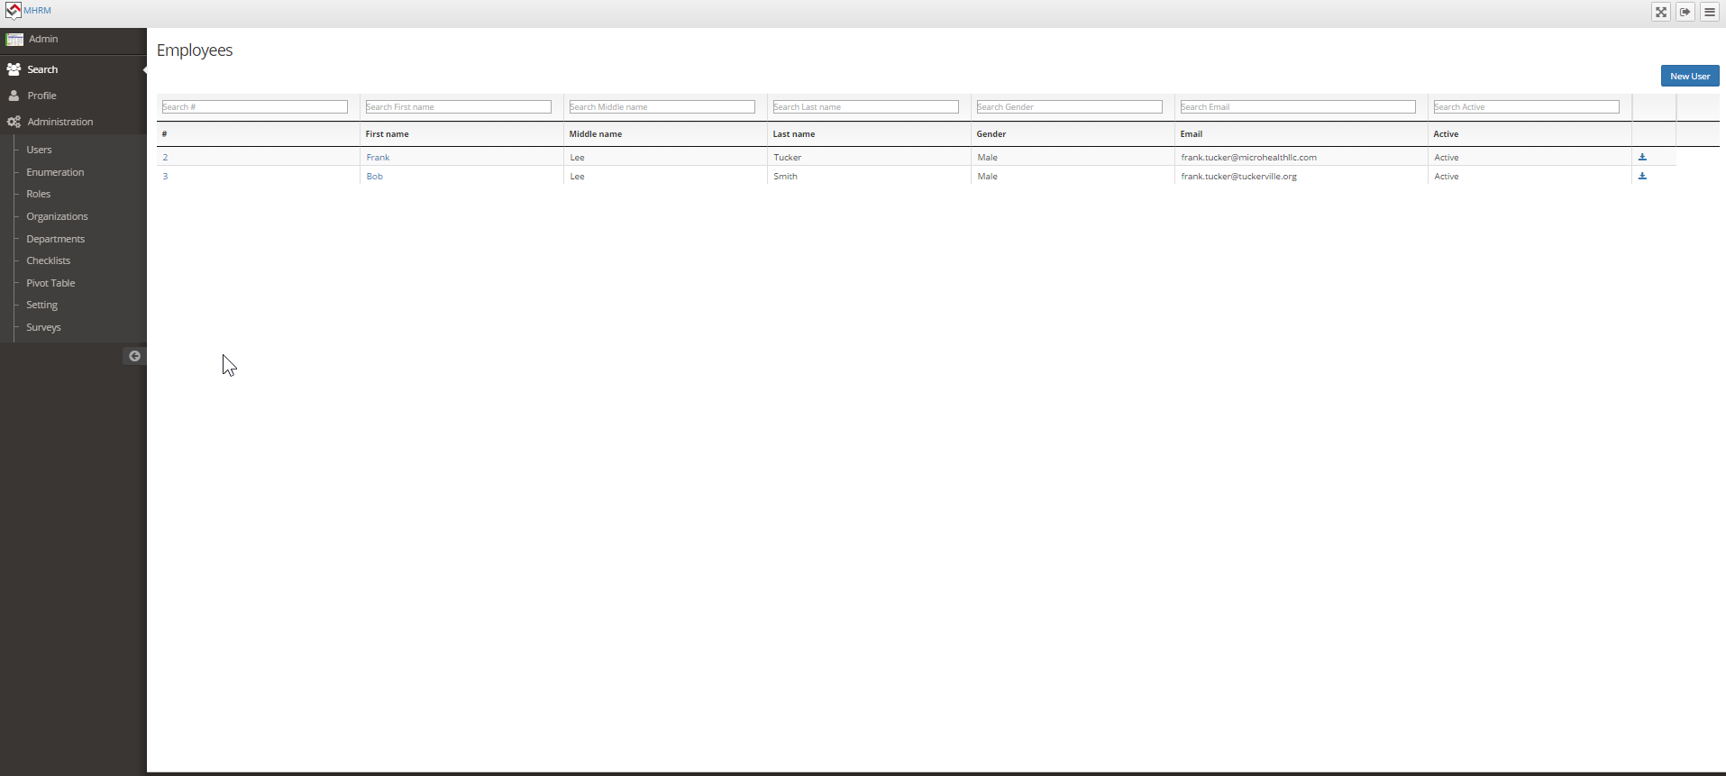
New menu item called My Lists
Add a column to the right that has the ability to sort the list by these enumerations where they can select one or more of the enumeration and select the operator Of AND/OR then display a list of people that match and they can save it as a favorite list And give it a name And they can export it to excel and show the fields below that matches
Organization
Zipcode
State
Country
Language Type
Skills Type
Certification Type
Clearance Type
Document Type
Employment Type
Case Type
Case Start Date Range
Case Complete Date Range
Case Status
Case Category
Survey Type
Survey Status
Task Type
Task Status
Checklist Type
Checklist Status
Case Note Type
Case Document Type
Case Support Type
Measurement Type
Measurement Status
Measurement Flag
Appointments Type
Appointment Date and Time range
Appointment Status
Integrate webrtc audio video chat and keep records as part of case
https://github.com/assaf416/conference
Chat
When the case manager logs into the person’s record and clicks chat
When the person for the case logs into their record and clicks chat
Both can have audio video chat in a session whose chat record recording
Can be saved as part of the case record
Chat

Slide 9
EMAIL NOTIFICATIONS
Email notifications just like redmine!!!!!!!!!!!
Configurable per user just like redmine
SETUP through GUI like redmine using SMTP SSL/TLS connections
Configure the content of the email notification

Slide 10
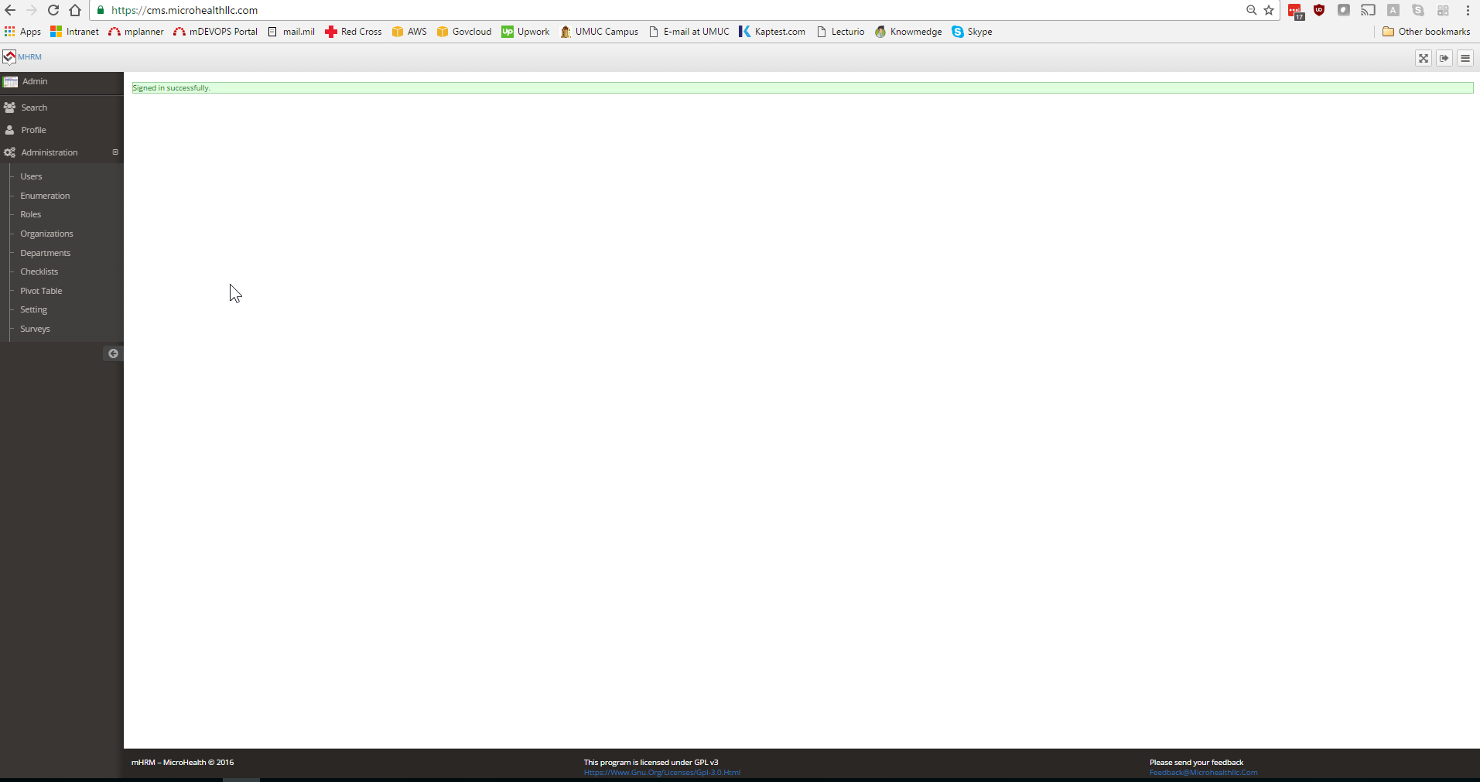
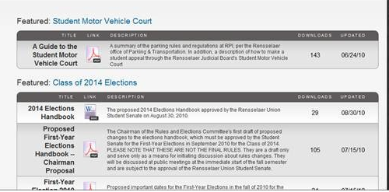
Document Management System for collaboration OUTSIDE of cases
Like redmine https://github.com/wtg/flagship_docs_4
Files

Slide 11
List of people and their cases where tasks in cases are assigned to the user logged in
List of people and their cases where Appointments in cases are assigned to the user logged in with
Calendar view
Action Items
My Appointments
These are Notes, Tasks, Checklist, Survey, Documents, Measurements
Case Support, Virtual Visit, Messaging for cases assigned to the case worker logged in
that are new, and the status. Each of the above should have its own container so they
Can see each of those separated by each box in lists and click to get more info on that specific
person
Has not been marked done (so in the enumeration for status on these,
Like redmine we need to know which status enumeration is considered done)
This also means for any of the above, if status is not an option, then that has to be
Added to each with enumerations in setup

Slide 12
Mark Private
In redmine, you can mark a specific ticket as private.
Similarly, for any below, they can mark a specific entry as private and it will NOT be visible to the person for their record view when they see their own record
Notes
Tasks
Appointments
Checklist
Survey
Documents
Measurements
Case Support
Virtual Visit
Messaging

Slide 13
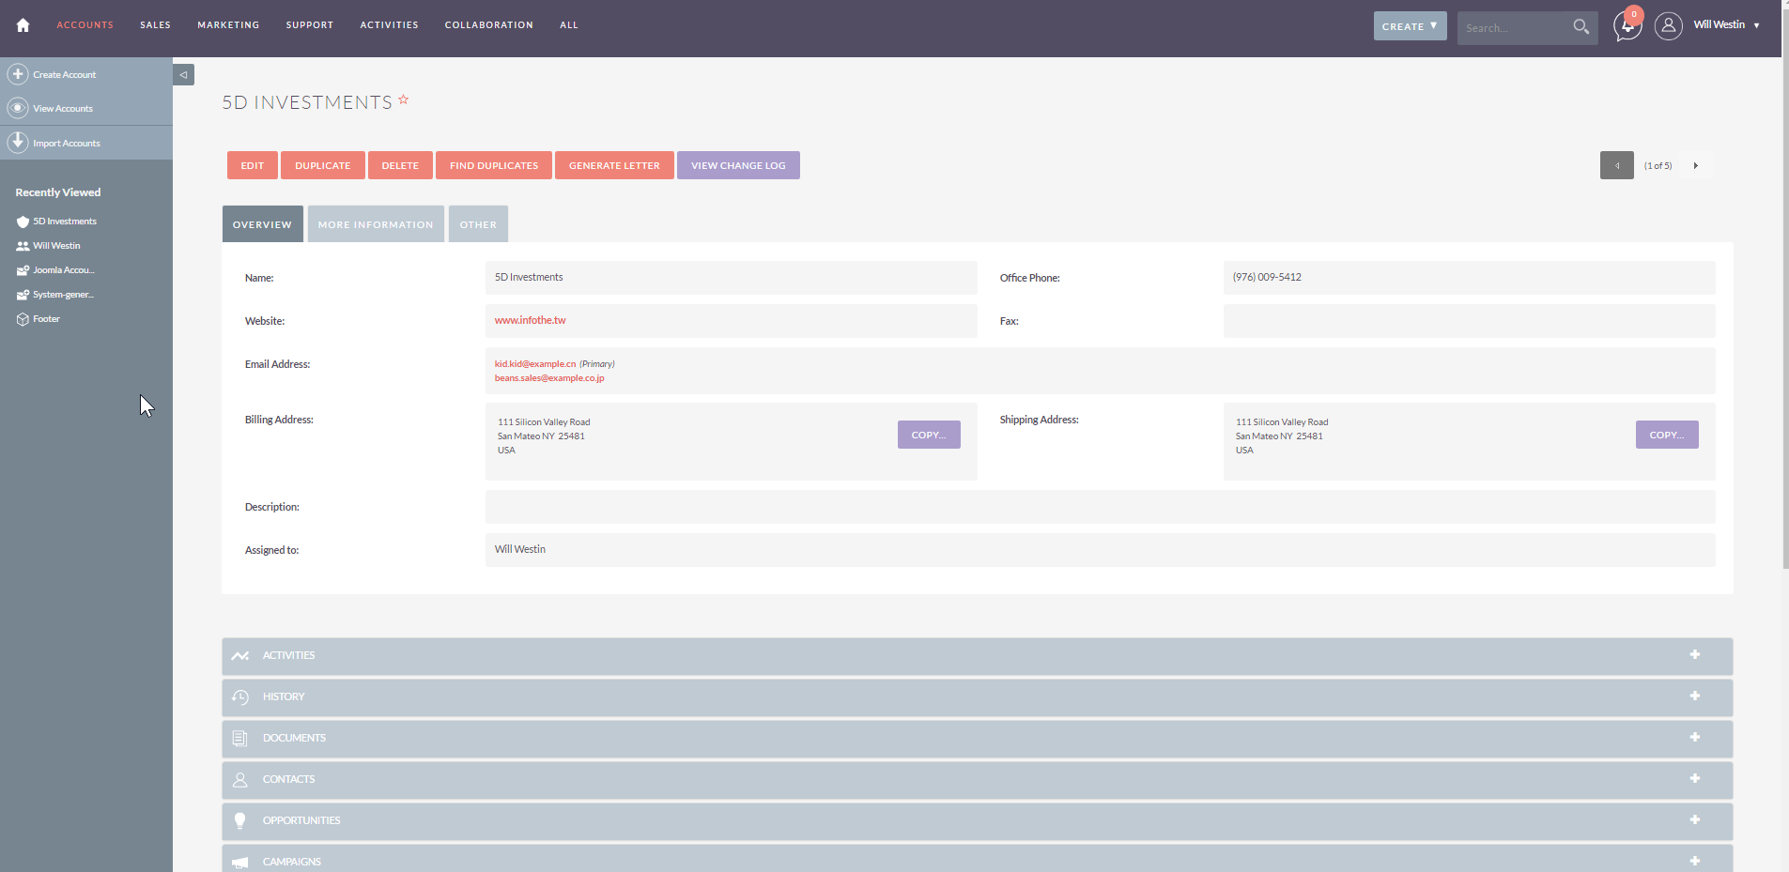
Themable
We should have a about 5 color themes they can chose from including this. User can select their theme in their provile

Slide 14
Code clean up
Any code clean up needed heavily commented to make sure its clean, very readable code, efficient as possible and secure. You might want to scan it with sonarqube which is free to address any problematic code areas specifically vulnerabilities and bugs
http://www.sonarqube.org/downloads/

Slide 15
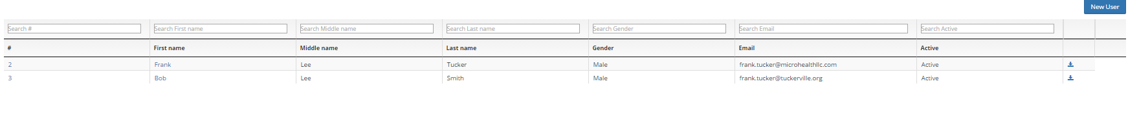
Make all grids configurable and sortable
Sort ascending or decending
Pagination on all grid to reduce the amount of data pulled
Allow users to select what fields to show in ALL grids. They can select something
Different from the default and change the order of the data elements

