Slide 1

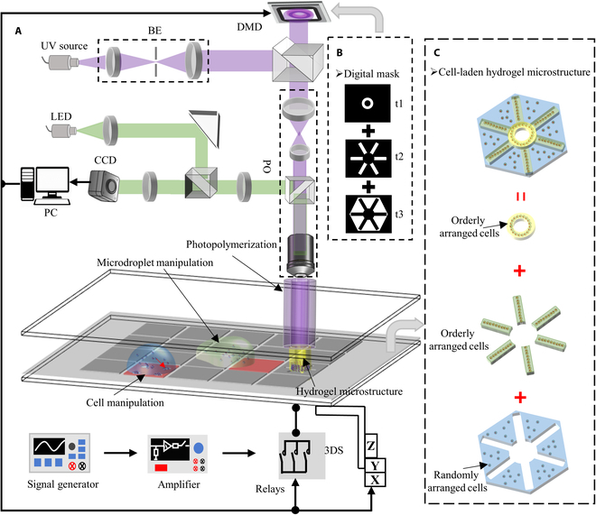
Integrated Cross-Scale Manipulation and Modulable Encapsulation of Cell-Laden Hydrogel for Constructing Tissue-Mimicking Microstructures, Volume: 7, DOI: (10.34133/research.0414)

Slide 2
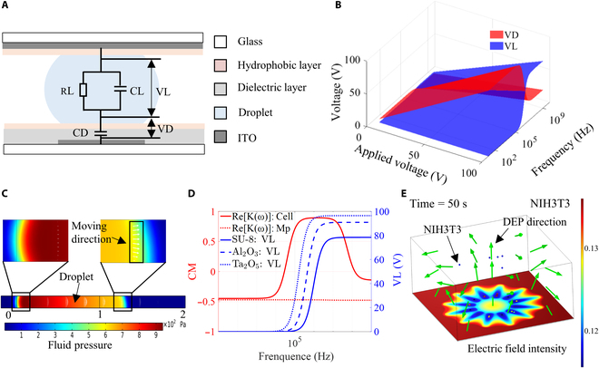
Integrated Cross-Scale Manipulation and Modulable Encapsulation of Cell-Laden Hydrogel for Constructing Tissue-Mimicking Microstructures, Volume: 7, DOI: (10.34133/research.0414)

Slide 3
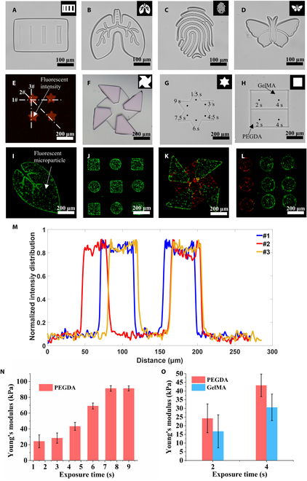
Integrated Cross-Scale Manipulation and Modulable Encapsulation of Cell-Laden Hydrogel for Constructing Tissue-Mimicking Microstructures, Volume: 7, DOI: (10.34133/research.0414)

Slide 4
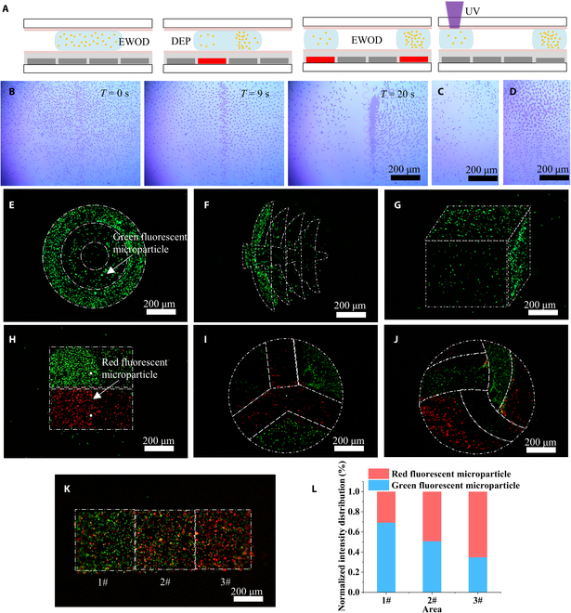
Integrated Cross-Scale Manipulation and Modulable Encapsulation of Cell-Laden Hydrogel for Constructing Tissue-Mimicking Microstructures, Volume: 7, DOI: (10.34133/research.0414)

Slide 5
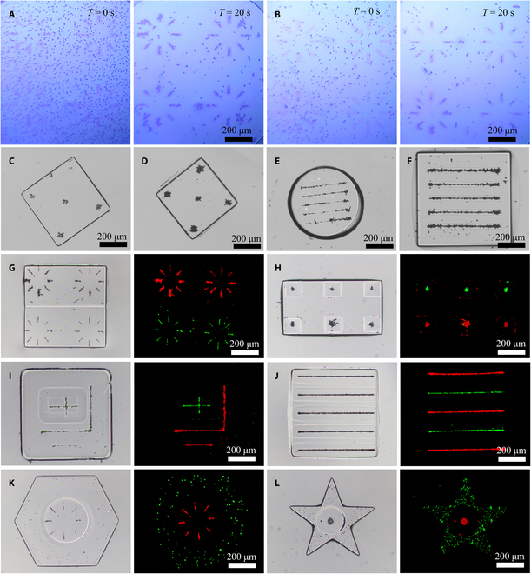
Integrated Cross-Scale Manipulation and Modulable Encapsulation of Cell-Laden Hydrogel for Constructing Tissue-Mimicking Microstructures, Volume: 7, DOI: (10.34133/research.0414)

Slide 6
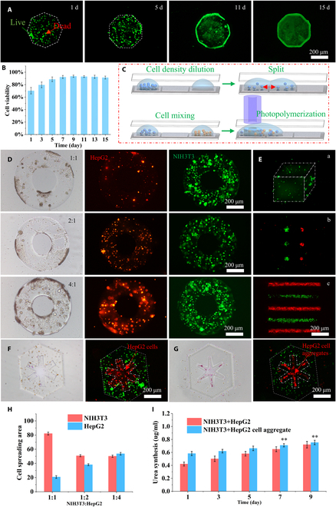
Integrated Cross-Scale Manipulation and Modulable Encapsulation of Cell-Laden Hydrogel for Constructing Tissue-Mimicking Microstructures, Volume: 7, DOI: (10.34133/research.0414)

