Slide 1
LightningPiggy &
The Unveiling of MicroPythonOS

Slide 2
LightningPiggy

Slide 3
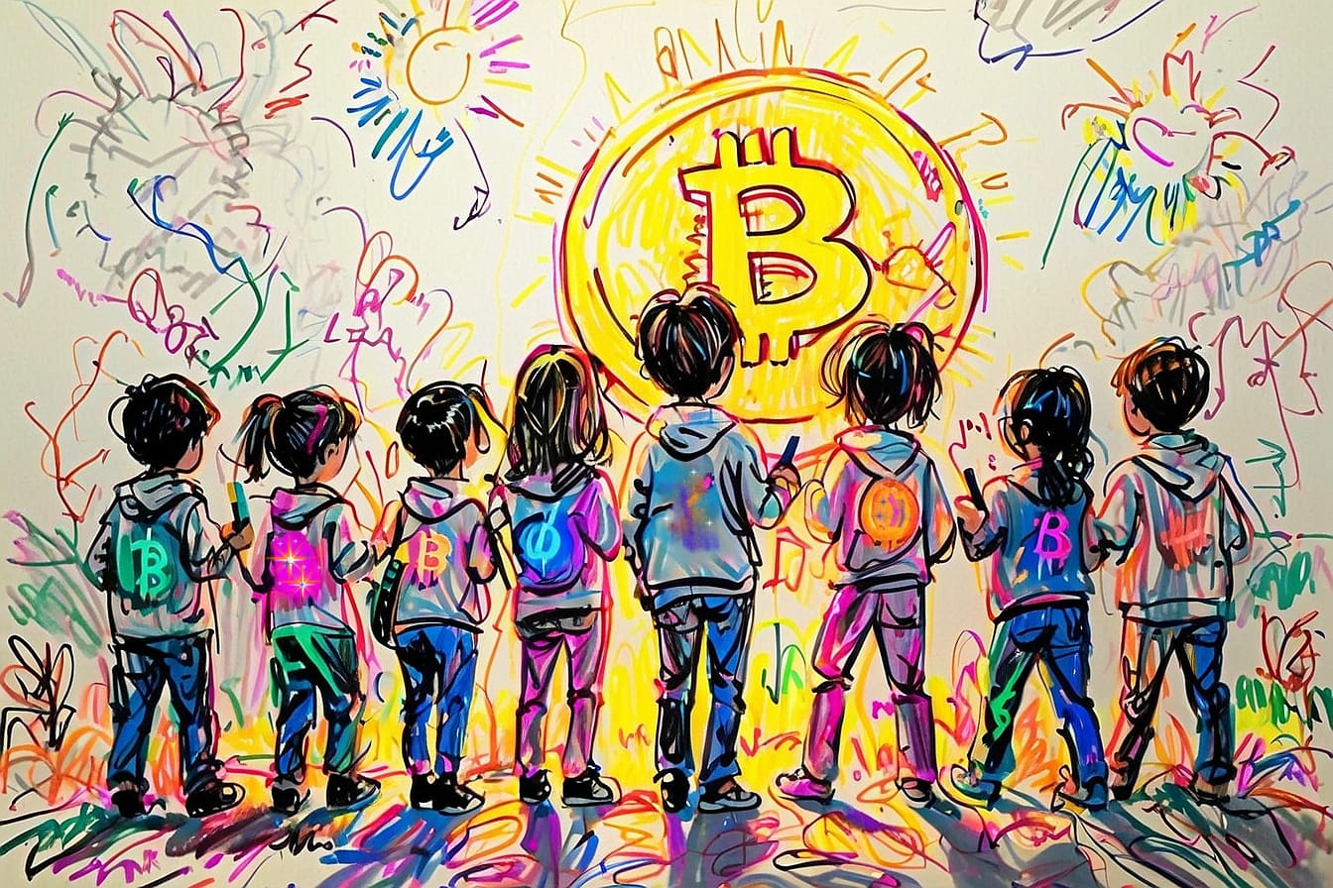
Teach kids when they’re young
Fun
Simple
Receive sats
Save Sats
Which wallet?

Slide 4
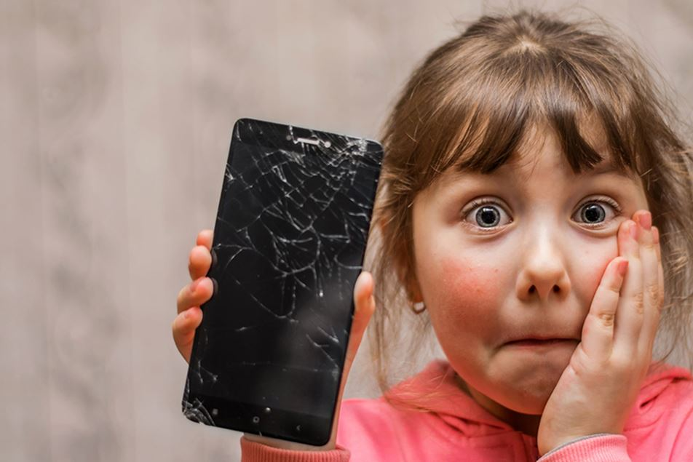
Why not a smartphone?
Fragile
Expensive
Complex
Distractions
Privacy?

Slide 5
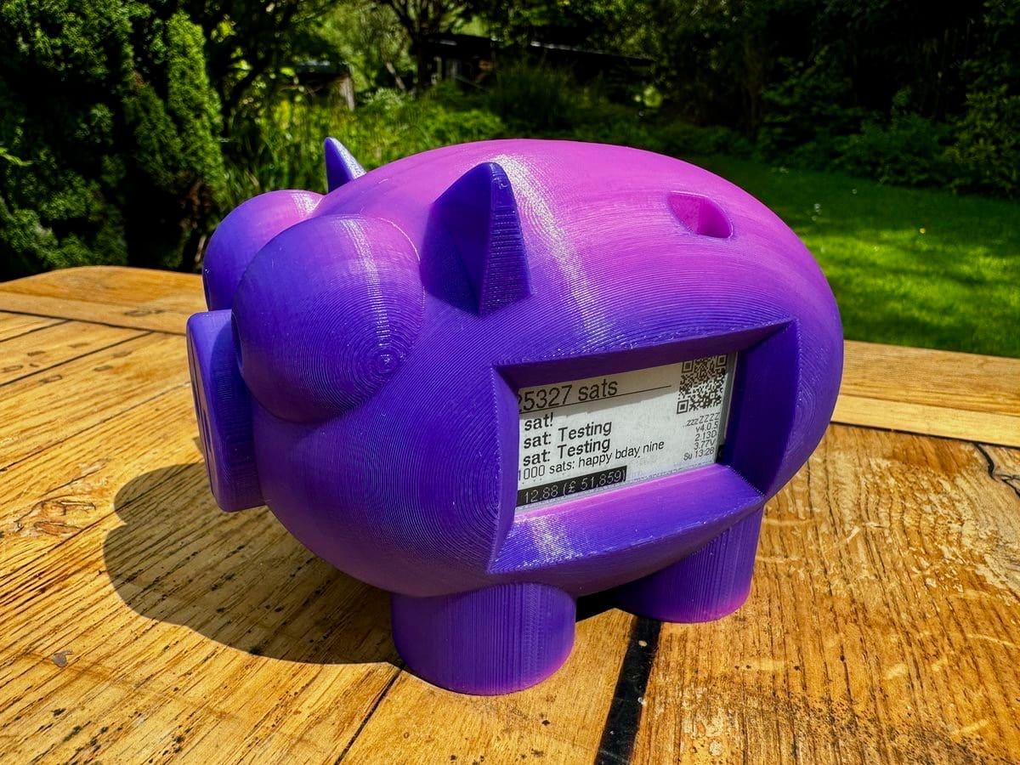
Perfect Kid’s Wallet
Always On (ePaper)
Balance in Sats
Amount & Comment
Receive QR code
Instant refresh

Slide 6
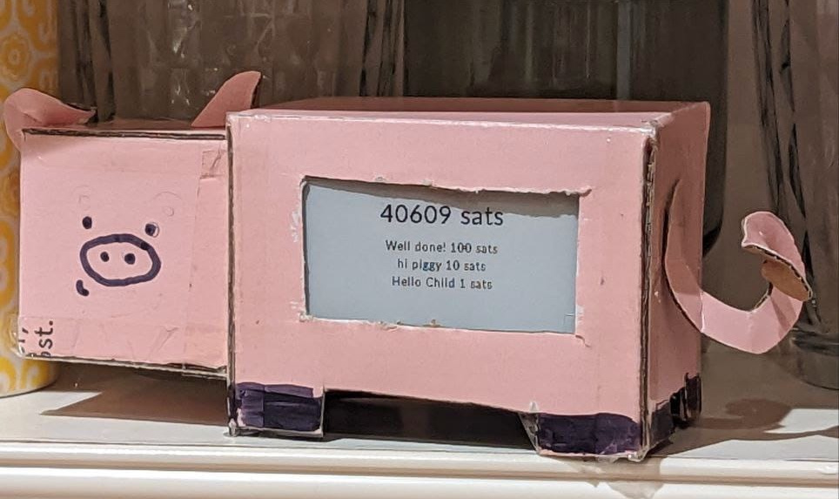
Proof-of-Concept
Credit: BlackCoffee
LilyGo ePaper Board
Backend: LNBits
Hard-coded Config
Arduino IDE Installer

Slide 7
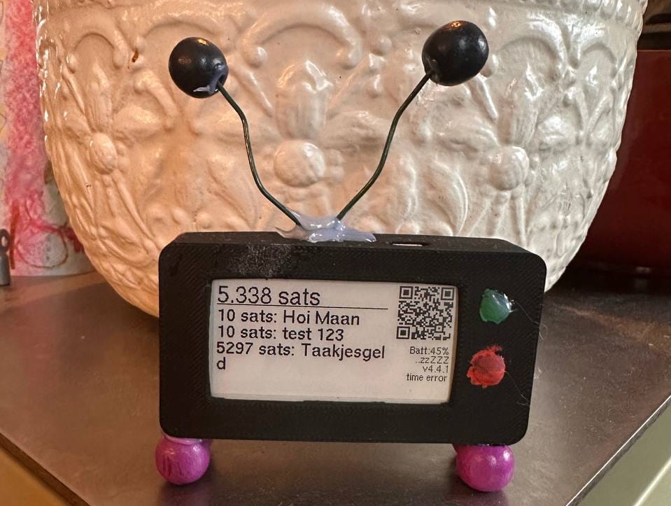
Awesome Added Features
Easy Web Installer
Battery Management
Shake-to-Wake
Update Notifications
Webbrowser Config

Slide 8
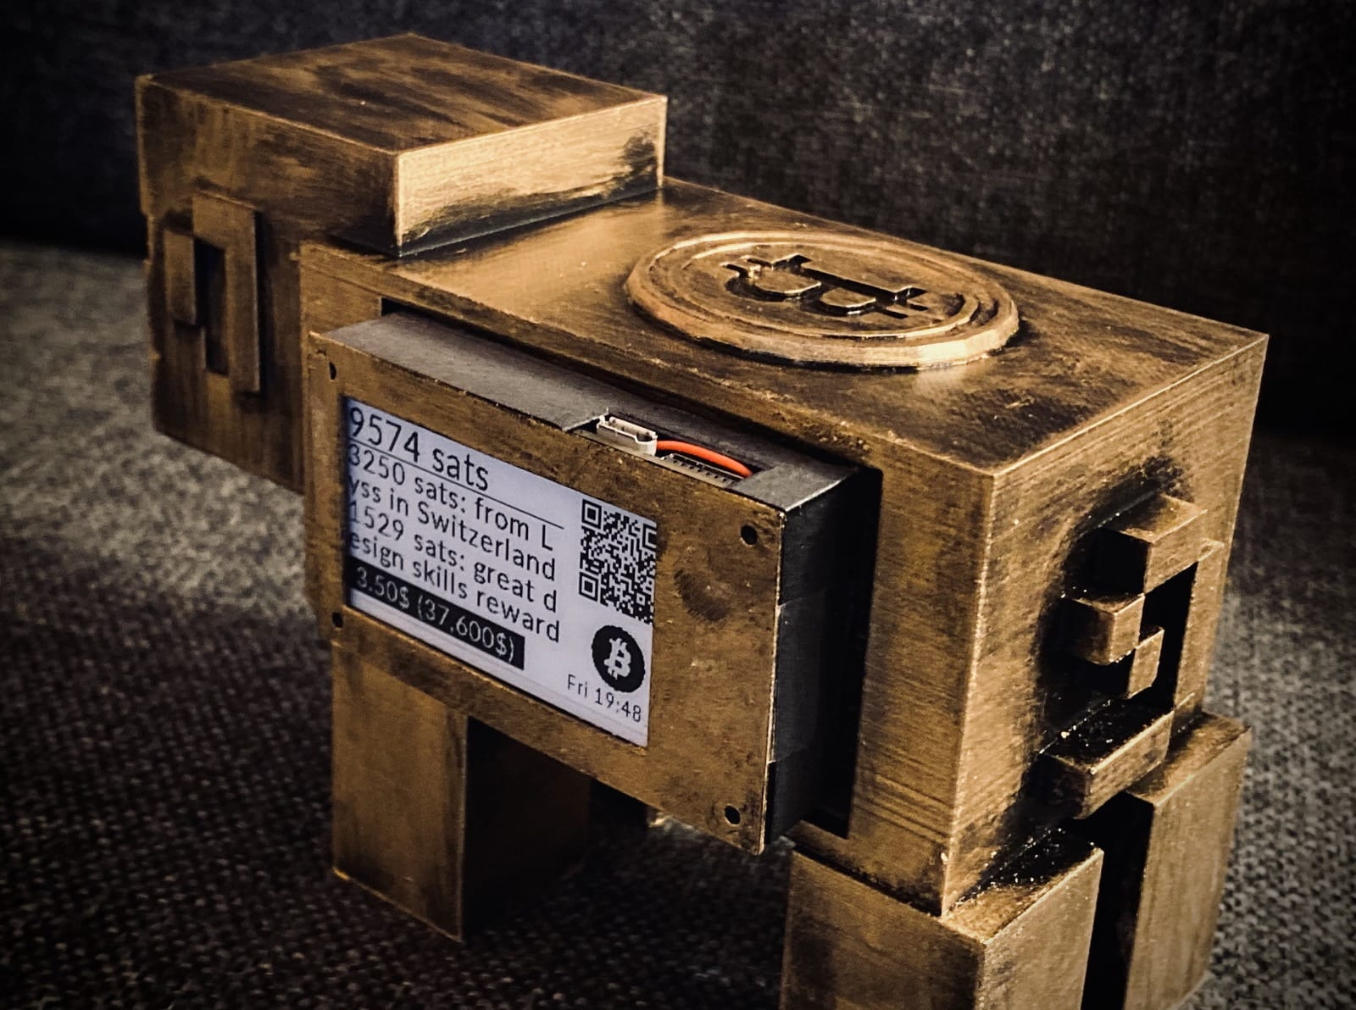
Great Product Finished
Wisdom and Greeting
Fiat Balance & Price
Localization
Access Point Config
Nostr Wallet Connect

Slide 9
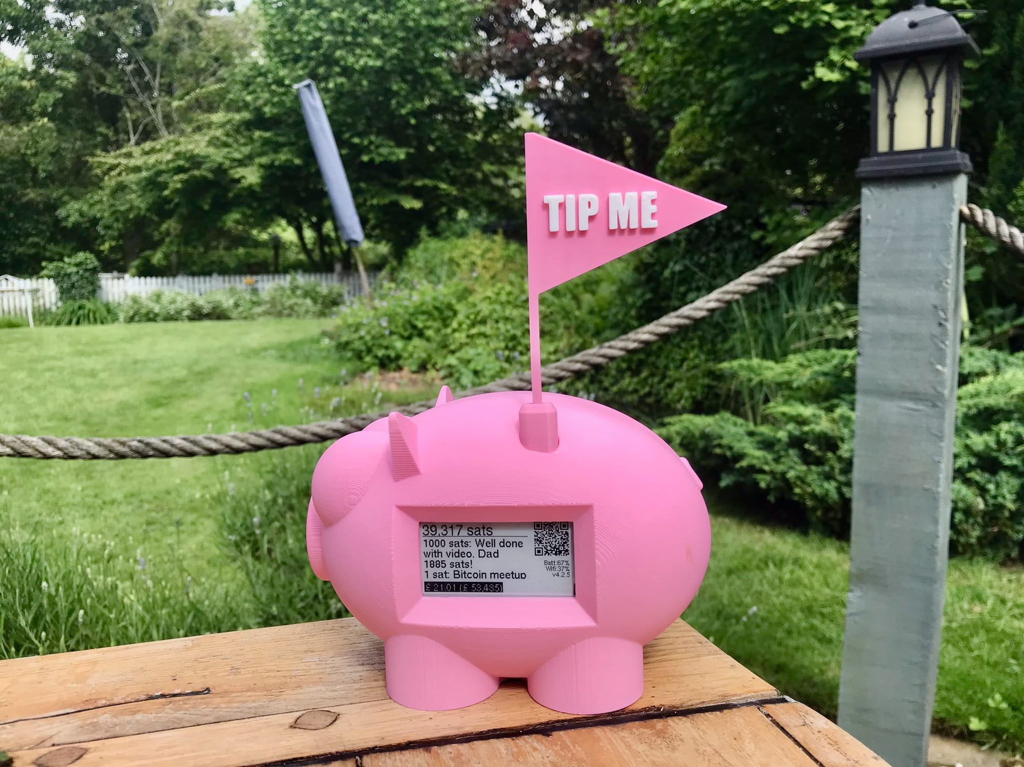
Build Your Own
LightningPiggy.com
  /market
  /build
Make It Your Own
3D Printable Cases
Valuable Present

Slide 10
New LightningPiggy

Slide 11

New LightningPiggy
Color Touch Screen
251% More Pixels
Camera
Accelerometer
MicroSD Card

Slide 12

Need Android-like OS for ESP32
WiFi Manager
Update and Rollback
Slick User Interface
Easy Development
App Store

Slide 13

Impossible?
Like IBM PS/2 (1981)
No MMU
300KB SDRAM
8MB PSRAM
16MB ROM

Slide 14
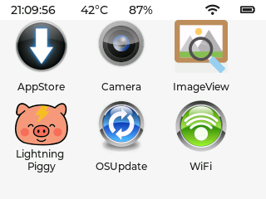
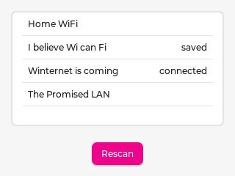
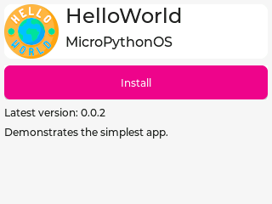
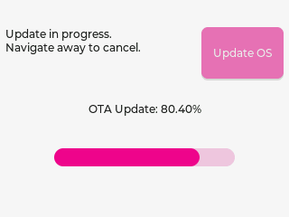
It’s MicroPythonOS!
Launcher
WiFi + Auto-Connect
OSUpdate
AppStore
Settings

Slide 15

MicroPython Works
Born 2014, ESP 2017
Surprisingly fast
mip.install()
Also desktop (native)
Quick Coding Cycle

Slide 16

LVGL 9.3
Lightweight
30+ Widgets
Animations
Image Decoders
L10n, i18n
UI Editor

Slide 17
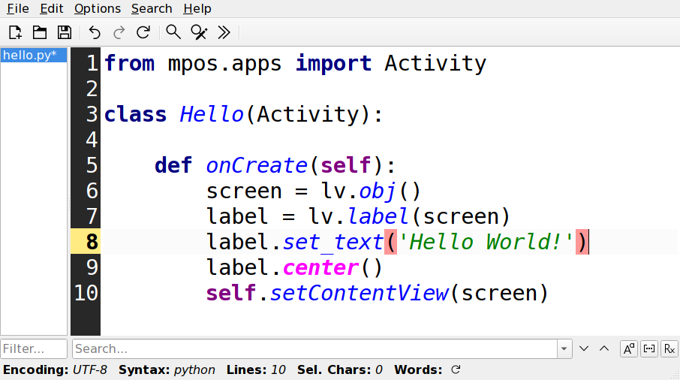
Easy Android-like Development Flow
Create Screen
Add Label
Set Label Text
Center Label
Activate Screen

Slide 18
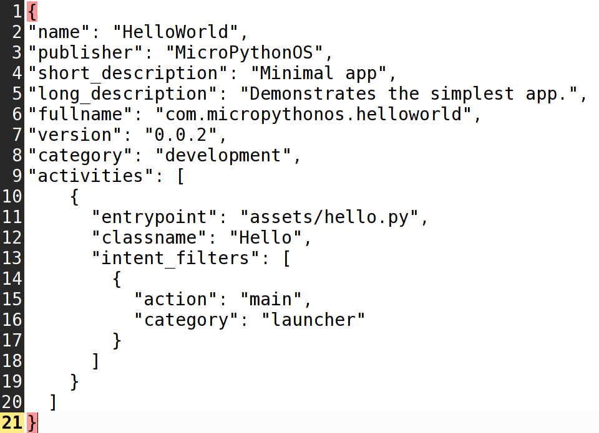
Android-like MANIFEST.JSON
Name
Publisher
Descriptions
Version
Entrypoints

Slide 19
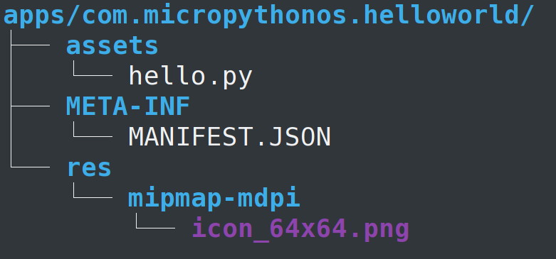
Android-like file structure
Code (hello.py)
MANIFEST.JSON
Icon(s)
Zipped to .mpk

Slide 20
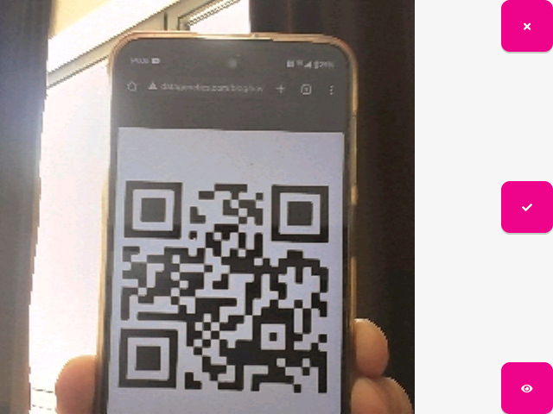

More Apps in the AppStore
Camera + QR decode
Image Viewer
<Your Apps Here>
  Games / Education
  Nostr Client
  Music Player
Lightning Piggy

Slide 21
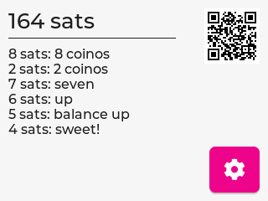
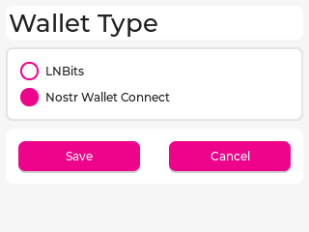
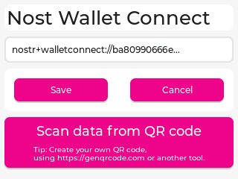
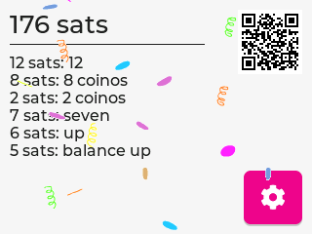
LightningPiggy App
First Release
Showcase OS
Validate Frameworks
Feature Parity
Ported python-nostr

Slide 22
Complementary LightningPiggies
Grayscale ePaper
Button and Tilt Input
Receive Only
Low Power Draw
Single Purpose
Color IPS Panel
Touch Screen Input
Scan QR to Spend
High Power Draw
Multi Purpose

Slide 23
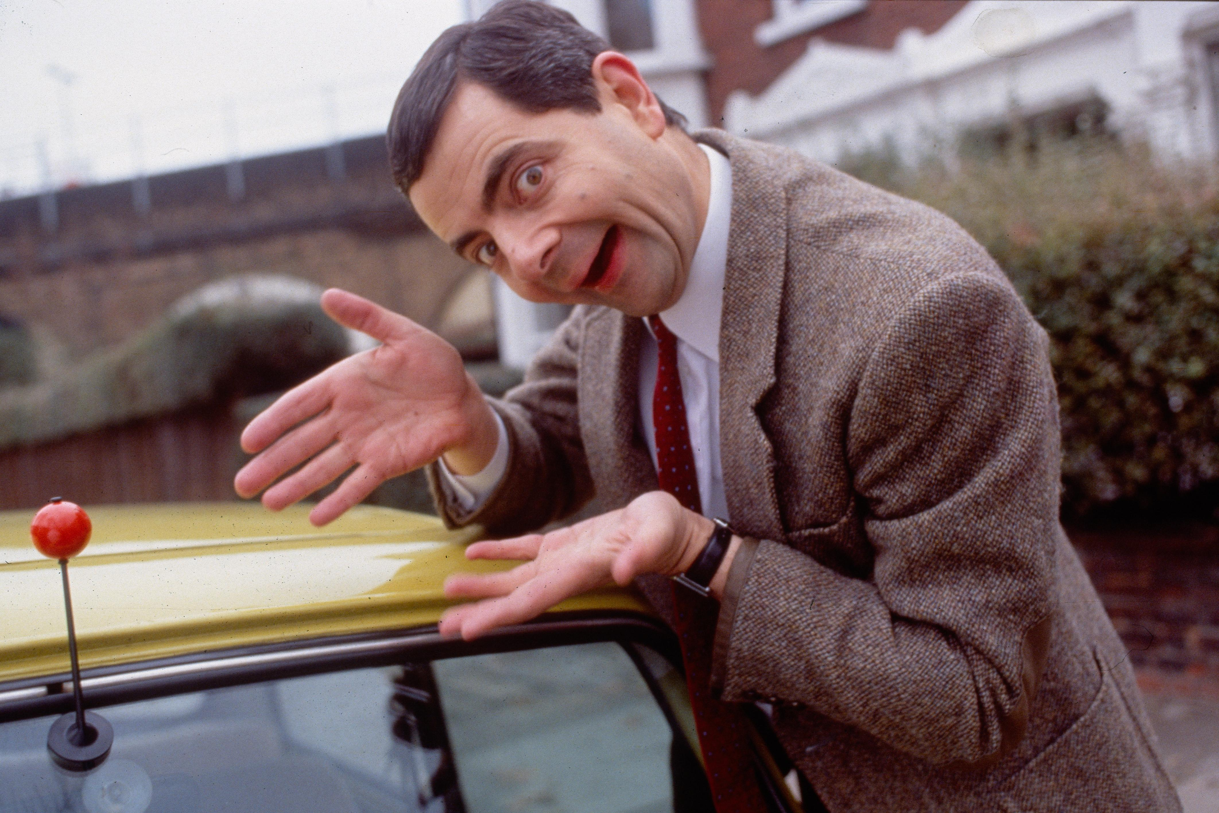
Live Demo
You are looking at it.
Yes, really!
You were in it...
the whole time!

Slide 24
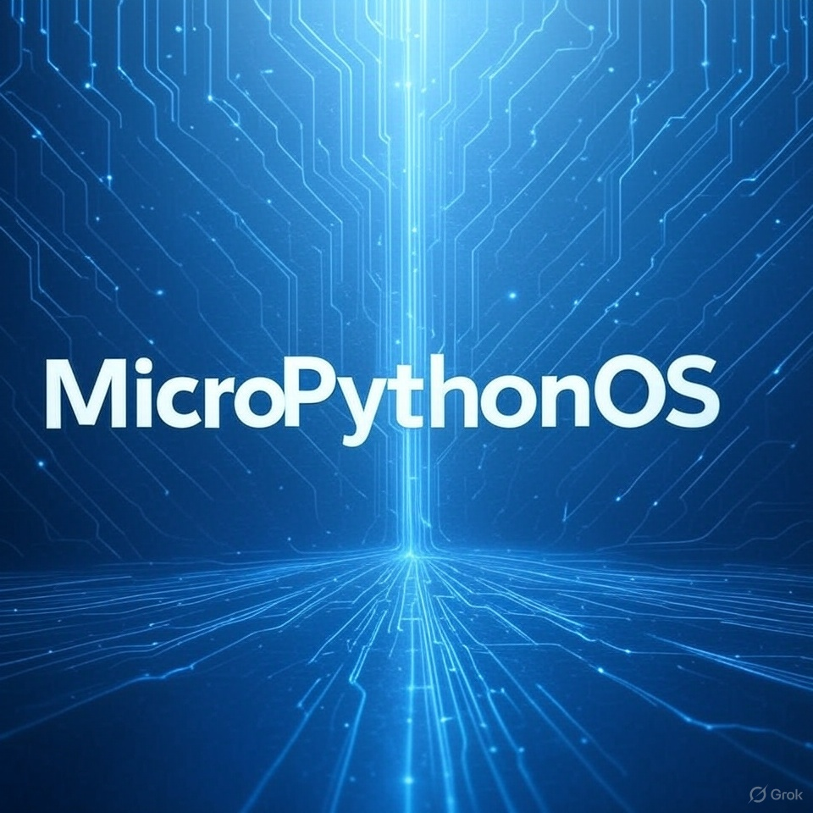
MicroPythonOS.com is Here
Open Source
Open to Developers
Perfect for OEM’s
Grants and Funding
Commercialization

Slide 25

Your turn!
Get a few Piggies
Build Cool Apps
Share
Reach out
chat.MicroPythonOS.com

Slide 26
Thank you!
MicroPythonOS.com
info@MicroPythonOS.com

