Slide 1
LightningPiggy &
The Unveiling of MicroPythonOS

Slide 2
LightningPiggy

Slide 3
LightningPiggy

Slide 4

Teach kids when they’re young
Fun
Personal
Save
Invest
Bitcoin and Sats

Slide 5

Why not a smartphone?
Fragile
Complex
Expensive
Distractions
Turns Off

Slide 6
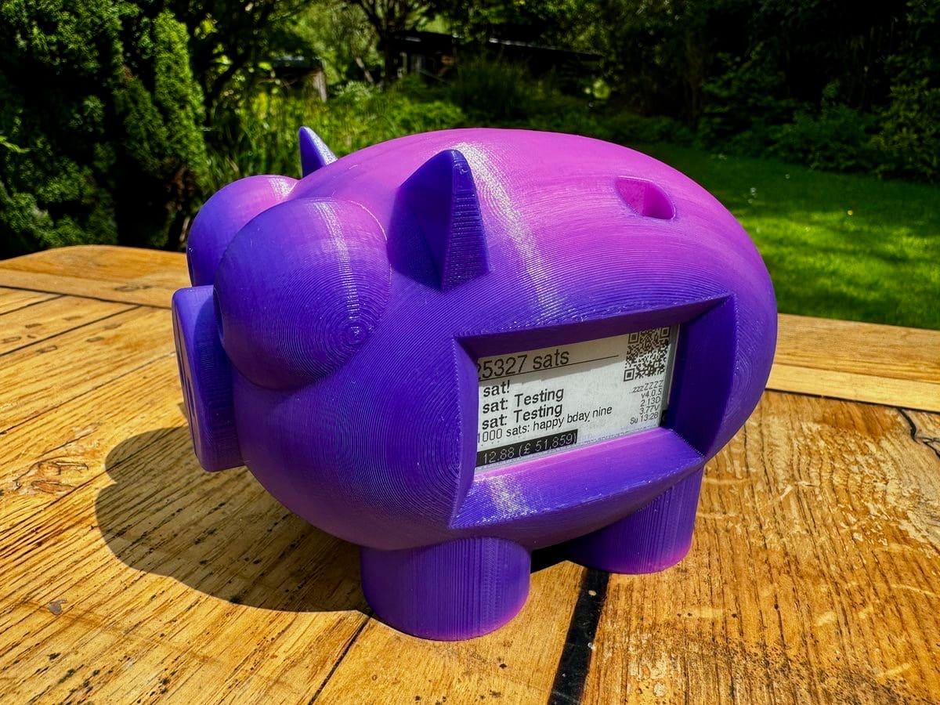
Perfect Kid’s Wallet
Always On (ePaper)
Balance in Sats
Amount & Comment
Receive QR code
Instant refresh

Slide 7
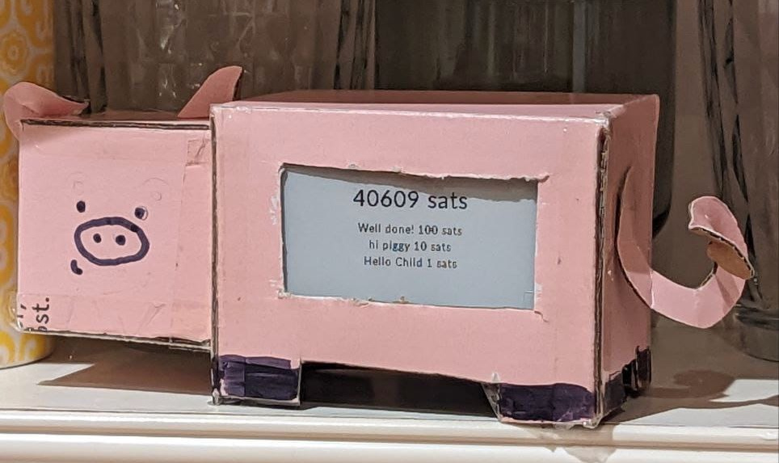
Proof-of-Concept
Credit: BlackCoffee
LilyGo ePaper Board
Backend: LNBits
Hard-coded Config
Arduino IDE Installer

Slide 8
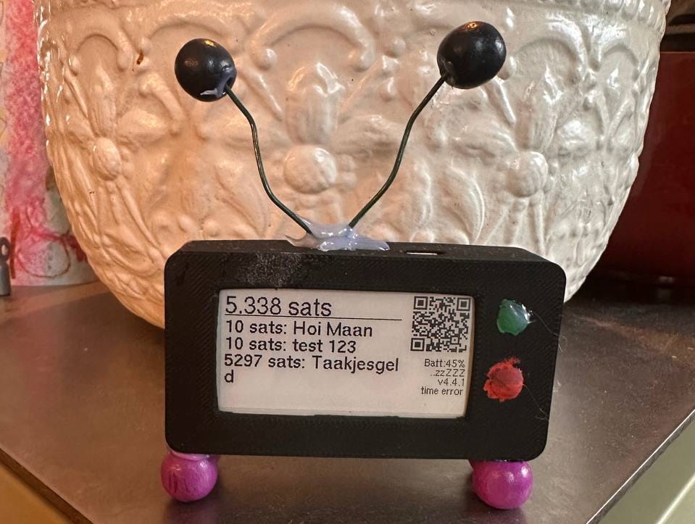
Awesome Added Features
Easy Web Installer
Battery Management
Shake-to-Wake
Update Notifications
Webbrowser Config

Slide 9
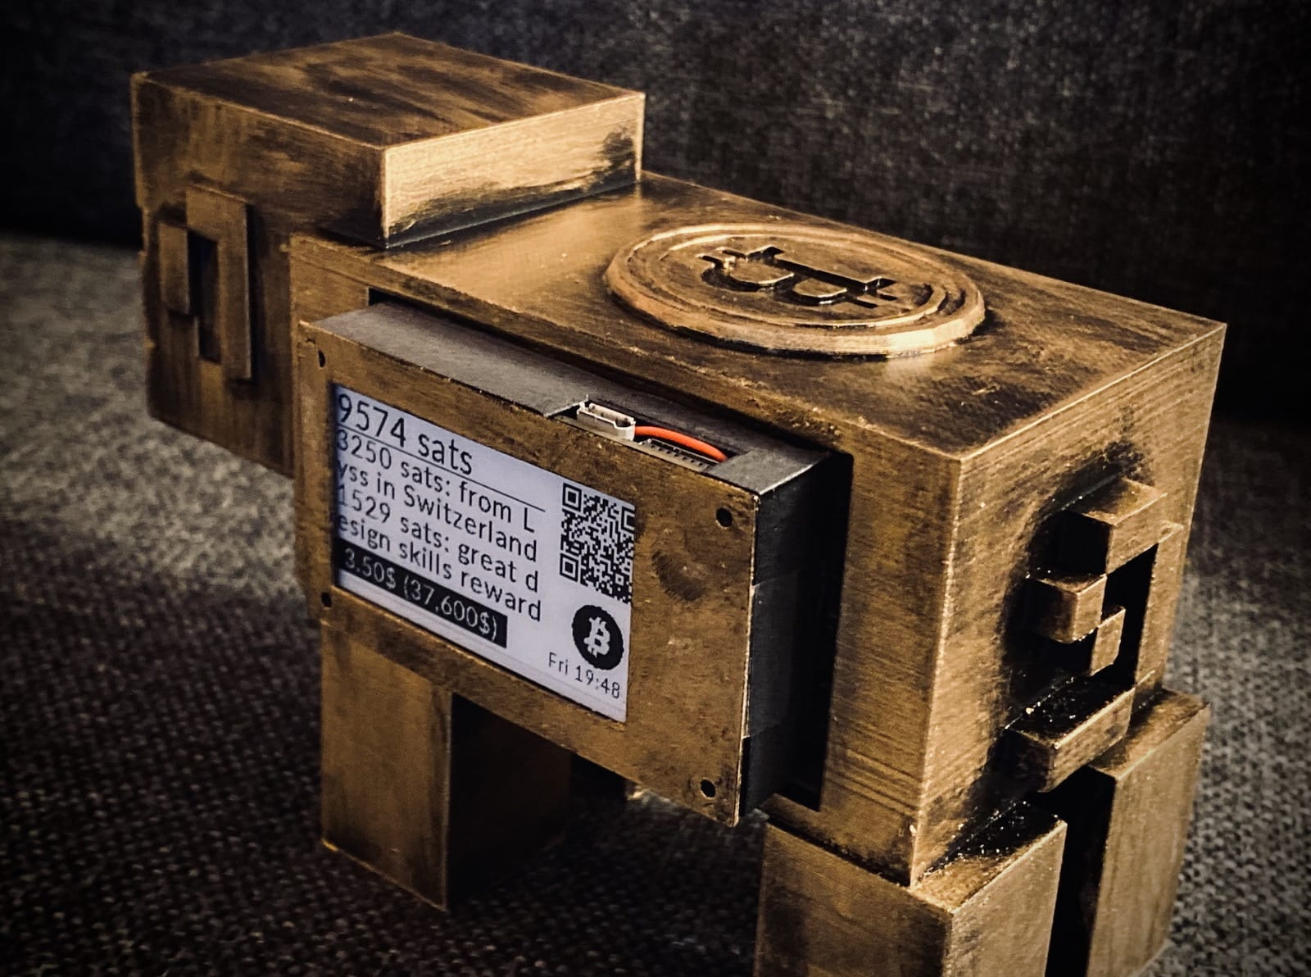
Great Product Finished
Wisdom and Greeting
Fiat Balance & Price
Localization
Access Point Config
Nostr Wallet Connect

Slide 10
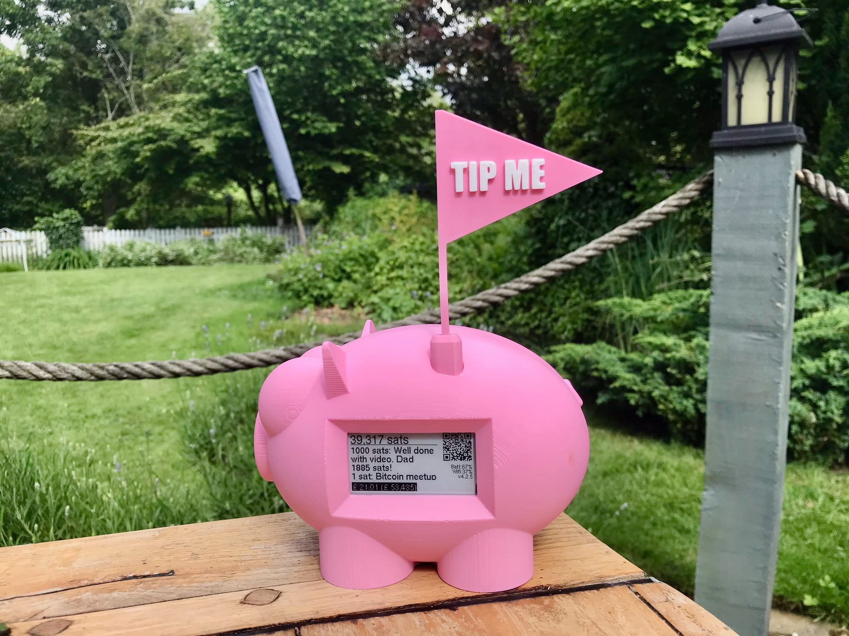
Build Your Own
LightningPiggy.com
  /market
  /build
Make It Your Own
3D Printable Cases
Valuable Present

Slide 11
New LightningPiggy

Slide 12

New LightningPiggy
Color Touch Screen
251% More Pixels
Camera
Accelerometer
MicroSD Card

Slide 13

Need Android-like OS for ESP32
App Store
WiFi Manager
Update and Rollback
Slick User Interface
Easy Development

Slide 14

Possible?
No MMU
300KB SDRAM
8MB PSRAM
16MB ROM
IBM PS/2 1981

Slide 15
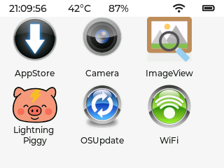
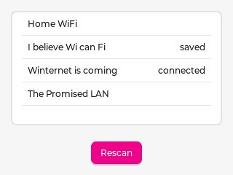
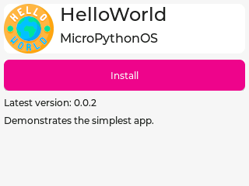
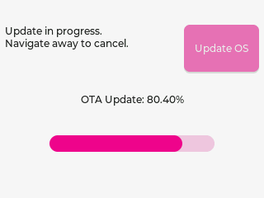
Enter MicroPythonOS!
Launcher
WiFi + Auto-Connect
OSUpdate
AppStore
Settings

Slide 16

LVGL 9.3
Lightweight
30+ Widgets
Animations
Image Decoders
L10n, i18n
UI Editor

Slide 17
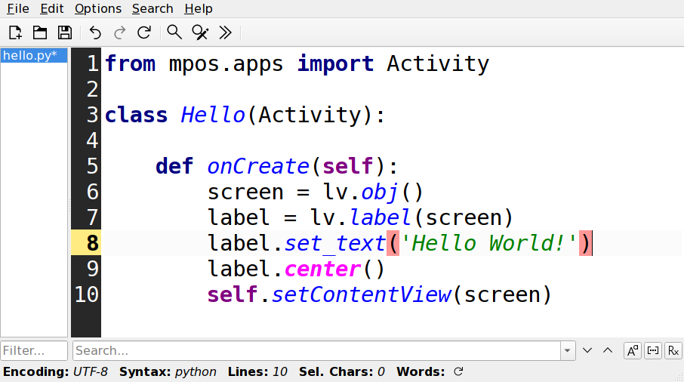
Easy Android-like Development API
Create Screen
Add Label
Set Label Text
Center Label
Activate Screen

Slide 18
Available Apps
Camera + QR decode
Image Viewer
Lightning Piggy
Your App Here ;-)
  Games
  Nostr Client
  Music Player

Slide 19
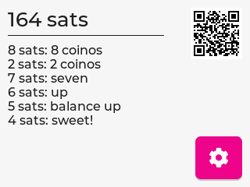
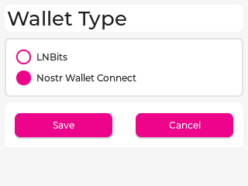
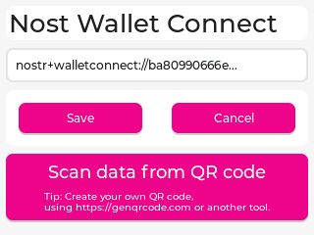

LightningPiggy App
First Release
Showcase OS
Validate Frameworks
Feature Parity

Slide 20

Live Demo
You are looking at it.
Yes, really!
This is it.
You were in it this whole time!

Slide 21

Your turn!
Buy the devices
Join the projects
Build lots of apps
Share
Reach out

