Slide 1

NewLine – Saturday 30-5-2026
Notes:
What Fri3d Camp 2026 needs:
- Useful software apps for badge
- Ready before camp
- Easy to pick, choose and install
- Easy to connect to wifi
- Easy to update
- Easy to use

Slide 2
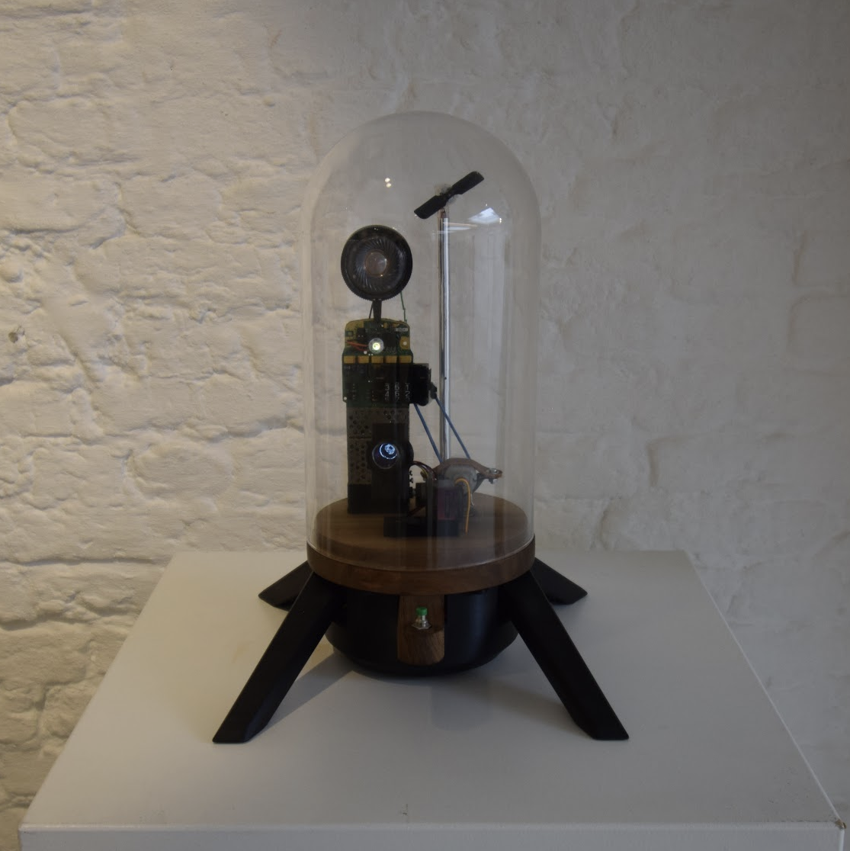
whoami
Quasi Kili
Maker and Artist
Contributor MicroPythonOS
Fan of MPOS

Slide 3

whoishe
Thomas Farstrike
Creator of MPOS
Background:
  Kernel development
  Embedded Linux
  C/C++

Slide 4

Origins
Almost 2 Years Ago
Building new device
Need for modern ESP32 Touch OS
...with AppStore
Didn’t exist!

Slide 5
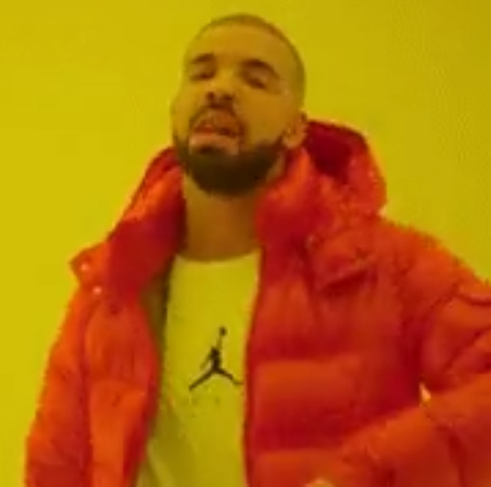
Create it in C/C++ ?
Known territory
Most ESP32 libraries
Lightweight
Logical choice
Why not?

Slide 6
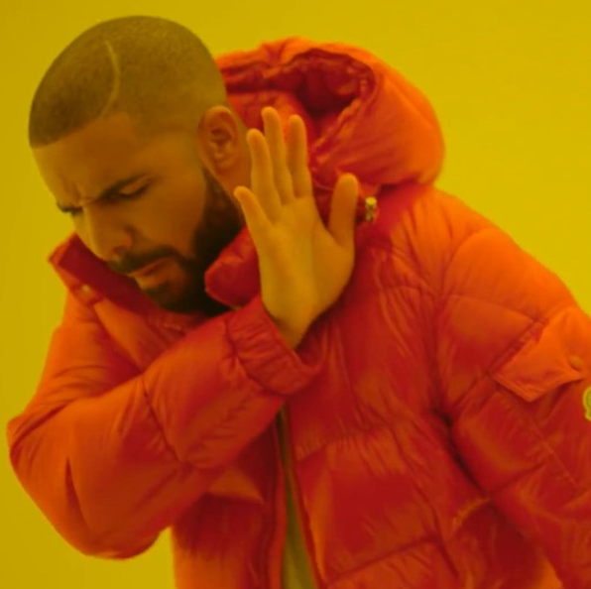
Create it in C/C++ ?
Limited MMU
Custom compilation
​Challenge to maintain
Unforgiving
Difficult to create OS
Not easy for app developers

Slide 7
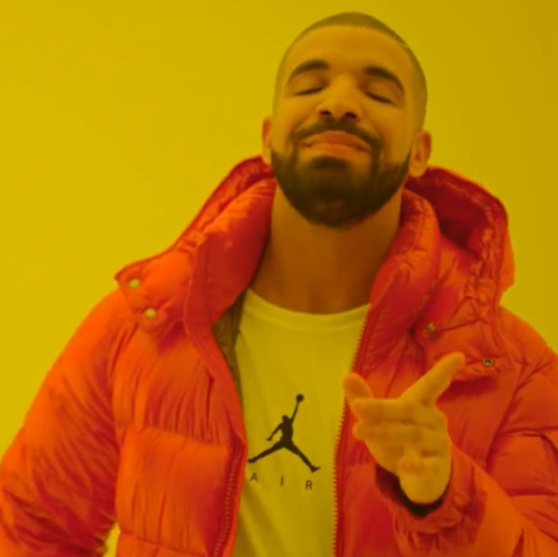
Create it in MicroPython!
Dynamic loading
Scripts (.py)
Binaries (.mpy)
Modern language
Easy for app developers
Drivers in MicroPython

Slide 8

MicroPython
Born 2014, ESP 2017
Surprisingly fast
Many libraries
Also desktop (native)
Quick Coding Cycle
99% like Python

Slide 9

LVGL makes it beautiful
Light and Versatile
30+ Widgets
Animations
Image Decoders
UI Editor
MicroPython bindings Credit: lvgl_micropython

Slide 10
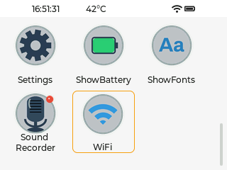
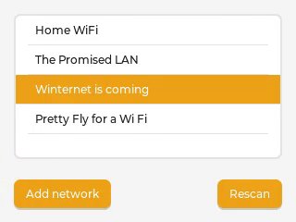
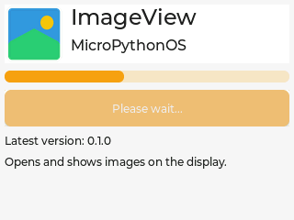
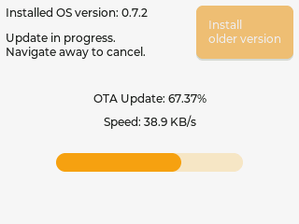
Proving the concept
Launcher
WiFi + Auto-Connect
AppStore
OSUpdate
Settings
About

Slide 11
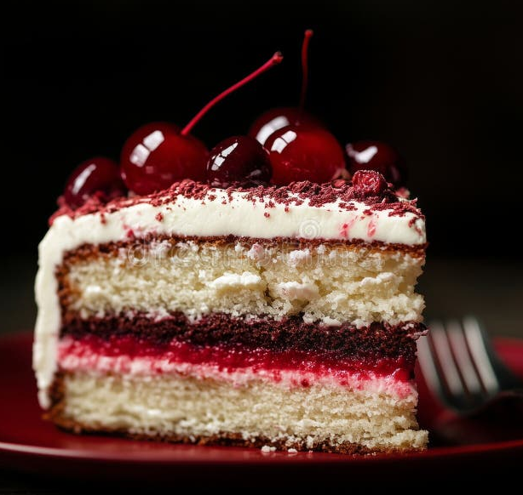
High-level architecture
Apps
Frameworks:
MicroPython and C
High-level drivers:
MicroPython and C
MicroPython Runtime
Low-level drivers:
FreeRTOS, Darwin, Linux

Slide 12
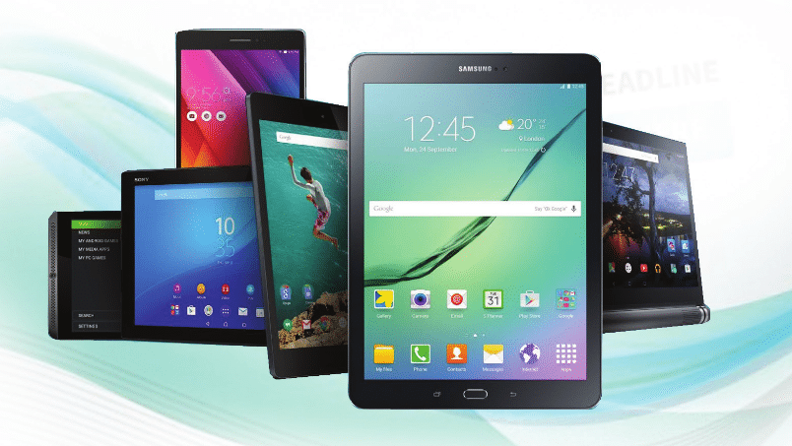
Lessons from Android
Create once, run on all (compatible) devices
Easy app development
User Interface
BUT more open source!

Slide 13

Why MicroPythonOS
Very Lightweight
Boots in 3 seconds
Python language
100% open development
Frequent releases
Runs native on desktop
Up-and-coming

Slide 14
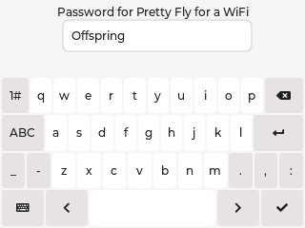
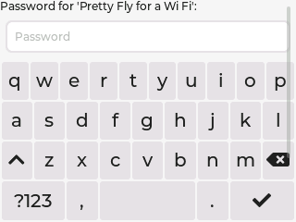
Innovations
MposKeyboard +50% buttons
Swipe gestures for navigation
Optimize QR decoding (960x960)
Joystick for focus direction
Bindings and bindings!

Slide 15
Apps
NewLine – Saturday 30-5-2026
Notes:
What Fri3d Camp 2026 needs:
- Useful software apps for badge
- Ready before camp
- Easy to pick, choose and install
- Easy to connect to wifi
- Easy to update
- Easy to use

Slide 16
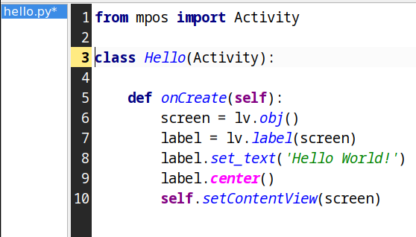
Familiar app life cycle
Create Screen
Add Label
Set Label Text
Center Label
Activate Screen

Slide 17
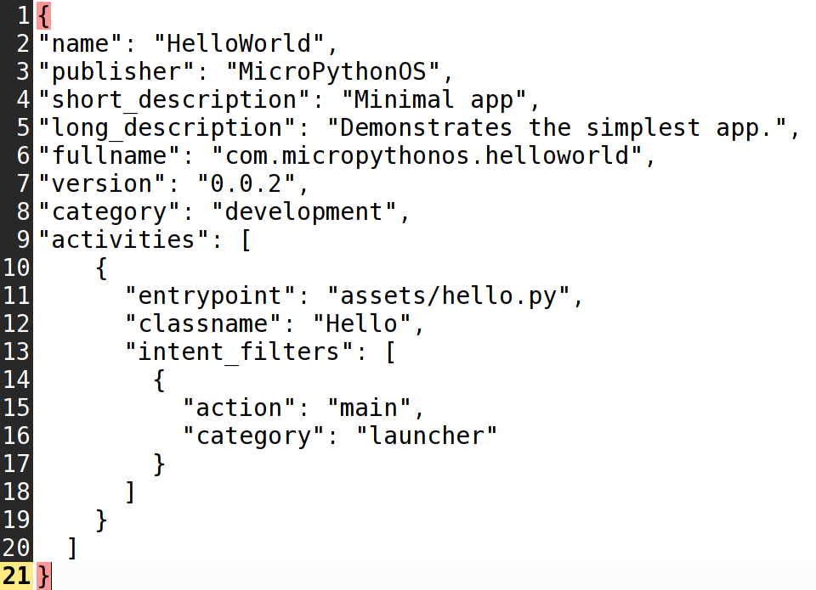
Familiar MANIFEST.JSON
Name
Publisher
Descriptions
Version
Entrypoints

Slide 18
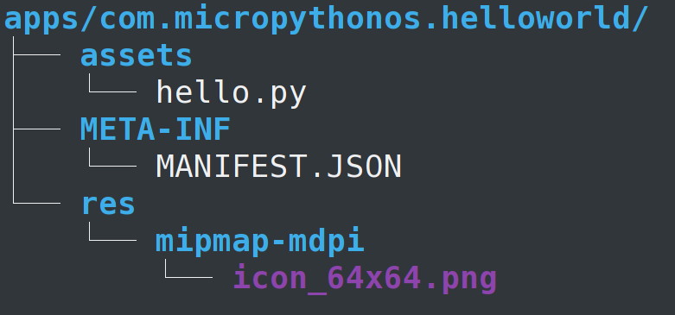
Familiar file structure
Code (hello.py)
MANIFEST.JSON
Icon(s)
Zipped to .mpk
See docs

Slide 19
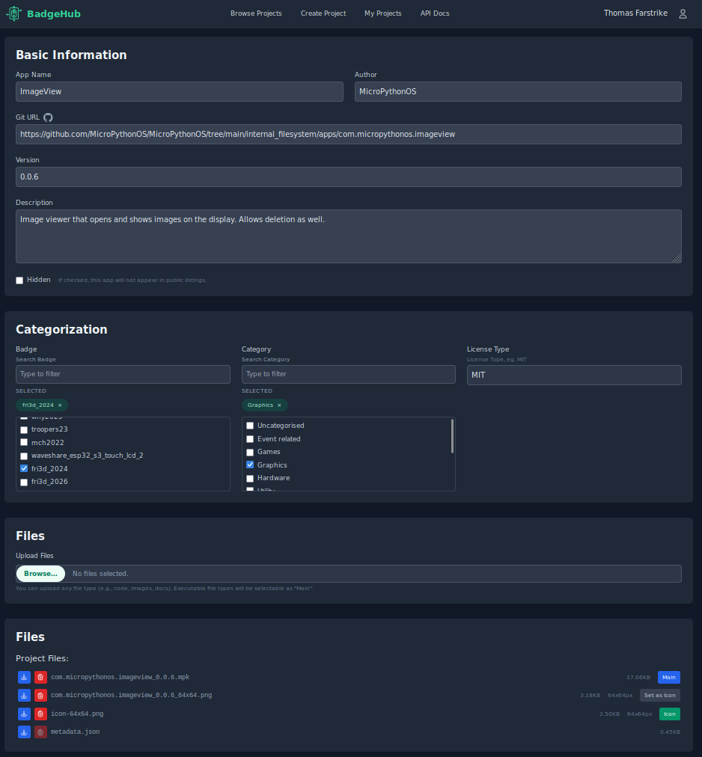
AppStore backends
apps.MicroPythonOS.com
  Original
  Curated List
  To be listed: reach out
New: BadgeHub.eu
Add your own!

Slide 20
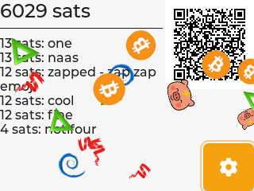
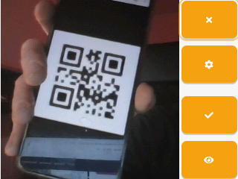

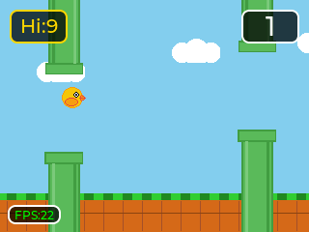
Apps in the AppStore
LightningPiggy
Camera (with QR)
Image Viewer
Games
Music Player
Sound Recorder
+ more every week

Slide 21
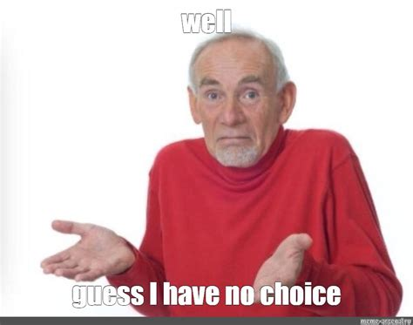
Why build a MicroPythonOS app
Fun
Easy (or Hard)
Educational
Many OSS examples
Supportive community
1/1 > 1/100
Growing niche

Slide 22
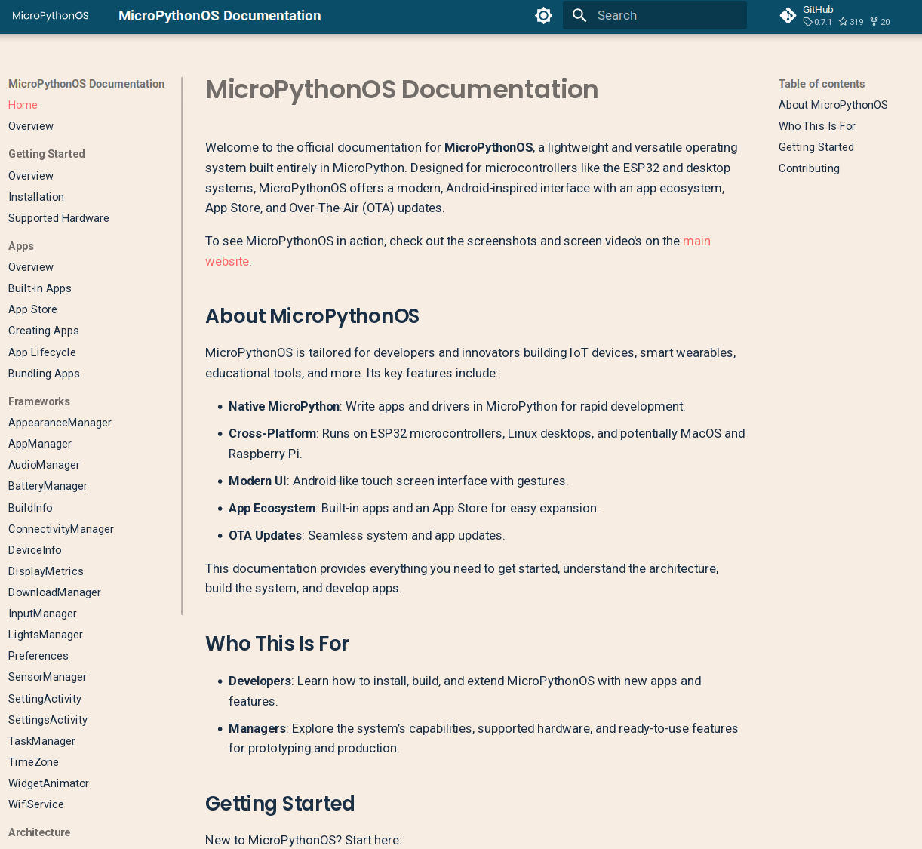
Good documentation
All frameworks documented
Updated regularly
https://docs.MicroPythonOS.com

Slide 23
Supported hardware
NewLine – Saturday 30-5-2026
Notes:
What Fri3d Camp 2026 needs:
- Useful software apps for badge
- Ready before camp
- Easy to pick, choose and install
- Easy to connect to wifi
- Easy to update
- Easy to use

Slide 24

First board: Waveshare S3 Touch 2
320x240
2 inch screen
Capacitive Touch
Camera 5MP
Accelerometer (IMU)
MicroSD Card
Battery support

Slide 25
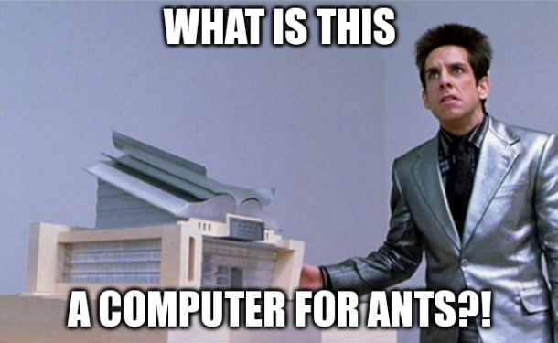
Hardware Specs
300KB SDRAM
8MB PSRAM
16MB ROM

Slide 26

Hardware Specs
300KB SDRAM
8MB PSRAM
16MB ROM
=~ IBM PS/2 (1981)

Slide 27
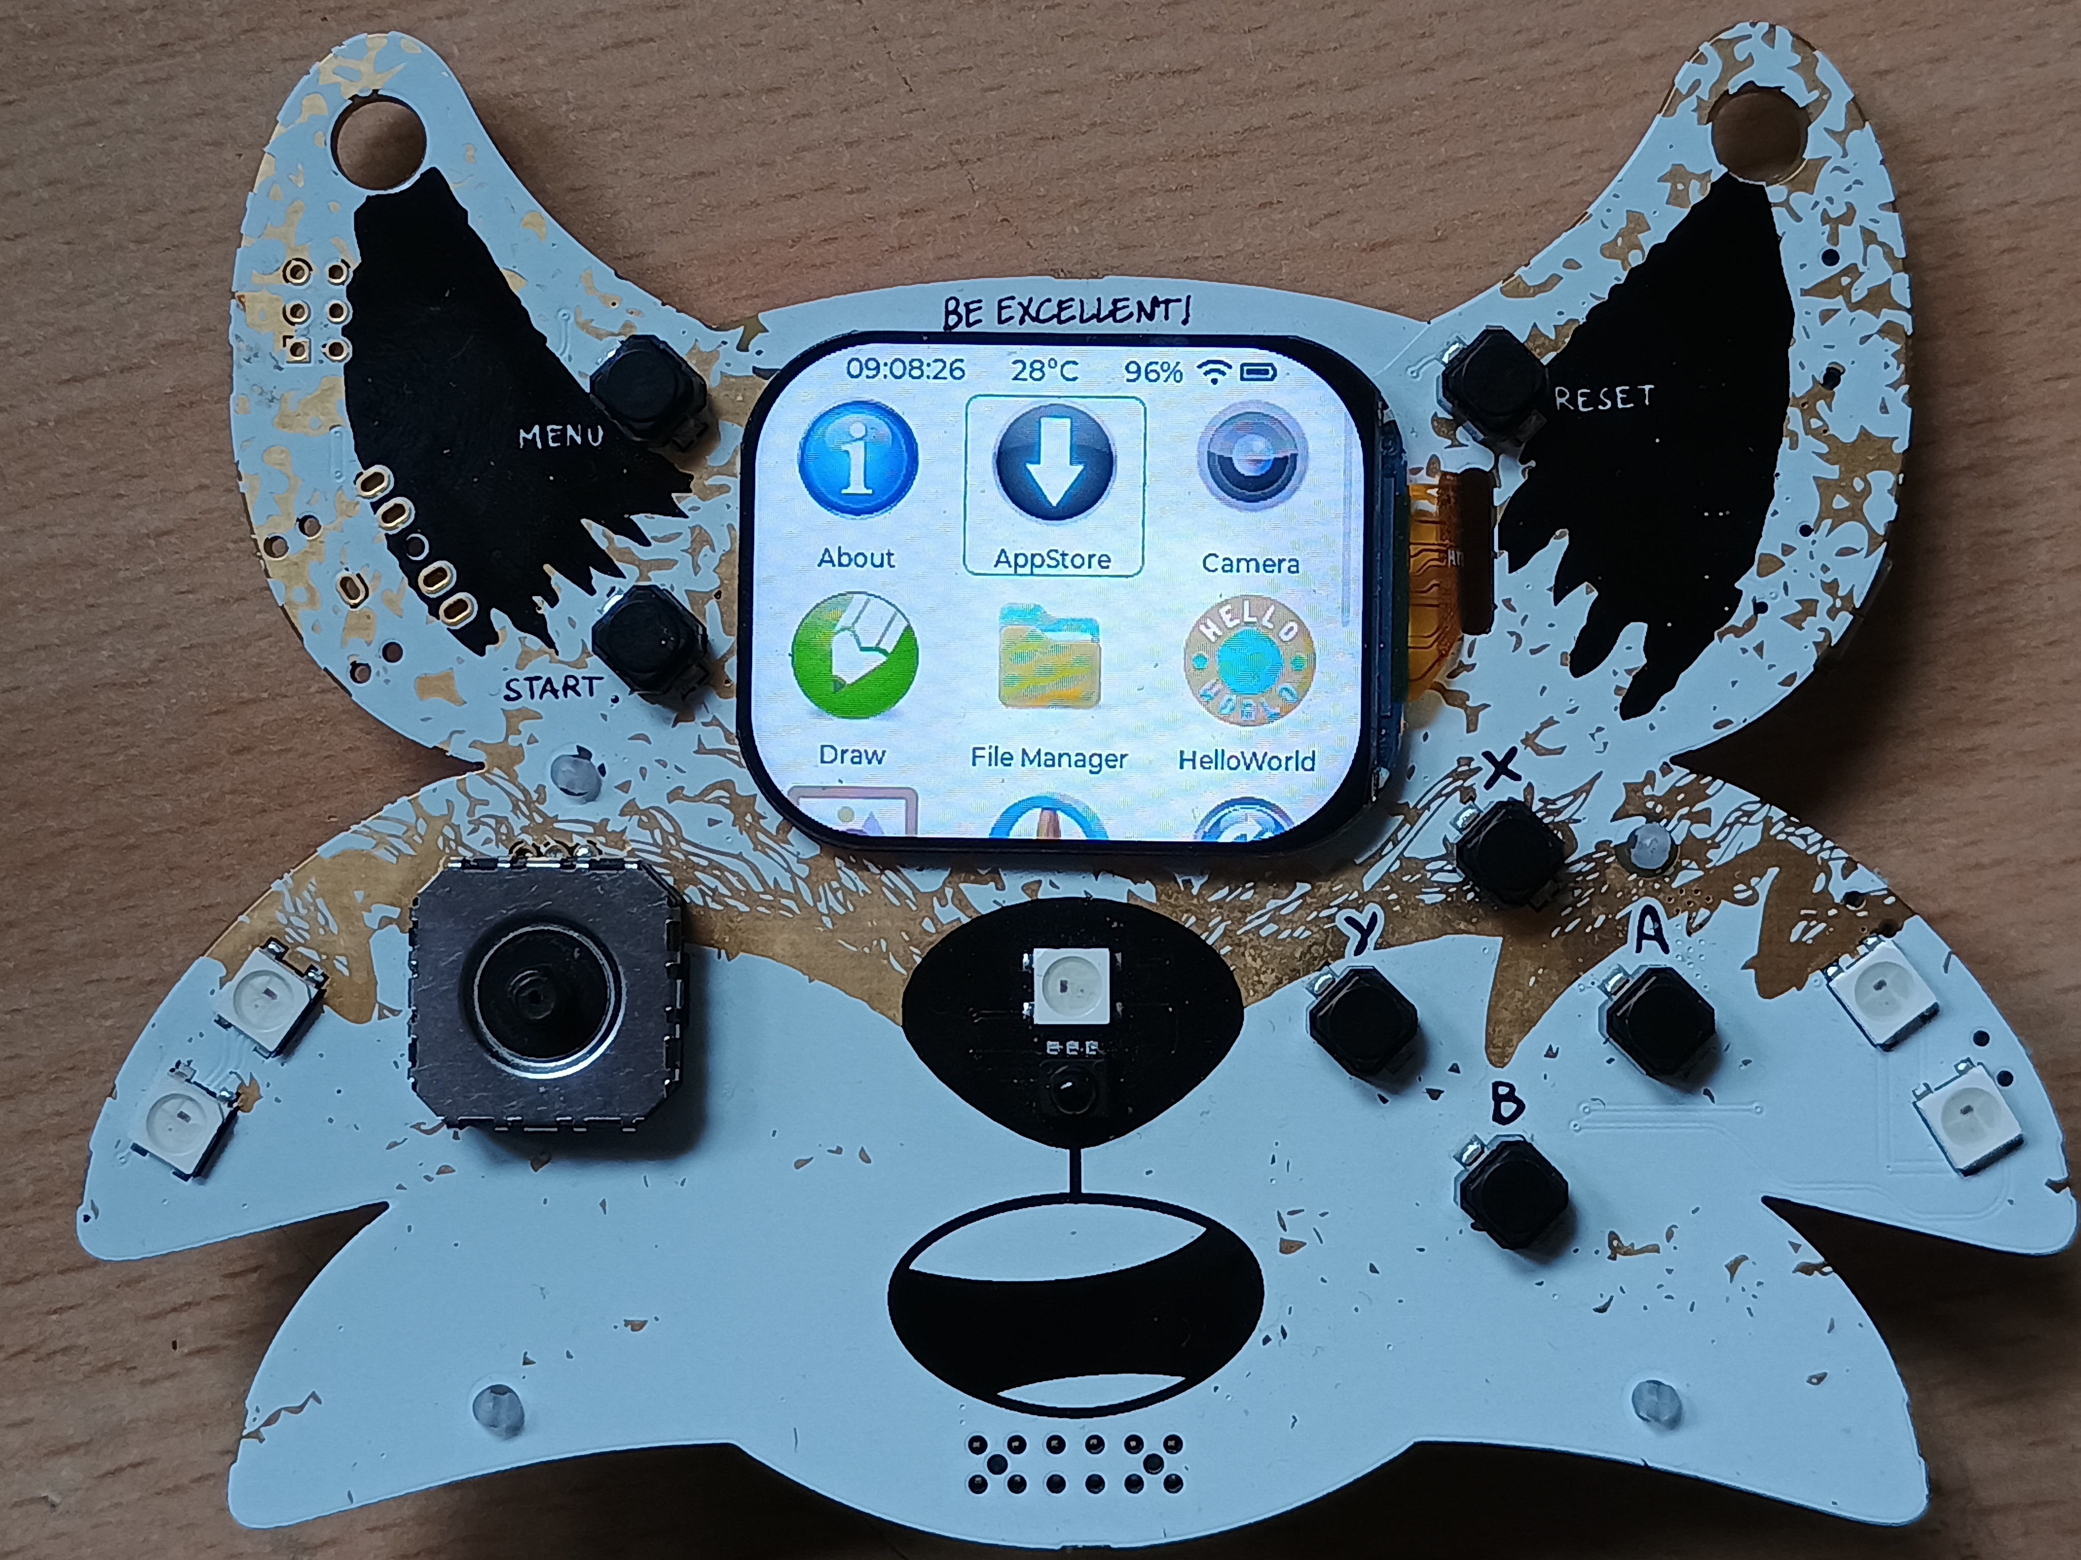
Second board: Fri3d Camp 2024
296x240
2 inch screen
IMU
Buzzer
Multicolor LEDs
Expansions

Slide 28
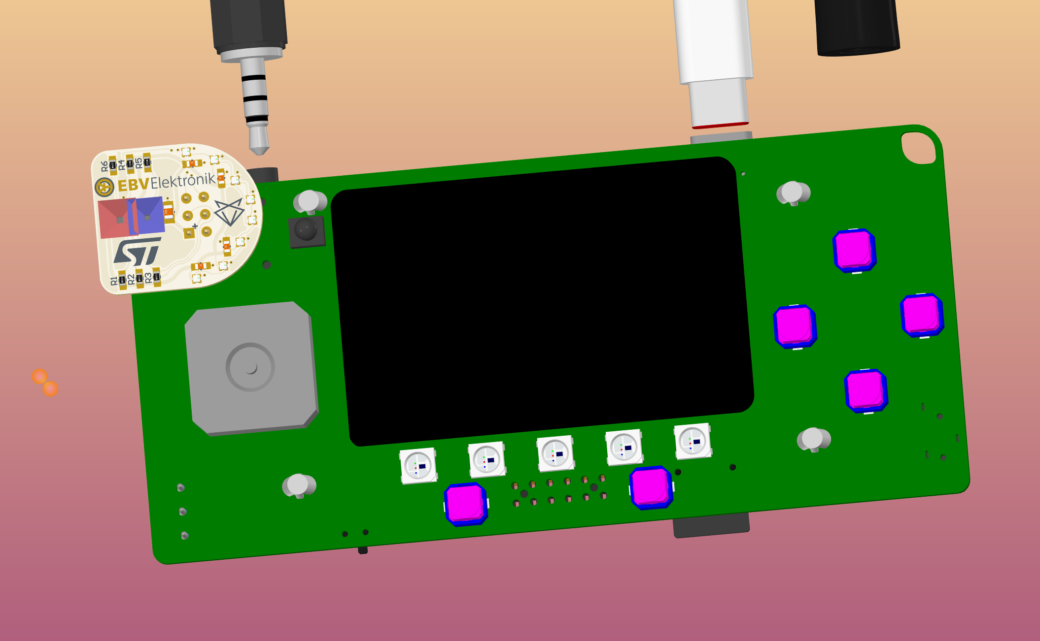
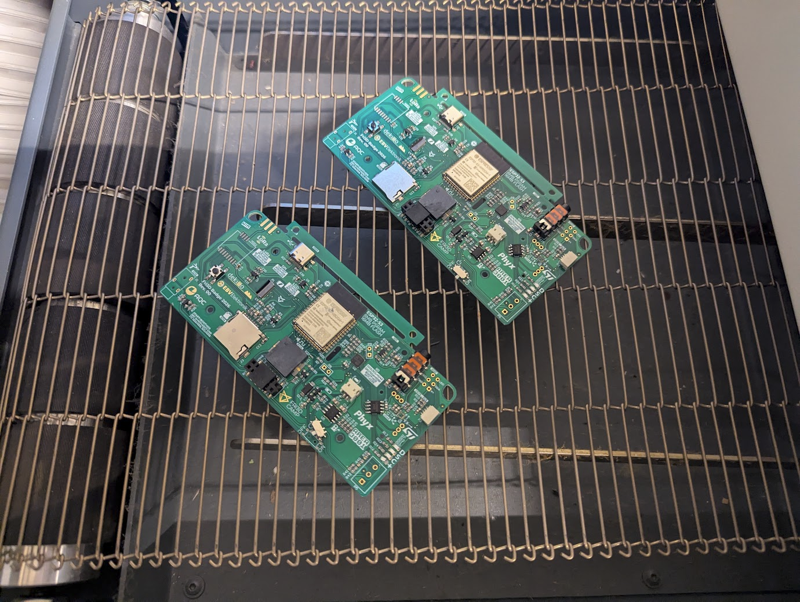
Third board: Fri3d Camp 2026
320x240 2 inch display
Capacitive Touch!
Audio Jack
MicroPythonOS
Retro-Go
  Doom
  Gameboy
  NES

Slide 29
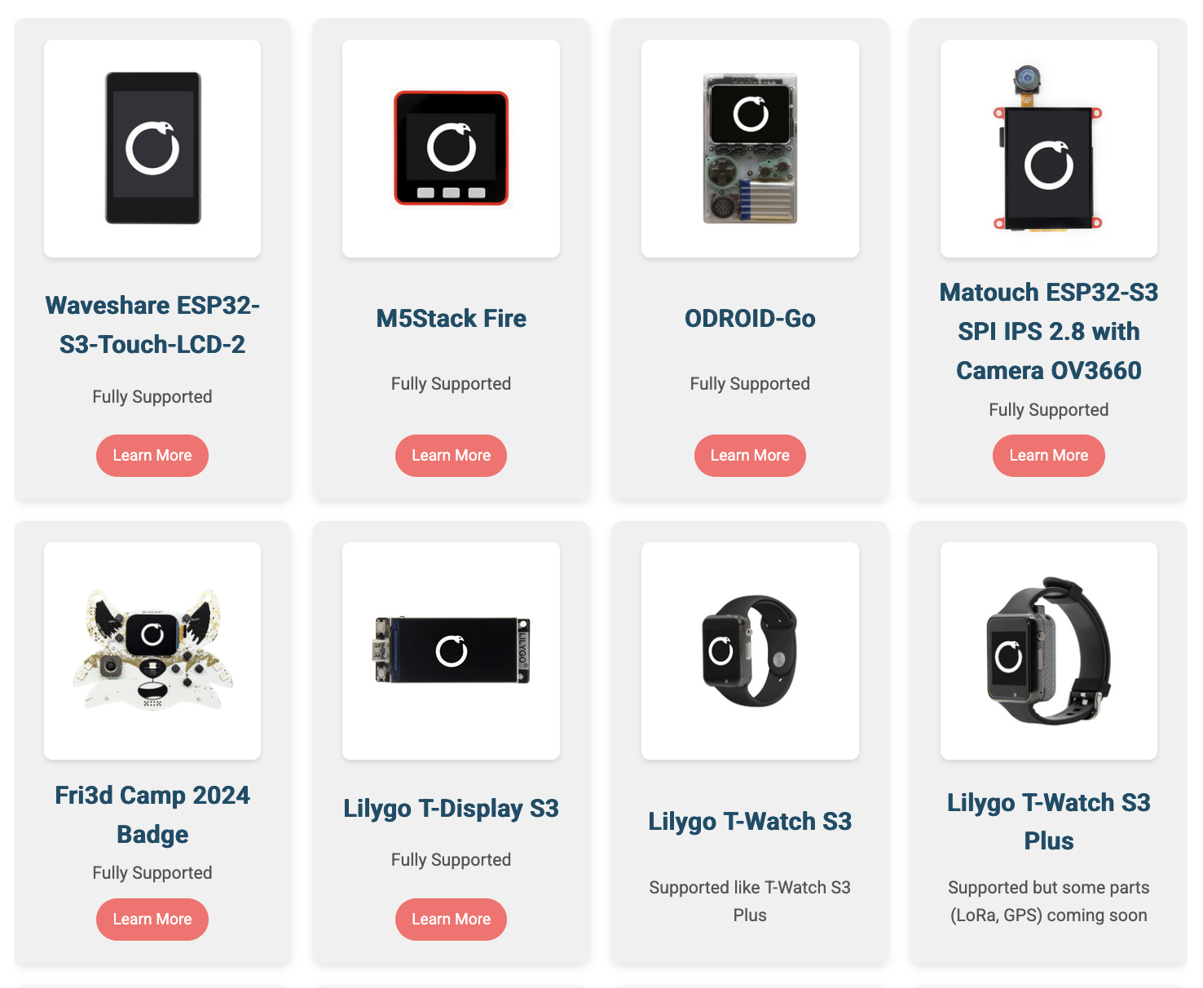
More boards every months
Manufacturers are interested – adds value
1st: samples received
2nd: samples shipped
New form factors
LoRa
Porting for free
  Hurry if you want it

Slide 30

Next boards
Manufacturers are interested – adds value
1st: samples received
2nd: samples shipped
New form factors
LoRa
Porting for free
  Hurry if you want it

Slide 31
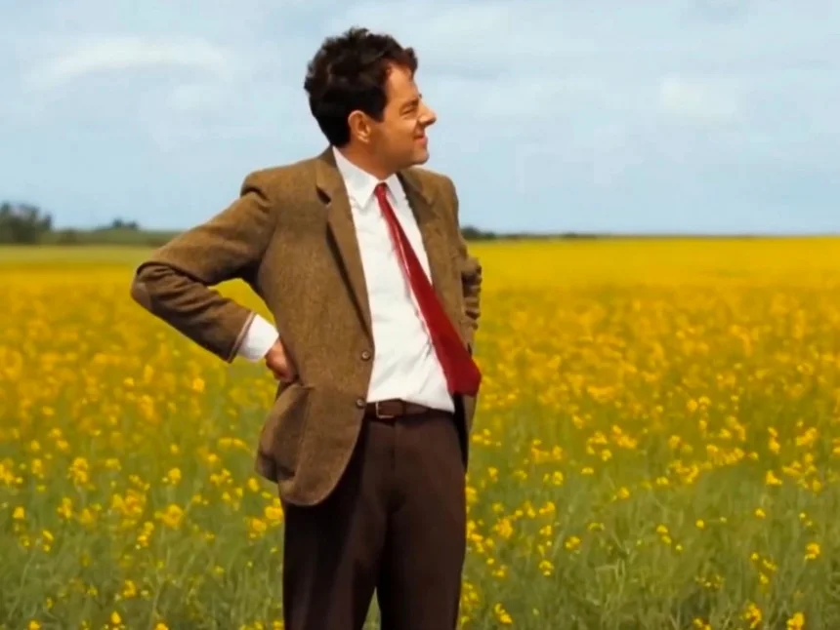
Live Demo
Demo’s are risky
Demo’s are scary
Will it work?
Where is it?

Slide 32
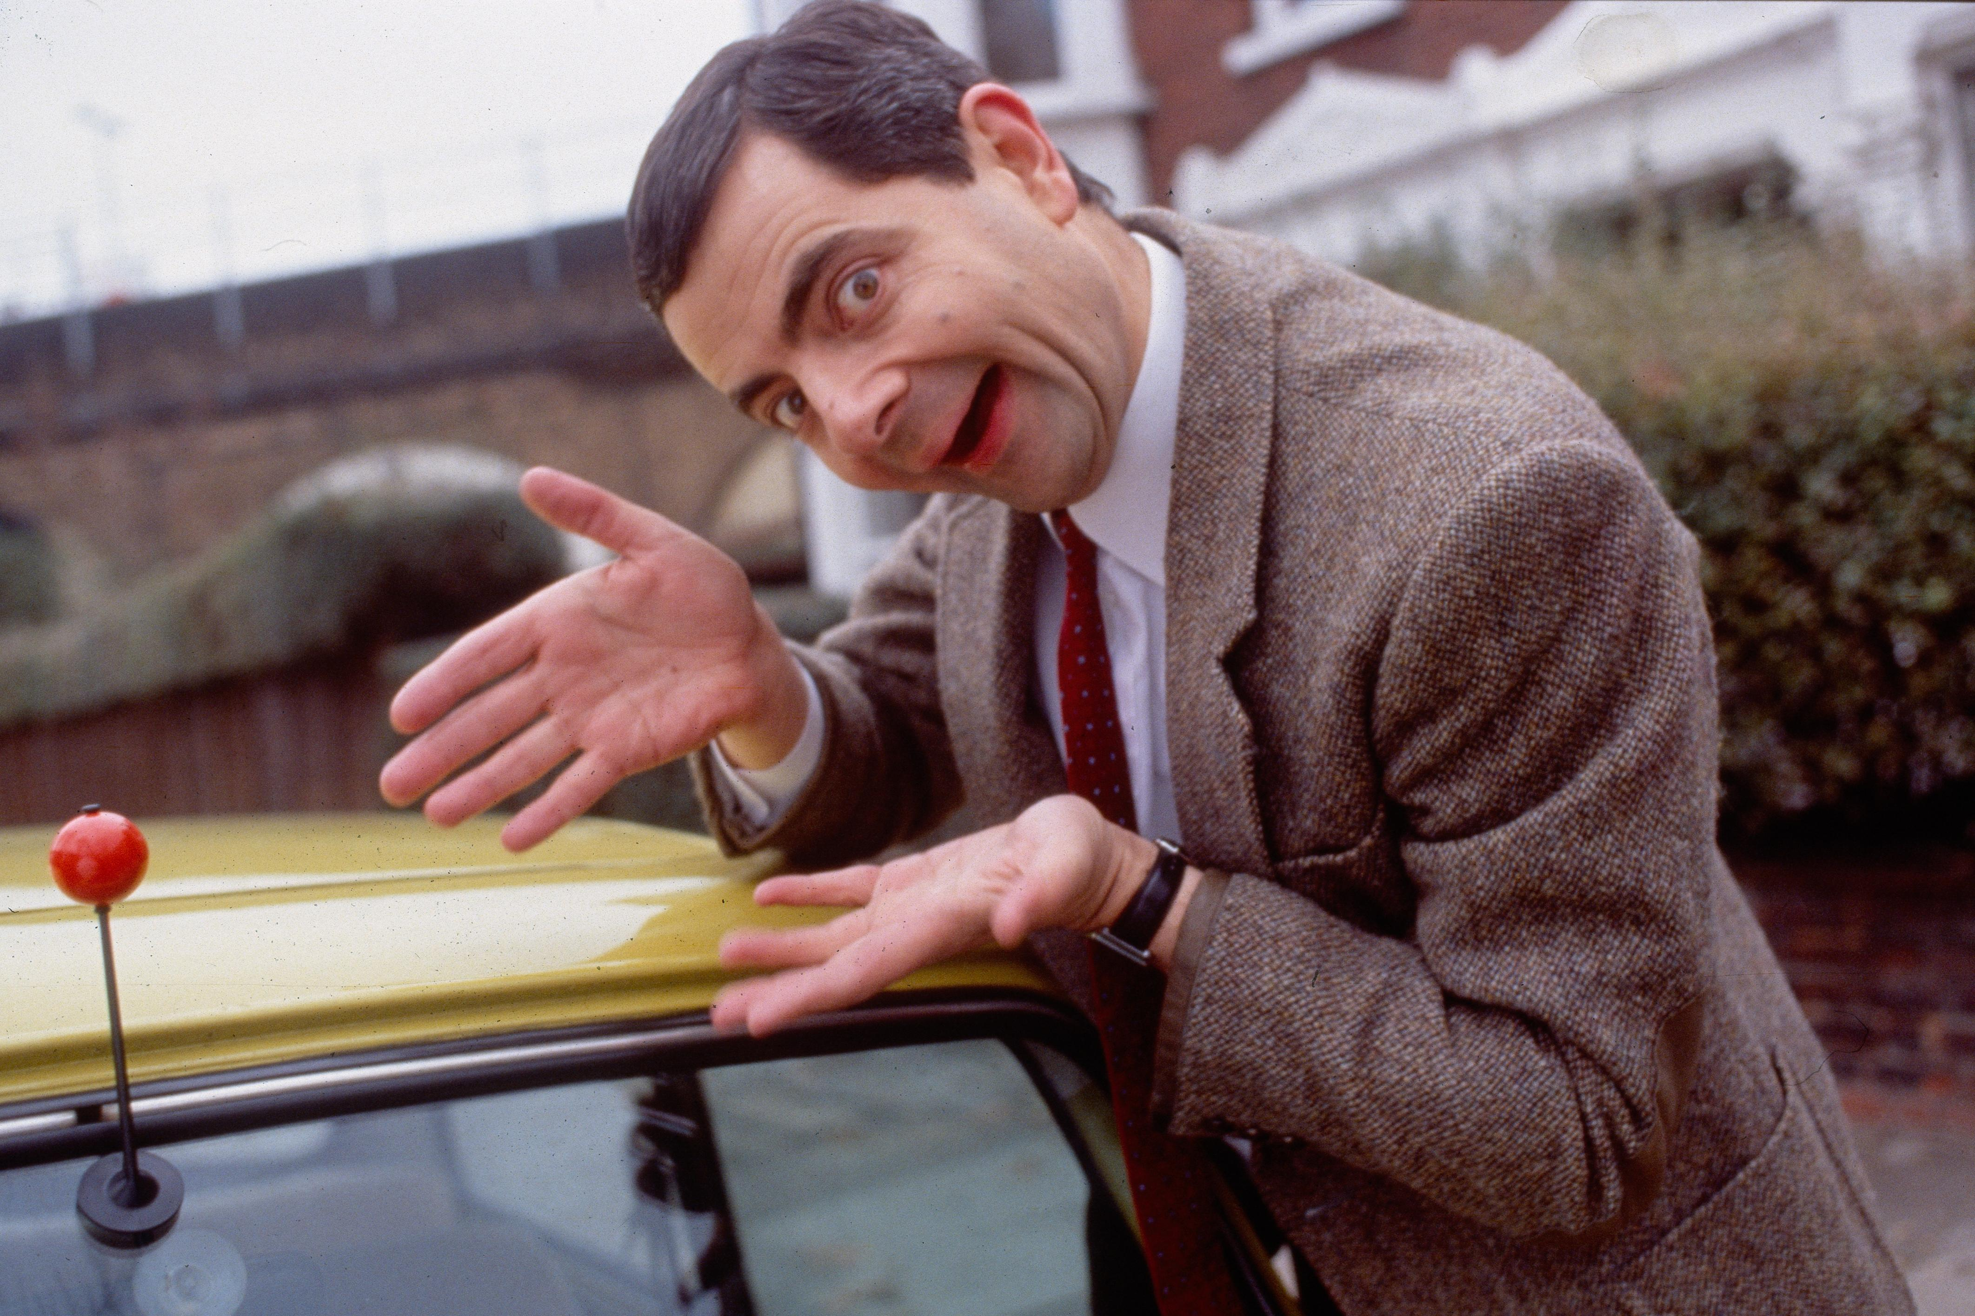
Live Demo
You’re looking at it!
You’ve been it...
the whole time!

Slide 33
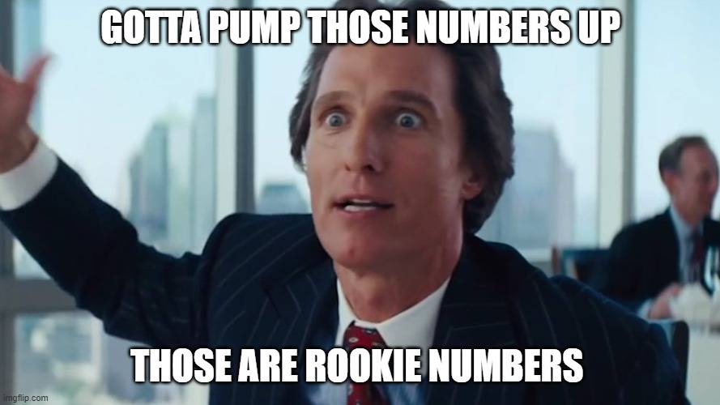
MicroPythonOS in Numbers
Core Contributors: 14
Watching: 13
Apps: 15
Forks: 71
Community Chat: 170
GitHub stars: 715
Code commits: 2900

Slide 34
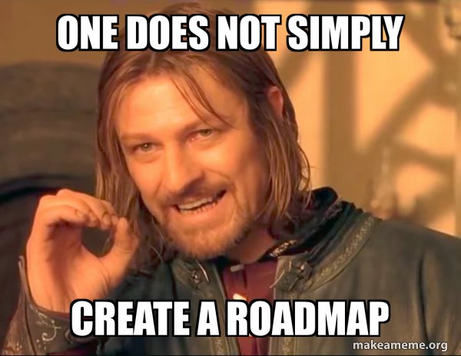
Roadmap
Factory installs
More frameworks
API 1.0
More drivers
More boards
Community driven

Slide 35

Next Steps: free stuff
Run it on desktop
Prebuilt binaries:
  Linux
  MacOS
  WSL
Build an app

Slide 36
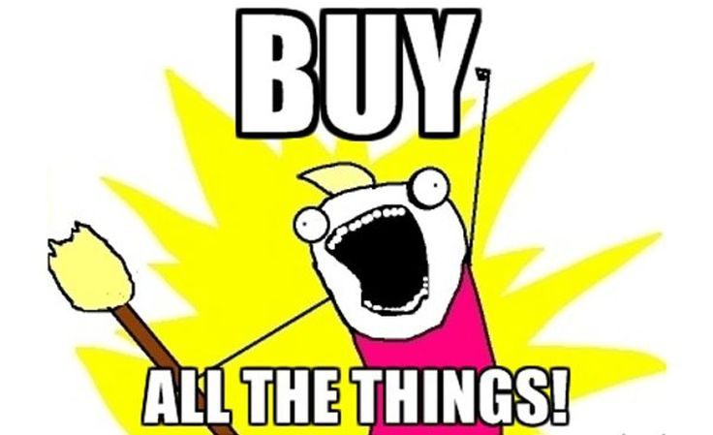
Next Steps: buy stuff
Get a supported device
Flash it
Install your app
Publish in AppStore
  Multiple backends

Slide 37
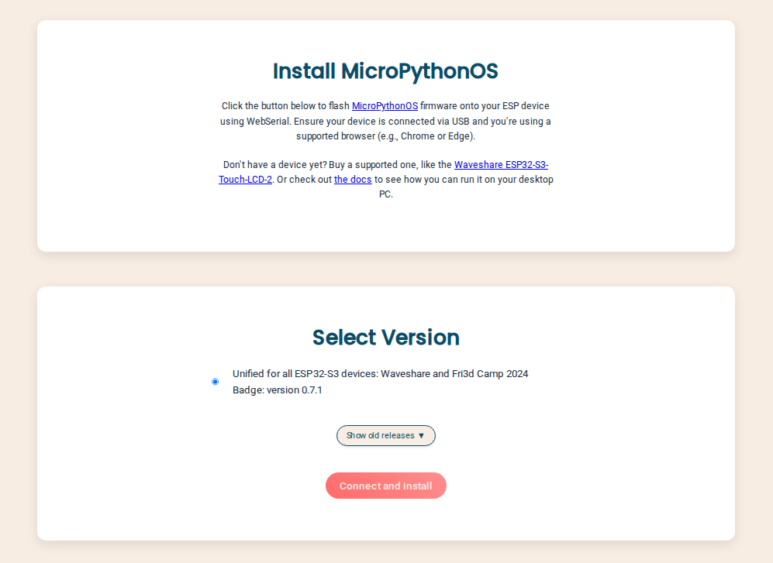
Easy Installation
WebSerial installer
One firmware
to rule them all
https://install.MicroPythonOS.com

Slide 38

Conclusion
MicroPythonOS is waiting for you
Join the chat
Clone the repo
Questions?
https://chat.MicroPythonOS.com

Slide 39
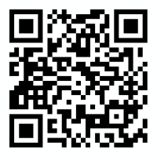
Thank you!
Notes:
What Fri3d Camp 2026 needs:
- Useful software apps for badge
- Ready before camp
- Easy to pick, choose and install
- Easy to connect to wifi
- Easy to update
- Easy to use

