Slide 1
Automatic image captioning with CNN-RNN
Chenglong Lin
Chenan Wang
Notes:
Hi everyone. My name is Chenglong. My partner Chenan and I are here to present Automatic image captioning with CNN and RNN.

Slide 2
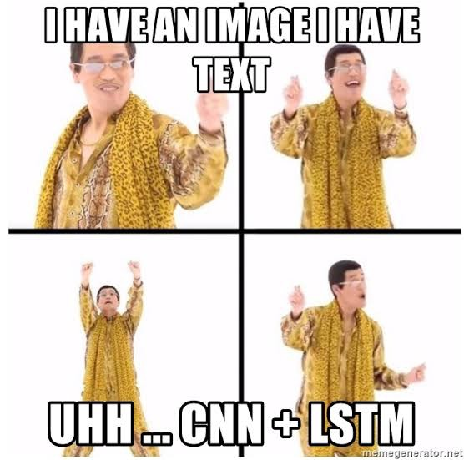
End-to-end Image captioning model
Notes:
In this project, we used end to end deep learning methodology. A end to end deep learning method combines pipeline of tasks, such as feature extraction and natural language processing into one homogenous process.
And
In our image captioning model, we combine two separate architecture that is Convolutional Neural Networks & Recurrent Neural Networks with LSTM, which is a special kind of RNN that includes a memory cell to maintain the information for a longer period of time.

Slide 3
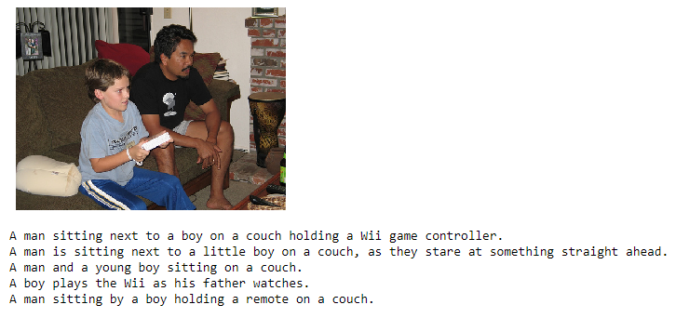
Dataset
Microsoft Common Objects in Context
A dataset where each image is paired with five associated captions that describes the content of that particular image
Notes:
The dataset we used to train our model is Microsoft Common Objects in Context. Each data sample contains a image and 5 associated captions that describes the context of the image.

Slide 4
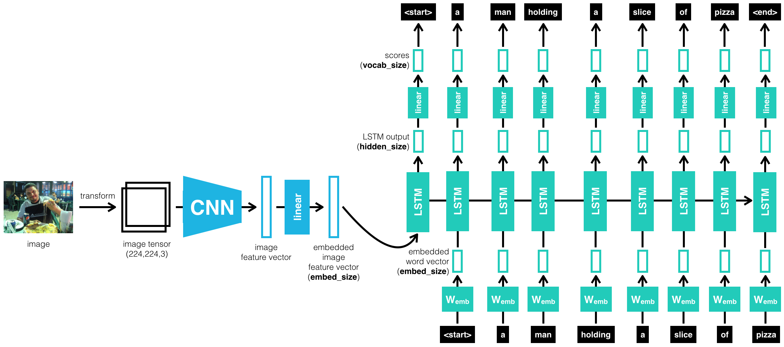
Model architecture
Notes:
This is our model architecture, the model takes in a image as input and output a text description of that image.
Basically, CNN is used to generate feature vectors from the spatial data in the images and the vectors are feed through the fully connected linear layer into the RNN architecture to generate sequence of words that describes the image.

Slide 5
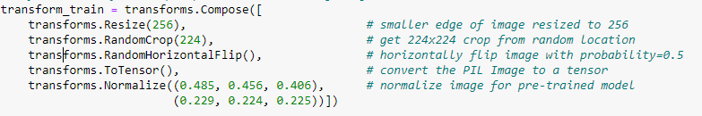
Image pre-processing
Notes:
So to feed the colored image into the CNN model, preprocessing is needed. The COCO data set has all kind of image sizes, so it was resize and crop the image into a 224 by 224 image. And it has 50/50 chance to get a horizontal flip. Then, I transforms it a 224 by 224 by 3 tensor, and at the end, we normalize it using these mean value and deviation value from ImageNet.

Slide 6
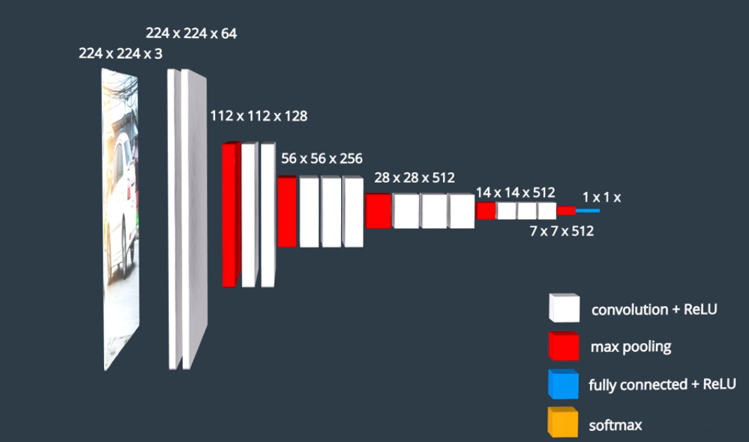
Image encoder-CNN
1. Pre-trained Resnet – freeze parameters
2. Remove SoftMax activation on the last FC layer, and add Linear activation FC layer with output size matching input size of the RNN.
Notes:
In this project, the CNN architecture we used is resnet-50.
The original resnet architecture has a fully connected layer at the end with the softmax activation, I removed it because we are not doing image classification, but to extract features from it. So I replaced it with a linear activation FC layer with output size matching that embedding size of the RNN. So right here the output is 1 by 1 by embedding size of the RNN.
The resnet-50 we are using is pretrained using ImageNet to save training time. I froze these pretrained parameters and only train the last layer.

Slide 7
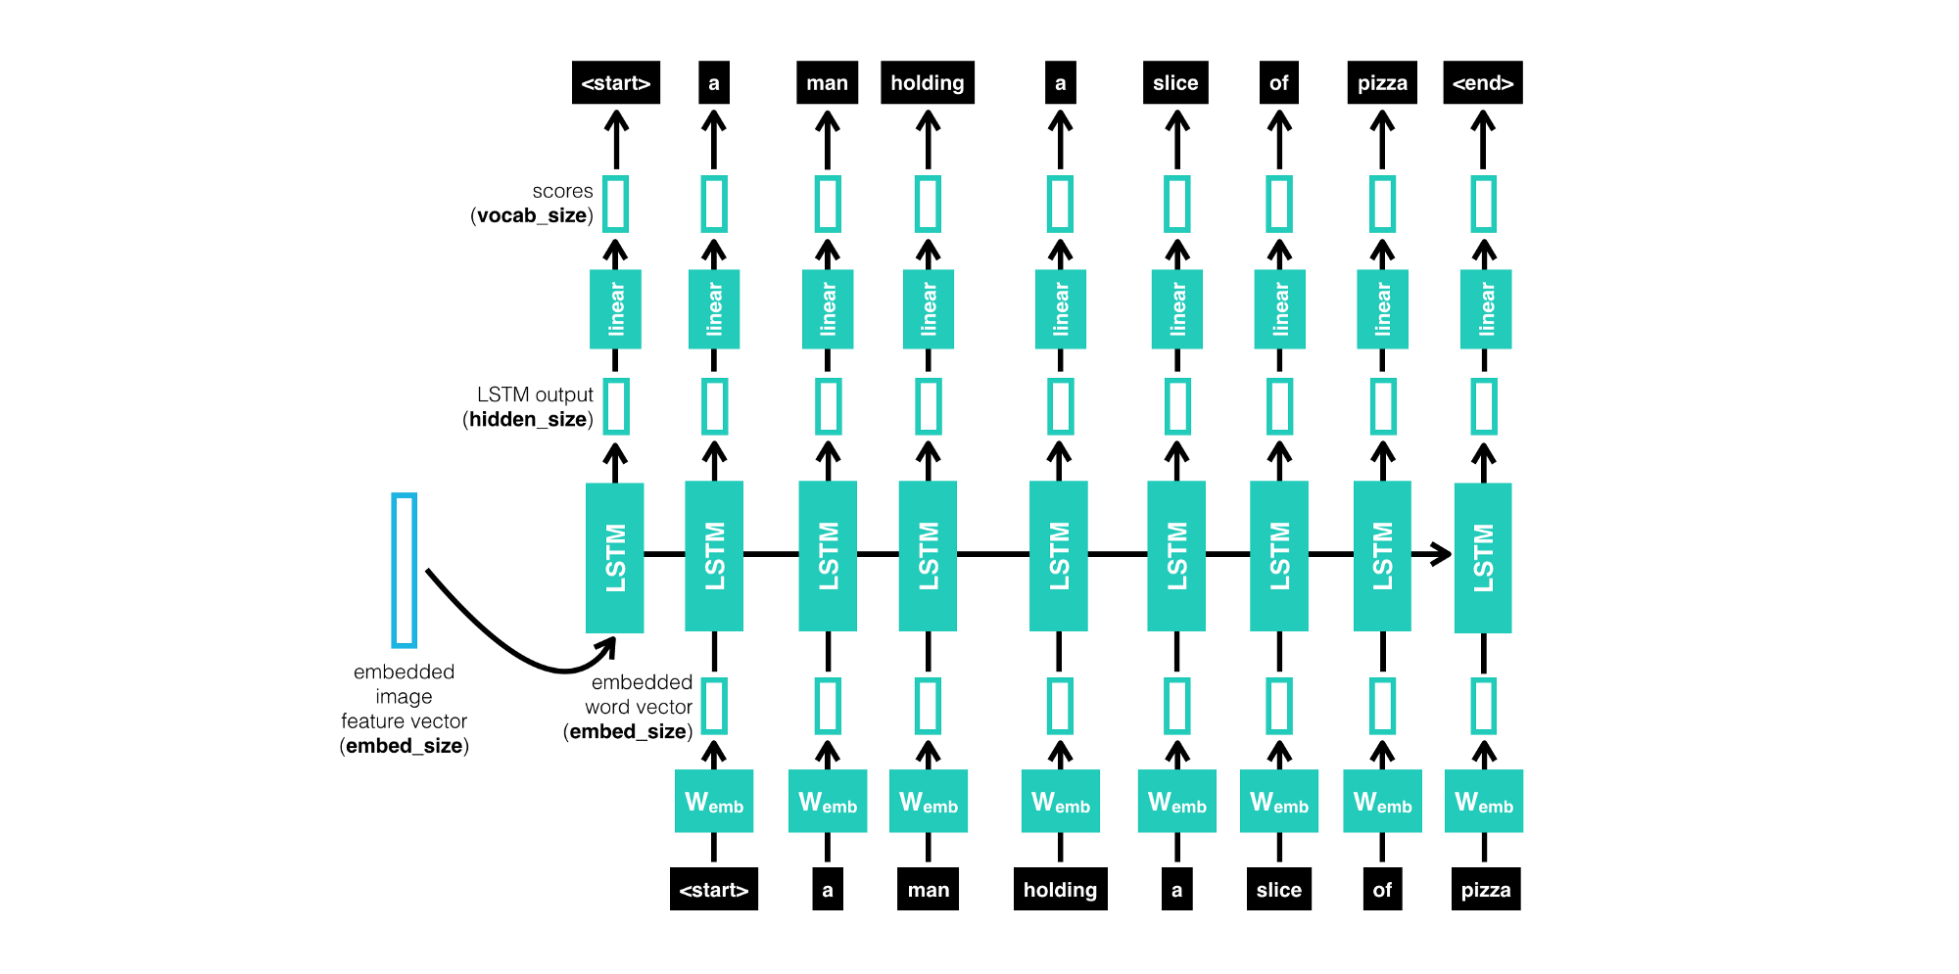
Feature vector decoder-RNN
Notes:
Embedding laryer
LSTM algorithm

Slide 8
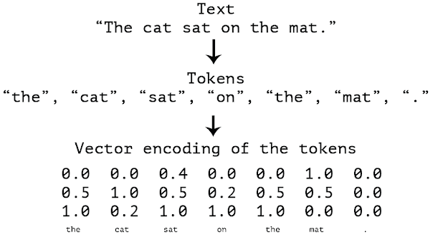
WordEmbeddings
Word embeddings are a type of word representation that allows words with similar meaning to have a similar representation.
Notes:
Each word become a vector

Slide 9
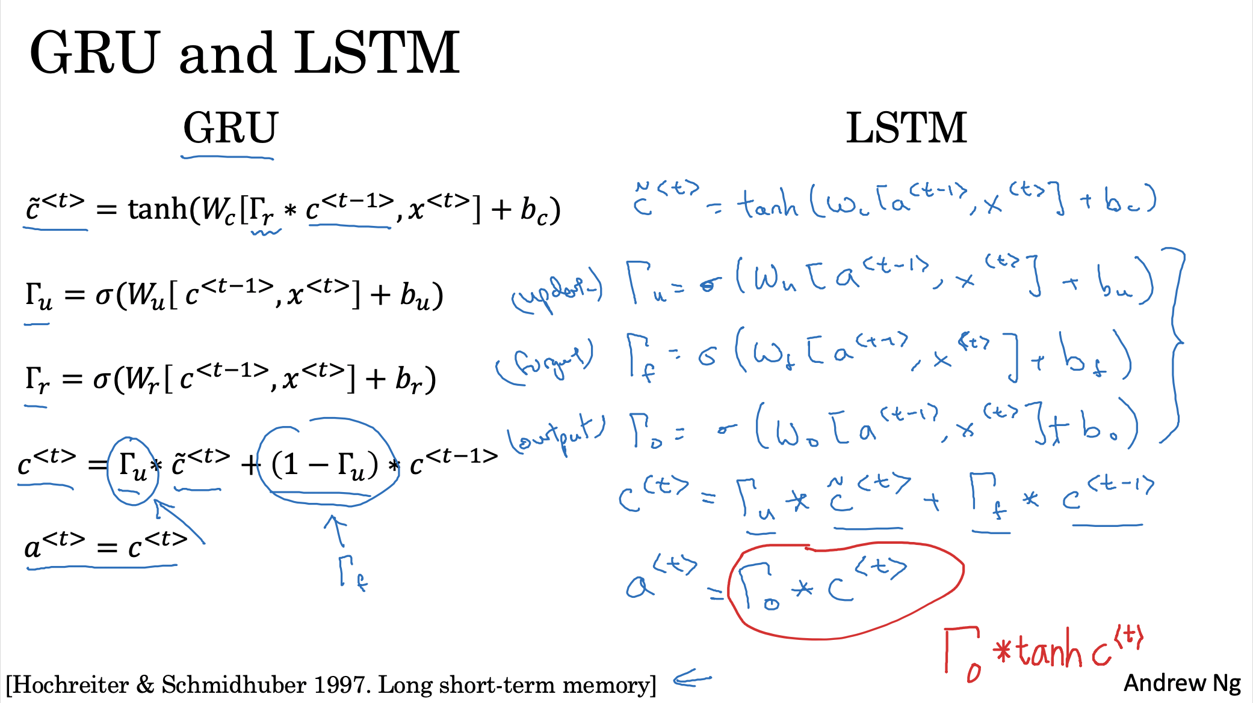
Attention models

Slide 10
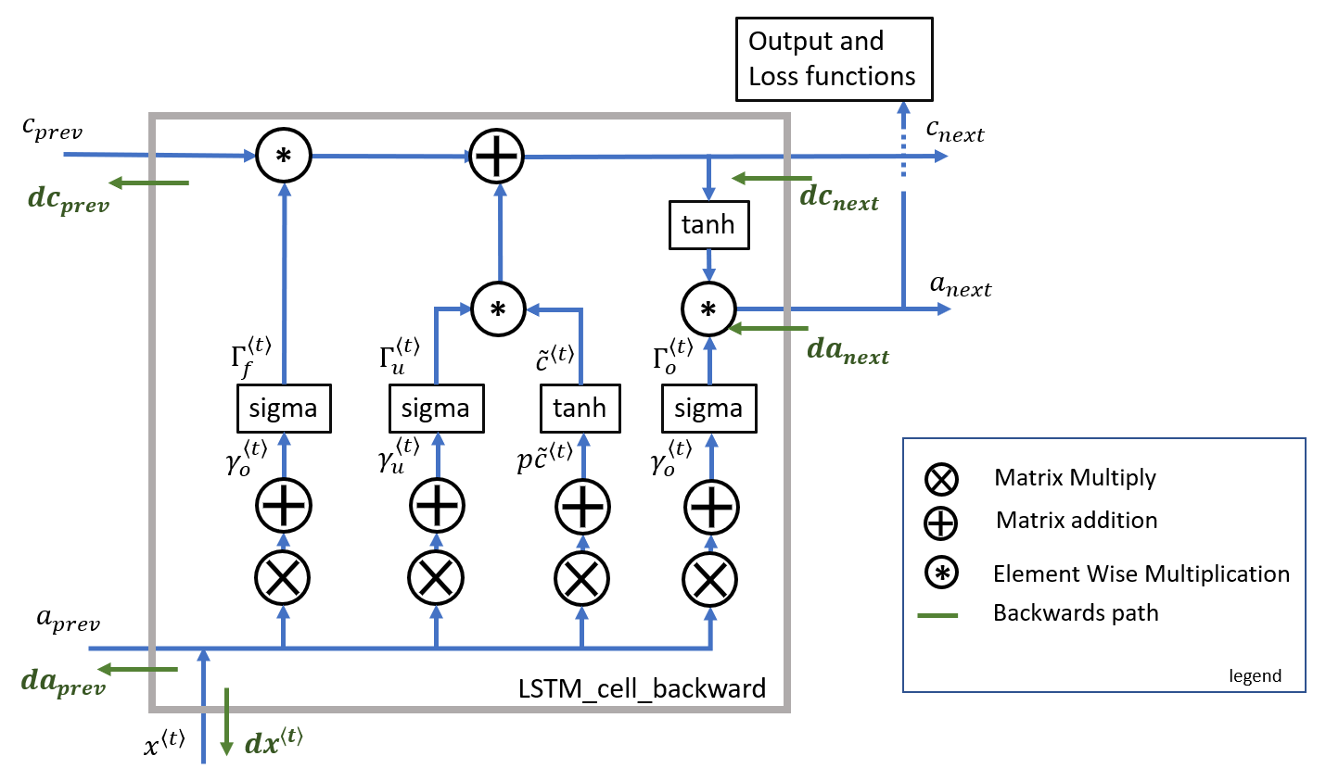

Slide 11
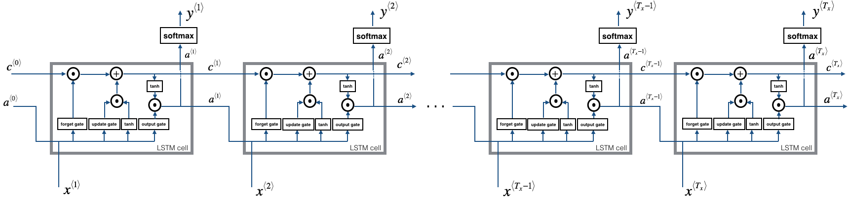
LSTM forward sequence

Slide 12
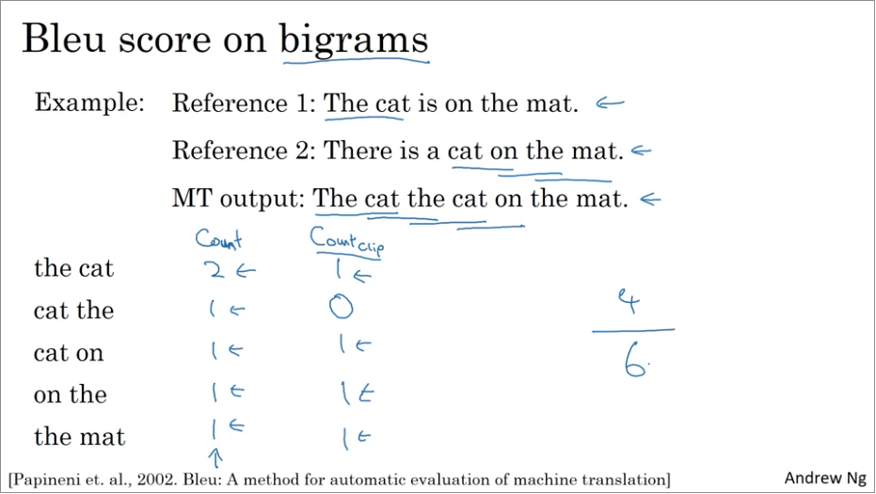
BLEU score

Slide 13
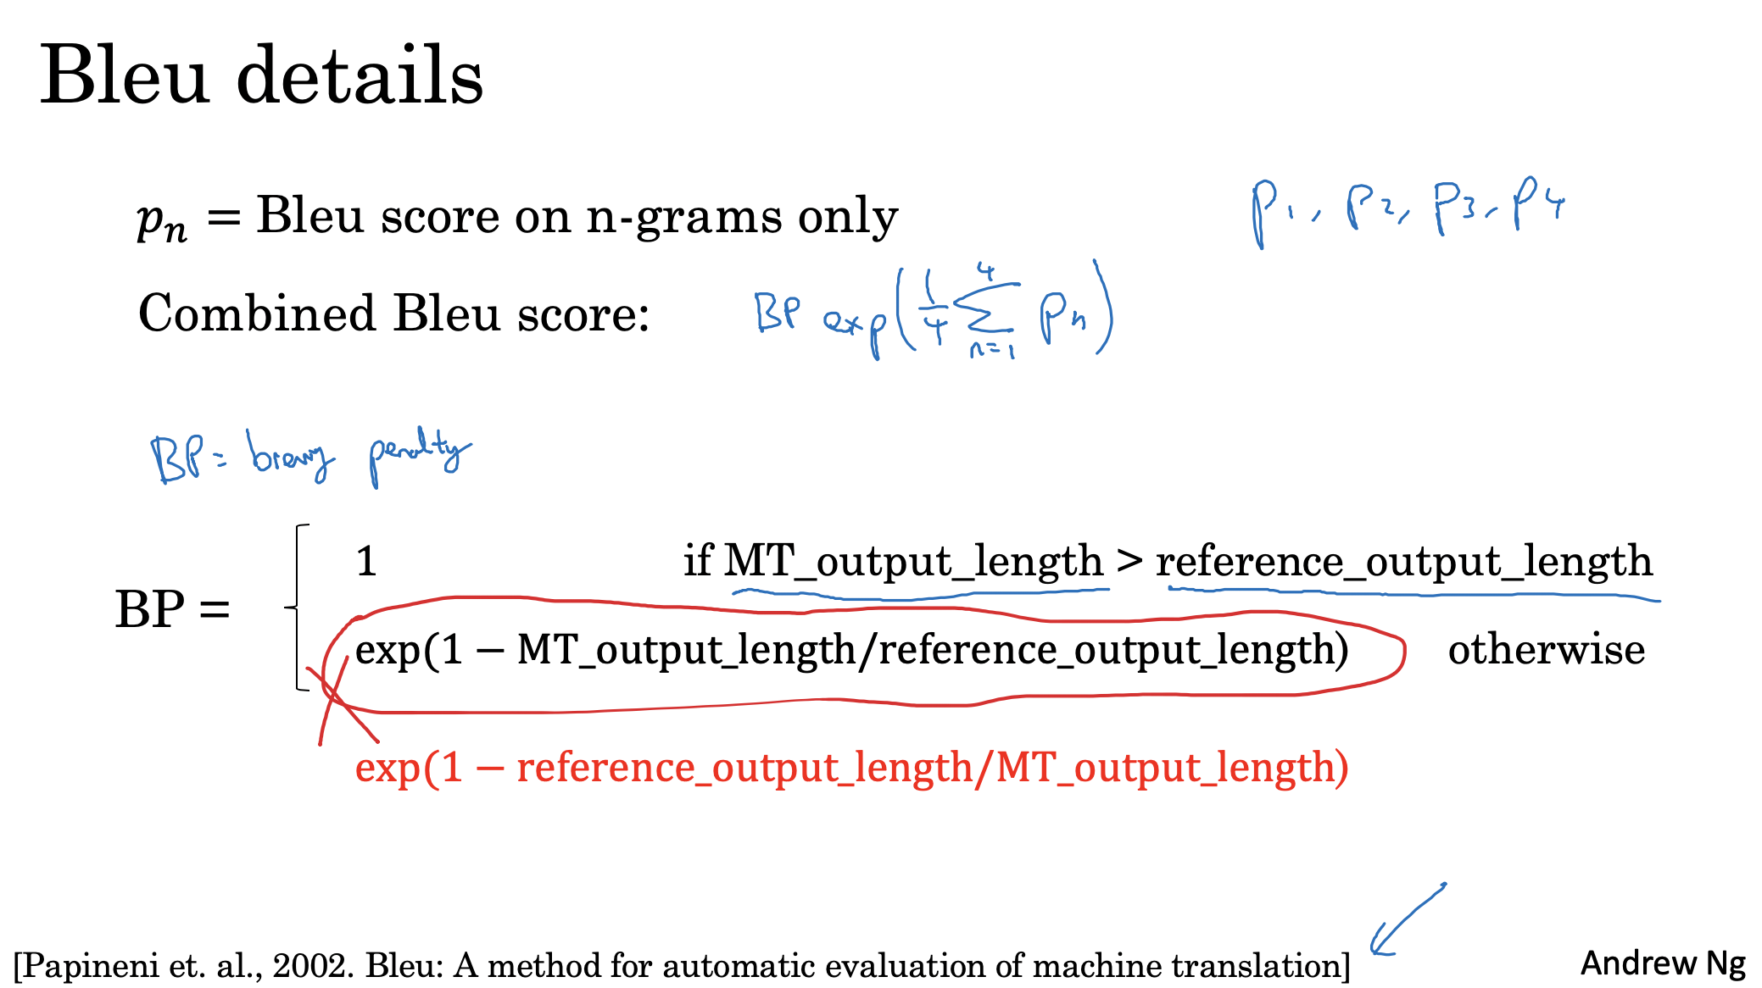
Bleu-4

Slide 14
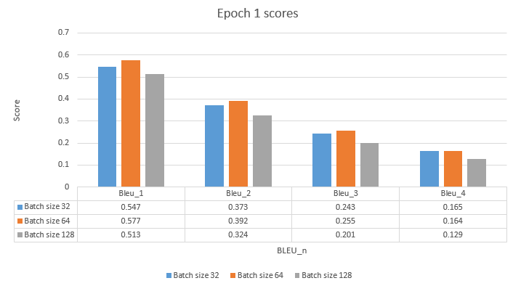
Result
Notes:
Due to limited time and the huge dataset to train, we weren’t able to evaluate the model with cross validation, however, we manually change some parameters to see the effect on the model. Here is our result.
From the figures below, you can see as the BLEU_n increases, the score decreases. This is because it’s harder to find exact matching n-grams between the generated sentence and original image captions. Also, you can see that the batch size do not affect the accuracy of the model. Also, as the number of epoch increases, we see an improvement in accuracy on the validation dataset until the model becomes over-fitted to the training data.

Slide 15
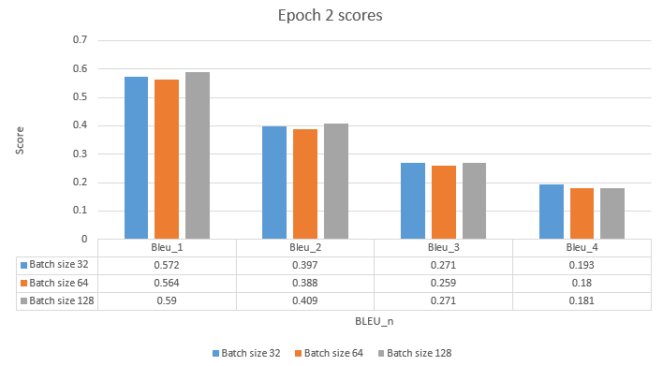
Result

Slide 16
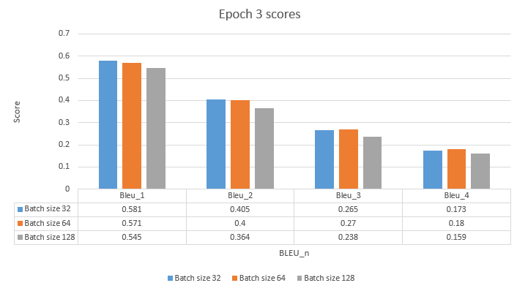
Result

Slide 17
Possible improvement and tweaks
1. Deeper CNN;
2. Use GRU instead of LSTM for RNN;
3. Use bi-directional RNN;
Notes:
In this project, we can also improve our model by
1. Deeper networks such as resnet 101;
2. Use GRU instead of LSTM for RNN;
3. Use bi-directional RNN;
vocab_threshold - the minimum word count threshold. Note that a larger threshold will result in a smaller vocabulary, whereas a smaller threshold will include rarer words and result in a larger vocabulary.
embed_size - the dimensionality of the image and word embeddings.
hidden_size - the number of features in the hidden state of the RNN decoder.

Slide 18

Any questions?

