Slide 1
Automatic image captioning with CNN-RNN
Chenglong Lin
Chenan Wang
Notes:
Hi everyone. My name is Chenglong. My partner Chenan and I are here to present Automatic image captioning with CNN-RNN.

Slide 2
End-to-end learning
Meaning:
replace the pipeline with a single learning algorithm
Applications:
Speech Recognition
Self-driving car
Notes:
Here we introduce the end-to-end learning. The end-to-end learning is a pipeline

Slide 3
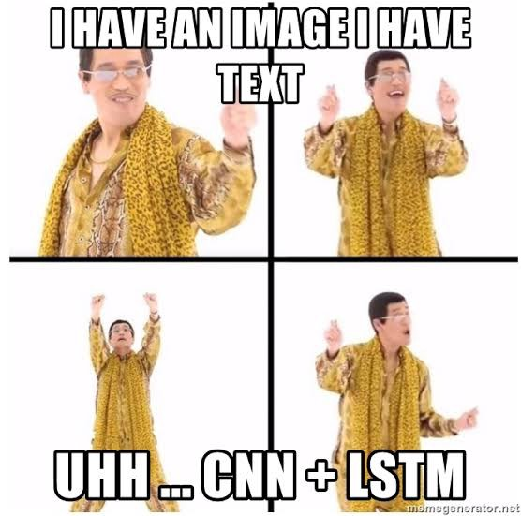
End-to-end Image captioning model
Notes:
In this project, we used end to end deep learning methodology. A end to end deep learning method combines pipeline of tasks, such as feature extraction and natural language processing into one homogenous process.
And
In our image captioning model, we combination of two separate architecture that is CNN (Convolutional Neural Networks)& RNN (Recurrent Neural Networks) with LSTM (Long Short Term Memory), which is a special kind of RNN that includes a memory cell, in order to maintain the information for a longer period of time.

Slide 4
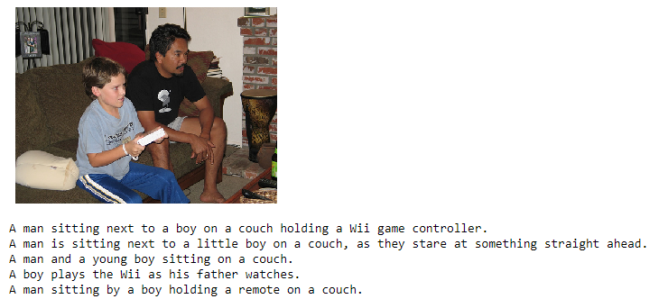
Dataset
Microsoft Common Objects in Context
A dataset where each image is paired with five associated captions that describes the content of that particular image
Notes:
The dataset we used to train our model is Microsoft Common Objects in Context. Each data sample contains a image and 5 associated captions that describes the context pf the image.

Slide 5
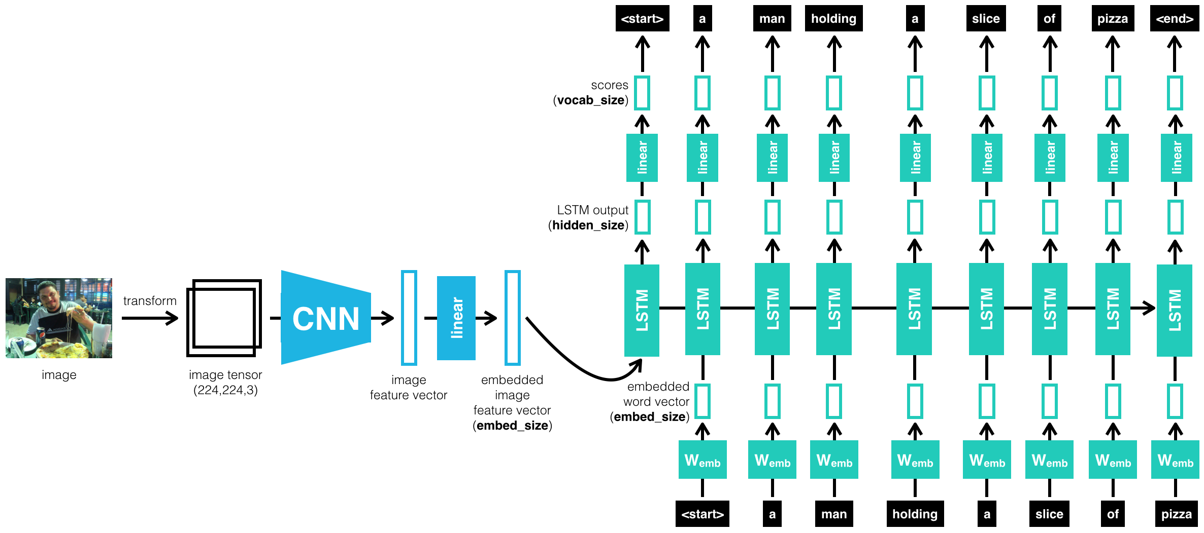
Model architecture
Notes:
This is our model architecture, the model takes in a image as input and output a text description of that image.
Basically, CNN is used to generate feature vectors from the spatial data in the images and the vectors are fed through the fully connected linear layer into the RNN architecture to generate sequence of words that describes the image.

Slide 6
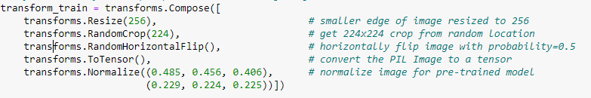
Image pre-processing
Notes:
So to fed the colored image into the CNN model, I transformed the image like this. The COCO data set has all kind of image sizes, I resize and crop the image into a 224 by 224 image. And it has 50/50 chance to get a horizontal flip. Then, I transforms it a 224 by 224 by 3 tensor, and at the end, we normalize it using these mean value and deviation value. These mean and deviation values comes from ImageNet.

Slide 7
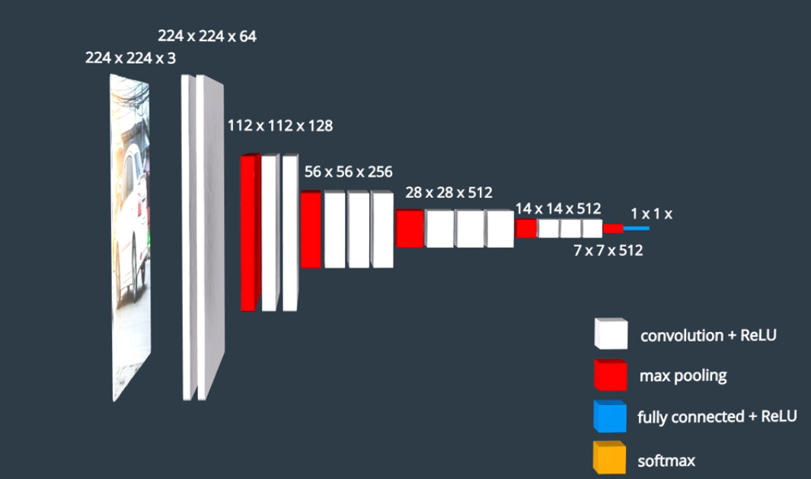
Image encoder-CNN
1. Pre-trained Resnet – freeze parameters
2. Remove SoftMax activation on the last FC layer, and add Linear activation FC layer with output size matching input size of the RNN.
Notes:
In this project, the CNN architecture we used is resnet-50. In here, we have some convolution layers and some pooling layers.
The original architecture has a fully connected layer at the end with the softmax activation, I removed it because we are not doing image classification, but to extract features in the image. So I added a linear activation FC layer with output size matching that input size of the RNN. So right here the output is 1 by 1 by input size of the RNN.
The resnet-50 we are using is pretrained using ImageNet to save training time. I froze these pretrained parameters and only train the last layer.

Slide 8
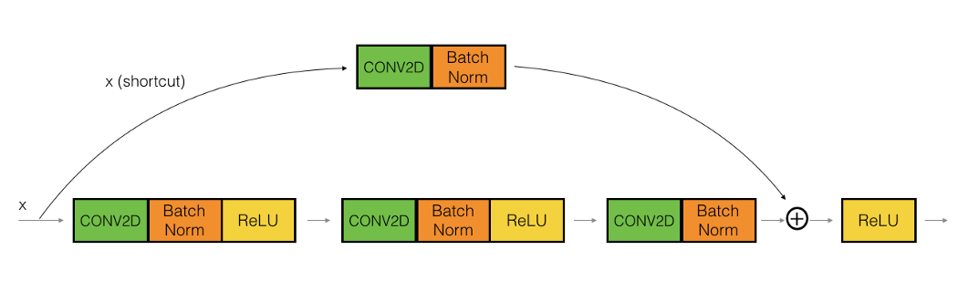
Resnet CNN
1. Short for Residual Networks.
2. Solves vanishing gradients problem for deep network.
3. Skipping connection.
Notes:
So why we choose Resnet for feature extraction?
ResNet, short for Residual Networks is a classic neural network used for many computer vision tasks. This model was the winner of ImageNet challenge in 2015.
Typically as the neural network go deeper, the backpropagation isn’t feasible because of the vanishing gradient problem.
Resnet mitigate this problem by allowing alternate shortcut path for gradient to propagate through. Therefore, allowing us to train an extremely deep neural networks.

Slide 9
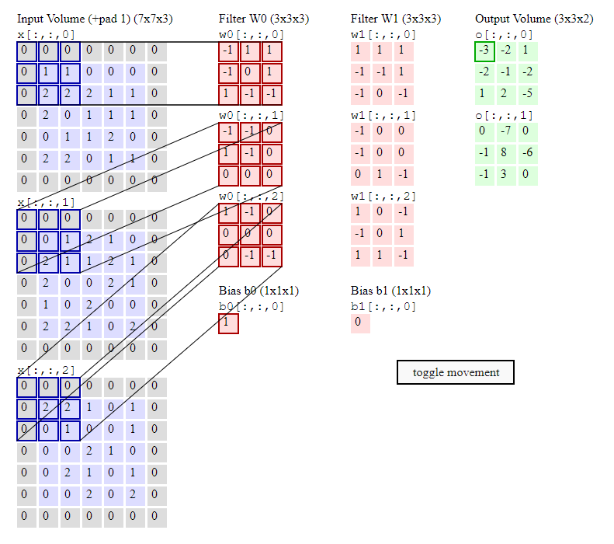
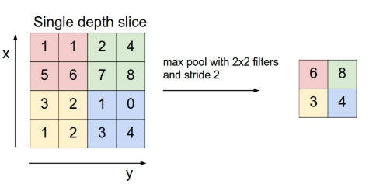
Convolution and Max pooling layers
Notes:
For

Slide 10
Hyper parameters and effect
batch_size - the batch size of each training batch. It is the number of image-caption pairs used to amend the model weights in each training step. Default 64.
vocab_threshold - the minimum word count threshold. Note that a larger threshold will result in a smaller vocabulary, whereas a smaller threshold will include rarer words and result in a larger vocabulary.
embed_size - the dimensionality of the image and word embeddings.
hidden_size - the number of features in the hidden state of the RNN decoder.
---num_epochs - the number of epochs to train the model. We recommend that you set num_epochs=3, but feel free to increase or decrease this number as you wish. This paper trained a captioning model on a single state-of-the-art GPU for 3 days, but you'll soon see that you can get reasonable results in a matter of a few hours! (_But of course, if you want your model to compete with current research, you will have to train for much longer._)
transform_train normalization value – the default value is recommended by many research papers.
Optimizer- default Adam optimizer performs better than SGD most of times according to many papers.

Slide 11
Feature vector decoder-RNN
def __init__(self, embed_size, hidden_size, vocab_size, num_layers=1):
super().__init__()
self.embedding_layer = nn.Embedding(vocab_size, embed_size)
self.lstm = nn.LSTM(input_size = embed_size,hidden_size = hidden_size,
num_layers = num_layers, batch_first = True)
self.linear = nn.Linear(hidden_size, vocab_size)
Notes:
Embedding laryer
LSTM algorithm

Slide 12
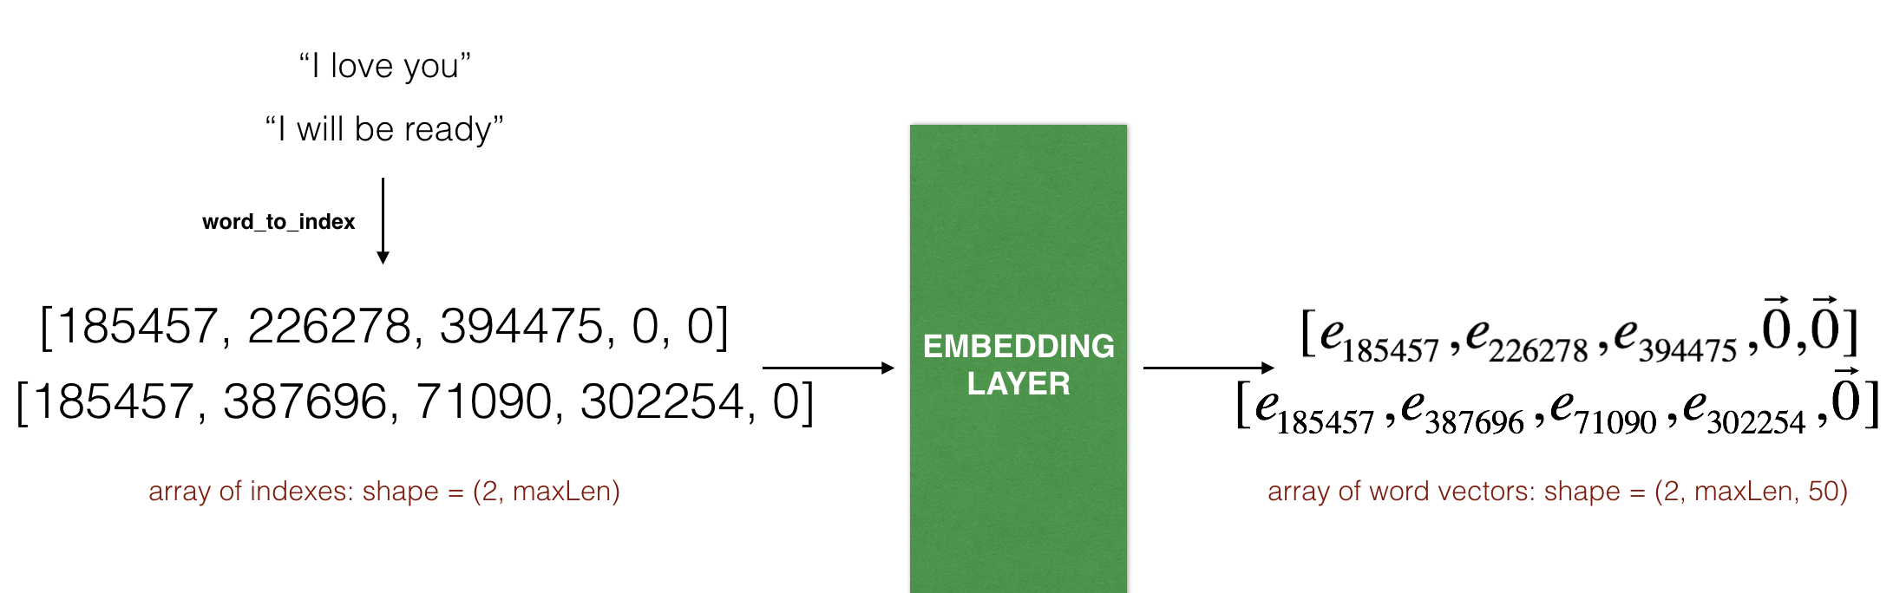
WordEmbeddings
Notes:
Each word become a vector

Slide 13
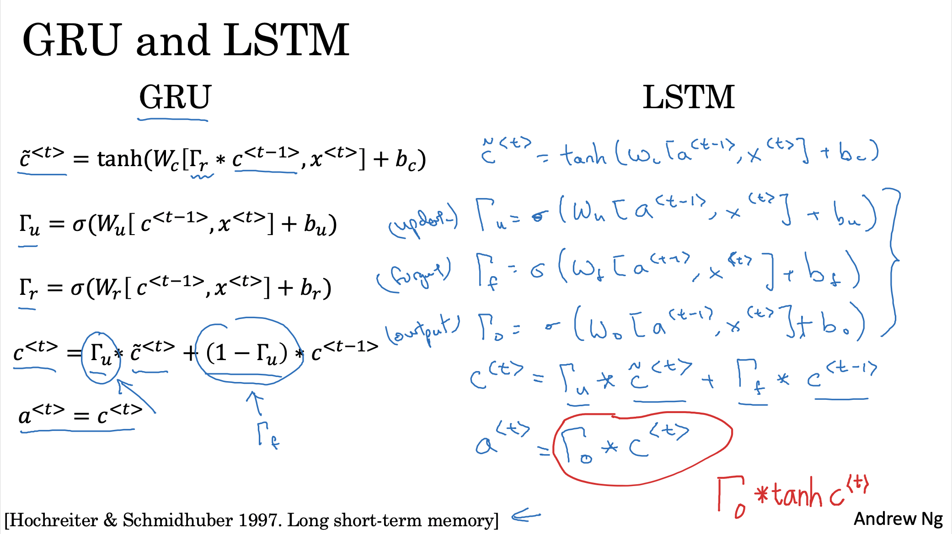
Attention models

Slide 14
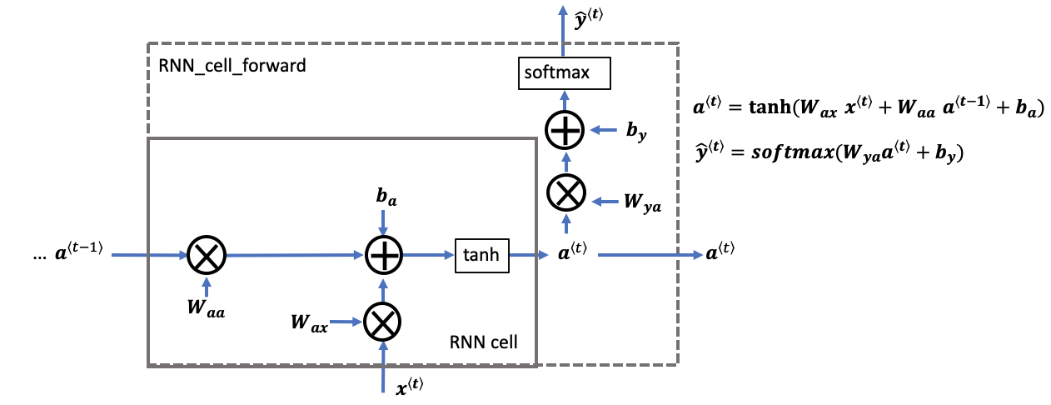
Traditional RNN cell

Slide 15
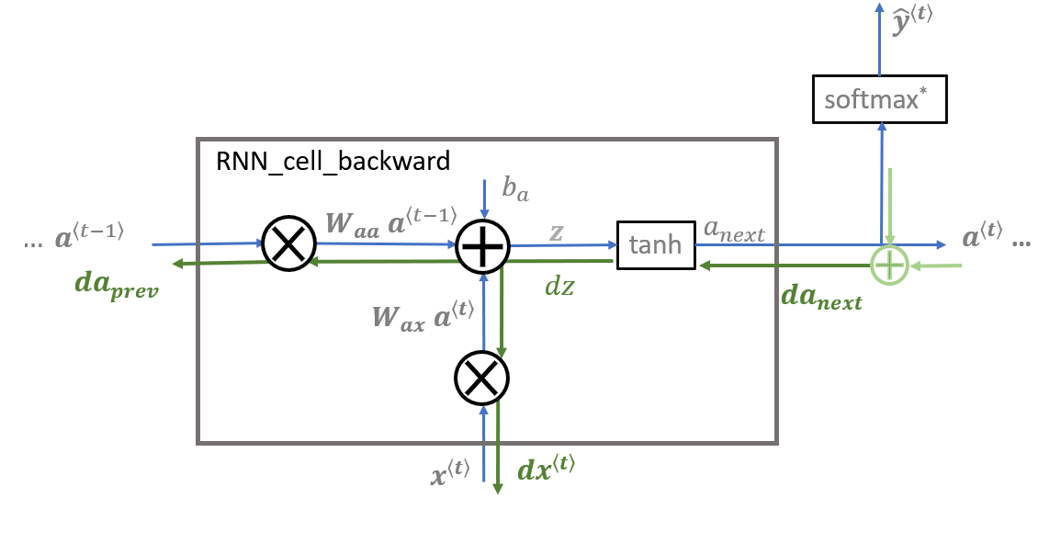
Traditional RNN cell
Notes:
shorter

Slide 16
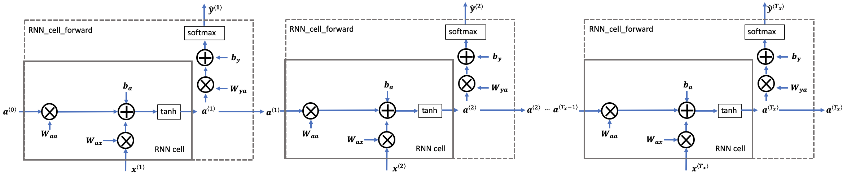
RNN forward sequence

Slide 17
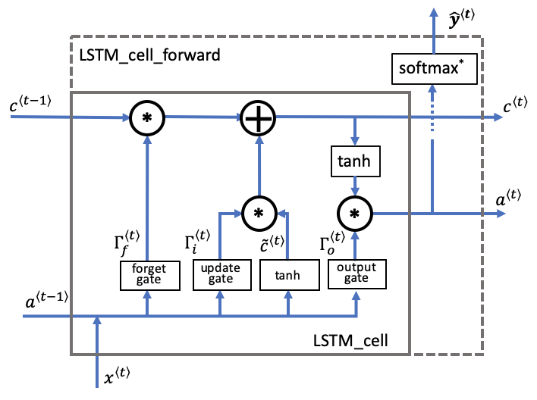
LSTM RNN cell
Notes:
shorter

Slide 18
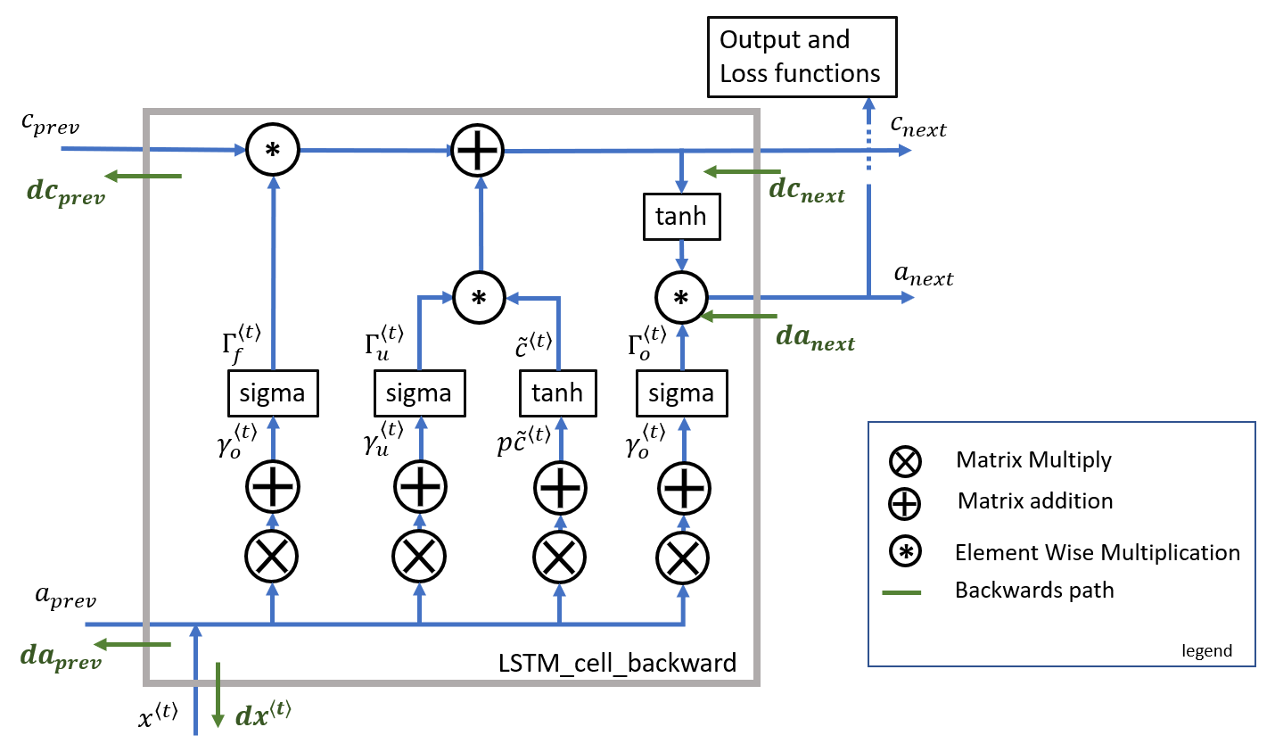
LSTM RNN cell

Slide 19
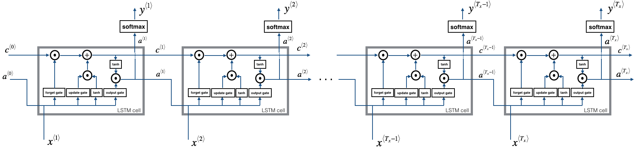
LSTM forward sequence

Slide 20
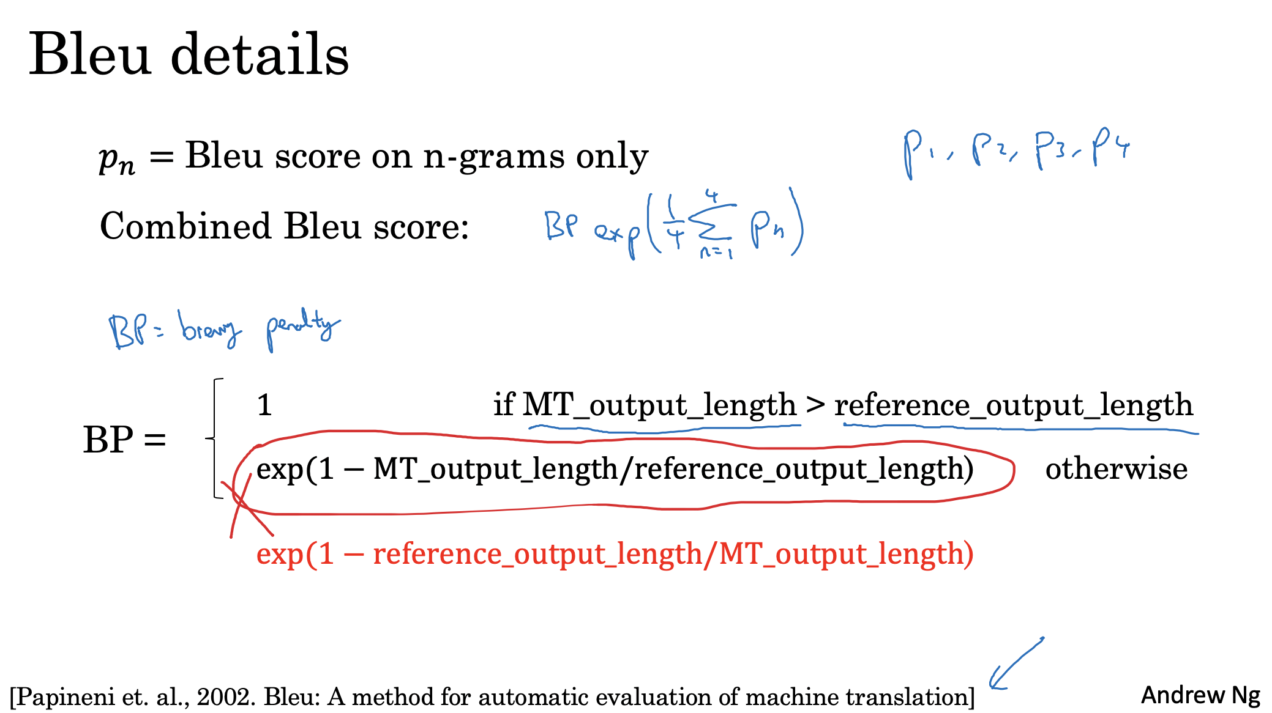
Bleu score

Slide 21
Possible improvement
Use GRU instead of LSTM
Use bi-directional RNN
Use deep RNN

