Slide 1
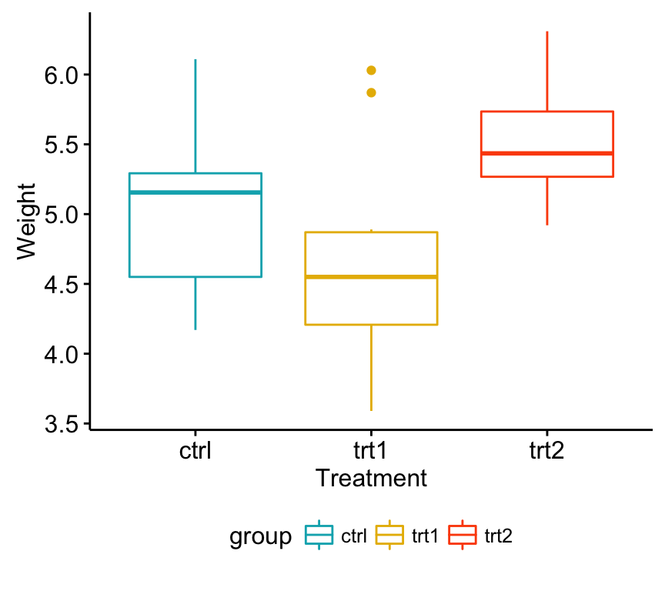
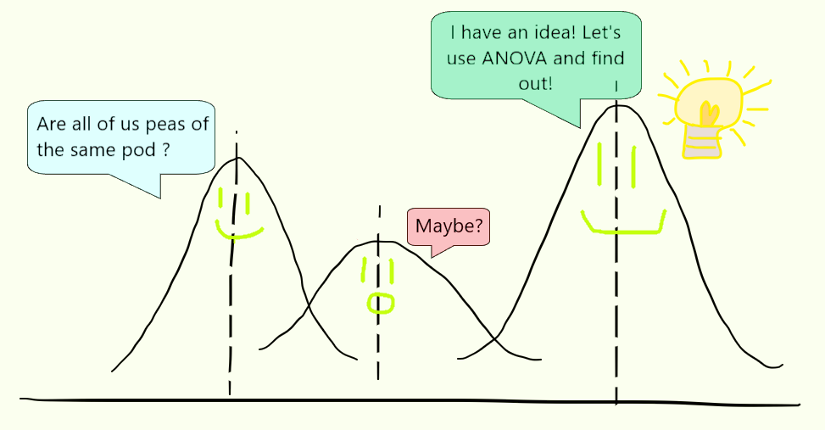
One-way ANOVA?
Definition:
(Analysis of Variance) tests whether significant differences exist between the means of two or more independent groups (t-tests but for more than two groups)
How It Works:
Compares variability:
Between Groups: Differences between group means.
Within Groups: Variability within each group.
(STHDA)
(Geeksforgeeks)

Slide 2
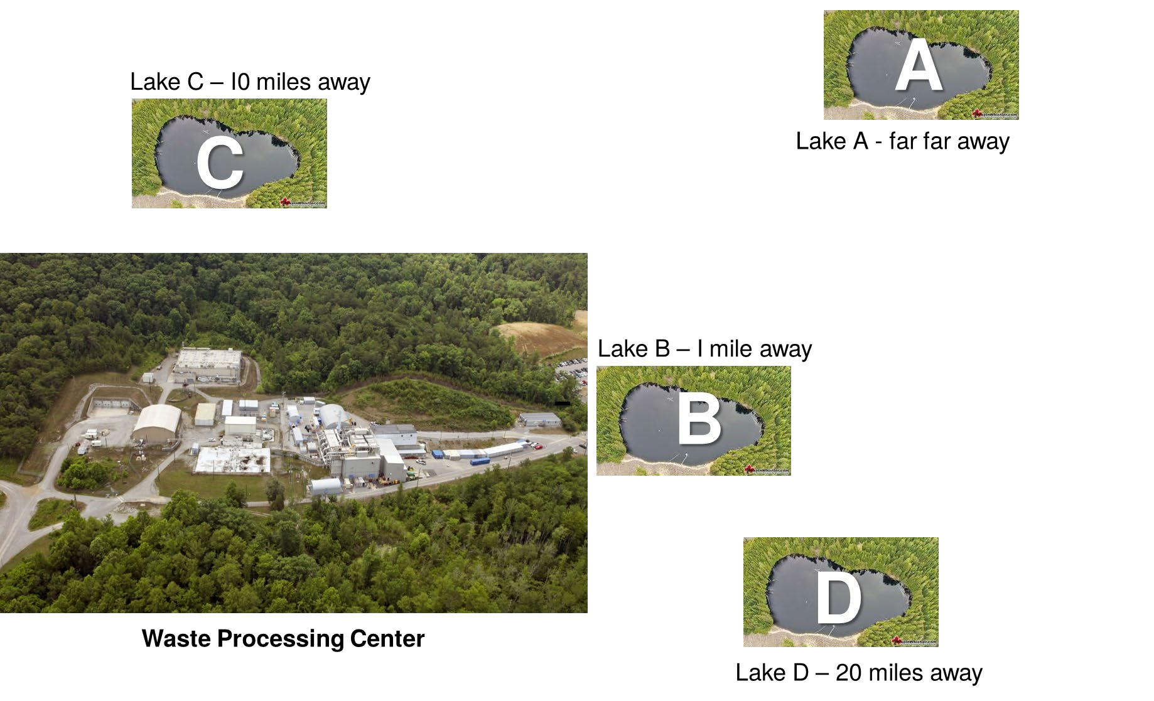
Case Study
control site (control)
An Environmental Manager working in the State of Texas collects pollutant concentrations
moderately far site (mid)
Four locations (treatment groups) were chosen, and pollutant concentrations were measured once a day over 10 days (number of replicates = 10).
near site (near)
The collection locations A, B, C, D are arranged such that A is located far away from the center (the control, untreated), and location B is 1 mile from the facility, C is 10 miles, D is 20 miles. The data table are presented below.
far site (far)

Slide 3
Background summary:
  An Environmental Manager working in the State of Texas collects pollutant concentrations (unit: mM/l) from several lakes to assess the effects of a waste processing center.
  Four locations (treatment groups) were selected, with pollutant concentrations measured daily over ten days (10 replicates).
  The locations are arranged as follows:
  A: control (far from the facility)
  B: 1 mile from the facility
  C: 10 miles from the facility
  D: 20 miles from the facility

Slide 4
Data
Day | Site A | Site B | Site C | Site D
1 | 5 | 62 | 20 | 24
2 | 8 | 60 | 20 | 25
3 | 1 | 58 | 14 | 24
4 | 2 | 55 | 21 | 18
5 | 3 | 54 | 10 | 20
6 | 5 | 66 | 15 | 19
7 | 2 | 62 | 18 | 12
8 | 2 | 56 | 17 | 11
9 | 4 | 55 | 24 | 18
10 | 5 | 60 | 19 | 17

Slide 5
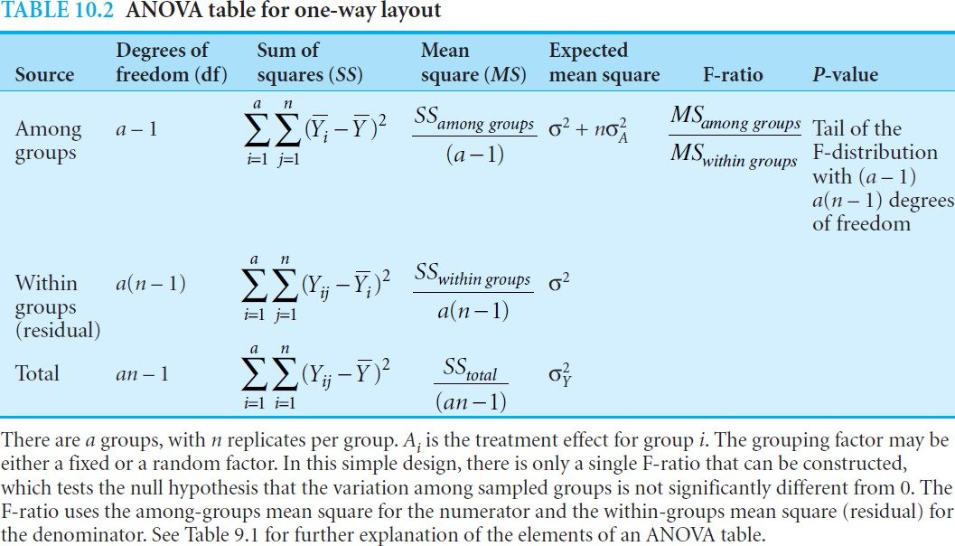
Null hypothesis
One-way ANOVA
table

Slide 6
Part A: Post Hoc Comparison
Exploratory and compare every pair
(A vs B, B vs C, C vs D, A vs D)

Slide 7
Part B: a priori/planned contrast
Define some hypothesis, plan some predefined comparisons between the group
How: Each group is assigned an integer coefficient.
1. represent the weights for the corresponding treatment groups in the contrast.
2. Sum of the coefficient is 0.
B versus C and D
C versus D
Read more from textbook from P. 339 for a priori contrast
Notes:
Comparing the means of different treatment groups is essential for correctly interpreting the ANOVA results.
In a priori contrasts, We specify ahead of time particular combinations of means that we want to test. Delimited to specific hypotheses that we are interested in assessing.
In apriori contrasts, the idea is to establish specified comparisons between particular sets of means that test specific hypotheses.
We assign an integer to each treatment group. This set of integer coefficients is the contrast to test. One of the rules is that the sum of coefficients for a particular contrast must equal 0

Slide 8
Plan the contrast
Control
Near
Mid
Far
Contrast | A | B | C | D | Meaning
I | 0 | 2 | –1 | –1 | Is Site B higher than the two farther sites (C and D)? Control is not looked.
II | 3 | –1 | –1 | –1 | A significant than (B C D)?
III | 0 | 0 | 1 | –1 | C and D different (10 vs 20 miles)?
You can plan others too, we are using these
for the lab 7 assignment.

Slide 9

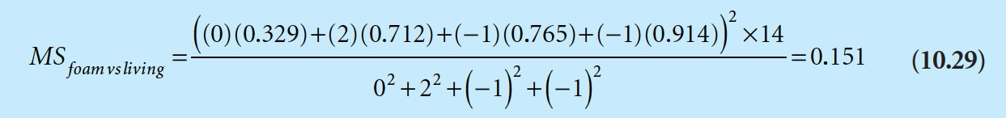
Calculate parameters for a priori contrast ANOVA table
Notes:
Once the contrast is established, we use it to construct a new mean square, which has one degree of freedom associated with it. The term in parentheses is the sum of each coefficient (ci) multiplied by the corresponding group mean.
For the first contrast, the mean square looks like 10.29
The sum of squares for each of these three contrasts add up to the total for the treatment sum of squares (10.32)

