Slide 1

Pet Shop Management

Slide 2
INTRODUCTION
Online Pet Shop Management has been developed to override the problems prevailing in the practice of manual system.
Online Pet Shop Management is a platform for buying different categories of Pets through Online by the Customers.
It has three main users Admin, Vendors and Customers.
This Management is designed for the particular need of the organization to carry out the Operations in a effectively and smoothly.

Slide 3
OBJECTIVES
To Provide Web based interface to a pet shop owner to manage his Pet shop activities.
To provide an option for storing and for managing the basic information about pets.
To provide different categories of pets for end users.
To provide an option for storing and for managing the sales details of the Pet shop.
To track the Information about sold pets to a Customer.
To reduce the Manual work of the Pet shop.

Slide 4
STRUCTURE OF THE SYSTEM
Structure chart represent hierarchical structure of modules. It breaks down the entire system into lowest functional modules, describe functions and sub-functions of each module of a system to a greater detail.
Structure Chart partitions the system into black boxes (functionality of the system is known to the users but inner details are unknown).
Inputs are given to the blank boxes and appropriate outputs are generated.

Slide 5
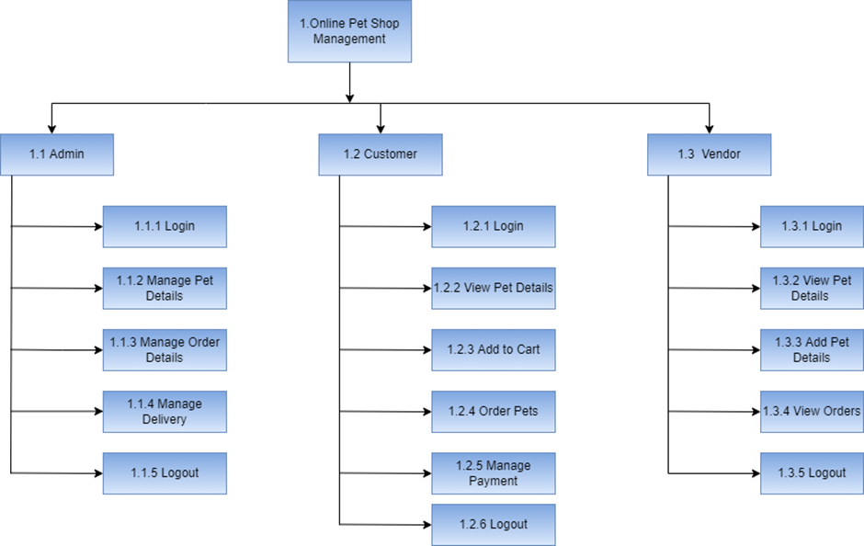
STRUCTURE CHART

Slide 6
SOFTWARE REQUIREMENTS (SOFTWARE INTERFACES)
IDE: Visual Studio Code
Server: Apache 2.4.39
Database: MySQL 5.7.26
Client Side: Chrome, Opera, Mozilla Firefox

Slide 7
HARDWARE REQUIREMENTS (HARDWARE INTERFACES)
Operating System: Windows 7 or above, Linux, Mac OS
RAM: 4GB or above
HDD: 500GB or above
Processor: 2.4 GHz or above

Slide 8
USER CHARACTERISTICS
Users | Description
Admin | Admin will login to the system. He has separate username and password. He has the dashboard to trace all the activities of the Project. The main function of the Admin to manage all the entities of the Project.
Customer | Customer should register with their basic Details. They can login with Username and password. Once the Login process is done customer is allowed to view pet details, Order, to make payment, add to cart and add favorites.
Vendor | Vendor should register with their basic details. They can login with vendor id and email. Once the login process is done vendor is allowed to add pets with its details ,view, update, order and delete the pet details

Slide 9
CONTEXT FLOW DIAGRAM
Context Flow Diagram is a top level (also known as level 0) data flow diagram.
It contains only one process node that generalises the functions of the entire system in relationship to external entities.
In the context diagram the entire system is treated as a single process and all its inputs, outputs, sinks and sources are identified.

Slide 10
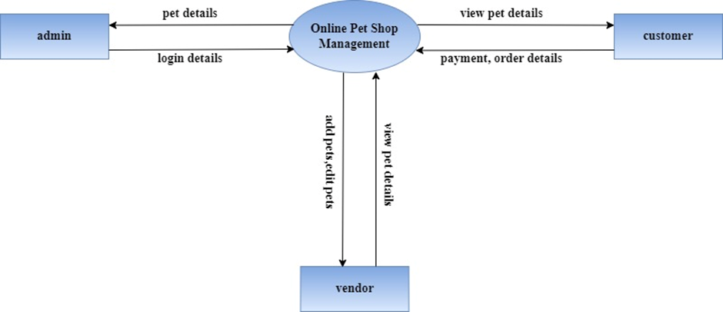
CONTEXT FLOW DIAGRAM

Slide 11
DATA FLOW DIAGRAM
A Data flow diagram is a graphical representation of the flow of data through an information system.
A data flow diagram can also be used for the visualization of data processing.
It is common practice for a designer to draw a context-level DFD.
It shows the interaction between the system and the outside entities.
This context-level DFD is then exploded to show more detail of the system being modelled.
A DFD represents the flow of data through a system.

Slide 12
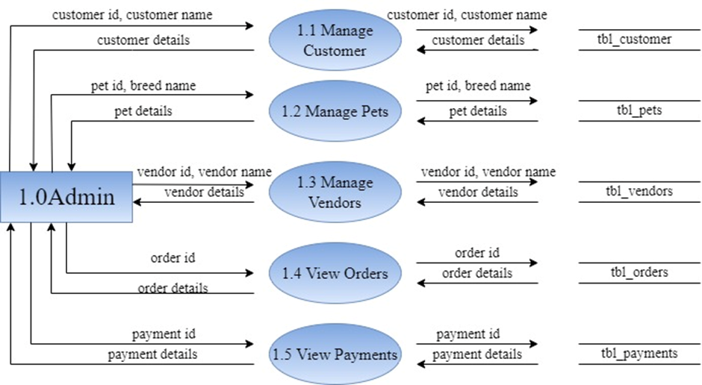
DATA FLOW DIAGRAM

Slide 13
FUNCTIONAL COMPONENTS
Functional Component: Customer
Input: Customer ID, Customer Name.
Output: Customer Details
Functional Component: Vendors
Input: Vendor ID, Vendor Name.
Output: Vendor Details
Functional Component: Order
Input: Customer ID, Pet ID, Amount
Output: Acknowledgment or Error Message

Slide 14
TABLES USED IN DATABASE
admin
cart
customer
favourites
notification
orders
payment
pets
vendor

Slide 15
ER DIAGRAM
Entity relationship diagram is used in modern database software engineering to illustrate logical structure of database.
It is a relational schema database modelling method used to model a system and approach.
This approach is commonly used in database design.
The diagram created using this method is called the E-R diagram.
An entity-relationship (ER) diagram is a specialised graphic that illustrates the relationships between entities in a database.

Slide 16
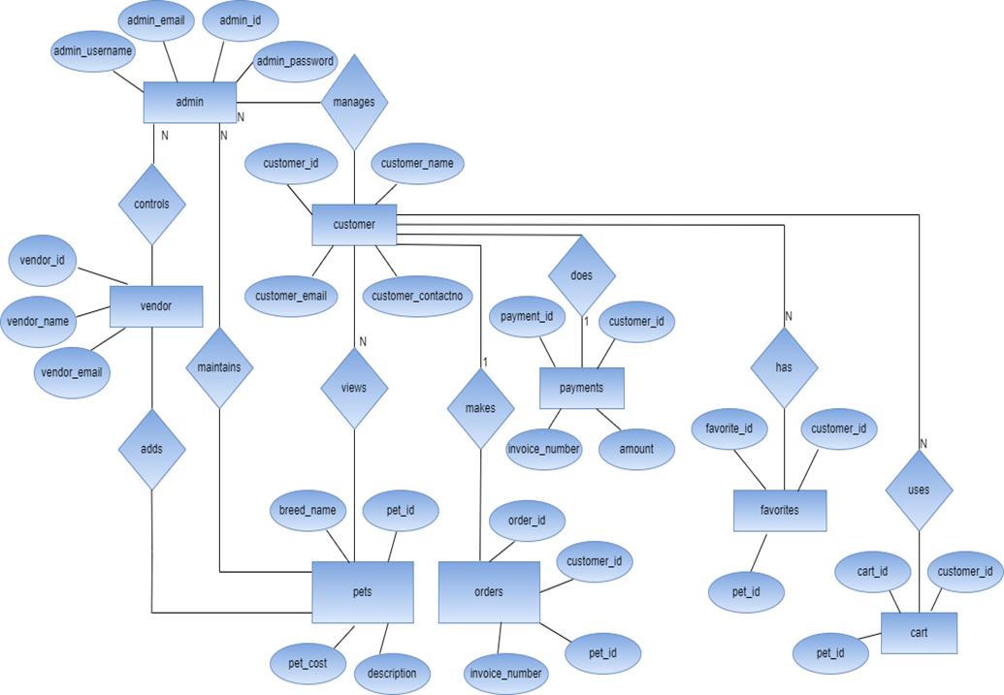
ER DIAGRAM

Slide 17
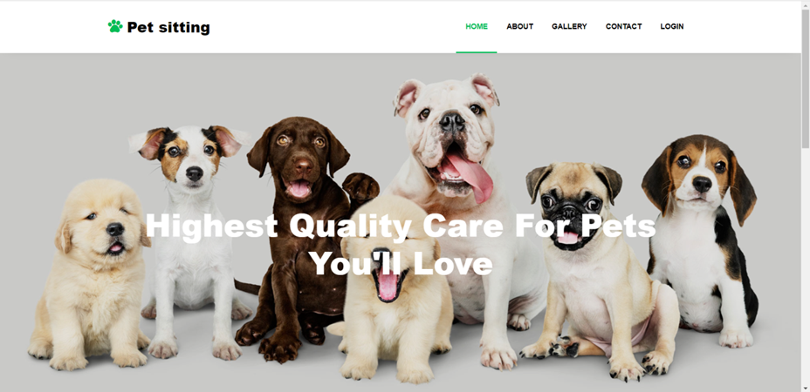
USER INTERFACES (UI)
HOME PAGE

Slide 18
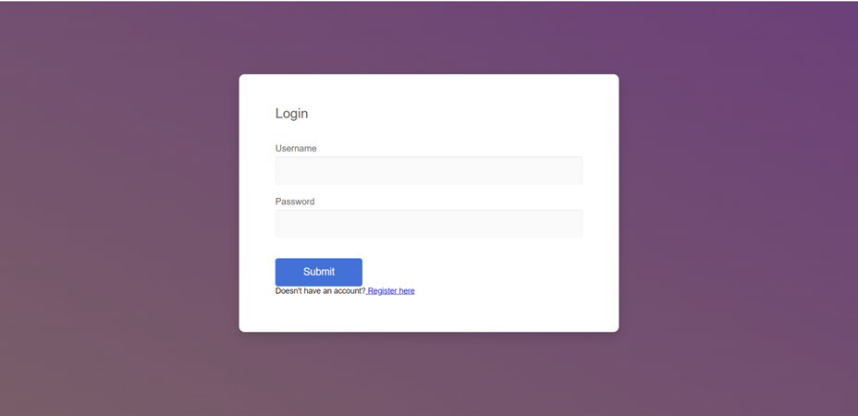
USER INTERFACES (UI)
CUSTOMER LOGIN

Slide 19
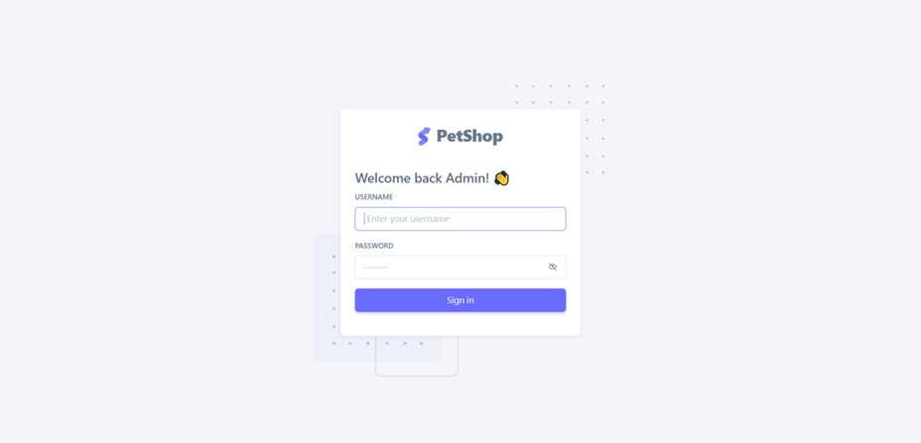
USER INTERFACES (UI)
ADMIN LOGIN

Slide 20
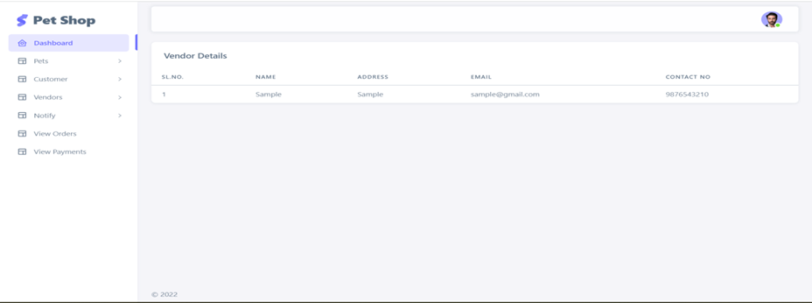
USER INTERFACES (UI)
ADMIN DASHBOARD

Slide 21
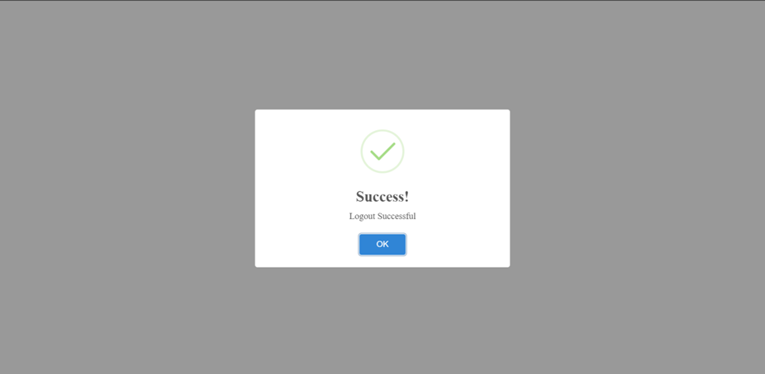
USER INTERFACES (UI)
LOGOUT

Slide 22
LIMITATIONS
Internet is mandatory.
Currently is only a web application, it is not as an android or an IOS application.
No provision is incorporated for making payment in offline mode.
Search option is not provided in this application.
We cannot delete the vendor and customer details once we entered.

Slide 23
FUTURE SCOPE
In future, this web application could be integrated with android and IOS application.
In future, we are adding the search option in this web application.
In future, we are adding the option to delete the details of vendor and customer once we entered.

Slide 24
CONCLUSION
So here my project report came to end.
I would like to sincerely thank all the people who directly or indirectly involved in this project without whose help the completion of this project would have been impossible.
If you have any doubts, I am happy to answer.
THANK YOU

