Slide 1
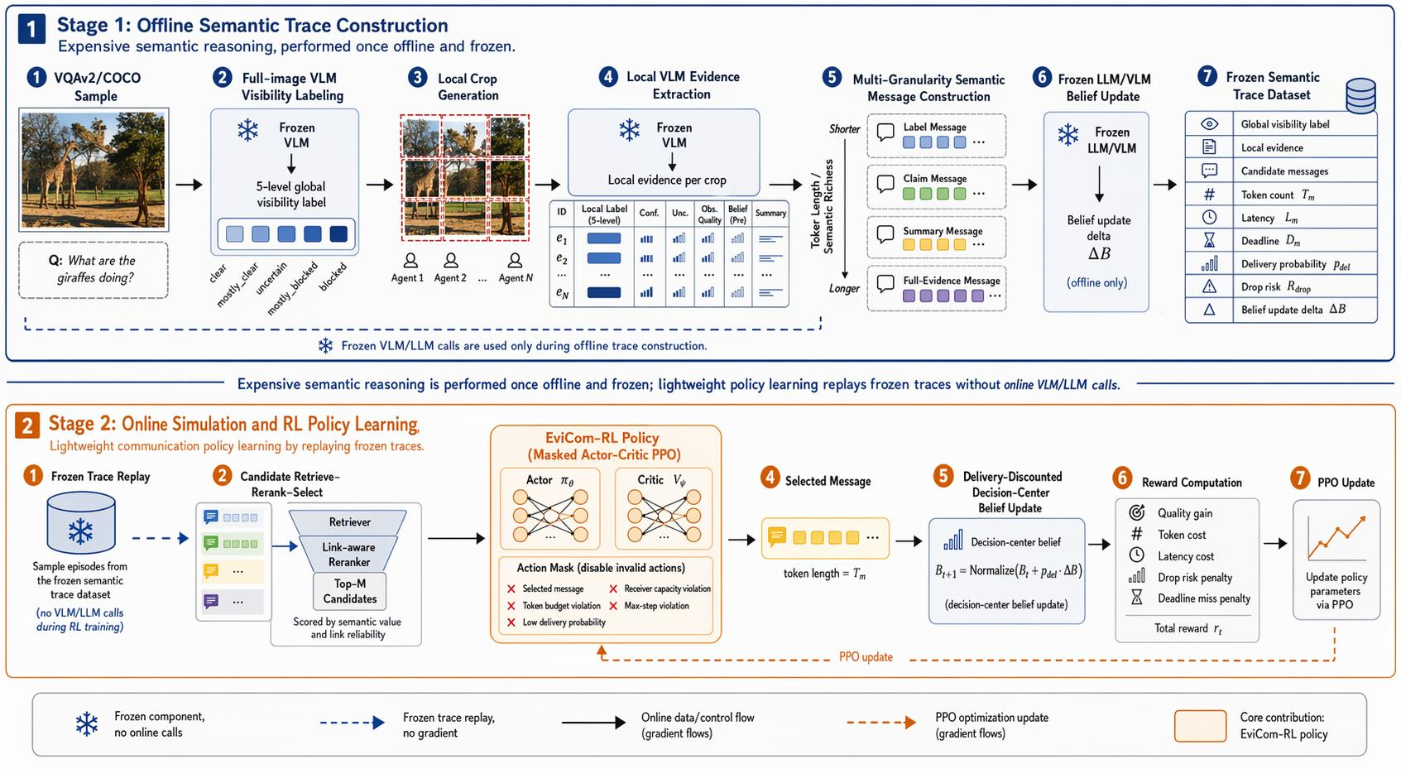
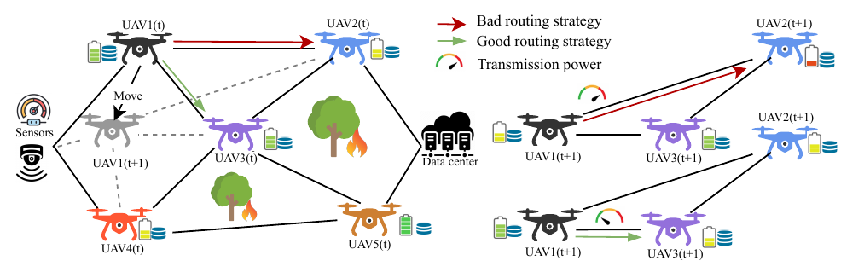
QoS-aware Communication for Multi-agent Services
Dynamic Links and Fragile Service Quality
From Sustainable Transmission to Useful Semantic Evidence
UAVs, mobile robots, edge cameras and vehicular nodes increasingly provide field services through temporary multi-hop links.
Sensor data, local observations and dispersed evidence all have to move through unstable links before decisions can be made.
Here, link availability, latency, bandwidth and node energy all matter.
The research follows this service process at two connected levels. LEADR keeps data forwarding sustainable through energy-aware routing and power control.
EviComRL then asks which semantic evidence should be exchanged for visual reasoning when communication opportunities are limited and unreliable.
The robustness analysis connects both layers by testing semantic decisions under physical link and energy dynamics.
Research Question
How can multi-agent services maintain communication quality when links, bandwidth and node energy are limited and changing?
2026/6/23
1

