Slide 1
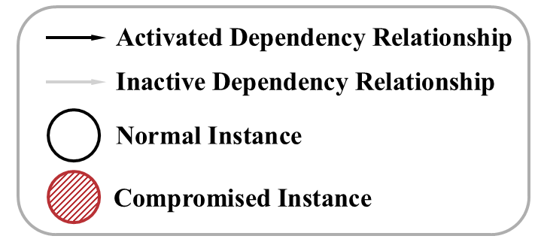
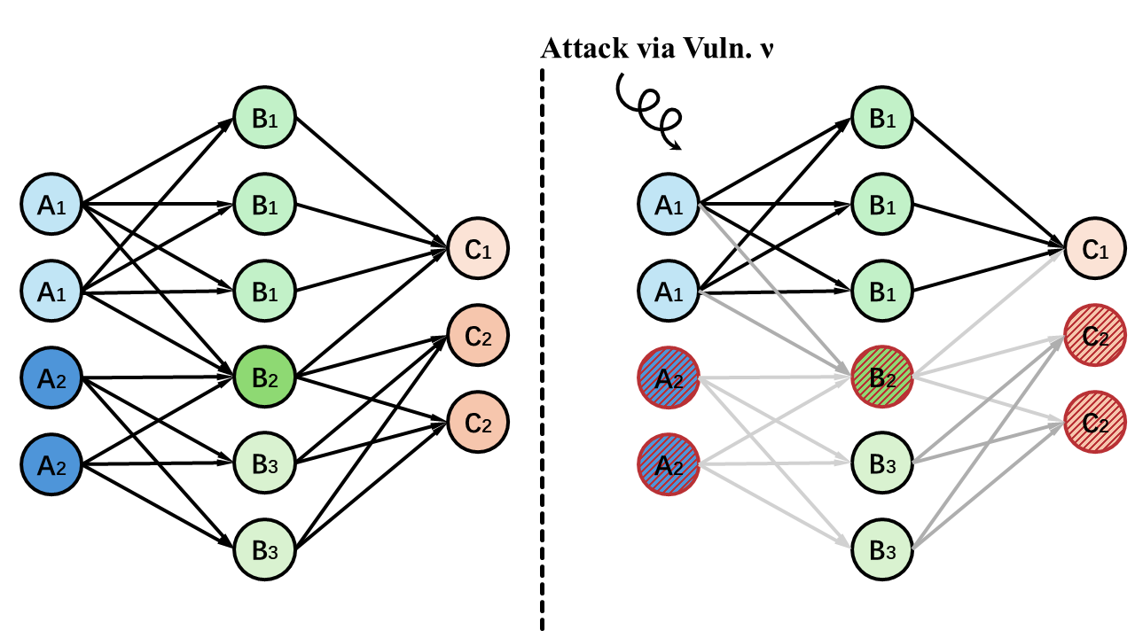
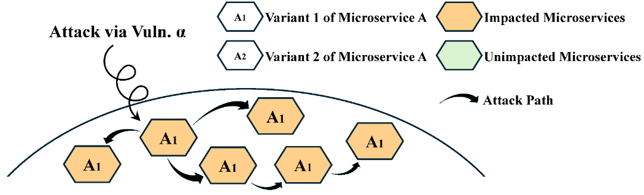
Resilient Microservices through Heterogeneity
Homogeneity and
Systemic Vulnerabilities
Security through Heterogeneity
Inspired by biology and information theory, heterogeneity can be introduced into microservice deployments using diverse images and software versions. This fragments the attack surface and limits the impact of shared vulnerabilities. When a vulnerability is exploited in one variant, other variants without the same vulnerability remain unaffected. These unaffected variants can continue providing the service, thereby improving system resilience and service continuity under attack.
Microservices divide a complex application into small, independently deployable services. To improve availability, each service is often deployed as multiple instances.
These instances usually run the same software version and container image. As a result, they often share the same vulnerabilities.
Once one instance is compromised, the same attack may rapidly spread to other identical instances, potentially disrupting the entire service.
Research Question
How can resilience against attacks be improved through heterogeneous microservice deployment under system constraints?

