Slide 1
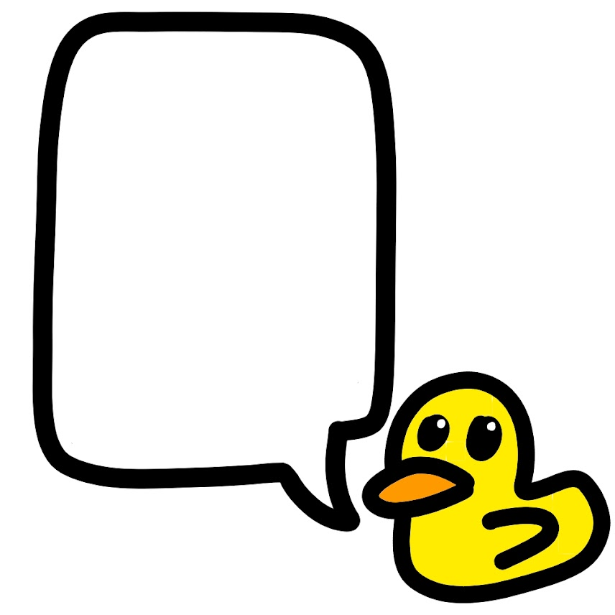
Quack! Tell me more about the problem by selecting a button below:
An error message is displayed
My code doesn’t do what I want it to
View docs

Slide 2
What type of error is displayed?
Attribute Error
Syntax Error
TypeError
NameError
Indentation Error / TabError
Something else / I don’t know
View docs

Slide 3
Select the problem with your program
My program does nothing at all
A condition isn’t working (eg: in if statement or while loop)
Certain parts of my program are skipped
A list has changed even though I didn’t change it
Division is giving the wrong answer
Something else
View docs

Slide 4
An AttributeError tells you that a certain type (such as int or str) doesn’t have a certain attribute. For instance, if you write display.potato, Python will give an AttributeError to tell you that display has no potato attribute.
Tell me more…
View docs

Slide 5
A SyntaxError might happen if you used the wrong punctuation (eg: using ‘;’ instead of ‘:’) or if you misspelt a keyword (such as for, while, if, or else). A tiny arrow symbol ( ^ ) normally points to the word that Python is confused about.
Ah, that’s it!
No I still need help
View docs

Slide 6
Python throws a TypeError if you use a value in a way that doesn’t make sense for its type. For instance, “3” + 5 would throw a TypeError because you cannot add a str to an int.
Ah, that’s it!
No I still need help
View docs

Slide 7
I didn’t mean to put this slide here but it’s too late to delete it now. Quack.
Ah, that’s it!
No I still need help
View docs

Slide 8
The indentation is a fancy way of saying the amount of space at the beginning of the line. Within a given loop, all lines must have the same indentation. You should always use tabs rather than spaces for this.
Ah, that’s it!
View docs

Slide 9
Sometimes a helpful message appears with a SyntaxError, such as “can’t assign to literal”. Which message do you see?
Invalid Syntax (no further message)
Invalid syntax for (number / integer with base 10)
Can’t assign to [something]
Something else
View docs

Slide 10
Your error message tells you that the SyntaxError is on line 9, so I’ve highlighted that line for you in the editor. Do you spot the mistake now?
Yes, thank you!
No, I still need help
View docs

Slide 11
That’s alright. Are you following one of the MicroPython tutorials?
Yes I am
No I’m not
View docs

Slide 12
Which tutorial are you following?
None of them
Hello, World!
Images
Buttons
Input/ Output Pins
Music
Random
Movement
Gestures
Speech
Direction
Storage
Next steps
Network
Radio
View docs

Slide 13
Okay, hang on a second while I compare line 9 of your code to what’s in the tutorial…
View docs

Slide 14
Line 10 of the code in the tutorial is :
boat2 = Image(“00000:”
But your line 9 almost matches, with :
boat2 = Image(“00000:’
Thanks, I can fix that now.
That wasn’t what I was trying to write
View docs

Slide 15
I’m happy that I could help you! Now you’ve learnt something new, so you’ll know what to do next time you get that problem.
Remember you can click on my icon any time if you need more help!
Thanks Duck, bye for now!
View docs

Slide 16
Python complains that it “can’t assign to expression” if you use the single equals sign ( = ) in a place where it doesn’t belong. For example, “3 = x” would be read as “change the value of 3 to make it x. But that’s nonsense because you can’t change 3!
Tell me more…
View docs

Slide 17
If you’re trying to change the value of a variable, the variable name (eg: x) needs to go on the left, and the value (eg: “hello”, or 10) needs to go on the right of the = sign.
If you’re trying to test if 2 values are equal, use == rather than = .
Ah, that’s it!
I still need help
Back
View docs

Slide 18
Python gives this message when you attach something confusing to the end of a number. Eg: Python knows about 3, but it doesn’t know about 3f or 3.f. If you are trying to multiply a number by a variable, use the * symbol. Or maybe you just made a typo.
Ah, that’s it!
I still need help
View docs

Slide 19
To get an AttributeError, you might have accidentally used the wrong datatype or misspelt the function you called? Or perhaps you used a capital letter by mistake – Python treats show and Show as two different things.
Ah, that’s it!
I still need help
Back
View docs

Slide 20
You might get this error if you write an “empty” for loop or while loop (one with nothing in it because you didn’t indent), or if you forgot to close the square brackets at the end of a list.
No, I still need help.
Ah, that’s it!
View docs

Slide 21
A NameError tells you that Python doesn’t understand a certain word that you used. Reread the error message to see which word this is. It might just be that you’ve mistyped it! Remember that Python is case-sensitive (so you mustn’t use a capital letter where it expects a lower-case one).
Ah, that’s it!
No, I still need help.
View docs

Slide 22
Another reason for a nameError might be if you used a variable before it was defined (before you gave it a value).
Or maybe you forgot to write the namespace (eg:, if you just wrote show instead of display.show).
Ah, that’s it!
I still need help
Back
View docs

Slide 23
If your program does nothing at all but doesn’t show an error, it might be because you defined a function and forgot to call the function. To call a function, you need round brackets ().
No, that’s not what I’ve done
Ah, that’s it!
View docs

Slide 24
You’ve told me that a condition isn’t working. Is your condition simple (just uses one comparison) or complex (uses and / or ) ?
Simple
Complex
View docs

Slide 25
Which of the following match your issue?
My list should be modified by every iteration of the loop but it’s only modified by the last iteration
The last iteration of my loop is getting skipped
Something else
View docs

Slide 26
If you define a list in Python and then set a second list equal to the first, then any changes to the first list will happen in the second! Fix this by using the copy function on the first list. For example, instead of typing “list2 = list1”, type “list2 = list1.copy()”
Ah, that’s it!
I still need help
View docs

Slide 27
If you divide two ints (whole numbers) in Python, it rounds the answer down to a whole number, instead of giving it as a decimal or fraction. If you want a decimal answer, write “.0” at the end of your numbers. Eg: type 3.0/4.0 instead of 3/4.
Ah, that’s it!
I still need help
View docs

Slide 28
Another reason why your program might do nothing is if you forgot to output anything! Assigning to variables doesn’t show anything on the Micro:Bit display unless you also call display.show. Do not call print because it doesn’t work on the Micro:Bit.
Ah, that’s it!
I still need help
View docs

Slide 29
If two values should compare equal but they don’t, it might be because they’re different types. For example, 3 is an int but “3” is a string, so Python considers them to be totally different things and won’t consider them equal.
Ah, that’s it!
I still need help
View docs

Slide 30
When using complex conditions, Python groups and before or. For instance, “a or b and c“ is interpreted as “a or (b and c)”. If this isn’t what you want, then insert parentheses (round brackets).
Ah, that’s it!
I still need help
View docs

Slide 31
This error happens if you have defined the list inside the loop. Move the definition of the list to before the loop begins, and that should fix your problem!
Ah, that’s it!
I still need help
View docs

Slide 32
The range function in Python stops before the end value. For instance, range(1,10) will iterate through values 1-9 but miss out 10. Increase the end parameter in your call to range, and see if that fixes the problem.
Ah, that’s it!
I still need help
View docs

Slide 33
Try narrowing down exactly where your program “makes the decision” that skips a certain part of the code, by inserting display.show() calls (with different parameters!) after every line.
Ah, that’s it!
I still need help
View docs

