Slide 1
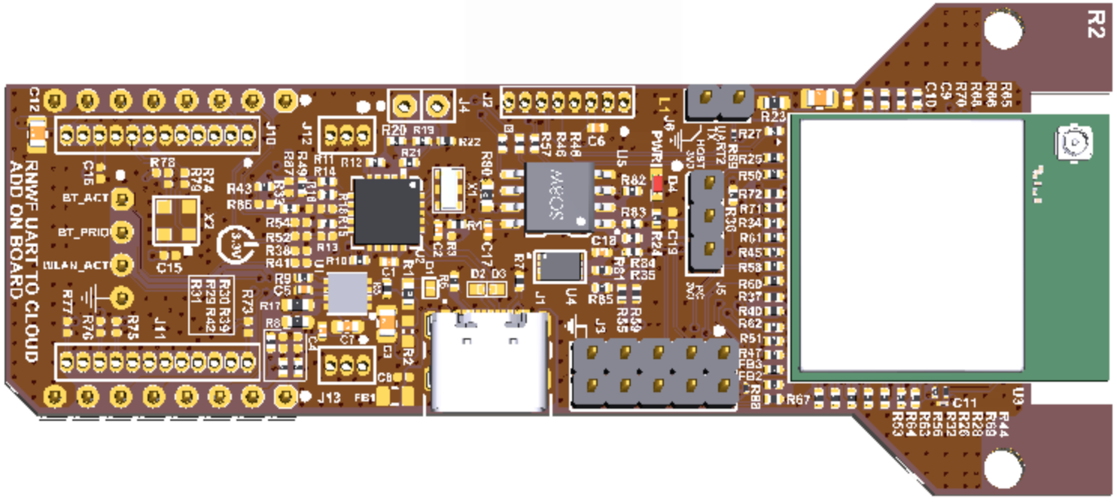
JUMPER (PC 3V3)

