Slide 1
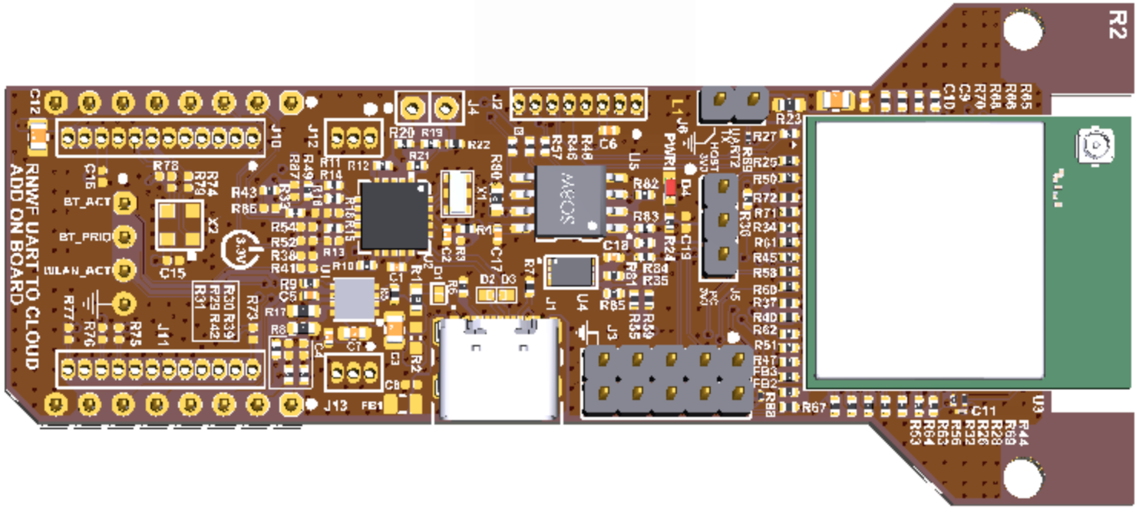
JUMPER (HOST 3V3)

