Slide 1
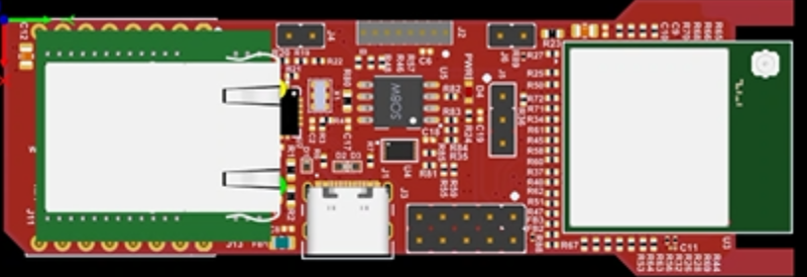

PWR LED
TO PC

