Slide 1
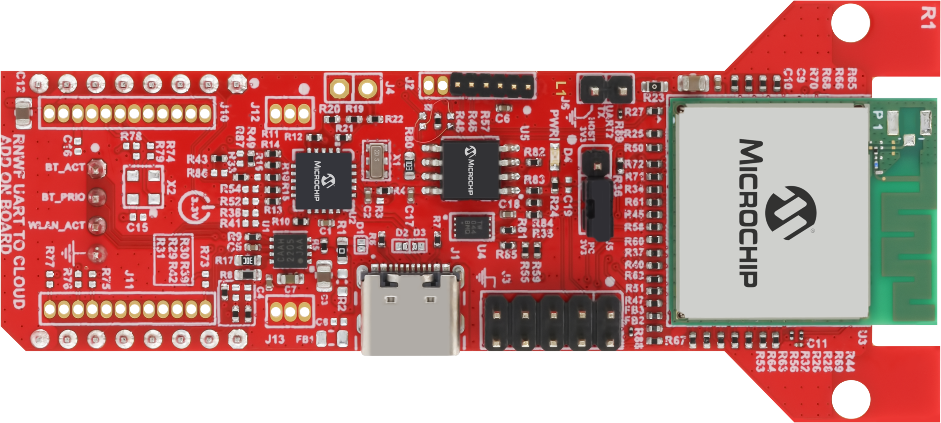

POWER LED
TO PC

