Slide 1
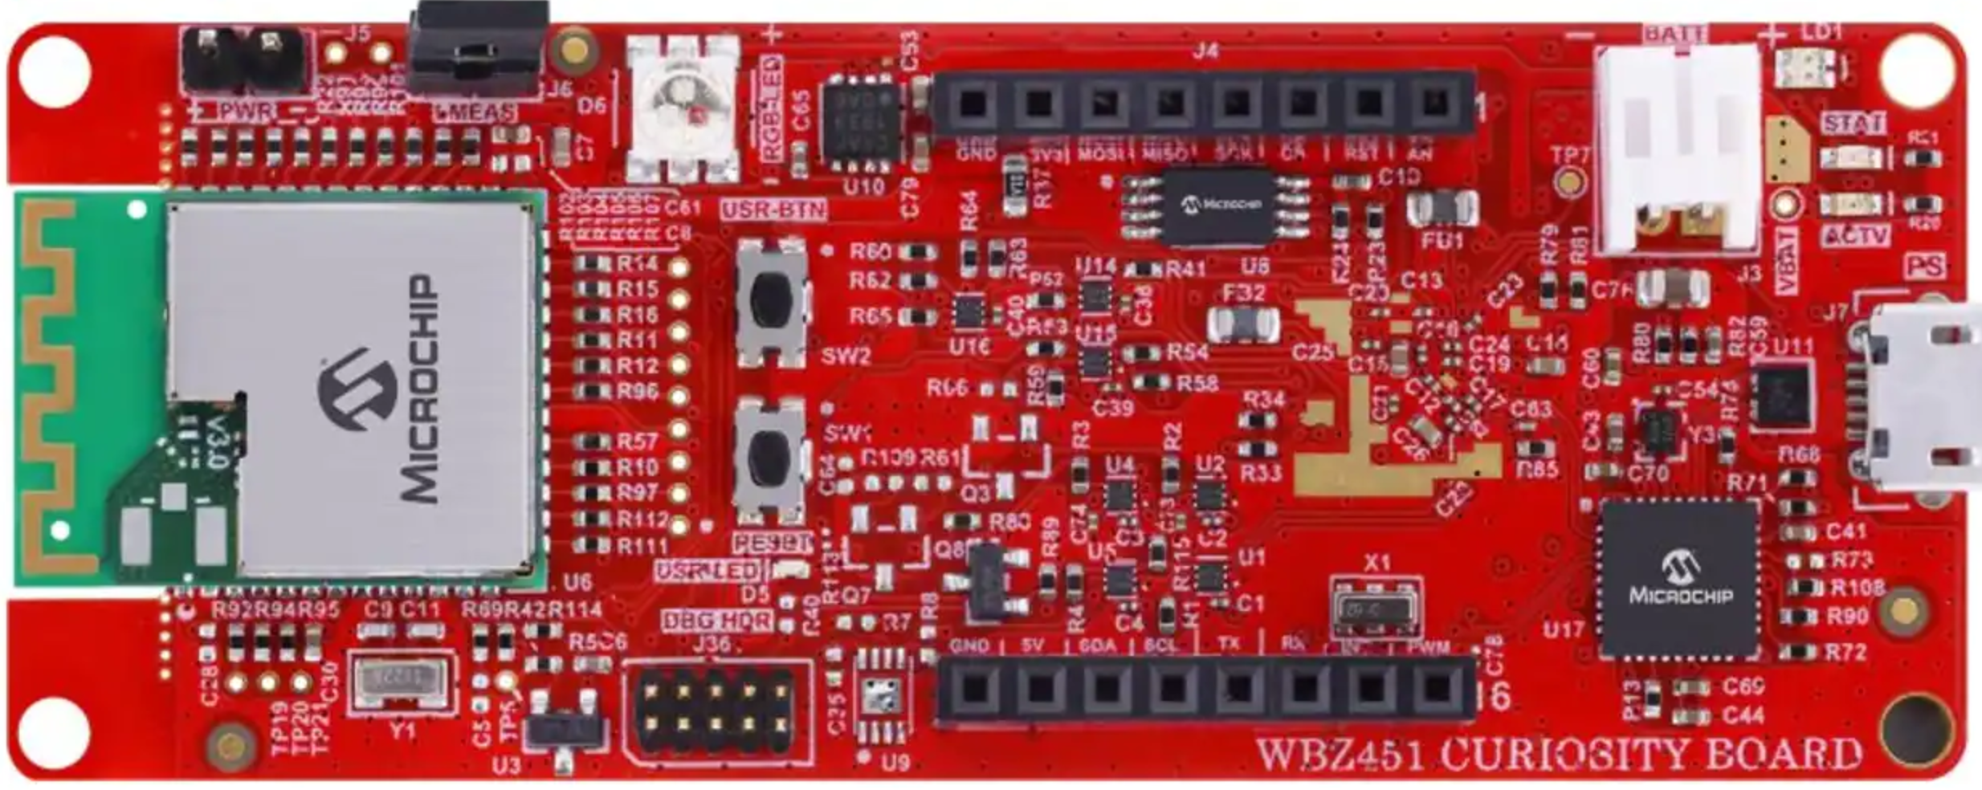
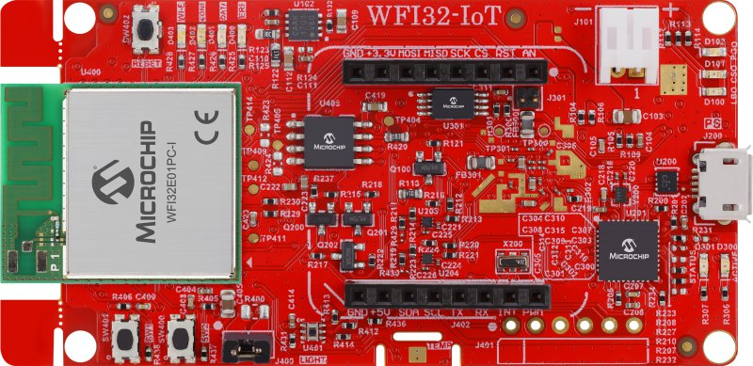
WBZ451 Curiosity Board
WFI32-IoT Development Board
mikroBUS Header (J4)
mikroBUS Socket (J402)
Pin Name | Pin Number
GND | 9
TX | 13
RX | 14
Pin Number | Pin Name
9 | GND
14 | RX
13 | TX

