Slide 1
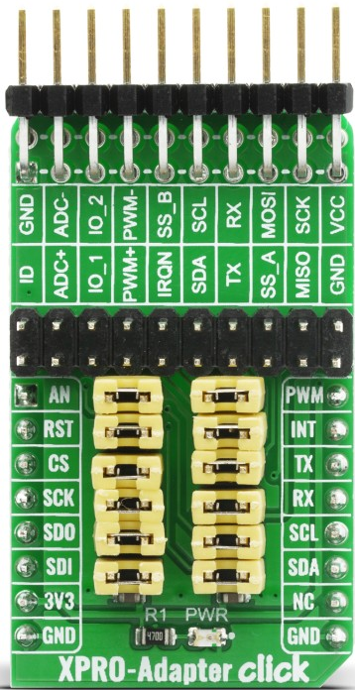
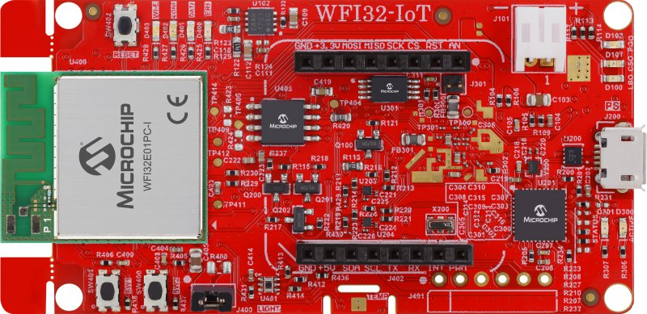
XPRO-Adapter Click
WFI32-IoT Development Board
mikroBUS Pins
mikroBUS Socket (J402)
Pin Name | Pin Number
GND | 9
SDA | 11
SCL | 12
Pin Number | Pin Name
9 | GND
14 | RX
13 | TX

