Slide 1

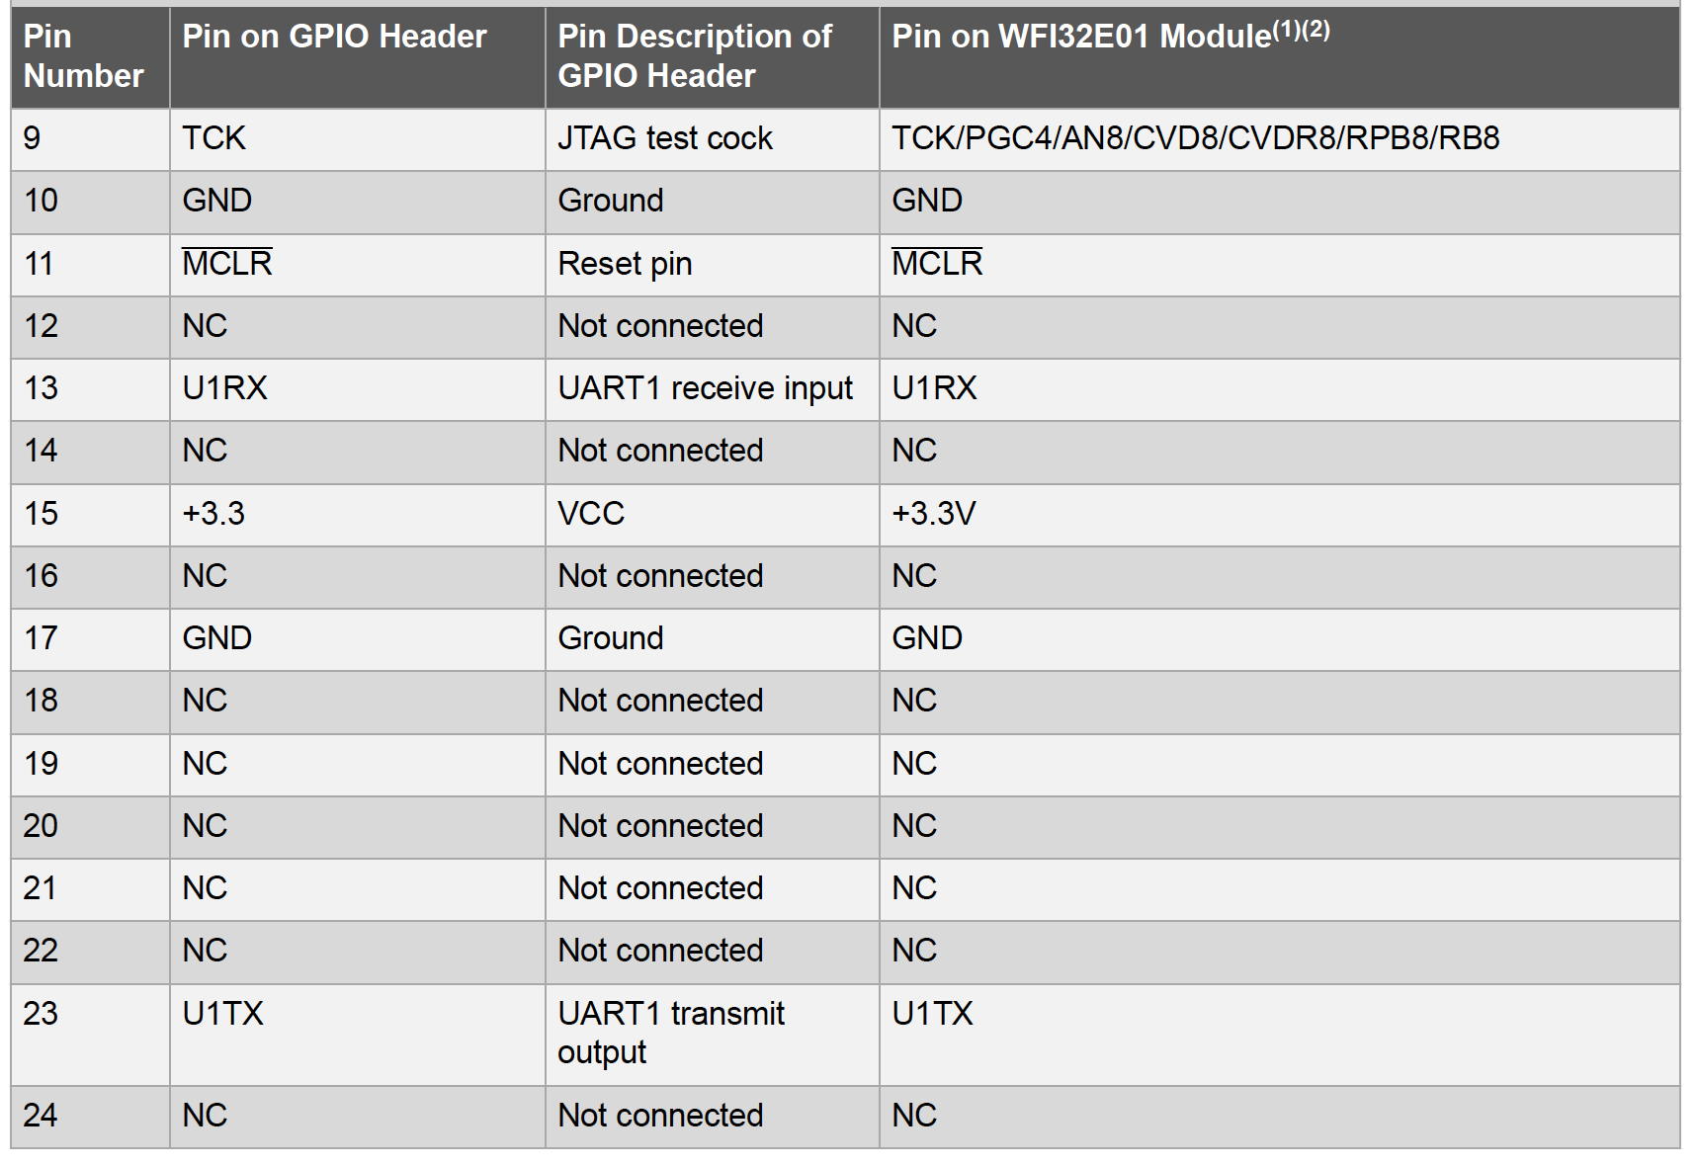
USB
to
UART
Converter
GND
TX
RX

