Slide 1
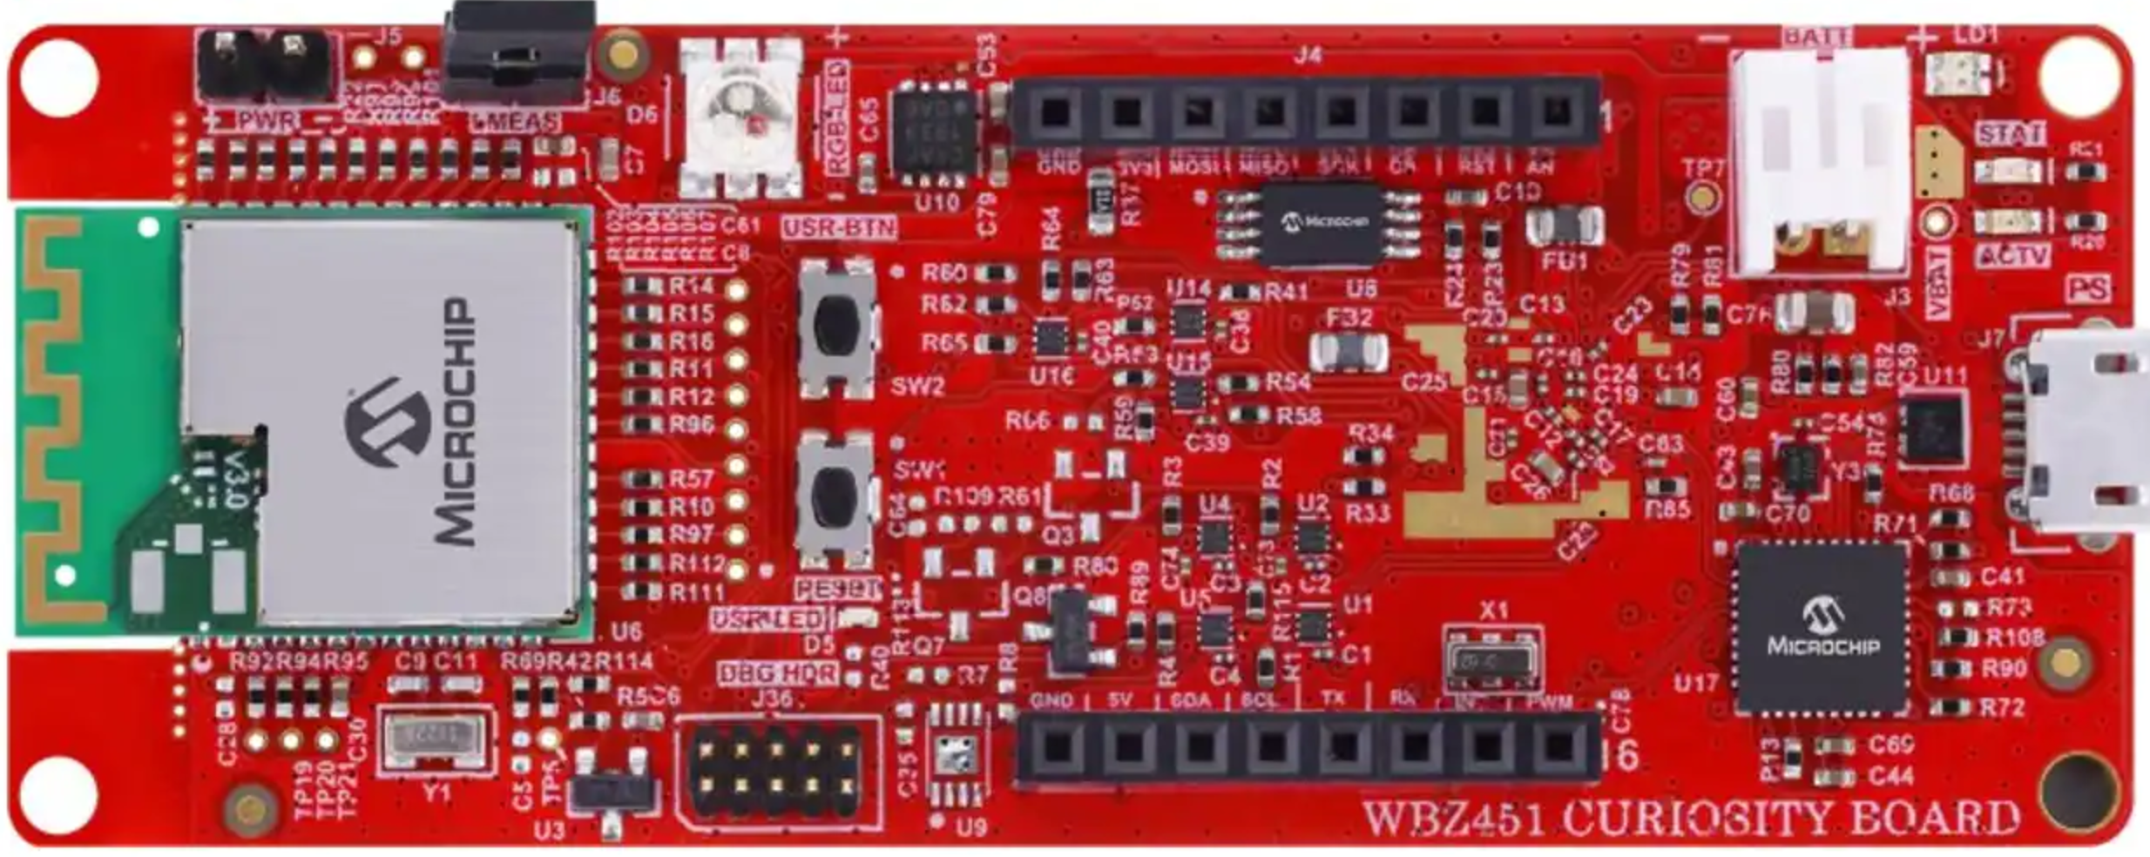
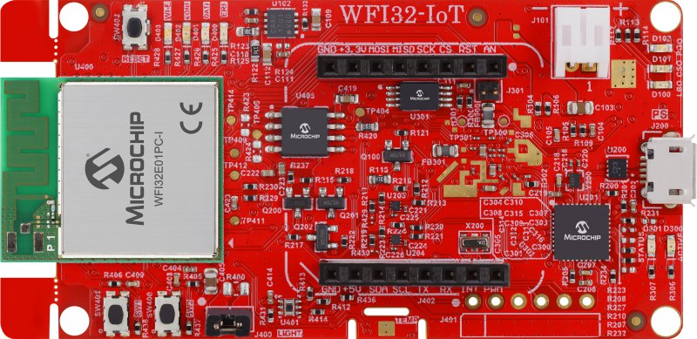
WBZ451 Curiosity Board
WFI32-IoT Development Board
mikroBUS Header (J4)
mikroBUS Socket (J402)
Pin Name | Pin Number
GND | 9
SDA | 11
SCL | 12
Pin Number | Pin Name
9 | GND
13 | TX
14 | RX

