Slide 1
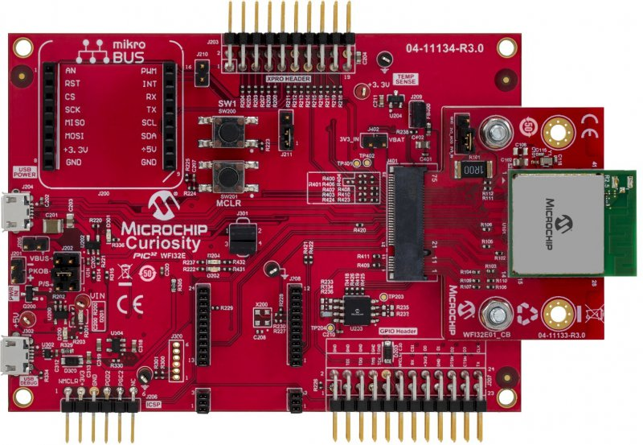
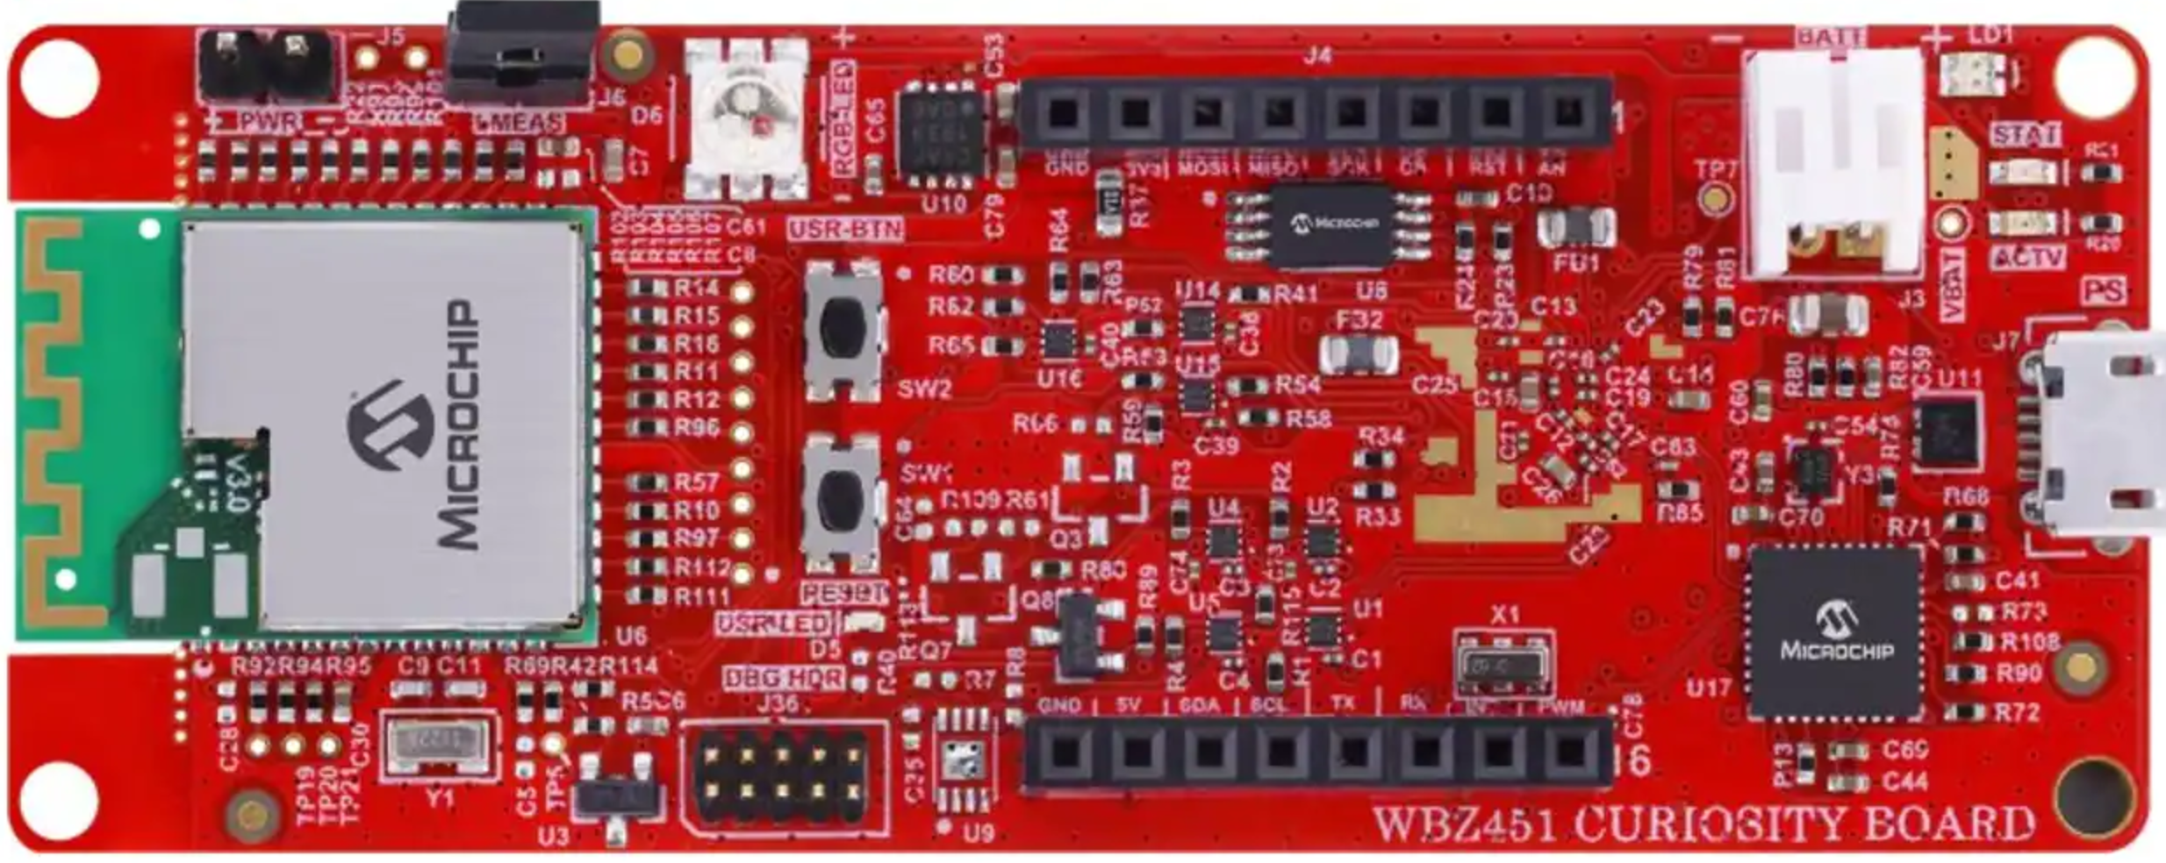
PIC32 WFI32E Curiosity Board
WBZ451 Curiosity Board
mikroBUS Header (J4)
GPIO Header (J207)
Pin Name | Pin Number
GND | 9
SDA | 11
SCL | 12
Pin Name | Pin Number
10 | GND
23 | U1TX
13 | U1RX

