Slide 1
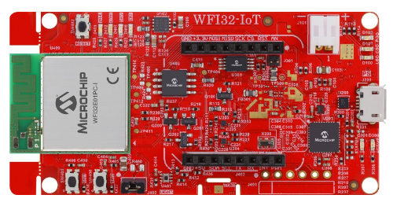
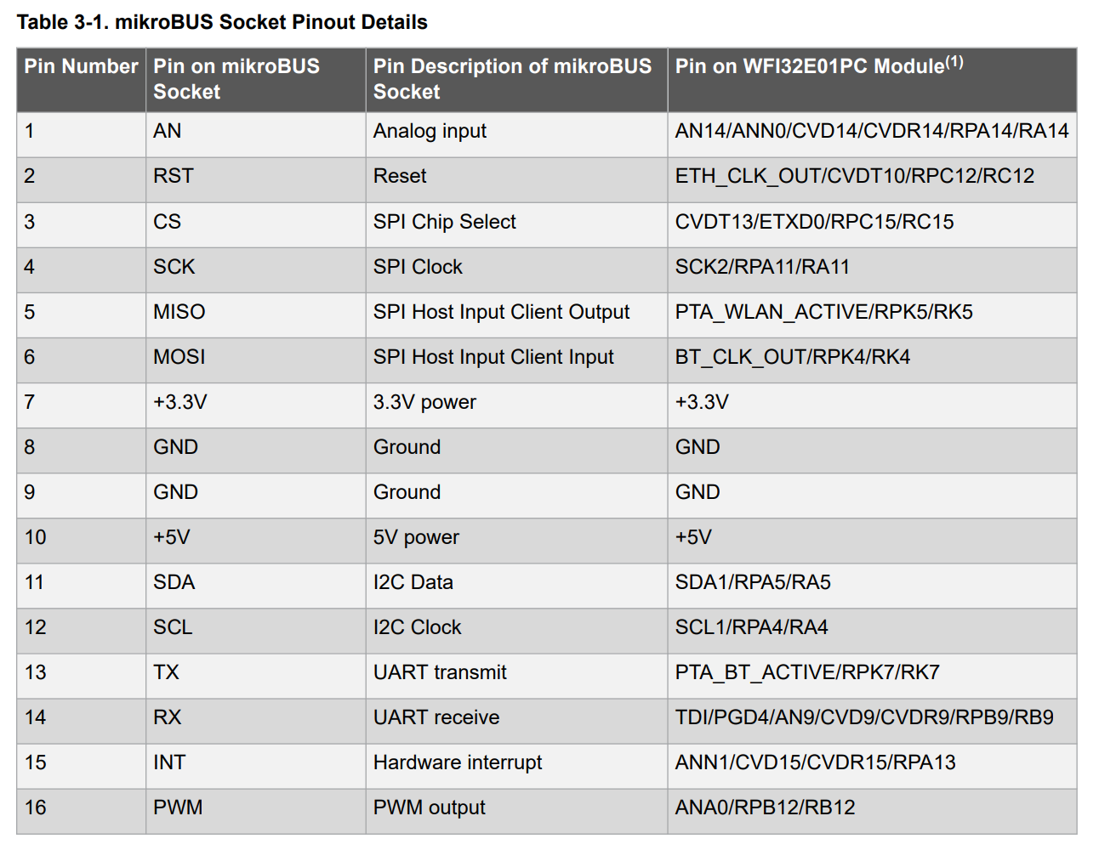
9
13
14
USB
to
UART
Converter
GND
RXD
TXD

