Slide 1
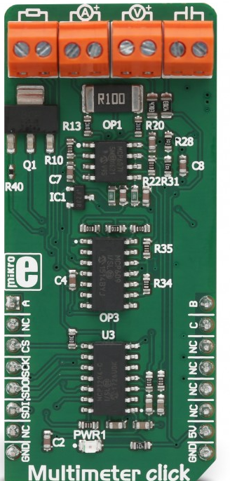
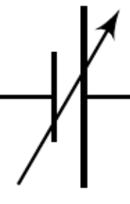
Adjustable DC Power Supply
+
_
0.008 V min
17.068 V max

Slide 2
_
Adjustable DC Power Supply
+
0.008 V min
17.068 V max

