Slide 1
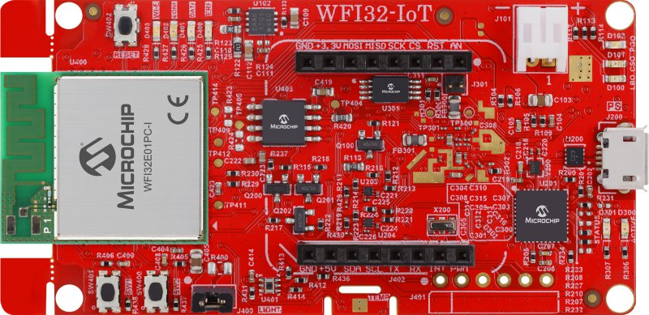
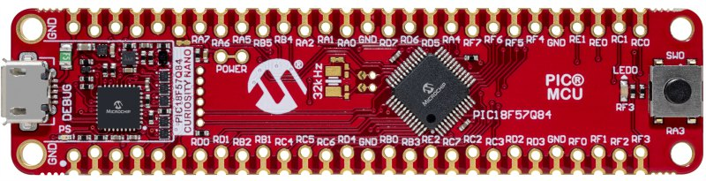
PIC18F57Q84 Curiosity Nano Evaluation Kit
WFI32-IoT Development Board
56-Pin Edge Connector (J200)
mikroBUS Socket (J402)
Pin Name | Pin Number
GND | 52
RD1 | 8
RD0 | 7
Pin Number | Pin Name
9 | GND
13 | TX
14 | RX

