Slide 1
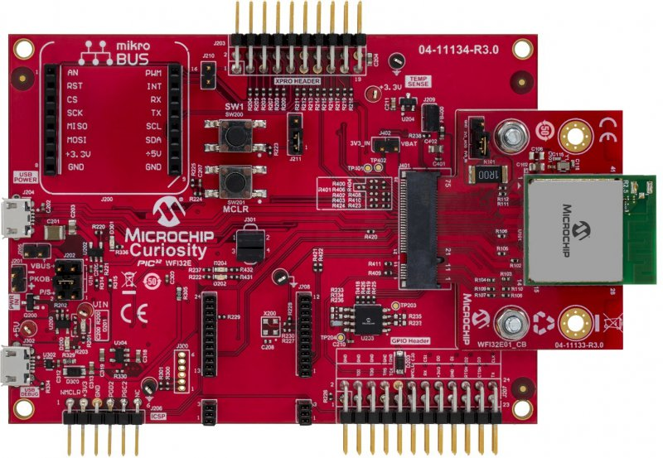
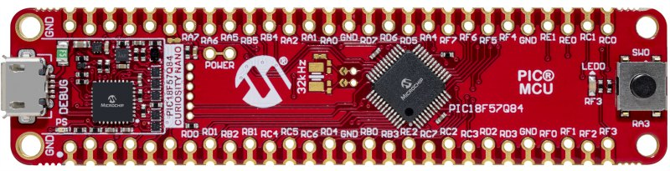
PIC32 WFI32E Curiosity Board
PIC18F57Q84 Curiosity Nano Evaluation Kit
56-Pin Edge Connector (J200)
GPIO Header (J207)
Pin Name | Pin Number
GND | 52
RD1 | 8
RD0 | 7
Pin Name | Pin Number
10 | GND
23 | U1TX
13 | U1RX

