Slide 1
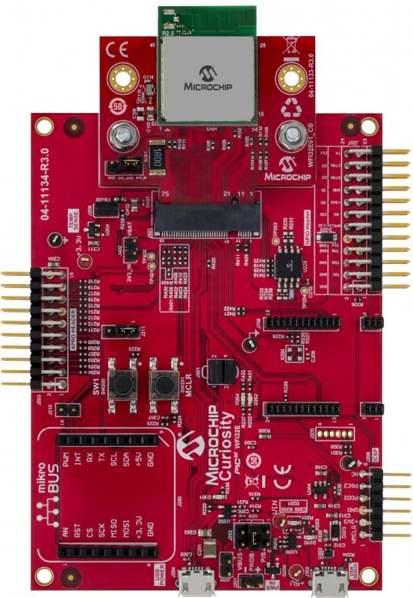
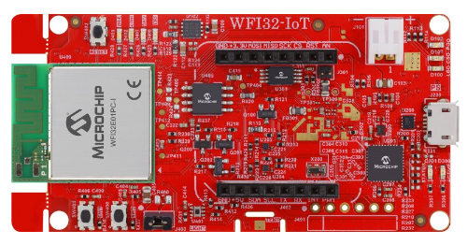
WFI32-IoT
PIC32 WFI32E Curiosity

