Slide 1
Azure IoT Device Model “SAM-IoT-Wx-v2” Version 1
Randy Wu, Principal ESE
Wireless Specialist (PACNW)

Slide 2
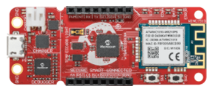
“SAM-IoT-WM” V2: Connecting an Application MCU
Application
MCU
UART (9600 baud)
CLI
Azure Cloud
MQTT
SPI (30 kHz)
DTI
NEW
FUNC | DIR | PIN | HEADER
TXD | ← | PB02 | N/A
RXD | → | PB03 | N/A
MOSI | → | PA04 | J20-6
SCK | → | PA05 | J20-4
CS | → | PA06 | J20-3
GOAL
Extend the “SAM-IoT-WM” Version 1 device model with additional interfaces to accommodate telemetry, properties, and commands for connecting an external application MCU
UART
SPI

Slide 3
Additional Interfaces for “SAM-IoT-Wx-v2” Version 1
Integers (4)
Strings (4)
Boolean (1)
Doubles (2)
Floats (2)
Long (1)
SAM-IoT Board
Sensors
- Light
- Temperature
4 LEDs
2 Buttons
Telemetry
Brightness
Temperature
Button events
Properties
Blue LED state
Green LED state
Yellow LED state
Red LED state
Telemetry interval
Commands
Reboot
NEW
Azure Cloud
MQTT
Integers – read only by cloud (2)
Integers – writable by cloud (2)
IP Address (read only string)
WINC1510 FW Version (read only string)
NEW
Azure Device Model
(“SAM_IoT_Wx_v2; ”)
1
Send ASCII Message
NEW

Slide 4
Application Parameters – Direction of Data Flow
SAM-IoT Board
Sensors
- Light
- Temperature
4 LEDs
2 Buttons
Telemetry
Brightness
Temperature
Button events
Properties
Blue LED state
Green LED state
Yellow LED state
Red LED state
Telemetry interval
Commands
Reboot
Integers (4)
Strings (4)
Boolean (1)
Doubles (2)
Floats (2)
Long (1)
Integers – read only by cloud (2)
Azure Cloud
Integers – writable by cloud (2)
Strings (IP Addr & FW ver) – read only
Send ASCII Message
Azure Device Model
(“SAM_IoT_Wx_v2;1”)
MQTT

Slide 5
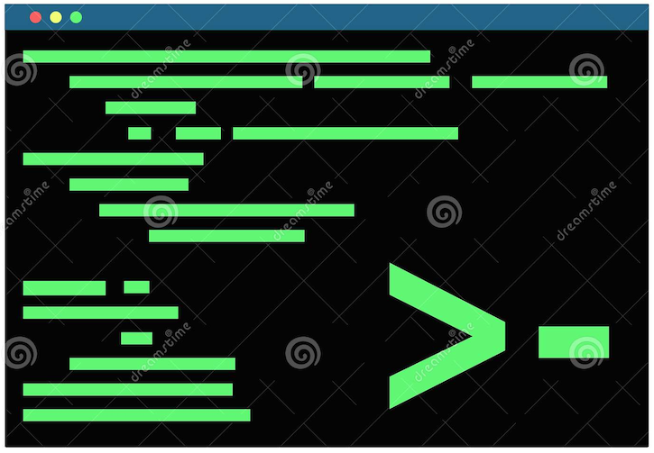
Command Line Interface (CLI) for SAM-IoT
Application MCU
Azure Cloud
CDC Interface (1200 to 500K baud)
UART (9600 baud)
MQTT
Update Telemetry & Properties using ASCII commands via Command Line Interface (CLI)
Telemetry Reported to Cloud
Properties Sync’d with Cloud

Slide 6
Standard ASCII Commands for SAM-IoT CLI
Command Format | Action
idscope [ID Scope] | Get and set Azure DPS ID Scope
reconnect | MQTT reconnect
wifi –set <ssid>[,<pass>,[authType]] | Set Wi-Fi credentials (authType: 1 = Open, 2 = WPA, 3 = WEP)
wifi –[scan|status] | Get list of Wi-Fi SSID’s or connection status
cloud -status | Get cloud connection status
key | Get ECC public key
device | Get ECC serial number
cli_version | Get CLI version
version | Get MCU application firmware version
debug [level] | Get and set debug level
reset | Reset host
q | Quit command processor
help | Help menu
NEW
Help
Notes:
Connection status – error in communication?

Slide 7
CLI Responses for [wifi & cloud] commands
>wifi -scan
Action | CLI Response
Get list of all SSID’s currently in range | <SSID_1>,<SSID_2>,..,<SSID_N>
>wifi -status
Wi-Fi Connection Status | CLI Response
Disconnected | 0.0.0.0
Connected | <IP_Addr>,<SSID>
>cloud -status
Cloud Connection Status | CLI Response
Disconnected | false
Connected | true

Slide 8
Application Command using CLI [telemetry]
NEW
Command: “telemetry”
Application MCU transmits its own telemetry updates using one of the storage slots in the table by choosing the desired index
index | description | name | schema | CLI Example | Action / Result
0 | Reset DTI command buffer |  |  | >telemetry 0,0 | Recommended before sending out a DTI data frame
1 | App Telemetry signed integer #1 | telemetry_Int_1 | integer | >telemetry 1,FE | telemetry_Int_1 = 254
2 | App Telemetry signed integer #2 | telemetry_Int_2 | integer | >telemetry 2,BA6E | telemetry_Int_2 = 47,726
3 | App Telemetry signed integer #3 | telemetry_Int_3 | integer | >telemetry 3,609D64 | telemetry_Int_3 = 6,331,748
4 | App Telemetry signed integer #4 | telemetry_Int_4 | integer | >telemetry 4,C36941E5 | telemetry_Int_4 = -1,016,512,027
5 | App Telemetry double #1 | telemetry_Dbl_1 | double | >telemetry 5,F537A021CF015B44 | telemetry_Dbl_1 = -4.43422395117885722194330763894E256
6 | App Telemetry double #2 | telemetry_Dbl_2 | double | >telemetry 6,9D1F2C043A774B55 | telemetry_Dbl_2 = 1.0367692620813990098267580227E-305
7 | App Telemetry float #1 | telemetry_Flt_1 | float | >telemetry 7,418345E1 | telemetry_Flt_1 = 16.40912
8 | App Telemetry float #2 | telemetry_Flt_2 | float | >telemetry 8,C20508DE | telemetry_Flt_2 = -33.25866
9 | App Telemetry Long | telemetry_Lng | long | >telemetry 9,CAFE1234BEEF5678 | telemetry_Lng = 14,627,148,657,496,905,336
10 | App Telemetry Boolean | telemetry_Bool | boolean | >telemetry 10,true | telemetry_Bool = true
11 | App Telemetry String #1 | telemetry_Str_1 | string | >telemetry 11,hello | telemetry_Str_1 = hello\0
12 | App Telemetry String #2 | telemetry_Str_2 | string | >telemetry 12,goodbye | telemetry_Str_2 = goodbye\0
13 | App Telemetry String #3 | telemetry_Str_3 | string | >telemetry 13,Hi!!! | telemetry_Str_3 = Hi!!!\0
14 | App Telemetry String #4 | telemetry_Str_4 | string | >telemetry 14,Bye!!! | telemetry_Str_4 = Bye!!!\0
> telemetry <index>,<data>

Slide 9

Enhancement: Dedicated Telemetry Interface (SPI)
Application MCU
(SPI Master)
Azure Cloud
MOSI (PA04)
SAM-IoT
(SPI Slave)
MQTT
SCK (PA05)
CS (PA06)
Data Frame
Header
Payload
Command Byte | Index Byte | Length (MSB) | Length (LSB) | Data Byte 1 | . . . . . . . | Data Byte N
Command = ASCII char ‘T’ or ‘t’ (hex value 0x54 or 0x74)
Index is defined by parameter table of the CLI telemetry command
Length (16-bit word) = total # of bytes in the payload
Max frame length = (4B header + 1024B max payload) bytes = 1028 bytes
Notes:
1. (5000 milliseconds / 2048 Words) = 2.44 msec per update
2. (5000 milliseconds / 1024 Integers) = 4.88 msec per update

Slide 10
Test Platform for Dedicated Telemetry Interface (SPI)
SPI Master (PIC-IoT)
https://github.com/randywu763/MCHP-IoT_SPI
SPI Slave
(SAM-IoT)
3. Yellow LED Toggles
2. Red LED Toggles
RB14
RB15
RA0
RA1
RB0
RB1
1. Press the SW1 Button
PA02
PA03
PA06
PA05
PA07
PA04
PIC24
FJ128
GA705
AN
RST
CS
SCK
MISO
MOSI
+3.3V
GND
SAMD21
G18A
AN
RST
CS
SCK
MISO
MOSI
+3.3V
GND
Mikro
BUS
Mikro
BUS
Notes:
1. (5000 milliseconds / 2048 Words) = 2.44 msec per update
2. (5000 milliseconds / 1024 Integers) = 4.88 msec per update

Slide 11
Application Command using CLI [property]
NEW
Command: “property”
Application MCU communicates information about itself (e.g. state or configuration) using any of the properties (which can be read by the cloud on demand whenever needed). If the property is defined as writable by the cloud, this means the cloud is also allowed to change the value. In this case, the property command is also used as a confirmation response message (i.e. serving as an ACK to the SAM-IoT which will then send an ACK to the cloud).
index | description | name | schema | writable (by Cloud)
1 | App Property #1 | property_1 | integer | false
2 | App Property #2 | property_2 | integer | false
3 | App Property #3 | property_3 | integer | true
4 | App Property #4 | property_4 | integer | true
> property <index>,<data(hex)>
CLI Examples
Update Property #1 with a bitmask of 01110100b
> property 1,76
Update Property #3 with a value of 20,000
> property 3,4E20
Confirm that new value of Property #4 has been changed to 51,996 (after receiving the change request from the SAM-IoT)
> property 4,CAFE

Slide 12
Property Write from the Cloud (writable = true)
Writable properties can be changed from the Cloud
SAM will notify APP of the updated property by sending an ASCII message on the CLI PROP<x>=<new_value(hex)> (e.g. “PROP3=BEEF”)
Application must confirm the change using the property command as the ACK response
UART
MQTT
1. Send New Property Value
Azure Cloud
2. Send New Property Value
PROP<x>=<new_val(hex)>
Application MCU
3. Send Confirmation (ACK)
property <x>,<new_val(hex)>
4. Send ACK to complete sync

Slide 13
Read-only Properties (writable = false)
Cloud cannot change read-only properties
Typically used for Application to sync its state information with the cloud
UART
MQTT
1. Update Property #<x>
property <x>,<new_val>
Azure Cloud
Application MCU
2. New property value is synchronized with the cloud

Slide 14
Command: Send ASCII Message (from the Cloud)
Quick way to send an arbitrary ASCII string from the Cloud to the Application MCU
NEW
UART
MQTT
Send ASCII message
(1KB string maximum)
Azure Cloud
Application MCU
2. ASCII message echoed on the console

Slide 15
Using the DTI for Large/Burst Data Transfers
Azure IoT Hub
string
Application MCU
2KB
Bucket #1
string
2KB
Bucket #2
string
2KB
Bucket #3
string
2KB
Bucket #4

Slide 16
Test Sequence: 8 1KB Strings → 4 Data Buckets
Data Frame
Header
Payload
Frame No. | Command Byte | Index Byte | Length (MSB) | Length (LSB) | String Data (1024 Bytes)
1 | ‘t’ (0x74) | 0x0B | 0x04 | 0x00 | START1111…1…1…1…1…1…1…1…1…1...1...1…1…1111END
2 | ‘t’ (0x74) | 0x0C | 0x04 | 0x00 | START2222…2…2…2…2…2…2…2…2…2...2...2…2...2222END
3 | ‘t’ (0x74) | 0x0D | 0x04 | 0x00 | START3333…3…3…3…3…3…3…3…3…3...3...3…3...3333END
4 | ‘t’ (0x74) | 0x0E | 0x04 | 0x00 | START4444…4…4…4…4…4…4…4…4…4...4...4…4...4444END
5 | ‘t’ (0x74) | 0x0B | 0x04 | 0x00 | START1111…1…1…1…1…1…1…1…1…1...1...1…1…1111END
6 | ‘t’ (0x74) | 0x0C | 0x04 | 0x00 | START2222…2…2…2…2…2…2…2…2…2…2...2…2...2222END
7 | ‘t’ (0x74) | 0x0D | 0x04 | 0x00 | START3333…3…3…3…3…3…3…3…3…3…3...3…3...3333END
8 | ‘t’ (0x74) | 0x0E | 0x04 | 0x00 | START4444…4…4…4…4…4…4…4…4…4…4...4…4…4444END
Test Conditions
Disable SAM-IoT light & temperature sensor telemetry reports (set the disableTelemetry property = 3)
Interframe delay = 500 msec
SPI Master SCK = 30 kHz
[Recommendation] Each data frame should be preceded with the CLI command telemetry 0,0
Notes:
1. (5000 milliseconds / 2048 Words) = 2.44 msec per update
2. (5000 milliseconds / 1024 Integers) = 4.88 msec per update

Slide 17
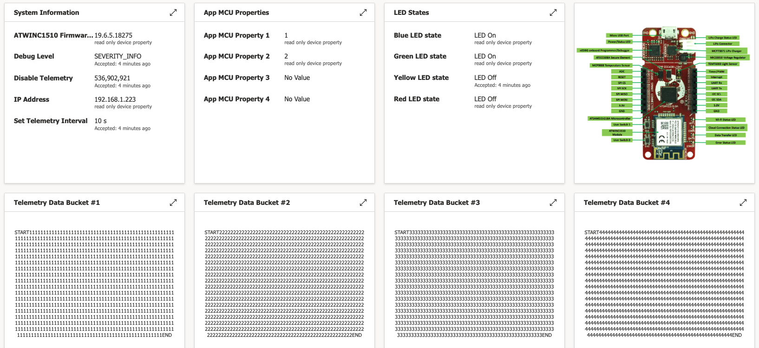
IoT Central Dashboard – 4 Data Buckets Visualized

Slide 18
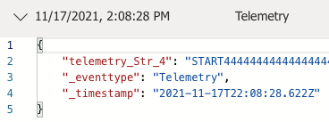
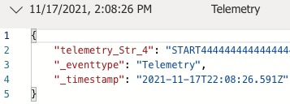
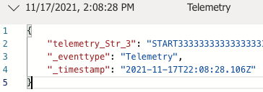
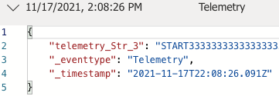
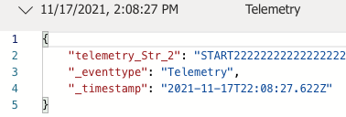
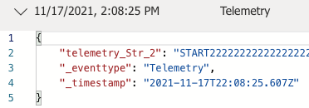
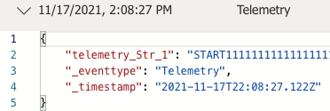
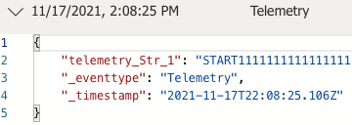
View Raw Data Messages Received by the App
Final Received Message
First Received Message

Slide 19







SAM-IoT-Wx-v2 Version 1 Available on GitHub
Developers get full MPLAB X projects from Microsoft-owned GitHub repositories
PIC-IoT https://github.com/Azure-Samples/Microchip-PIC-IoT-Wx
SAM-IoT https://github.com/Azure-Samples/Microchip-SAM-IoT-Wx
SAME54-XPRO https://github.com/azure-rtos/samples
PIC32 WFI32E Curiosity TBD (UNDER CONSTRUCTION)
ATSAMA5D27 Wireless SOM TBD (UNDER CONSTRUCTION)
Notes:
4 blocks of 1KB every 5 seconds

