Slide 1
Modifications when using WBZ451H with PL460-EK
Modifications on PL460-EL side
CUT PL460_NTHW0 trace
CUT PL460_ENABLE trace and PULL-UP (10k) to 3,3V
CUT PL460_STBY trace and PULL-DOWN (10K) to GND
SHORT BETWEEN Ports XPRO pins 10 and 12 (To CONTROL TX_EN with NTHW0 pin from host)

Slide 2
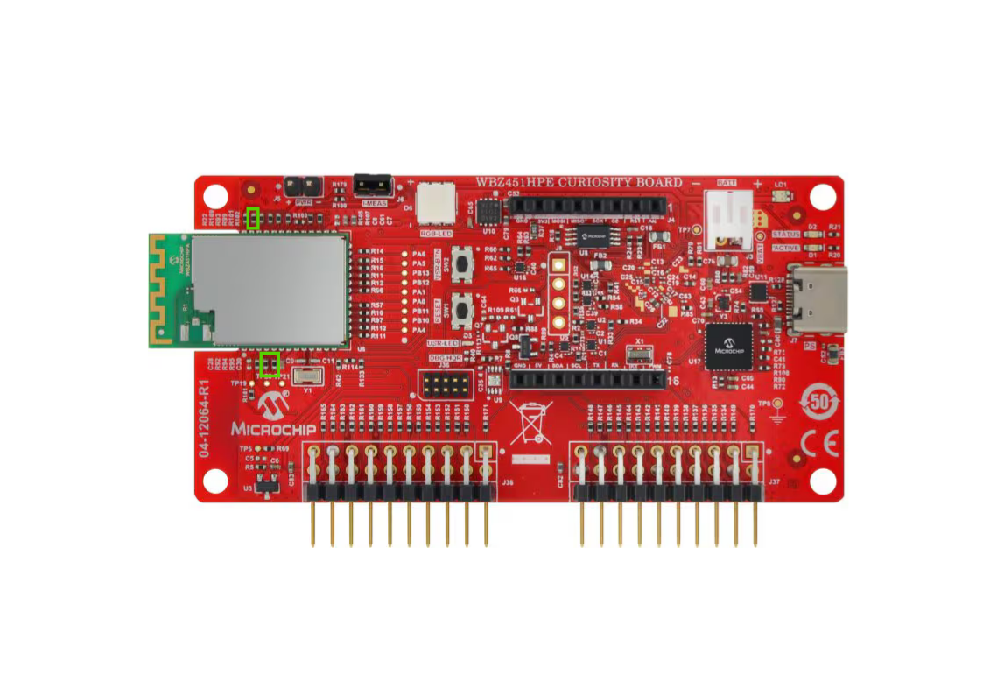
Modifications on WBZ451H side
Remove R169
to disable USR_BTN
Remove R94 to disable RGB_LED_GREEN
Remove R95 to disable RGB_LED_GREEN
Remove R5 and C5
to disable Temp Sensor
Remove R4
to disable RTS from UART Virtual Comm Port

Slide 3
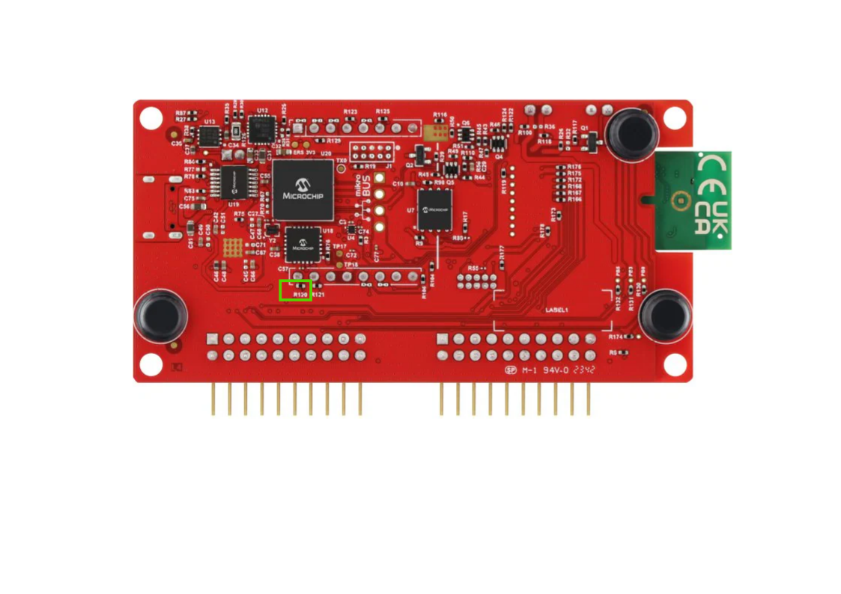
Remove R120
to use USER_LED
Remove R3
to disable CTS from UART Virtual Comm Port

Slide 4
Pin | WBZ451H - XPRO Header 1 | PL460-EK | Comment
1 | ID | ID | Not used
2 | GND | GND | Ground
3 | PB7 | Supply Monitor | Not used
4 | PB0 | - | Not connected
5 | PB12 | - | Not connected
6 | PB13 | - | Not connected
7 | PA4 – NRST | NRST | PL460 Reset Pin
8 | PA1 | ENABLE | PL460 fixed PULL-UP Trace is cutted
9 | PA3 - EXT_INT | EXT_INT | External Interrupt
10 | PA0 - TX_EN | NTHW0 | Shortcut with TXEN Pin12
11 | PA7 | STBY | PL460 fixed PULL-DOWN Trace is cutted
12 | PA8 | TXEN | Shortcut with NTHWo Pin10
13 | PA13 | - | not connected
14 | PA14 | - | not connected
15 | PB6 – CS | CS | SPI CS
16 | PB4 – MOSI | MOSI | SPI MOSI
17 | PB5 - MISO | MISO | SPI MISO
18 | PB3 – SCK | SCK | SPI SCK
19 | GND | GND | Ground
20 | 3,3V | 3,3V | Power Supply
XPRO Header
Used
Unused

