Slide 1
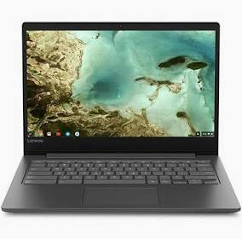
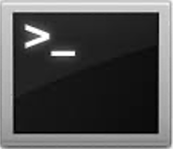

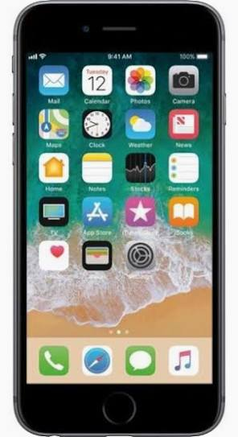

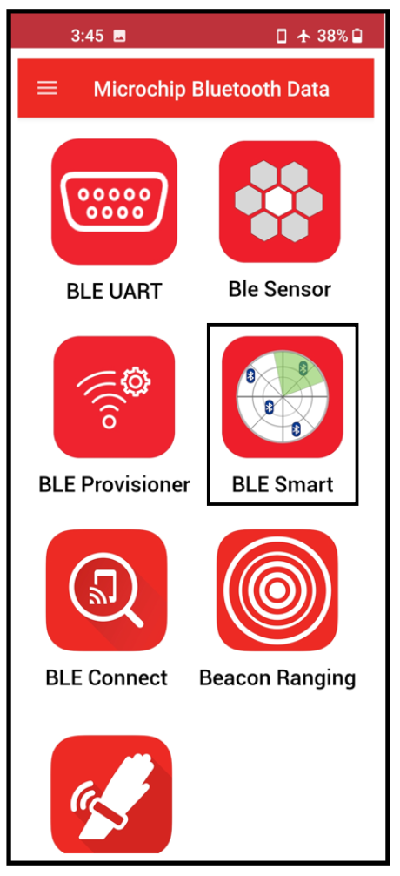

Microchip Demonstration Platform
(Certified BLE Module & CAN FD CTRL/XCVR)
USB
BLE Certified Module
WBZ451PE
CAN FD Controller + Transceiver
MCP251863
SPI
CAN BUS
BLE
Notes:
https://onlinedocs.microchip.com/oxy/GUID-A5330D3A-9F51-4A26-B71D-8503A493DF9C-en-US-5/index.html

Slide 2
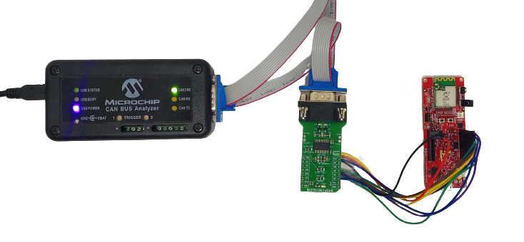
WBZ45x CAN Sniffer & BLE Peripheral Demo
https://github.com/MicrochipTech/pic32cxbz2_wbz45x_ble_can_bridge/tree/main
BLE
1. Generate CAN Messages
2. Display CAN Messages
BLE Peripheral Device

Slide 3
Hardware Requirements
1. WBZ451 Curiosity Development Board
https://www.microchip.com/en-us/development-tool/ev96b94a
2. MCP251863 Click
https://www.mikroe.com/mcp251863-click?srsltid=AfmBOoqqWx3FLqSSru9wg51ifptIEg7CX1Li5gTEB4vZSk3n0aIQFWH6
3. CAN Bus Analyzer Tool (or equivalent)
https://www.microchip.com/en-us/development-tool/APGDT002

Slide 4
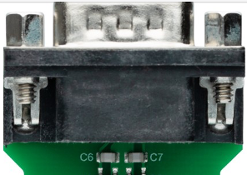
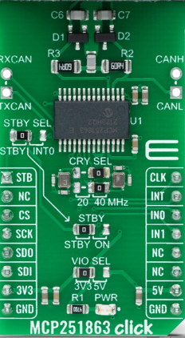
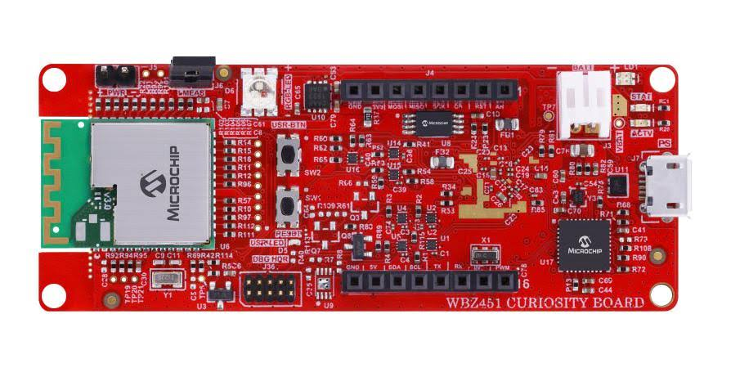
MCP251863 Connection Method #1:
Direct Connection to mikroBUSTM Socket
MCP251863 Click Board Modifications
Bend (outward 90 degrees) Pin 13 (IN1) & Pin 14 (IN0) so that they can’t be inserted into the mikroBUSTM header.
Solder a jumper wire to short/connect Pin 2 (NC) & Pin 13 (IN1).
Install the Click board directly onto the Curiosity mikroBUSTM socket (only Pins 13 & 14 will not make their connections).
1
2

Slide 5
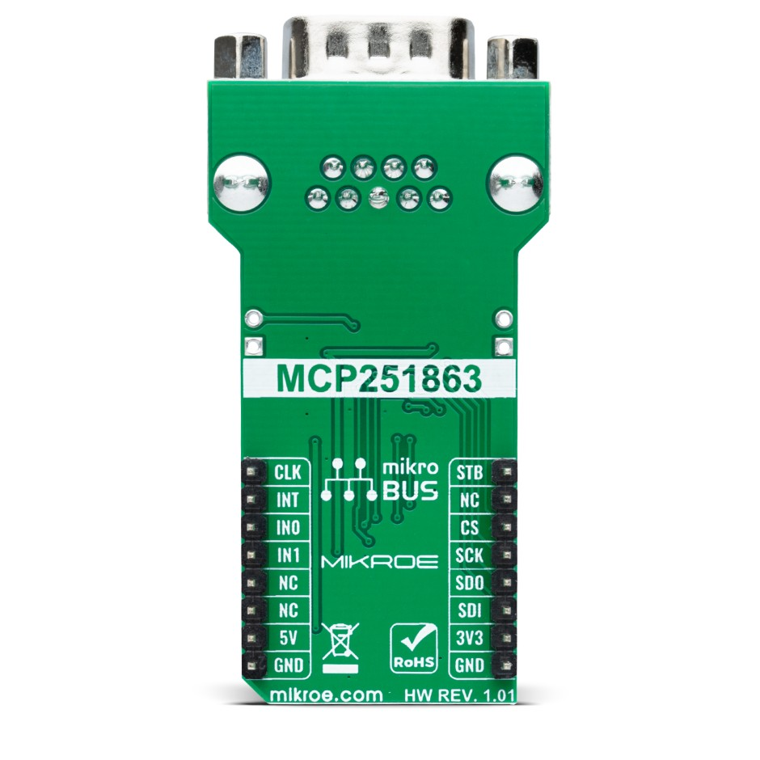
MCP251863 Connection Method #2:
Female-to-Male Jumper Wires (10)
Top Side
1
1
2
3
3
13
4
4
5
5
6
6
10
7
7
10
9
8
8
9
Bottom Side

Slide 6
WBZ451 Curiosity Development Board : RESET Button
RESET BUTTON

Slide 7
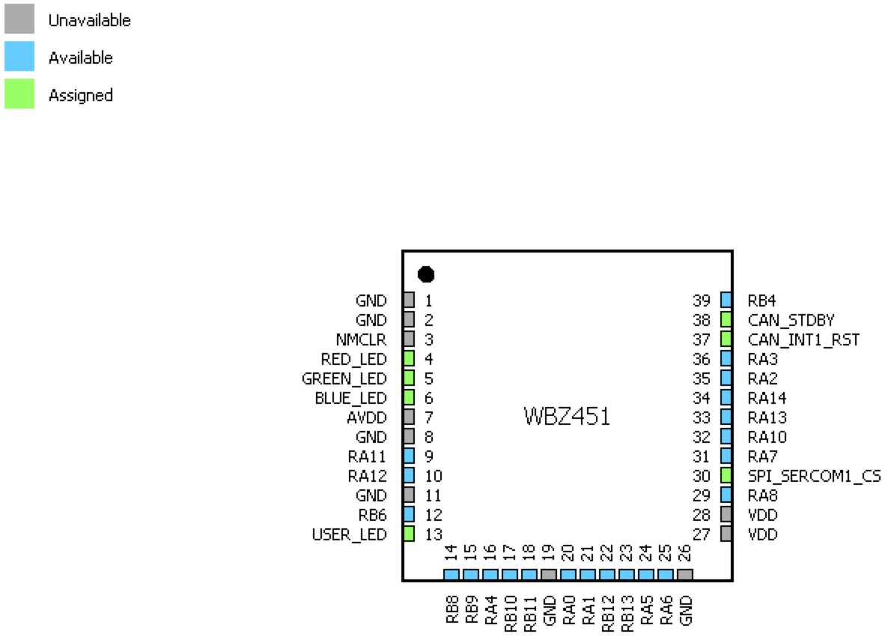
Module Pin Assignment

Slide 8
Software Development Tools
1. MPLAB X IDE
https://www.microchip.com/en-us/tools-resources/develop/mplab-x-ide#tabs
2. XC32 Compiler
https://www.microchip.com/en-us/tools-resources/develop/mplab-xc-compilers/xc32
3. Microchip Bluetooth Data (MBD) Smartphone App
https://play.google.com/store/apps/details?id=com.microchip.bluetooth.data&hl=en_US&pli=1

Slide 9
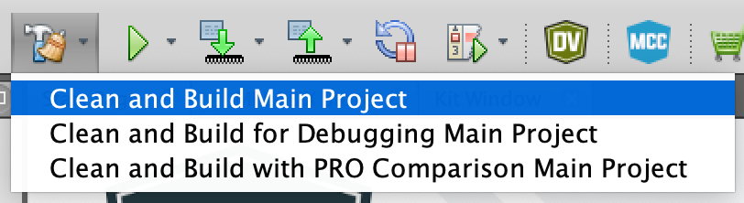
Demo Procedure
STEP 1: Launch the MPLAB X IDE
STEP 2: Open the Demo Project
From the MPLAB X main toolbar, select [File → Open Project]
Navigate to the location of the demo project folder:
pic32cxbz2_wbz45x_ble_can_bridge → 02_wbz451_mcp251863_CAN_BLE_Peripheral → firmware
Select (click on) the bleCan_Peripheral.X project folder
Click on the Open Project button
STEP 3: Clean and Build the Project
Click on the Clean and Build Main Project icon in the MPLAB X main toolbar
CLICK

Slide 10
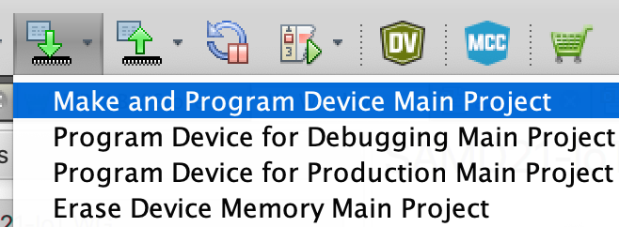
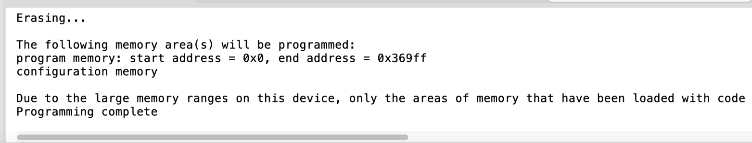
Demo Procedure
STEP 4: Program the WBZ451PE Module
a) Click on the Make and Program Device Main Project icon in the MPLAB X main toolbar
b) Verify that the programming phase was successful
STEP 5: Connect to the WBZ451 Module Using the Microchip Bluetooth Data (MBD) Application
Follow the procedure in the section titled “Connecting CAN Network to Mobile App (MBD App)”
https://github.com/MicrochipTech/pic32cxbz2_wbz45x_ble_can_bridge/tree/main?tab=readme-ov-file#connecting-can-network-to-mobile-app-mbd-app
CLICK
CLICK

Slide 11
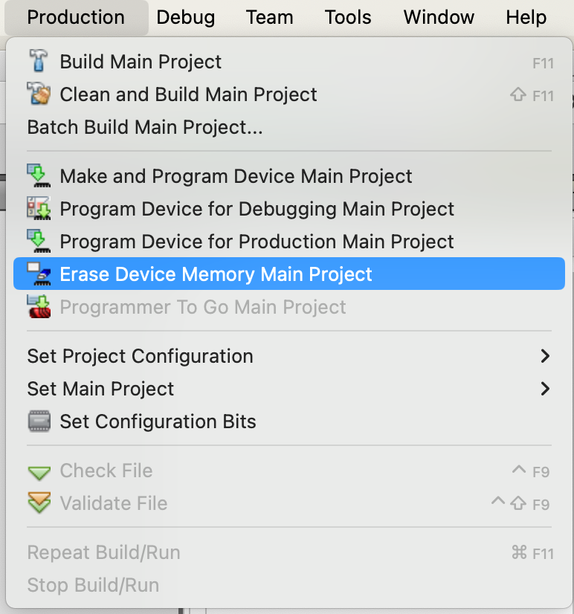
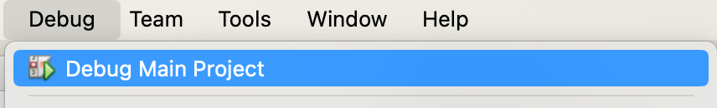
Launching the Debugger
STEP 1: Erase Device Memory Main Project
CLICK
STEP 2: Debug Main Project
CLICK

Slide 12
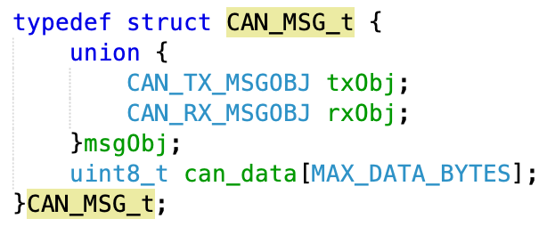
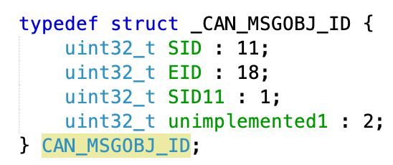
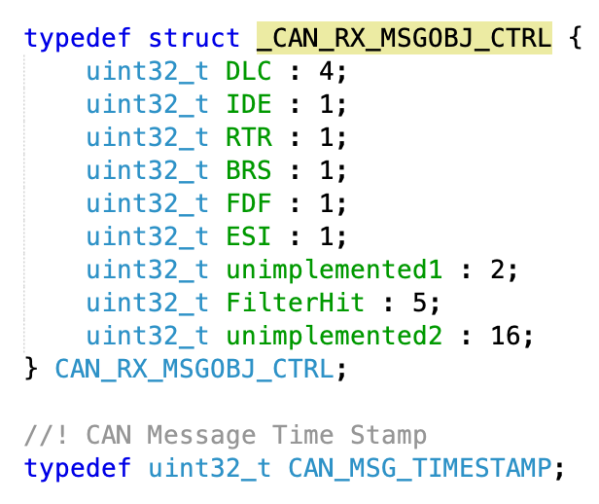
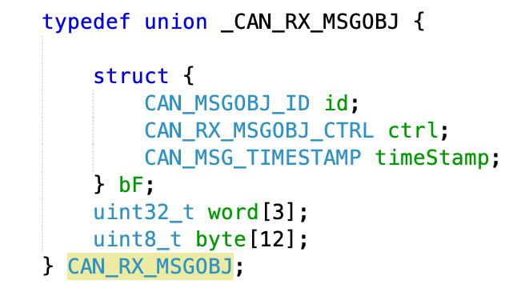
CAN RX Message Format
1
4
2
3

Slide 13
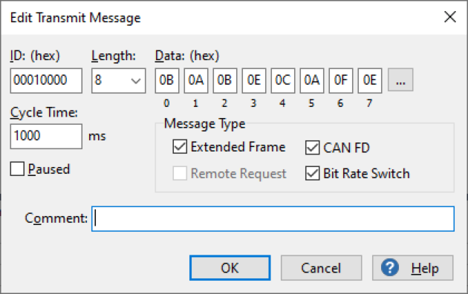
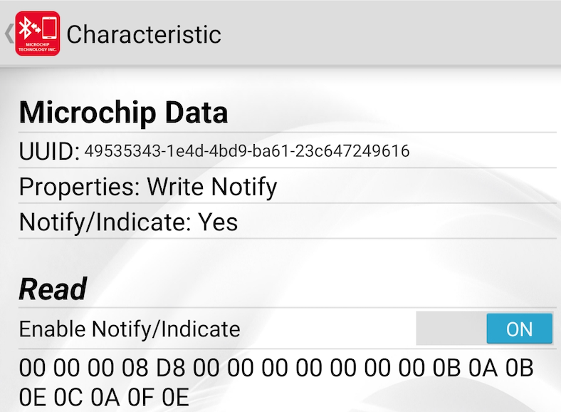
Example CAN RX Message
1
2
3
4

Slide 14
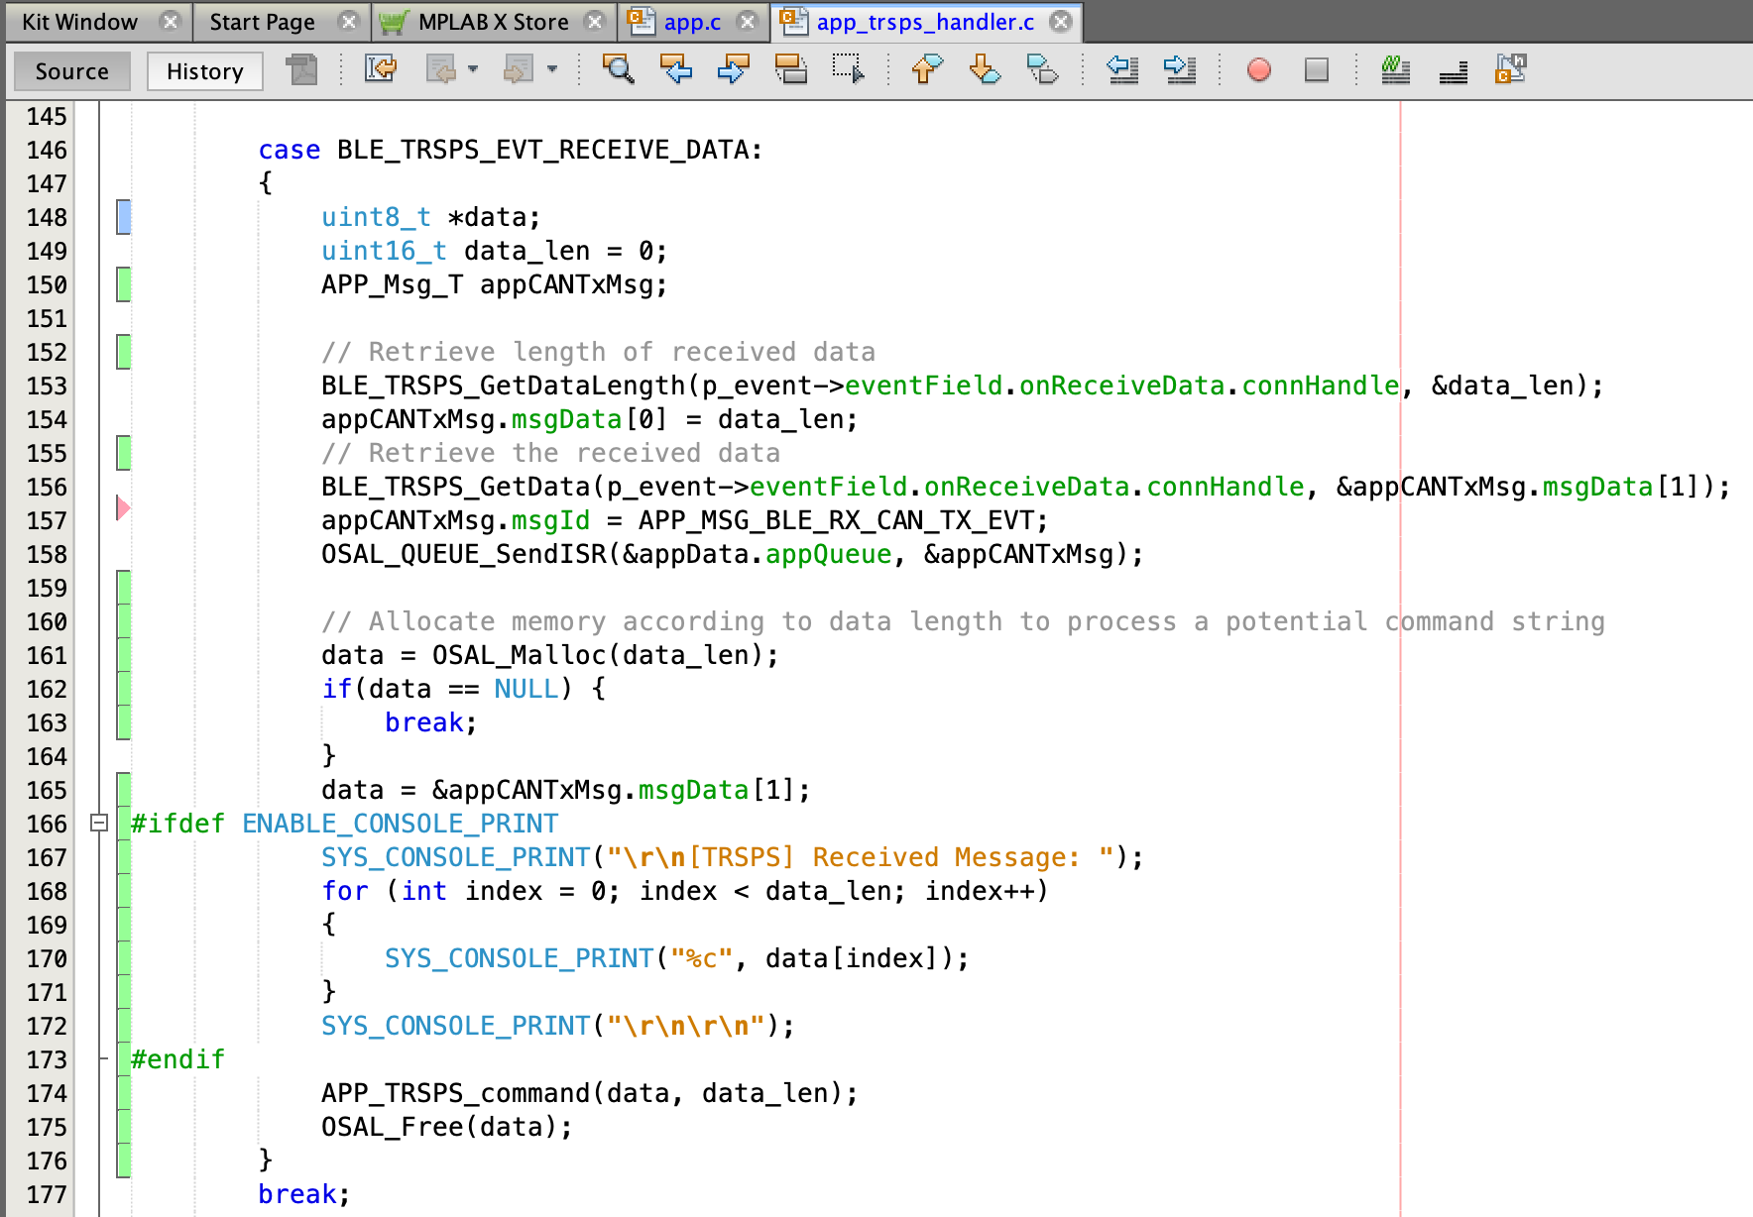
Transparent UART Service (TRSPS): RX Message

Slide 15
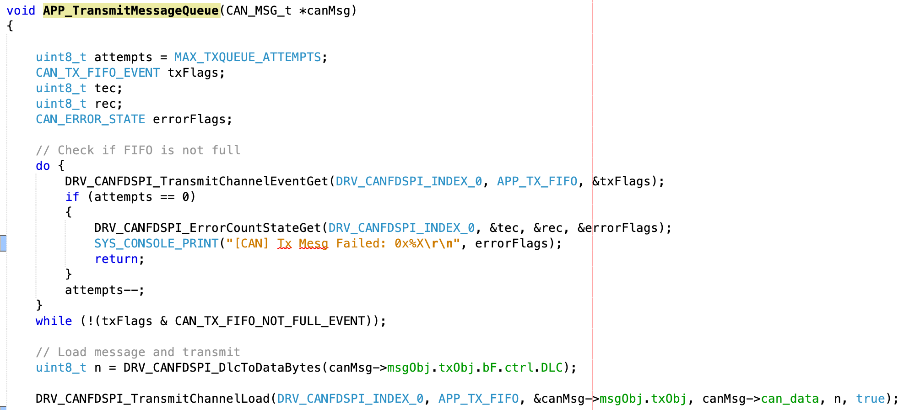
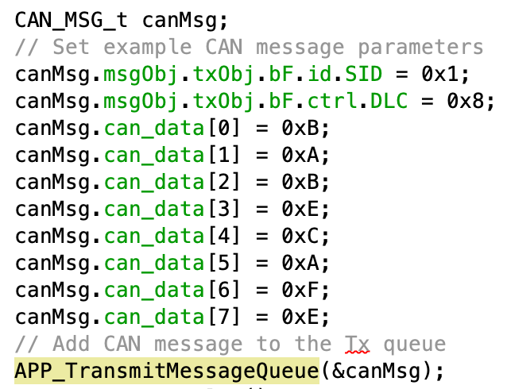
Transmitting CAN Messages (1)

Slide 16
Transmitting CAN Messages (2)

Slide 17
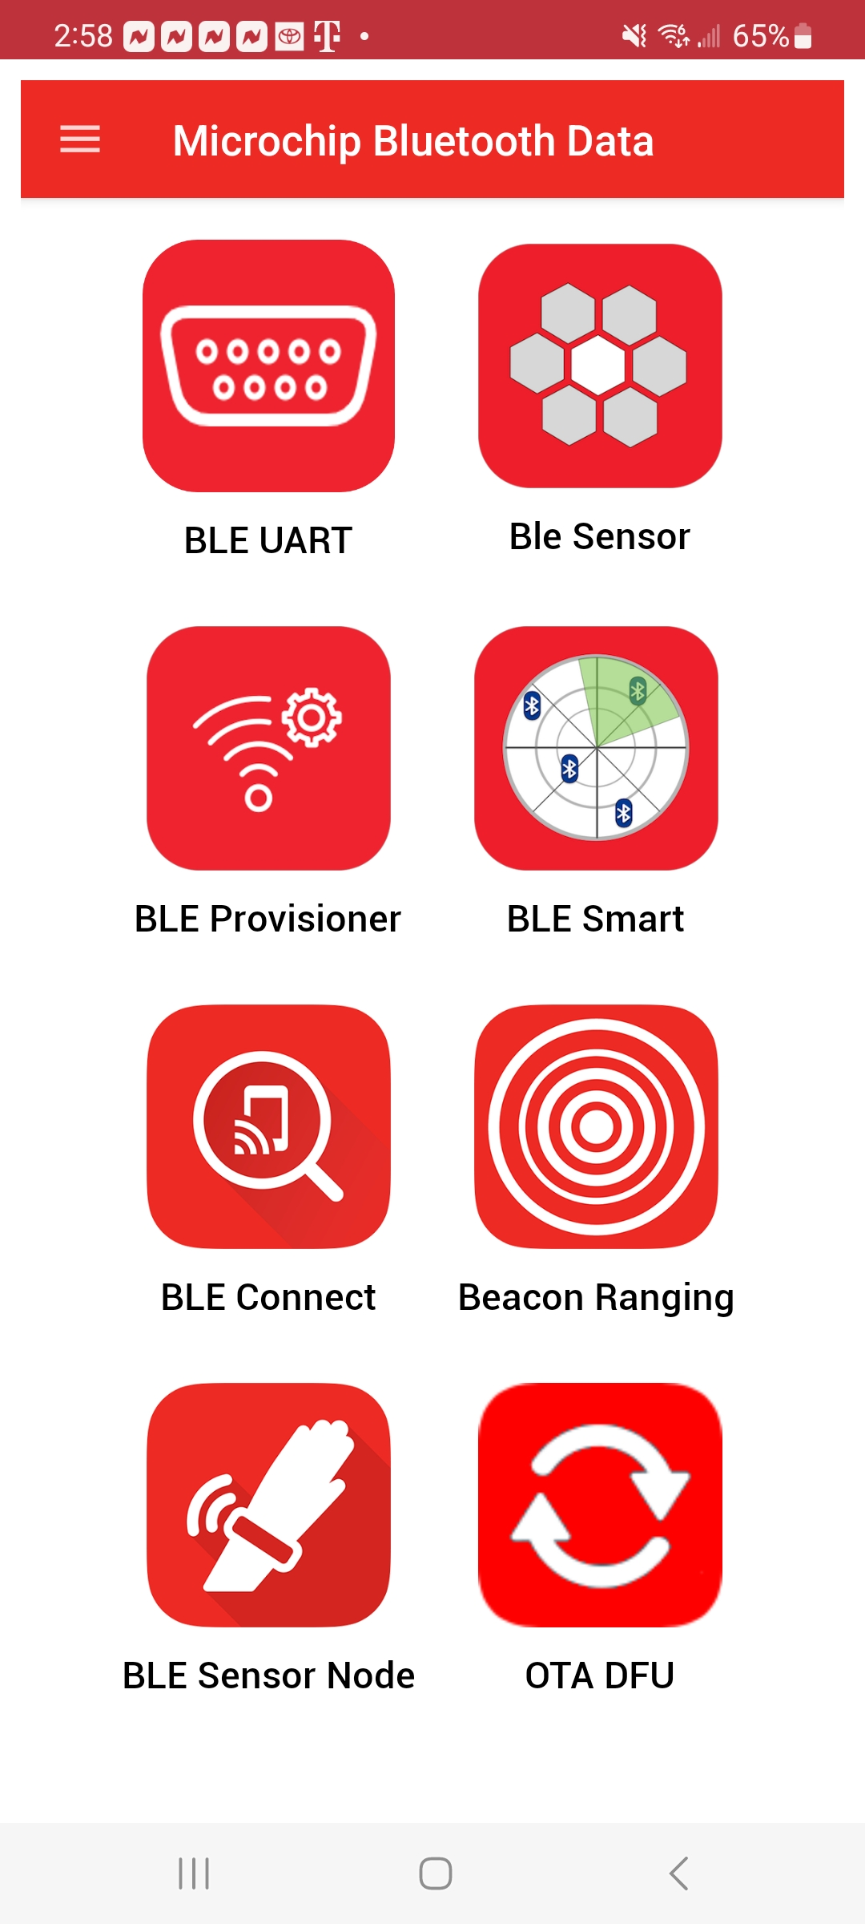
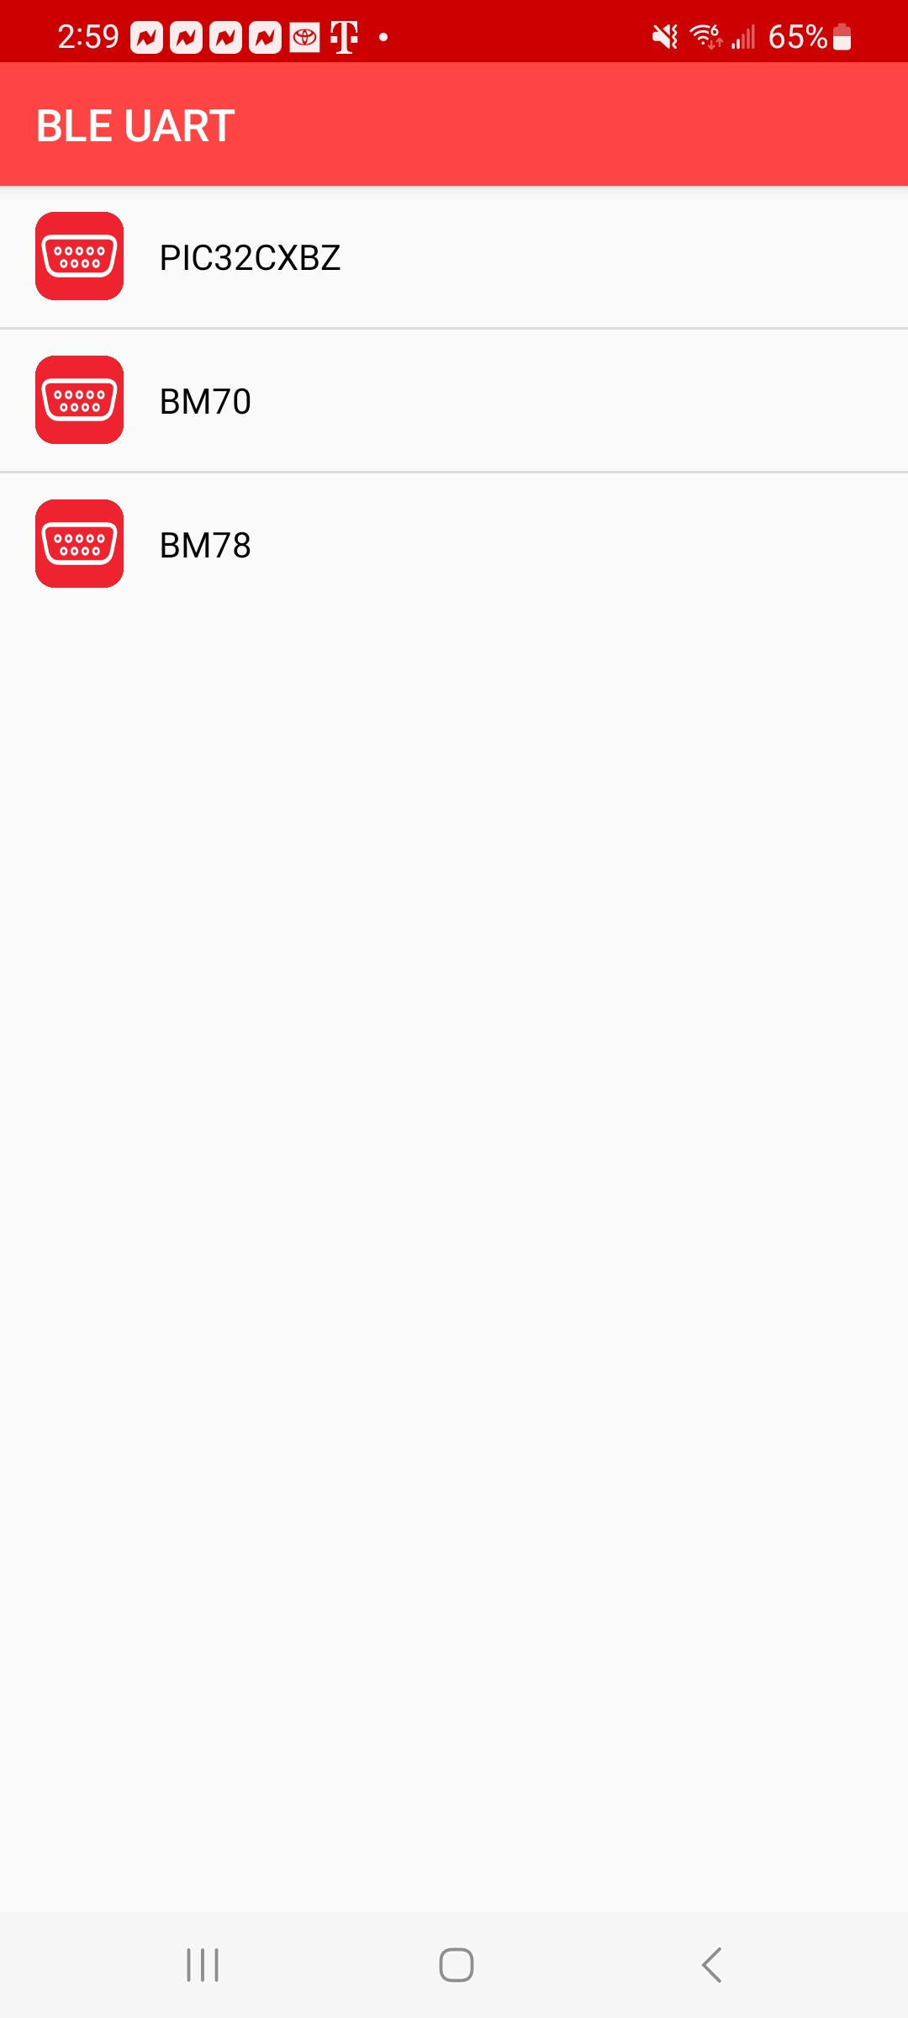
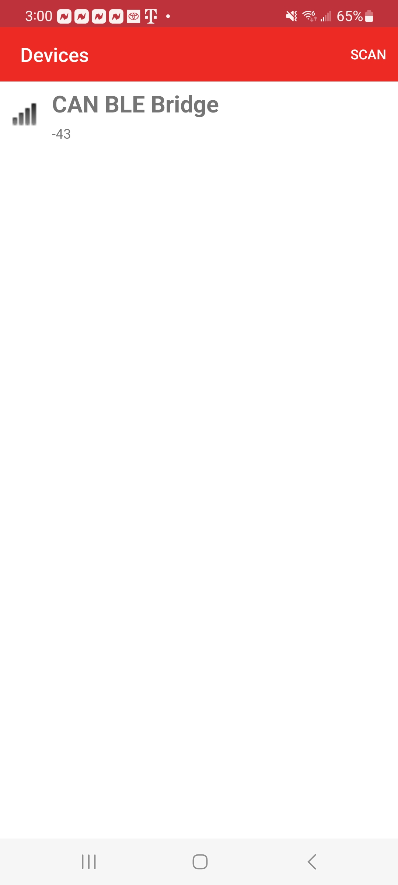

Slide 18
