Slide 1



TRAFFIC LIGHT SYSTEM
Team Noobcoder: Muhammad Amirul Hakimi bin Zaprunnizam Muhammad Farid Izwan Bin Mohamad Shabri Muhammad Amjad Bin Abdul Malik Muhammad Iqbal Bin Mohd Fauzi Stephen Patrick

Slide 2
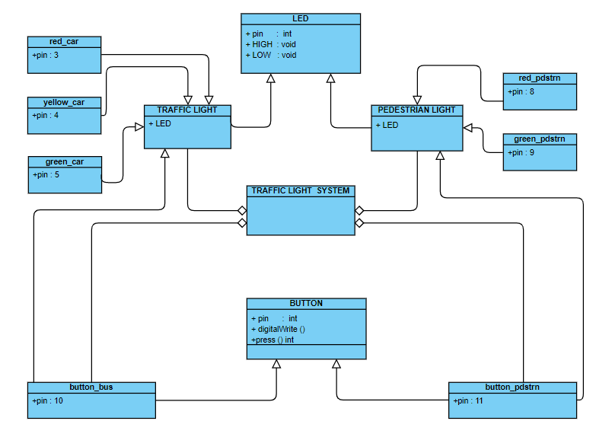
Class Diagram

Slide 3
STATE DIAGRAM
Car Move
Entry/green_car=on
Entry/red_pdstrn=on
Car Ready To Stop
pdstrn_button:&&
Delay(10000/)
bus_button=1
Entry/yellow_car=on
Entrty/yellow_car=off
Entry/green_car=on
Entry/red_pdstrn=on
Do/ delay(1000)
Delay(10000)
Car Stop
Exit/green_car=off
Entry/red_car=on
Entry/green_pdstrn=on
Delay(2000)
Bus button=1
Car Ready To Move
Bus Ready to move
Entry/yellow_car=on
Entry/red_pdstrn=on
Exit/yellow_car=off
Bus move
Entry/green_car=on
Do/delay(10000)
Delay(10000)
Entry/yellow_car=on
Exit/yellow_car=off
Bus Ready To Stop
Entry/yellow_car=on
Exit/yellow_car

Slide 4
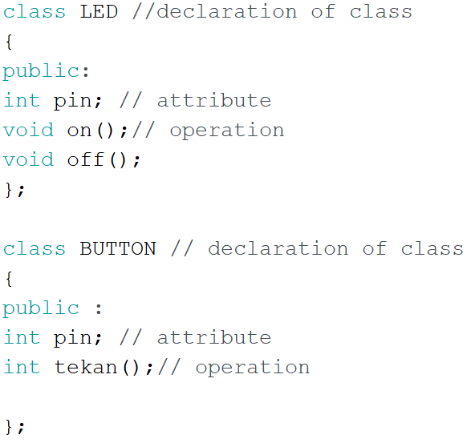
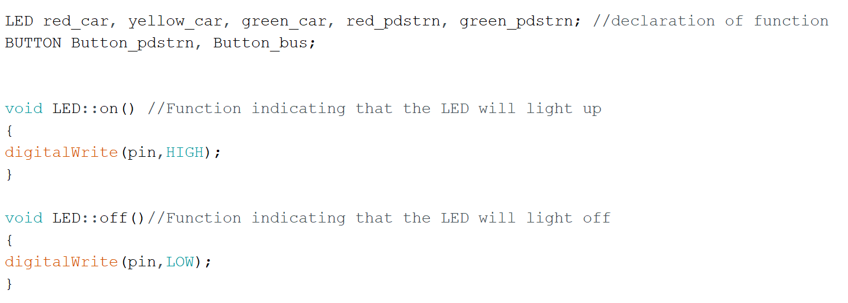
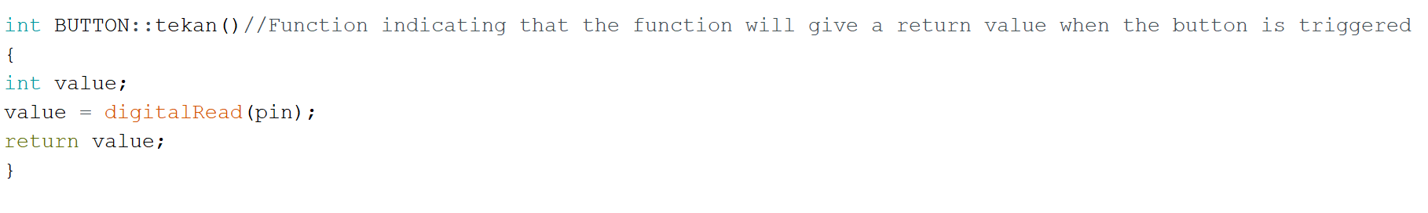
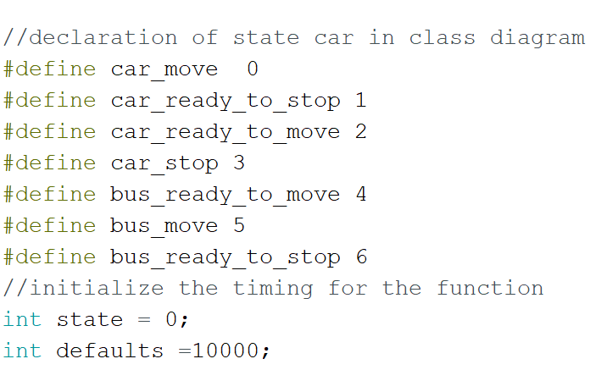
Coding

Slide 5
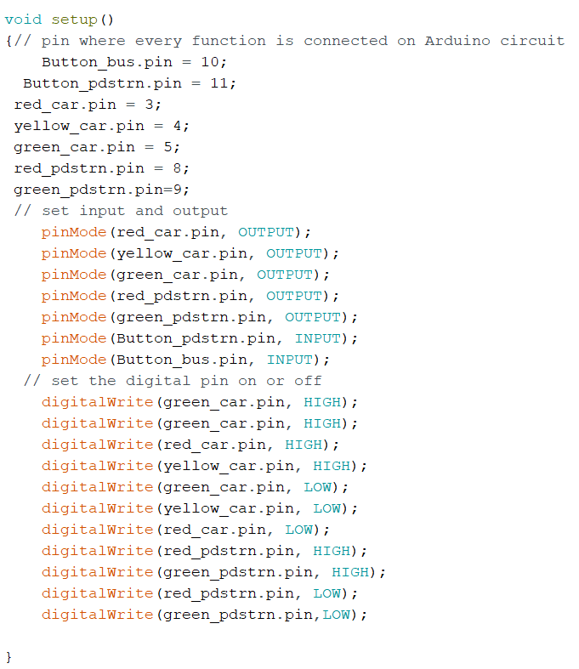
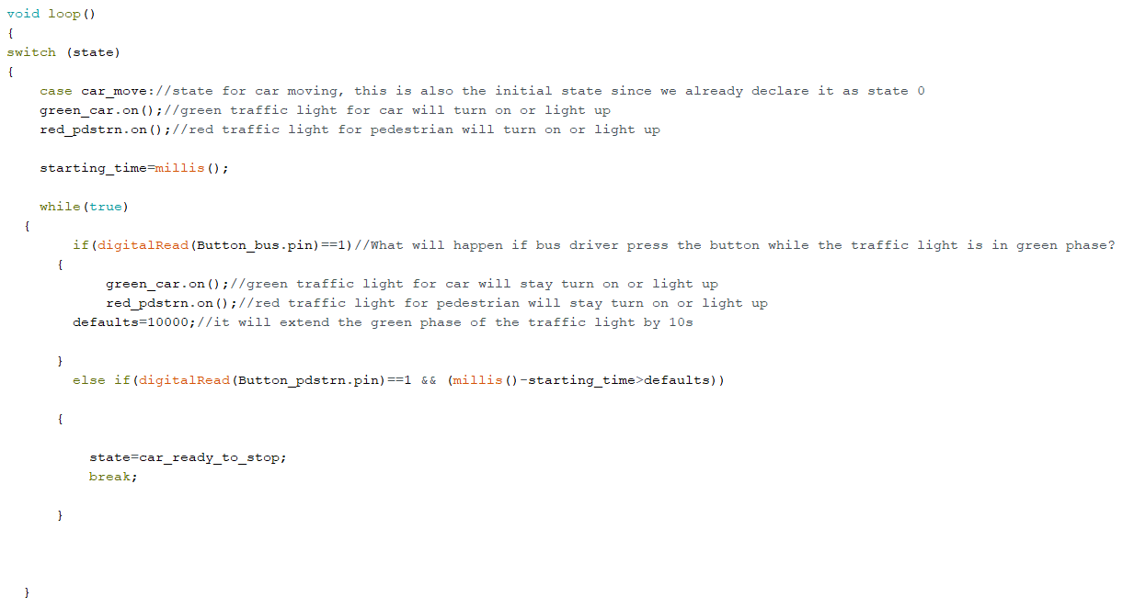
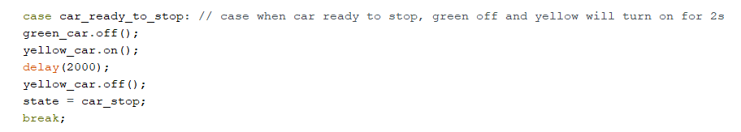
Coding

Slide 6
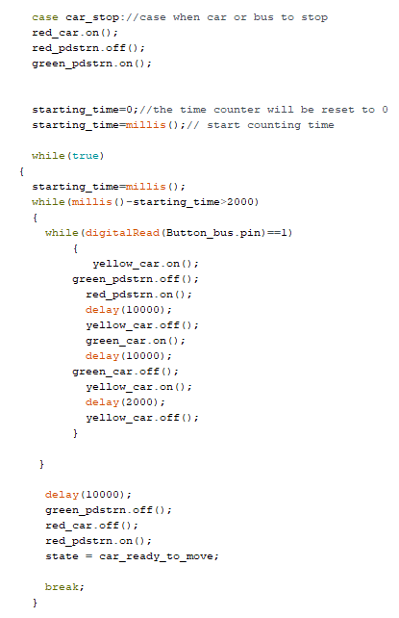
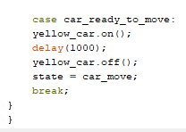
Coding

Slide 7
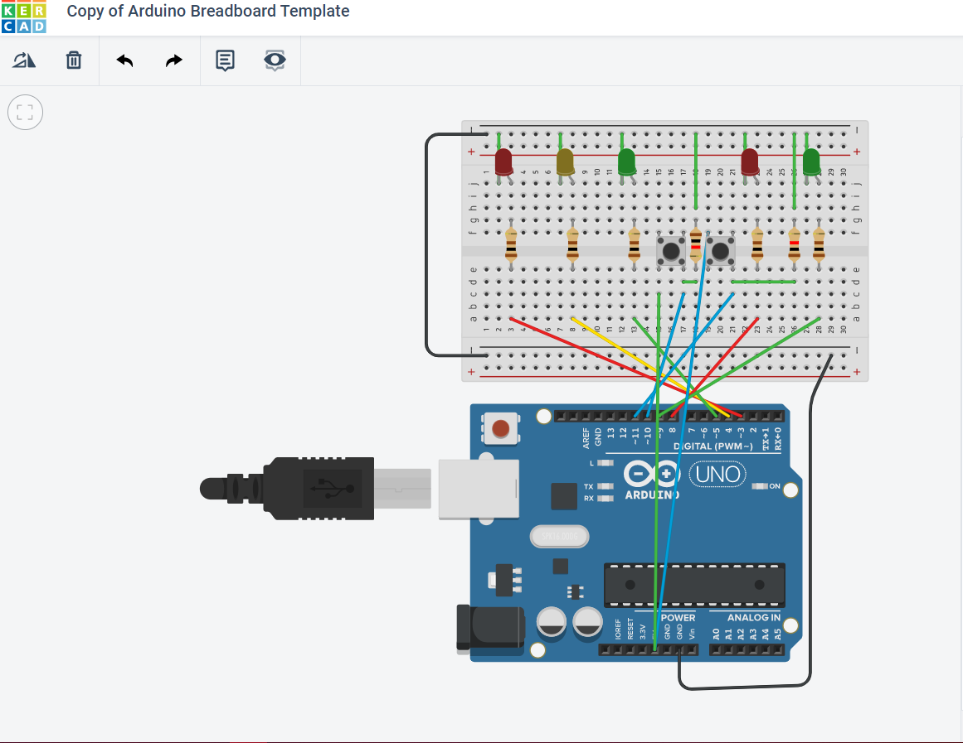
REAL VIEW OF CIRCUIT

Slide 8
THANK YOU

