Slide 1

Artificial Intelligence (AI)
Neural Networks

Slide 2
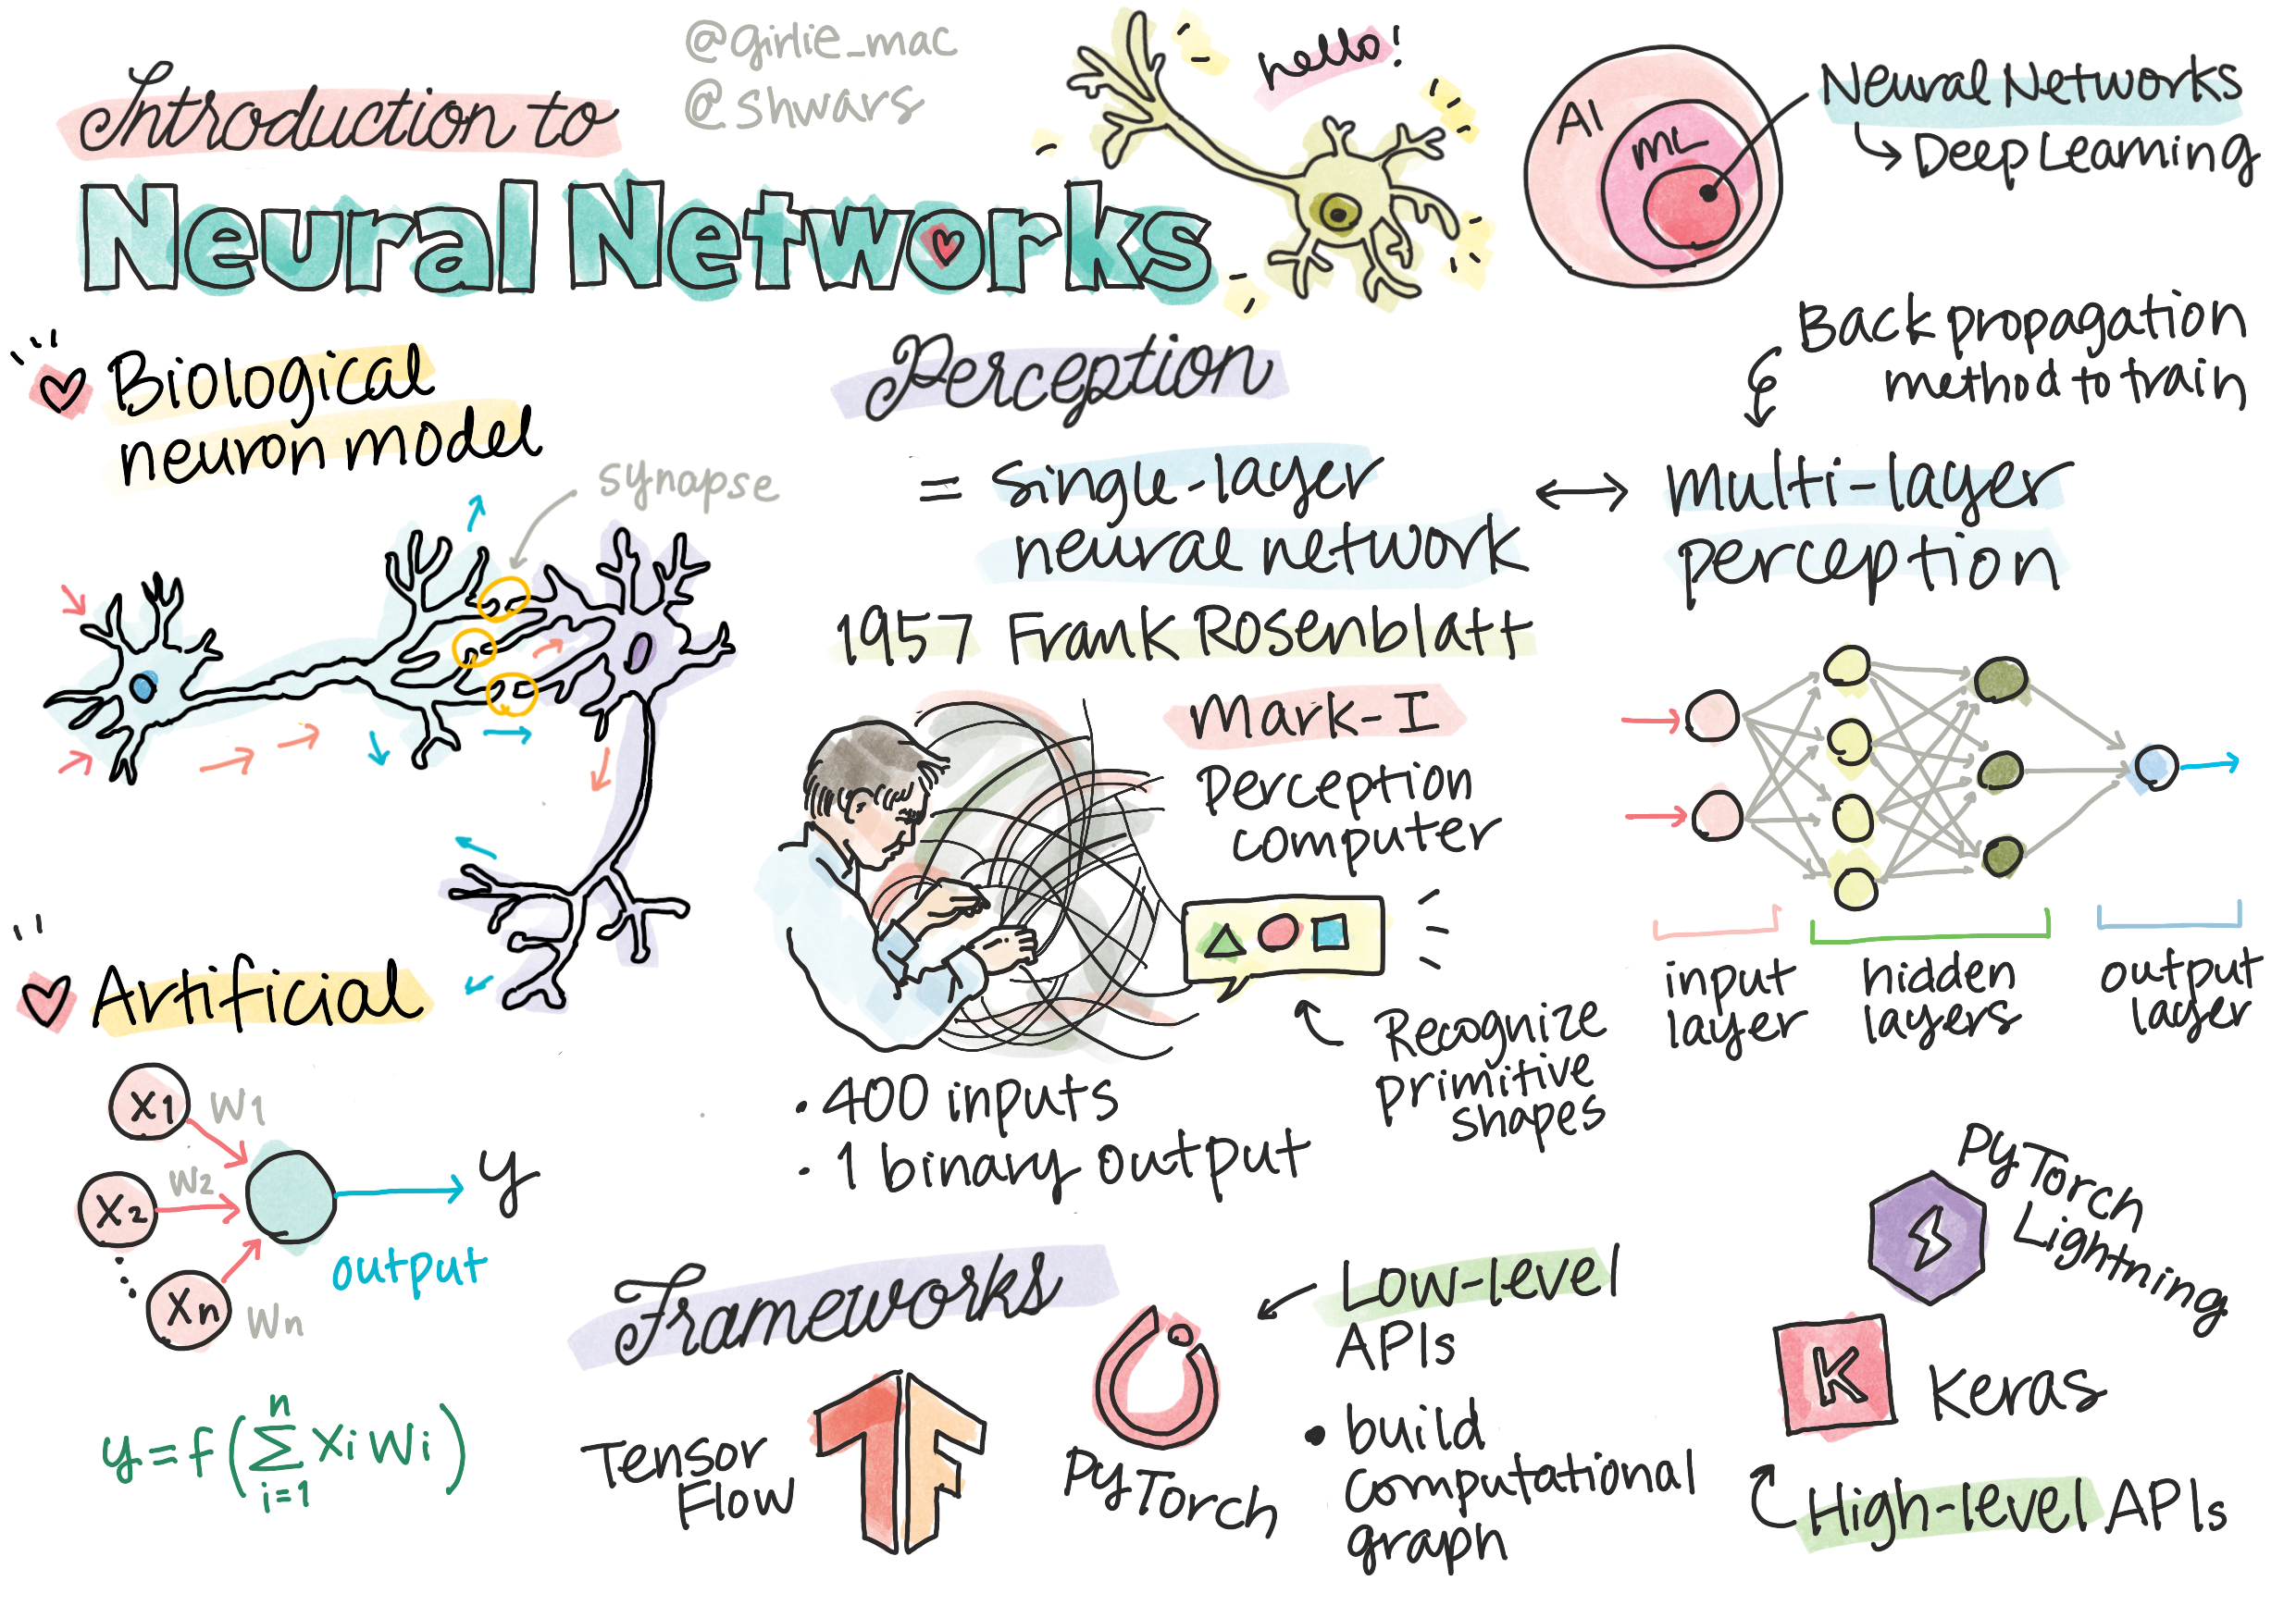
https://github.com/microsoft/AI-For-Beginners/blob/main/lessons/sketchnotes/ai-neuralnetworks.png

Slide 3

Achieving Intelligence in Computing
Training a computer model or an artificial brain is identified as a method to achieve intelligence
Historical Context:
  Since the mid-20th century, researchers have experimented with various mathematical models
Neural Networks:
  Mathematical models of the brain are referred to as neural networks
  Sometimes termed Artificial Neural Networks (ANNs) to distinguish them as models rather than actual neural networks

Slide 4
Machine Learning
A discipline aimed at training computer models to solve problems using data.
Data and Models:
Involves datasets of examples X and corresponding output values Y
Examples (X) are typically N-dimensional vectors of features. Outputs (Y) are known as labels
Common Machine Learning Problems:
Classification: Assigning an input object to one of two or more classes
Regression: Predicting a numerical value for each input sample

Slide 5
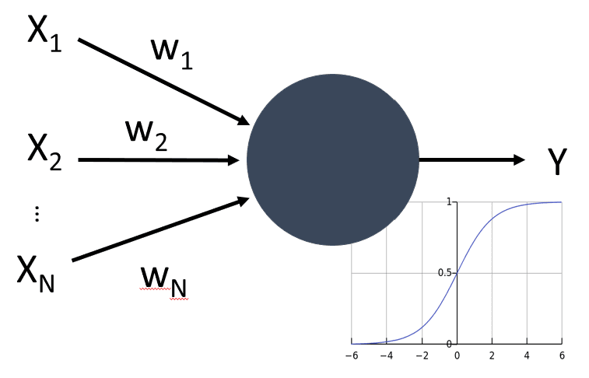
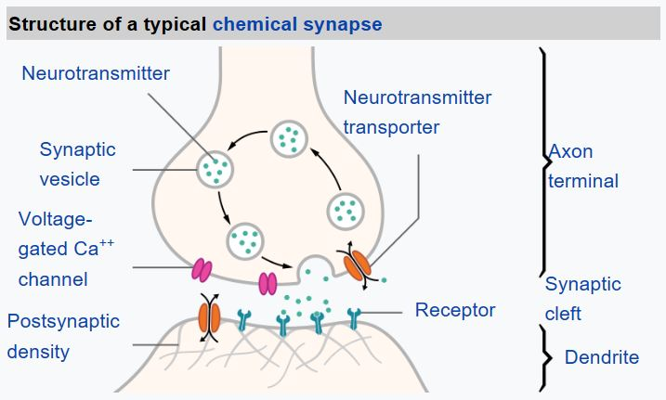
A Model of a Neuron
The human brain is composed of neural cells, each featuring multiple inputs (axons) and an output (dendrite)
Axons and dendrites conduct electrical signals, facilitating communication within the brain
The connections between axons and dendrites can have varying degrees of conductivity, which are regulated by substances called neuromediators
https://github.com/microsoft/AI-For-Beginners/blob/main/lessons/3-NeuralNetworks/images/artneuron.png
https://github.com/microsoftAI-For-Beginners/blob/main/lessons/3-NeuralNetworks/images/synapse-wikipedia.jpg

Slide 6

Mathematical Model of a Neuron
  Consists of several inputs X1​,…,XN​ and a single output Y, along with a series of weights W1​,…,WN​.
  The output Y is calculated using a formula that incorporates a non-linear activation function f, to simulate the neuron's response.
  This description highlights the basic structure of an artificial neuron, mirroring the functionality of biological neurons by using inputs, weights, and a non-linear activation to process signals.
6

Slide 7
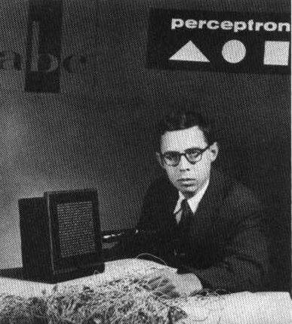
Perceptron
Early Neural Network Attempt by Frank Rosenblatt (1957)
  Initiative: Frank Rosenblatt from Cornell Aeronautical Laboratory pioneered one of the initial attempts to create a modern neural network
  Implementation: The project led to the creation of "Mark-1", a hardware-based system aimed at recognizing basic geometric shapes such as triangles, squares, and circles
https://github.com/microsoft/AI-For-Beginners/blob/main/lessons/3-NeuralNetworks/03-Perceptron/images/Rosenblatt-wikipedia.jpg

Slide 8
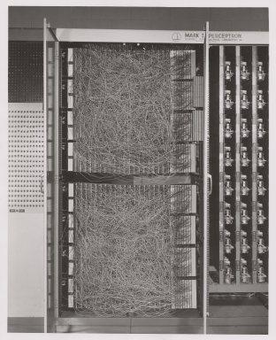
Perceptron (cont’d)
Design and Inputs:
  Utilized a 20x20 photocell array to represent input images, resulting in a neural network with 400 inputs
  The network was designed with a singular neuron, also referred to as a threshold logic unit, highlighting its simplicity
Output Mechanism: The system was capable of producing one binary output, signifying the recognition process's result
Adjustment and Training:
  Neural network weights functioned similarly to potentiometers, which are devices used to adjust a circuit's resistance manually
  These weights required manual tuning during the network's training phase, indicating a hands-on approach to learning and adjustment
https://github.com/microsoft/AI-For-Beginners/blob/main/lessons/3-NeuralNetworks/03-Perceptron/images/Mark_I_perceptron_wikipedia.jpg

Slide 9
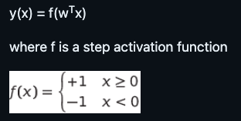
Perceptron Model
Suppose we have N features in our model, in which case the input vector would be a vector of size N
  A perceptron is a binary classification model, i.e. it can distinguish between two classes of input data
  We will assume that for each input vector x the output of our perceptron would be either +1 or -1, depending on the class
  The output will be computed using the formula:

Slide 10

Training the Perceptron
To train a perceptron we need to find a weights vector w that classifies most of the values correctly
  i.e. results in the smallest error
  This error is defined by perceptron criterion in the following manner:
  where:
    the sum is taken on those training data points i that result in the wrong classification
    xi is the input data, and ti is either -1 or +1 for negative and positive examples accordingly
10

Slide 11


Training the Perceptron (cont’d)
This criteria is considered as a function of weights w, and we need to minimize it
  Often, a method called gradient descent is used
    in which we start with some initial weights w(0), and then at each step update the weights according to the formula:
  Here η is the so-called learning rate, and ∇E(w) denotes the gradient of E
    After we calculate the gradient, we end up with

Slide 12
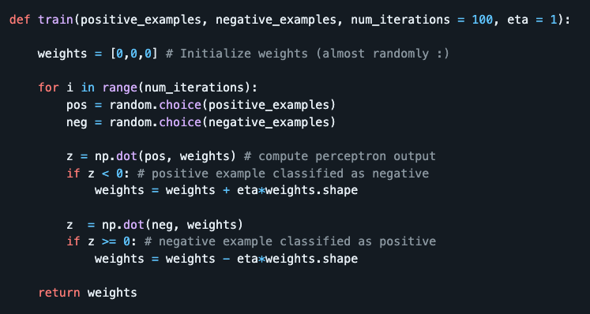
Python code

Slide 13
Exercise:
Multi-Class Classification with Perceptron
Task
Using the code for binary classification of MNIST handwritten digits, create a multi-class classified that would be able to recognize any digit
Compute the classification accuracy on the train and test dataset, and print out the confusion matrix
Hints
For each digit, create a dataset for binary classifier of "this digit vs. all other digits"
Train 10 different perceptrons for binary classification (one for each digit)
Define a function that will classify an input digit
If we combine weights of all 10 perceptrons into one matrix, we should be able to apply all 10 perceptrons to the input digits by one matrix multiplication
Most probable digit can then be found just by applying argmax operation on the output
https://github.com/microsoft/AI-For-Beginners/blob/main/lessons/3-NeuralNetworks/03-Perceptron/lab/PerceptronMultiClass.ipynb

Slide 14
Multi-Layered Perceptron
One-layered perceptron:
the simplest neural network model
a linear two-class classification model
We will extend this model into a more flexible framework, allowing us to:
perform multi-class classification in addition to two-class
solve regression problems in addition to classification
separate classes that are not linearly separable

Slide 15
Formalization of Machine Learning
Suppose we have a training dataset X with labels Y, and we need to build a model f that will make most accurate predictions
  The quality of predictions is measured by Loss function ℒ
  The following loss functions are often used:
    For regression problem, when we need to predict a number, we can use absolute error ∑_{i}|f(x^{(i)})-y^{(i)}|, or squared error ∑_{i}(f(x^{(i)})-y^{(i)})²
    For classification, we use 0-1 loss (which is essentially the same as accuracy of the model), or logistic loss

Slide 16
Formalization of Machine Learning (cont’d)
For one-level perceptron, function f was defined as a linear function f(x)=wx+b (here w is the weight matrix, x is the vector of input features, and b is bias vector)
For different neural network architectures, this function can take more complex form
In the case of classification, it is often desirable to get probabilities of corresponding classes as network output
To convert arbitrary numbers to probabilities (e.g., to normalize the output), we often use softmax function σ, and the function f becomes f(x)=σ(wx+b)
In the definition of f above, w and b are called parameters θ=⟨w,b⟩. Given the dataset ⟨X,Y⟩, we can compute an overall error on the whole dataset as a function of parameters θ
The goal of neural network training is to minimize the error by varying parameters θ

Slide 17
Gradient Descent Optimization
There is a well-known method of function optimization called gradient descent
  The idea is to compute a derivative (in multi-dimensional case call gradient) of loss function with respect to parameters, and vary parameters in such a way that the error would decrease
  This can be formalized as follows:
    Initialize parameters by some random values w⁽⁰⁾, b⁽⁰⁾
    Repeat the following step many times:
  w^{(i+1)} = w^{(i)}-η∂ℒ/∂w
  b^{(i+1)} = b^{(i)}-η∂ℒ/∂b

Slide 18
Gradient Descent Optimization (cont’d)
Optimization Steps in Training
Typically, optimization involves considering the entire dataset to calculate steps
Loss is computed as a sum across all training samples
Practical Approach: Minibatches
In practice, we use small portions of the dataset, known as minibatches, for calculation
Gradients are calculated based on these subsets of data
Stochastic Gradient Descent (SGD)
The method of using randomly selected subsets for gradient calculation is termed Stochastic Gradient Descent (SGD)
The randomness in minibatch selection is a key feature of SGD

Slide 19
Multi-Layered Perceptrons and Backpropagation
One-layer network is capable of classifying linearly separable classes
To build a richer model, we can combine several layers of the network
Mathematically it would mean that the function f would have a more complex form, and will be computed in several steps:
z₁=w₁x+b₁
z₂=w₂α(z₁)+b₂
f = σ(z₂)
α is a non-linear activation function, σ is a softmax function, and parameters
θ=<w₁,b₁,w₂,b₂>.

Slide 20
Multi-Layered Perceptrons and Backpropagation (cont’d)
The gradient descent algorithm would remain the same, but it would be more difficult to calculate gradients
  Given the chain differentiation rule, we can calculate derivatives as:
    ∂ℒ/∂w₂ = (∂ℒ/∂σ)(∂σ/∂z₂)(∂z₂/∂w₂)
    ∂ℒ/∂w₁ = (∂ℒ/∂σ)(∂σ/∂z₂)(∂z₂/∂α)(∂α/∂z₁)(∂z₁/∂w₁)
    Note that the left-most part of all those expressions is the same, and thus we can effectively calculate derivatives starting from the loss function and going "backwards" through the computational graph
    Thus the method of training a multi-layered perceptron is called backpropagation, or 'backprop'

Slide 21
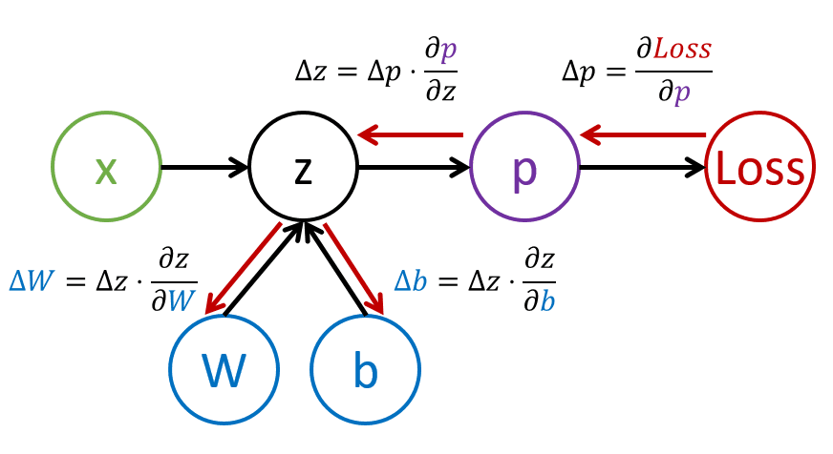

Slide 22

Implement a framework for building and training multi-layered perceptrons
Goal: Understand in detail how modern neural networks operate

Slide 23

Exercise:
MNIST Classification

Slide 24

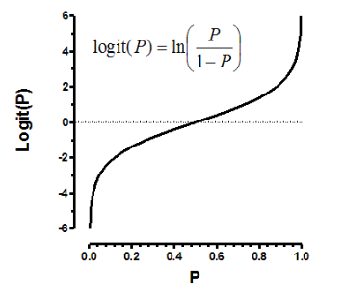
Neural Network Frameworks
To train neural networks efficiently we need to do two things:
  To operate on tensors, e.g., to multiply, add, and compute some functions such as sigmoid or softmax
  To compute gradients of all expressions, in order to perform gradient descent optimization
    시그모이드 함수는 S자형 곡선 또는 시그모이드 곡선을 갖는 수학 함수인데 예시로는 로지스틱 함수가 있음
    Tensor: https://deepai.org/machine-learning-glossary-and-terms/tensor
    Softmax: Softmax(소프트맥스)는 입력받은 값을 출력으로 0~1사이의 값으로 모두 정규화하며 출력 값들의 총합은 항상 1이 되는 특성을 가진 함수이고 분류하고 싶은 클래수의 수 만큼 출력으로 구성하는데 장 큰 출력 값을 부여받은 클래스가 확률이 가장 높은 것으로 이용

Slide 25
gradient descent
gradient descent 방법은 steepest descent 방법이라고도 불리는데, 함수 값이 낮아지는 방향으로 독립 변수 값을 변형시켜가면서 최종적으로는 최소 함수 값을 갖도록 하는 독립 변수 값을 찾는 방법
https://angeloyeo.github.io/2020/08/16/gradient_descent.html#google_vignette

Slide 26
Gradient Computation in Neural Networks
While libraries like NumPy can handle basic numerical operations, computing gradients requires additional mechanisms
Initially, derivatives for backpropagation must be manually coded within the framework's backward method
An ideal framework would automate gradient computation, allowing for gradients of any defined expression to be calculated efficiently

Slide 27

Computational Requirements for Deep Learning
Deep neural network training is computationally intensive
It's crucial to utilize specialized compute units like GPUs or TPUs to handle the computational load
Parallelization, or distributing computations across multiple devices, significantly enhances training efficiency and speed

Slide 28

Framework Features for Effective Training
Automatic gradient computation to simplify model development and enable complex model experimentation.
Support for computational parallelization on GPUs/TPUs to meet the high computational demands of deep learning.

Slide 29

Popular Neural Network Frameworks
Low-level API
  TensorFlow, Pytorch
High-level API
  Keras, Pytorch Lightning

Slide 30
Low-level API Features
Allows operation with tensors on both CPU and GPU
Enables building computational graphs that define the computations necessary for output (typically loss functions) based on input parameters
Supports differentiation of computational graphs to compute gradients for model parameter optimization
Foundational for custom and innovative neural network architectures, particularly useful in research

Slide 31
High-level API Utilities
TensorFlow's high-level API is known as Keras, while PyTorch's equivalent is PyTorch Lightning
Simplifies neural network construction as a sequence of layers, facilitating the development of common network architectures
Streamlines the training process through data preparation and a simple fit function for training
Ideal for quick development and deployment of typical neural networks without deep customization

Slide 32
Combining Low-level and High-level APIs
Both APIs are designed to be interoperable, allowing developers to leverage the strengths of each
Custom layer architecture can be developed using the low-level API and integrated into larger networks built with the high-level API
Networks defined with the high-level API can be optimized using custom training loops from the low-level API
This flexibility supports both rapid prototyping and detailed, research-oriented network design

Slide 33
Exercise: Framework
Pytorch

Slide 34
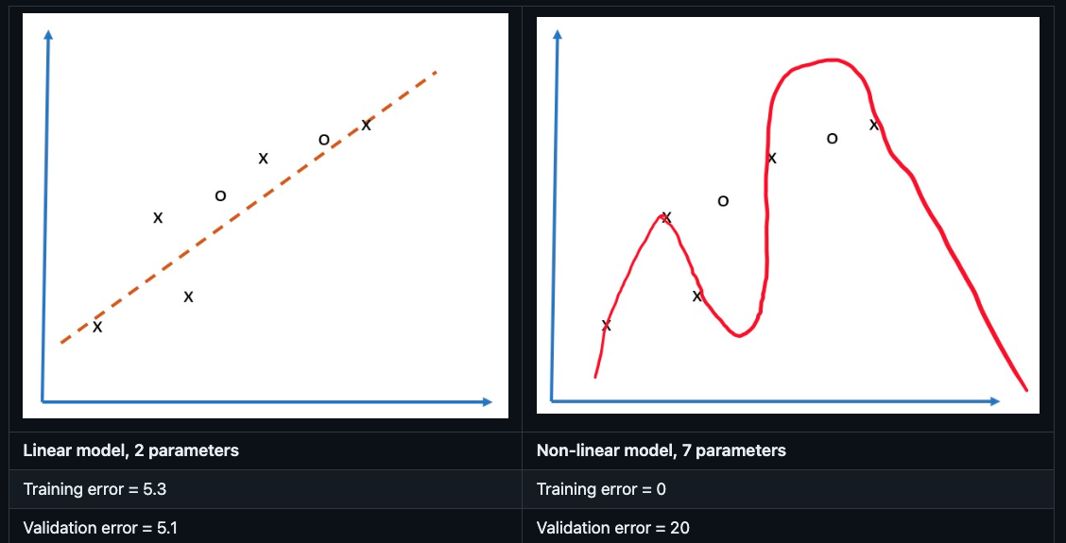
Overfitting
Consider the following problem of approximating 5 dots (represented by x on the graphs below):
  On the left, we see a good straight line approximation
    Because the number of parameters is adequate, the model gets the idea behind point distribution right
  On the right, the model is too powerful
    Because we only have 5 points and the model has 7 parameters, it can adjust in such a way as to pass through all points, making training the error to be 0
    However, this prevents the model from understanding the correct pattern behind data, thus the validation error is very high
  It is very important to strike a correct balance between the richness of the model (number of parameters) and the number of training samples.

Slide 35
Why overfitting occurs
Not enough training data
Too powerful model
Too much noise in input data

Slide 36
How to detect overfitting
Overfitting is indicated by a significant discrepancy between training and validation errors: very low training error alongside high validation error
Training and Validation Error Trends
Initially, both training and validation errors decrease as the model learns from the data
A key sign of overfitting occurs when the validation error ceases to decrease and begins to increase, despite continued reductions in training error
Strategies to Combat Overfitting
Early Stopping: Cease training when the validation error starts to rise, indicating the model is beginning to overfit to the training data
Model Snapshot: Taking a snapshot of the model at the point before the validation error rises can be useful for retaining a version of the model that has generalized well to unseen data

Slide 37
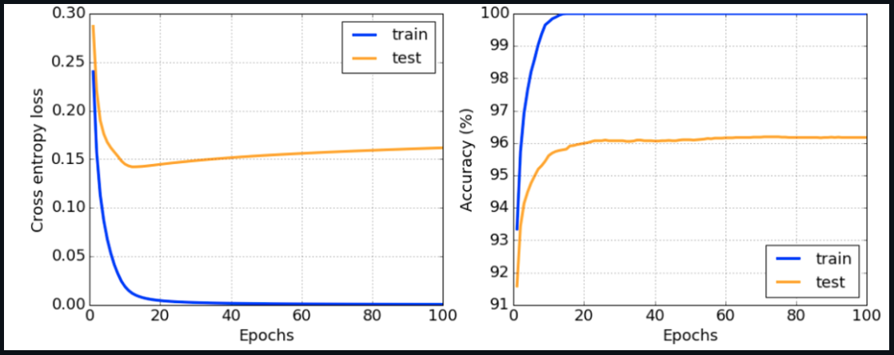

Slide 38

How to prevent overfitting
If you see that overfitting occurs, you can do one of the following:
  Increase the amount of training data
  Decrease the complexity of the model
  Use some regularization technique, such as Dropout

Slide 39
Understanding Overfitting in the Context of Bias-Variance Tradeoff
Overfitting is a manifestation of the bias-variance tradeoff, a fundamental concept in statistics and machine learning
Types of Errors
Bias Errors: Occur when the model is too simple to capture the underlying relationships in the training data, leading to underfitting
Variance Errors: Arise when the model is too complex, capturing noise as if it were a significant pattern, thus leading to overfitting

Slide 40
Error Dynamics During Training
As training progresses, bias error tends to decrease because the model increasingly learns to approximate the true relationship within the data
Conversely, variance error increases as the model begins to fit not just the signal but also the noise in the data
Strategies to Address Overfitting
Manual Intervention: Stop training when signs of overfitting, such as an increase in validation error, are detected
Automatic Mechanisms: Implement regularization techniques to automatically limit the complexity of the model, helping to balance bias and variance, and prevent overfitting

