Slide 1
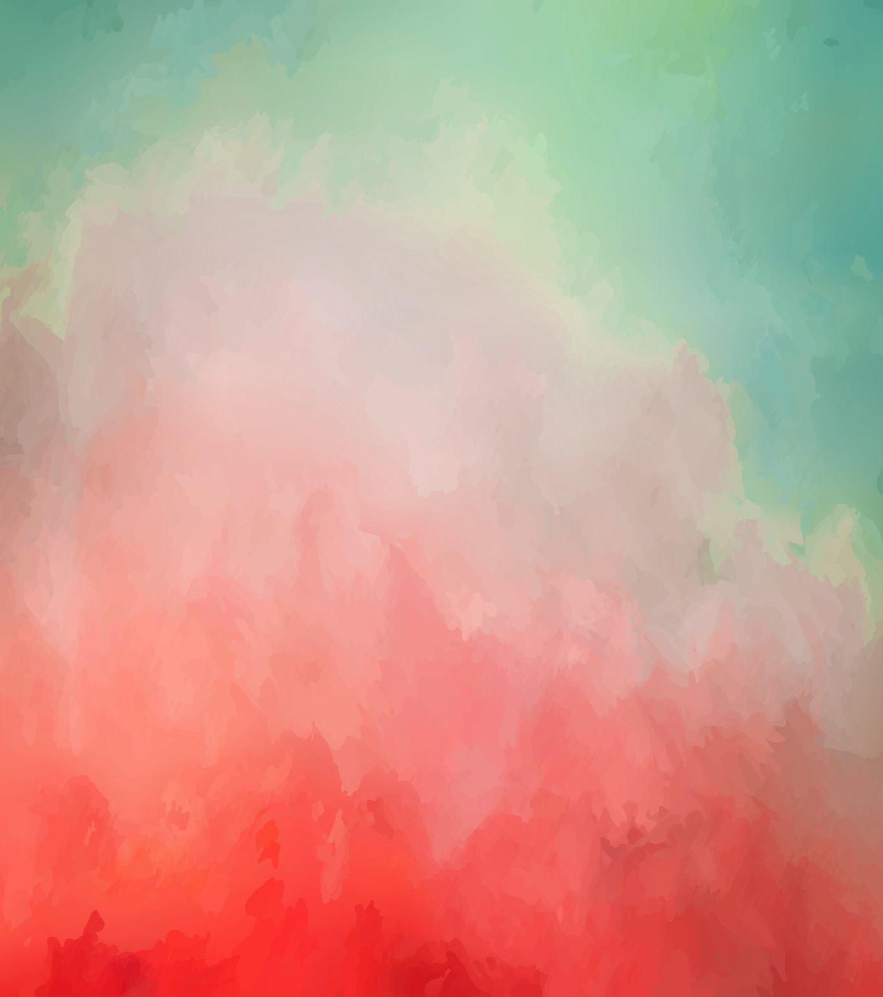
Computer Vision
Foundation of AI

Slide 2
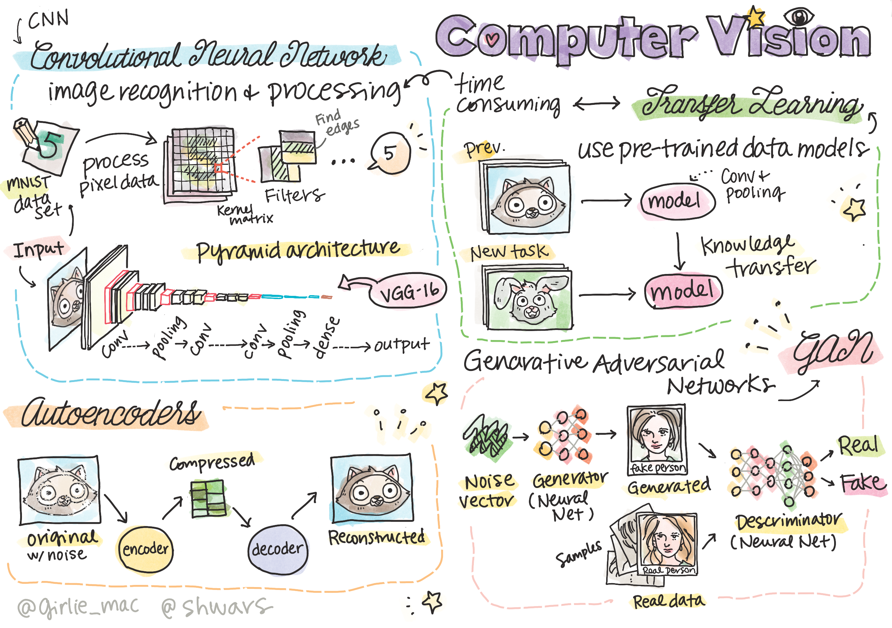

Slide 3

Definition
Computer Vision is a discipline whose aim is to allow computers to gain high-level understanding of digital images
  Understanding can mean many different things, including finding an object on a picture (object detection), understanding what is happening (event detection), describing a picture in text, or reconstructing a scene in 3D
  There are also special tasks related to human images: age and emotion estimation, face detection and identification, and 3D pose estimation

Slide 4

One of the simplest tasks of computer vision is image classification
Computer vision is often considered to be a branch of AI
Nowadays, most of computer vision tasks are solved using neural networks
We will learn more about the special type of neural networks used for computer vision, i.e. convolutional neural networks

Slide 5
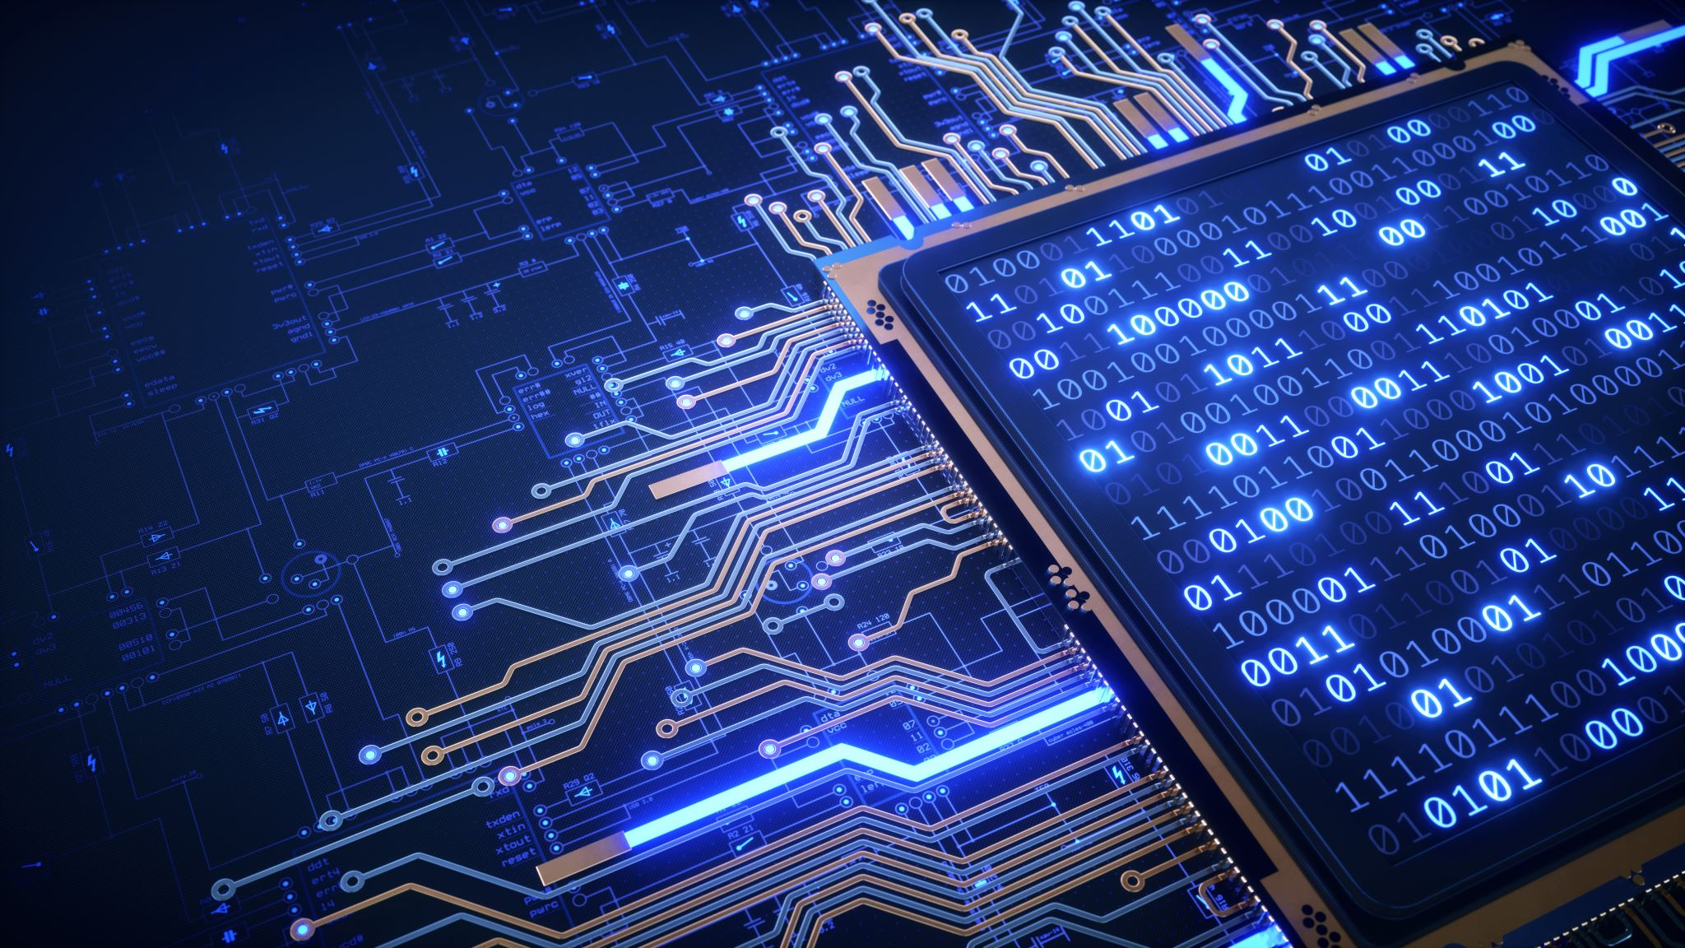
It makes sense to use some algorithmic techniques to enhance the image first
Python libraries available for image processing:
  imageio can be used for reading/writing different image formats. It also support ffmpeg, a useful tool to convert video frames to images
  Pillow (also known as PIL) supports some image manipulation such as morphing, palette adjustments
  OpenCV is an image processing library written in C++, which has become the de facto standard for image processing. It has a convenient Python interface
  dlib is a C++ library that implements many machine learning algorithms, including some of the Computer Vision algorithms. It also has a Python interface, and can be used for tasks such as face and facial landmark detection

Slide 6
OpenCV
Loading images
  Images in Python can be conveniently represented by NumPy arrays
  For example, grayscale images with the size of 320x200 pixels would be stored in a 200x320 array, and color images of the same dimension would have shape of 200x320x3 (for 3 color channels)
  To load an image, you can use the following code:
    import cv2
    import matplotlib.pyplot as plt
    im = cv2.imread('image.jpeg')
    plt.imshow(im)

Slide 7
OpenCV (cont’d)
Traditionally, OpenCV uses BGR (Blue-Green-Red) encoding for color images, while the rest of Python tools use the more traditional RGB (Red-Green-Blue)
For the image to look right, you need to convert it to the RGB color space, either by swapping dimensions in the NumPy array, or by calling an OpenCV function:
  im = cv2.cvtColor(im,cv2.COLOR_BGR2RGB)

Slide 8
OpenCV (cont’d)
The same cvtColor function can be used to perform other color space transformations such as converting an image to grayscale or to the HSV (Hue-Saturation-Value) color space
You can also use OpenCV to load video frame-by-frame

Slide 9
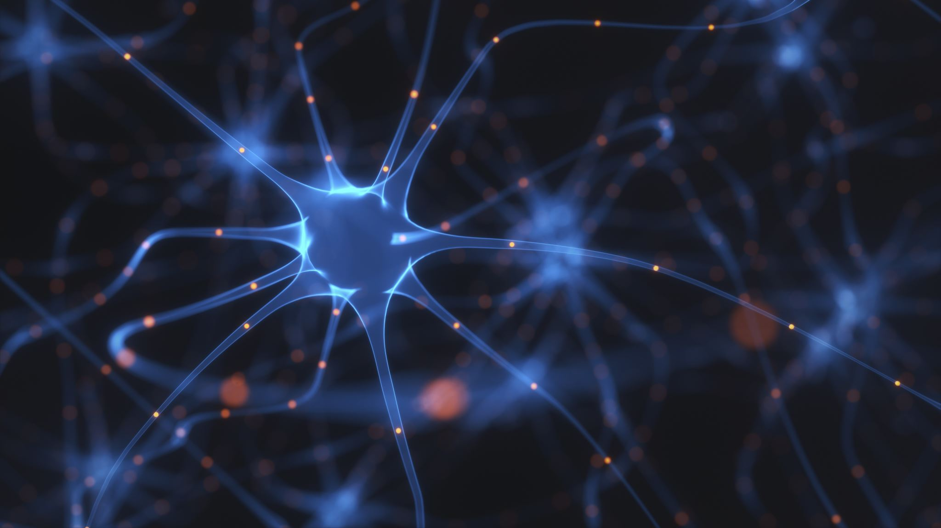
Image Processing
Before feeding an image to a neural network, we can apply several pre-processing steps. OpenCV can do many things, including:
  Resizing the image using im = cv2.resize(im, (320,200),interpolation=cv2.INTER_LANCZOS)
  Blurring the image using im = cv2.medianBlur(im,3) or im = cv2.GaussianBlur(im, (3,3), 0)
  Changing the brightness and contrast of the image can be done by NumPy array manipulations

Slide 10
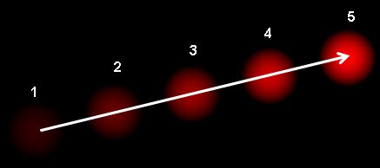
Image Processing (cont’d)
Using thresholding by calling cv2.threshold/cv2.adaptiveThreshold functions, which is often preferable to adjusting brightness or contrast
Applying different transformations to the image:
  Affine transformations can be useful if you need to combine rotation, resizing and skewing to the image and you know the source and destination location of three points in the image Affine transformations keep parallel lines parallel
  Perspective transformations can be useful when you know the source and destination positions of 4 points in the image. For example, if you take a picture of a rectangular document via a smartphone camera from some angle, and you want to make a rectangular image of the document itself
Understanding movement inside the image by using optical flow

Slide 11
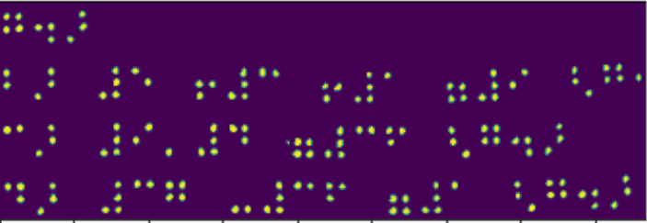
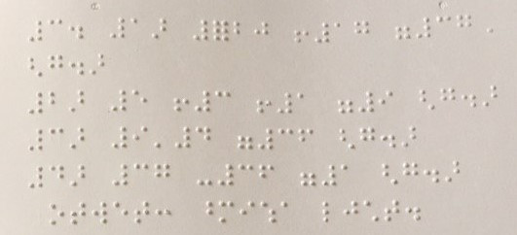
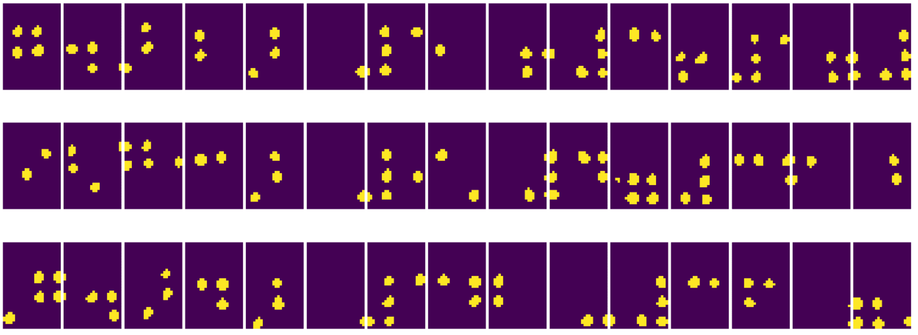
Examples of using Computer Vision
Pre-processing a photograph of a Braille book. We focus on how we can use thresholding, feature detection, perspective transformation and NumPy manipulations to separate individual Braille symbols for further classification by a neural network

Slide 12
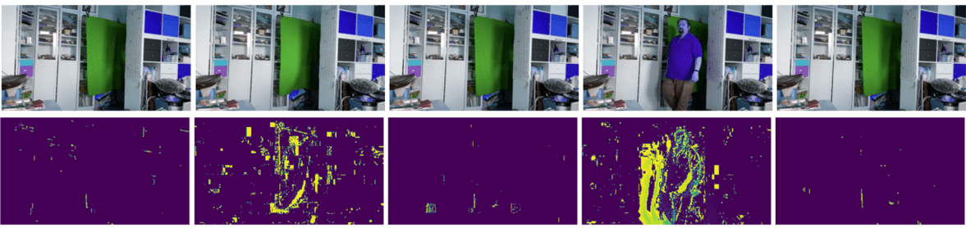
Examples of using Computer Vision (cont’d)
Detecting motion in video using frame difference. If the camera is fixed, then frames from the camera feed should be pretty similar to each other. Since frames are represented as arrays, just by subtracting those arrays for two subsequent frames we will get the pixel difference, which should be low for static frames, and become higher once there is substantial motion in the image.

Slide 13
Examples of using Computer Vision (cont’d)
Detecting motion using Optical Flow. Optical flow allows us to understand how individual pixels on video frames move. There are two types of optical flow:
  Dense Optical Flow computes the vector field that shows for each pixel where is it moving
  Sparse Optical Flow is based on taking some distinctive features in the image (eg. edges), and building their trajectory from frame to frame.

Slide 14
2021 OpenCV AI 대회 | 대상 수상자 | 코르틱 타이거스
https://learn.microsoft.com/ko-kr/shows/ai-show/ai-show--2021-opencv-ai-competition--grand-prize-winners--cortic-tigers--episode-32?WT.mc_id=academic-77998-cacaste

