Slide 1
Generalization Error
M AC H I N E L E A R N I N G W I T H T R E E - B A S E D M O D E L S I N P Y T H O N
Elie Kawerk
Data Scientist

Slide 2
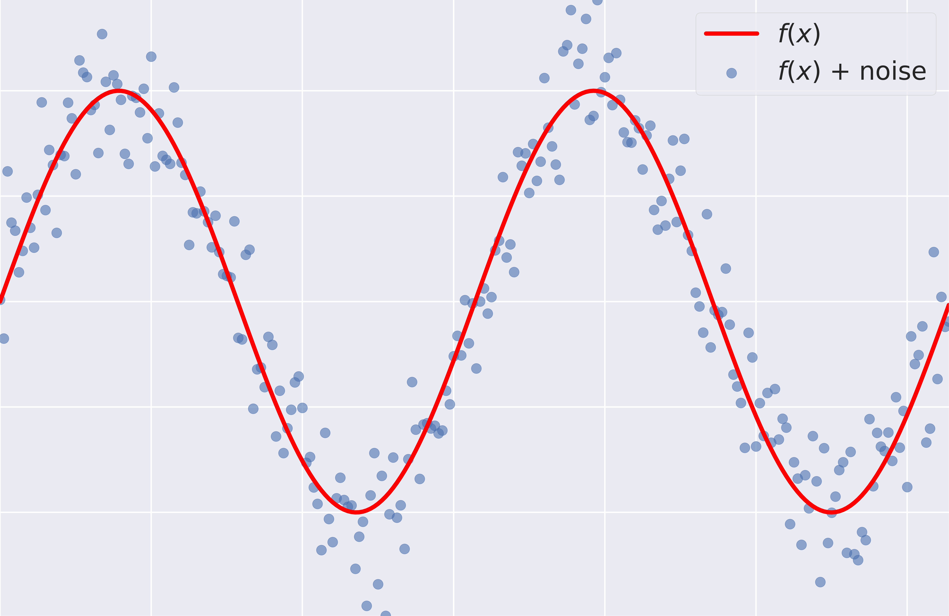
Supervised Learning - Under the Hood
Supervised Learning: y = f (x), f is unknown.

Slide 3
Goals of Supervised Learning
Find a model f^ that best approximates f : f^ ≈ f
f^ can be Logistic Regression, Decision Tree, Neural Network ... Discard noise as much as possible.
End goal: f^ should achieve a low predictive error on unseen datasets.

Slide 4
Difficulties in Approximating f
Overfitting: f^(x) fits the training set noise.
Underfitting: f^ is not flexible enough to approximate f .

Slide 5
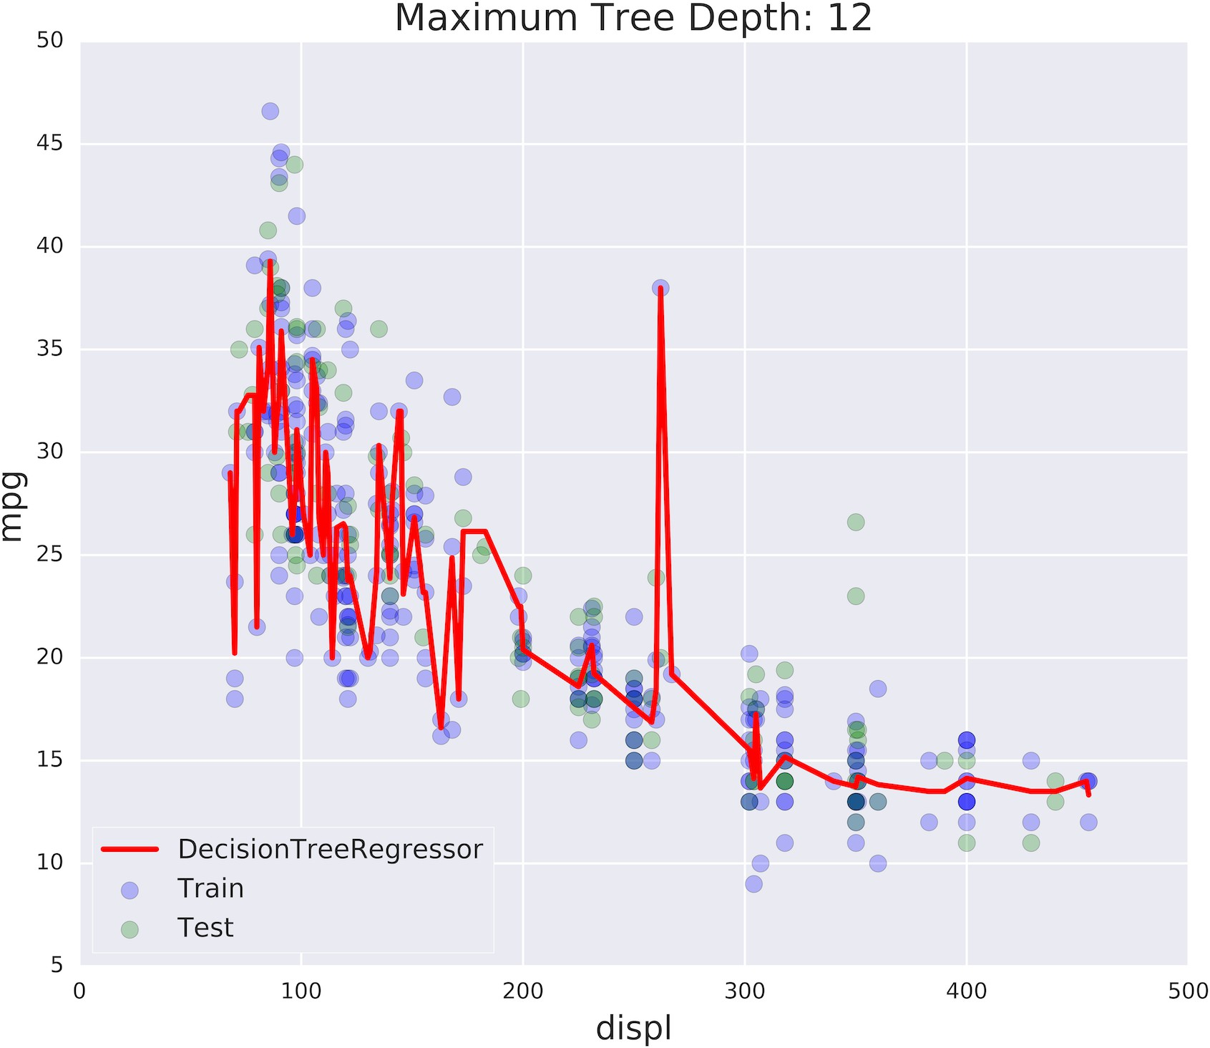
Overfitting

Slide 6
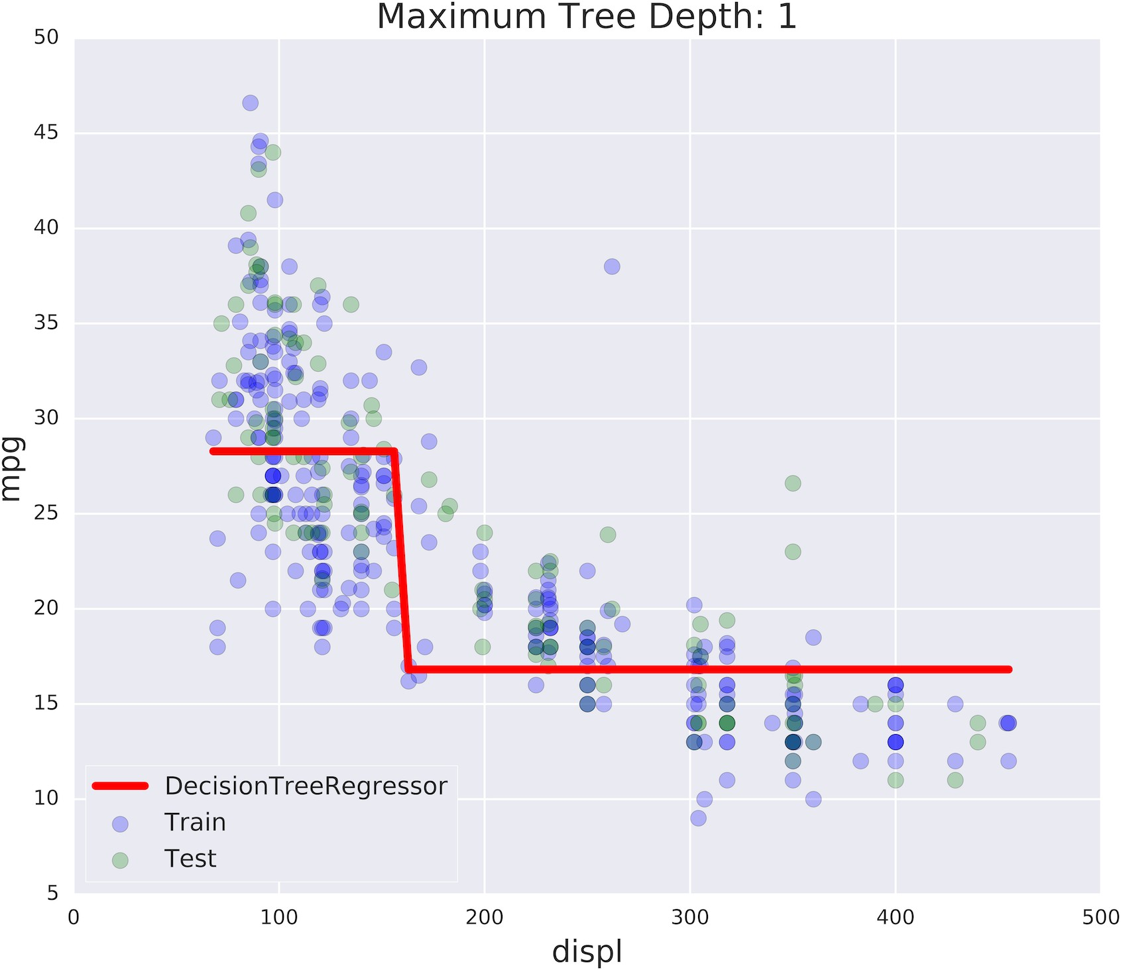
Underfitting

Slide 7
Generalization Error
Generalization Error of f^: Does f^ generalize well on unseen data?
It can be decomposed as follows: Generalization Error of
f^ = bias² + variance + irreducible error
Bias measures the error introduced by approximating a real-world problem (which may be complex) with a simplified model.
High Bias occurs when a model is too simple to capture the underlying structure of the data (e.g., linear regression applied to non-linear data). Results in underfitting, where the model performs poorly on both the training and test datasets.
Low Bias means the model is flexible enough to capture the true patterns in the data.
Variance measures the sensitivity of a model to small changes in the training data. A high variance model captures noise in the data along with the underlying patterns.
High Variance occurs when the model is overly complex and too closely fits the training data, including its noise. Results in overfitting, where the model performs well on the training data but poorly on unseen data.
Low Variance means the model is stable and consistent across different training datasets.
Irreducible error is the error caused by inherent noise in the data, such as measurement errors or random variability in the process being modeled.
This error cannot be eliminated, regardless of the model used.
Comes from factors outside the model's control, such as unmeasured variables, data inconsistencies, or inherent randomness.

Slide 8
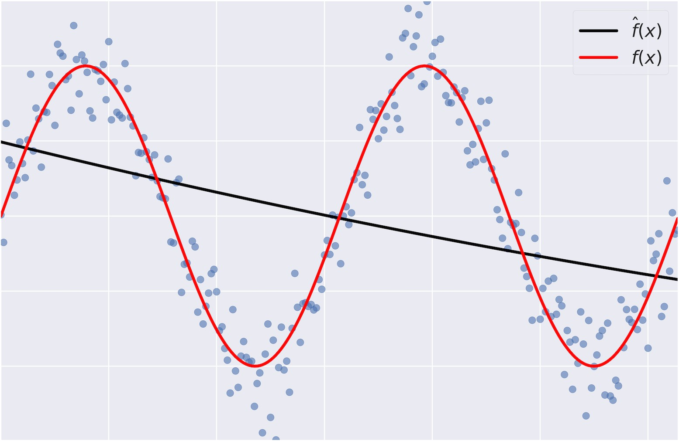
Bias
Bias: error term that tells you, on average, how much f^ ≠ f .

Slide 9
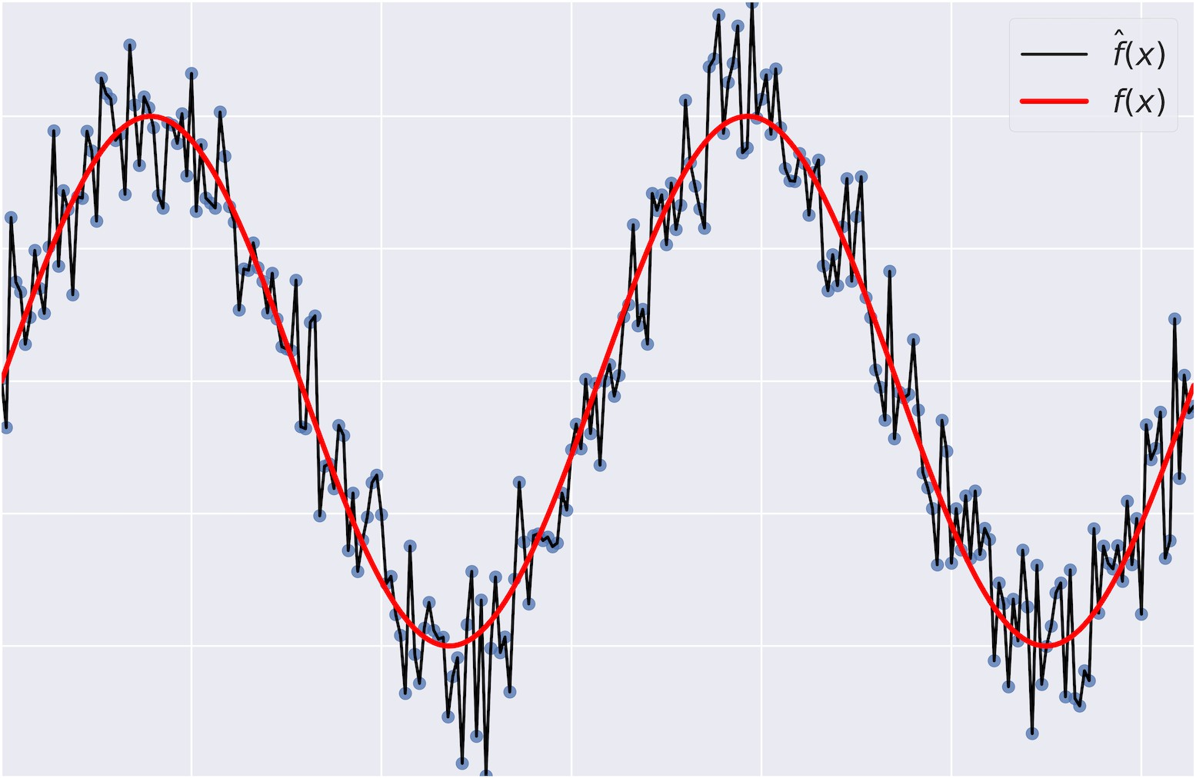
Variance
Variance: tells you how much f^ is inconsistent over different training sets.

Slide 10
Model Complexity
Model Complexity: sets the flexibility of f^.
Example: Maximum tree depth, Minimum samples per leaf, ...

Slide 11
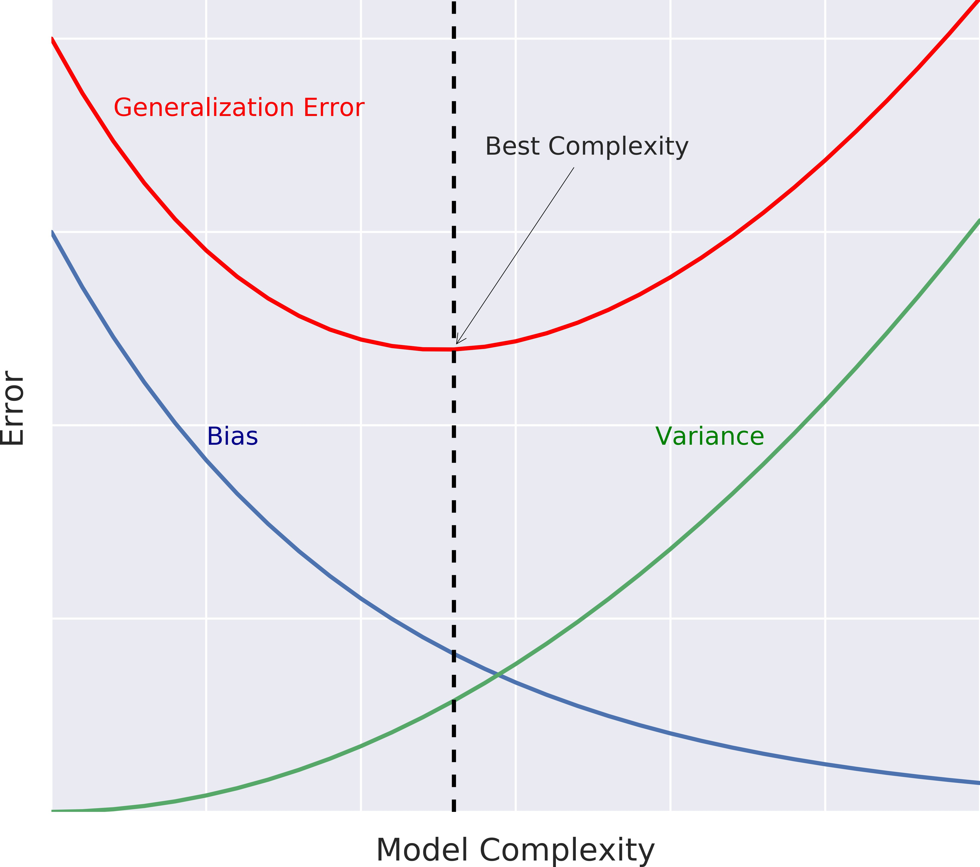
Bias-Variance Tradeoff
High Bias, Low Variance: A simple model (e.g., linear regression) has high bias because it cannot capture complex patterns, but it is stable and consistent across different datasets (low variance).
Results in underfitting.
Low Bias, High Variance: A complex model (e.g., deep neural network) has low bias because it can capture intricate patterns, but it is highly sensitive to the training data, leading to inconsistent predictions (high variance).
Results in overfitting.
Balanced Model: The ideal model minimizes both bias and variance, achieving the lowest possible total error while generalizing well to new data.
The Bias-Variance Tradeoff is a fundamental concept in supervised learning that describes the tradeoff between bias and variance, which are two sources of error in a predictive model.
The tradeoff occurs because reducing one often increases the other, and finding the right balance between bias and variance is critical for building a model that generalizes well to unseen data.

Slide 12
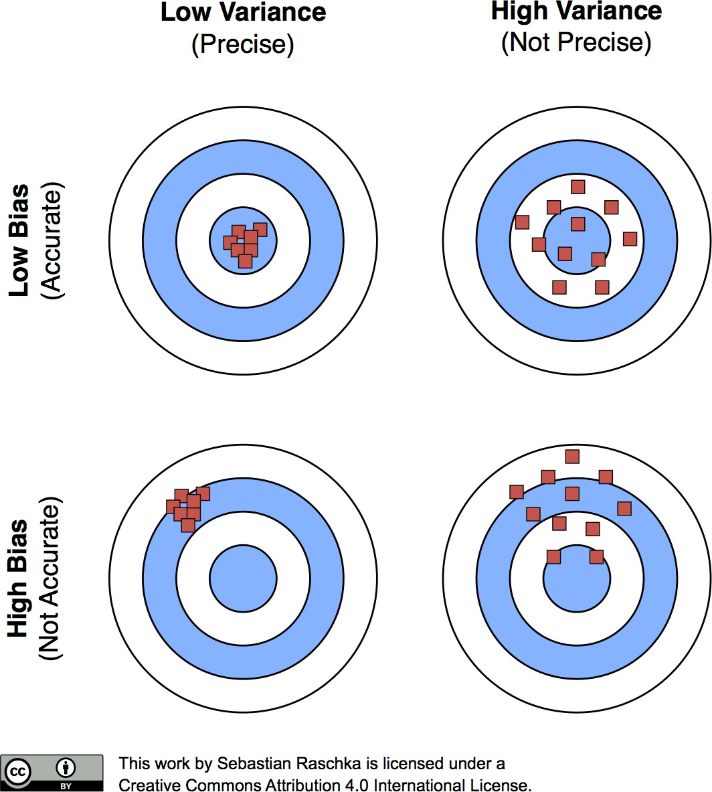
Bias-Variance Tradeoff: A Visual Explanation

Slide 13
Diagnosing Bias and Variance Problems
M AC H I N E L E A R N I N G W I T H T R E E - B A S E D M O D E L S I N P Y T H O N
Elie Kawerk
Data Scientist

Slide 14
Estimating the Generalization Error
How do we estimate the generalization error of a model?
Cannot be done directly because:
f is unknown,
usually you only have one dataset, noise is unpredictable.

Slide 15
Estimating the Generalization Error
Solution:
split the data to training and test sets, fit f^ to the training set,
evaluate the error of f^ on the unseen test set. generalization error of f^ ≈ test set error of f^.

Slide 16
Better Model Evaluation with Cross-Validation
Test set should not be touched until we are confident about f^'s performance. Evaluating f^ on training set: biased estimate, f^ has already seen all training points. Solution → Cross-Validation (CV):
K-Fold CV,
Hold-Out CV.

Slide 17
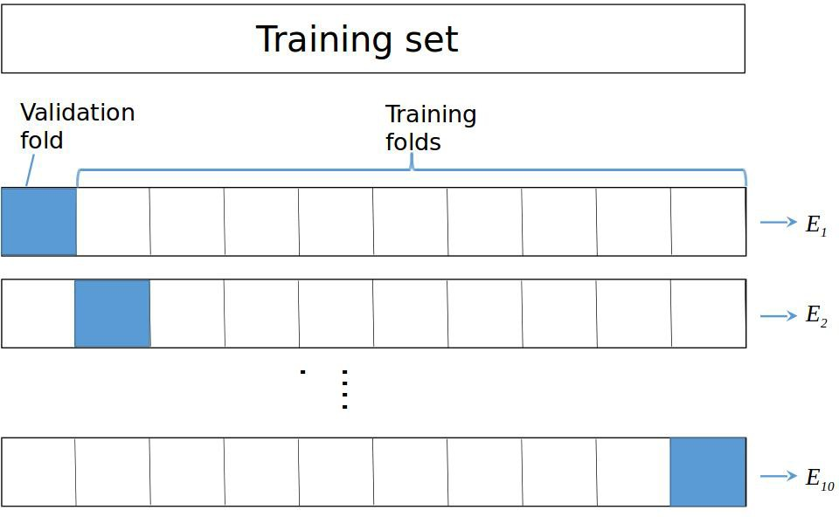
K-Fold CV

Slide 18

K-Fold CV

Slide 19
Diagnose Variance Problems
If f^ suffers from high variance: CV error of f^ > training set error of f^.
f^ is said to overfit the training set. To remedy overfitting: decrease model complexity,
for ex: decrease max depth, increase min samples per leaf, ... gather more data, ..

Slide 20
Diagnose Bias Problems
if f^ suffers from high bias: CV error of f^ ≈ training set error of f^ >> desired error.
f^ is said to underfit the training set. To remedy underfitting: increase model complexity
for ex: increase max depth, decrease min samples per leaf, ... gather more relevant features

Slide 21
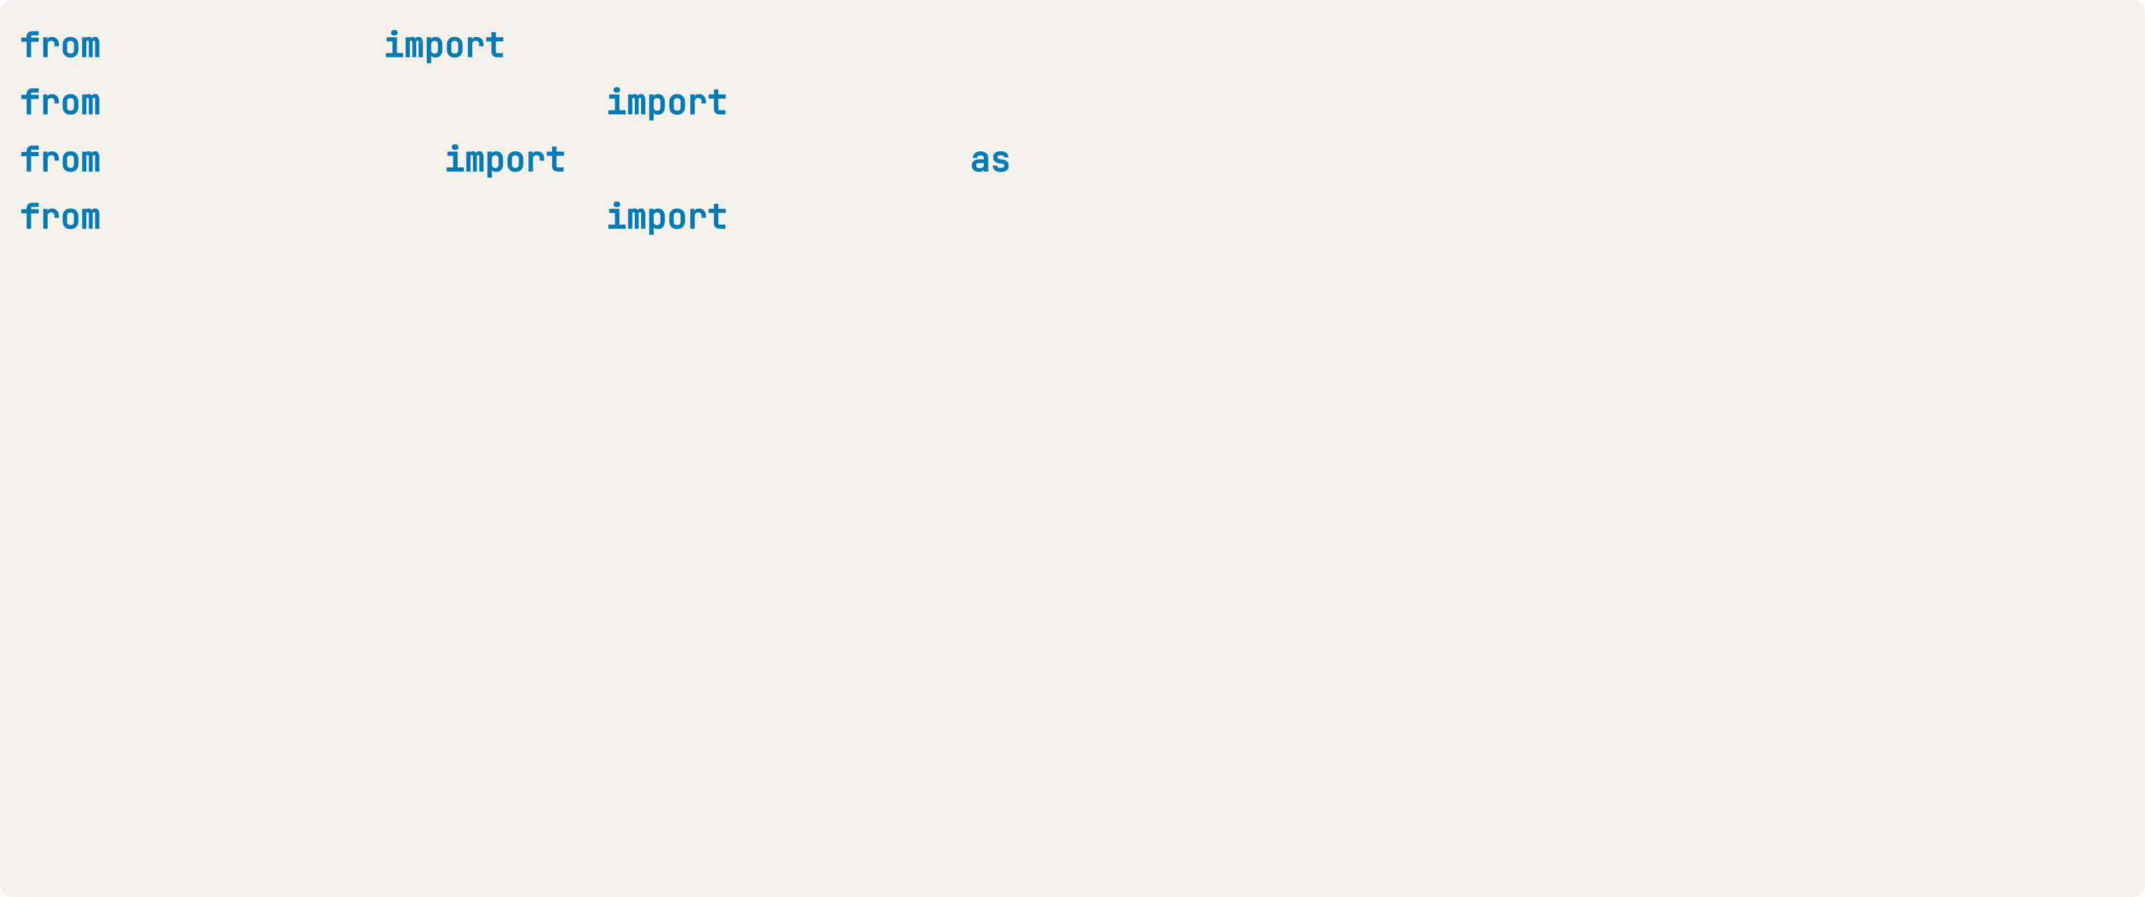
K-Fold CV in sklearn on the Auto Dataset
sklearn.tree DecisionTreeRegressor sklearn.model_selection train_test_split sklearn.metrics mean_squared_error MSE
sklearn.model_selection # Set seed for reproducibility SEED = 123
cross_val_score
# Split data into 70% train and 30% test
X_train, X_test, y_train, y_test = train_test_split(X,y,
test_size=0.3, random_state=SEED)
# Instantiate decision tree regressor and assign it to 'dt' dt = DecisionTreeRegressor(max_depth=4,
min_samples_leaf=0.14, random_state=SEED)

Slide 22
K-Fold CV in sklearn on the Auto Dataset
.
# Evaluate the list of MSE ontained by 10-fold CV
# Set n_jobs to -1 in order to exploit all CPU cores in computation MSE_CV = - cross_val_score(dt, X_train, y_train, cv= 10,
scoring='neg_mean_squared_error', n_jobs = -1)
# Fit 'dt' to the training set dt.fit(X_train, y_train)
# Predict the labels of training set y_predict_train = dt.predict(X_train) # Predict the labels of test set y_predict_test = dt.predict(X_test)
cross_val_score expects that a higher score corresponds to better model performance.
However, Mean Squared Error (MSE) is a loss function, where lower values are better.
To make MSE compatible with this convention, scikit-learn negates the MSE values during scoring, transforming it into -MSE, so higher values indicate better performance.

Slide 23
# CV MSE
print('CV MSE: {:.2f}'.format(MSE_CV.mean()))
CV MSE: 20.51
# Training set MSE
print('Train MSE: {:.2f}'.format(MSE(y_train, y_predict_train)))
Train MSE: 15.30
# Test set MSE
print('Test MSE: {:.2f}'.format(MSE(y_test, y_predict_test)))
Test MSE: 20.92

Slide 24
Ensemble Learning
M AC H I N E L E A R N I N G W I T H T R E E - B A S E D M O D E L S I N P Y T H O N
Elie Kawerk
Data Scientist

Slide 25
Advantages of CARTs
Simple to understand.
Simple to interpret. Easy to use.
Flexibility: ability to describe non-linear dependencies.
Preprocessing: no need to standardize or normalize features, ...

Slide 26
Limitations of CARTs
Classification: can only produce orthogonal decision boundaries.
Sensitive to small variations in the training set.
High variance: unconstrained CARTs may overfit the training set. Solution: ensemble learning.
What Does "Orthogonal Decision Boundaries" Mean?
Orthogonal:
  In the context of CART, "orthogonal" means that splits (decision boundaries) are aligned with the axes of the feature space.
  Each split divides the data by comparing a feature to a threshold, creating hyperplanes that are perpendicular to the feature axis.
Single-Feature-Based Splits:
  CART considers one feature at a time for splitting.
  The resulting decision regions are rectangular (in 2D) or hyper-rectangular (in higher dimensions).

Slide 27
Ensemble Learning
Train different models on the same dataset.
Let each model make its predictions.
Meta-model: aggregates predictions of individual models. Final prediction: more robust and less prone to errors.
Best results: models are skillful in different ways.
Ensemble learning is a machine learning technique where multiple models (often referred to as "weak learners" or "base models") are combined to create a more powerful and robust model, called an ensemble. The goal is to improve performance by leveraging the strengths of individual models while minimizing their weaknesses.

Slide 28
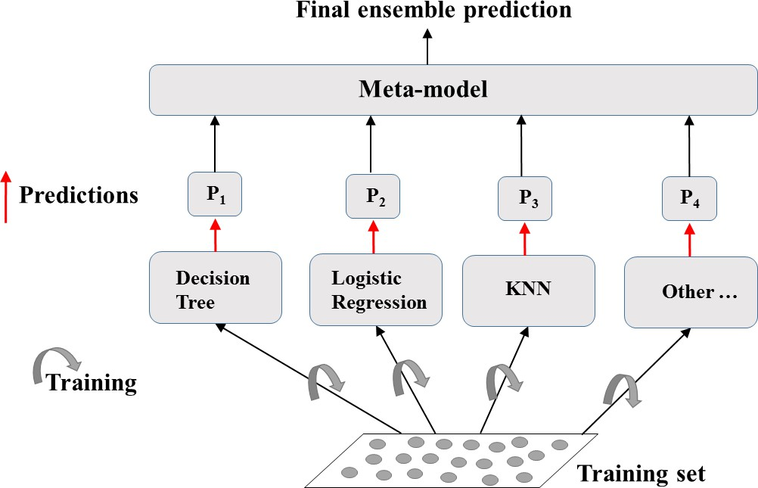
Ensemble Learning: A Visual Explanation

Slide 29
Ensemble Learning in Practice: Voting Classifier
Binary classification task.
N classifiers make predictions: P₁, P₂, ..., P_{N} with P_{i} = 0 or 1. Meta-model prediction: hard voting.

Slide 30
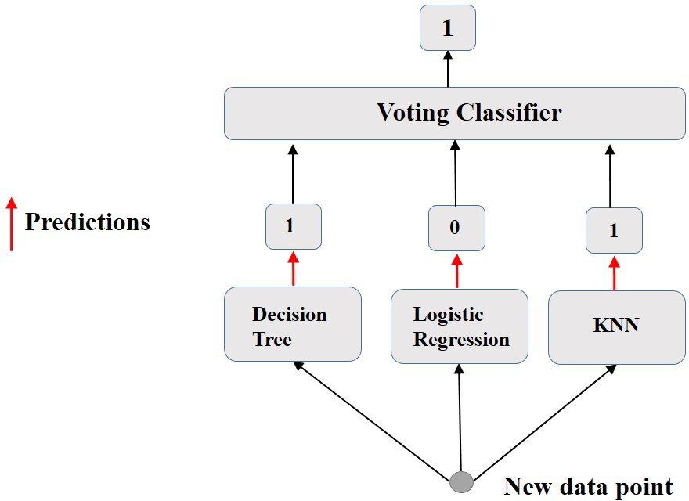
Hard Voting

Slide 31
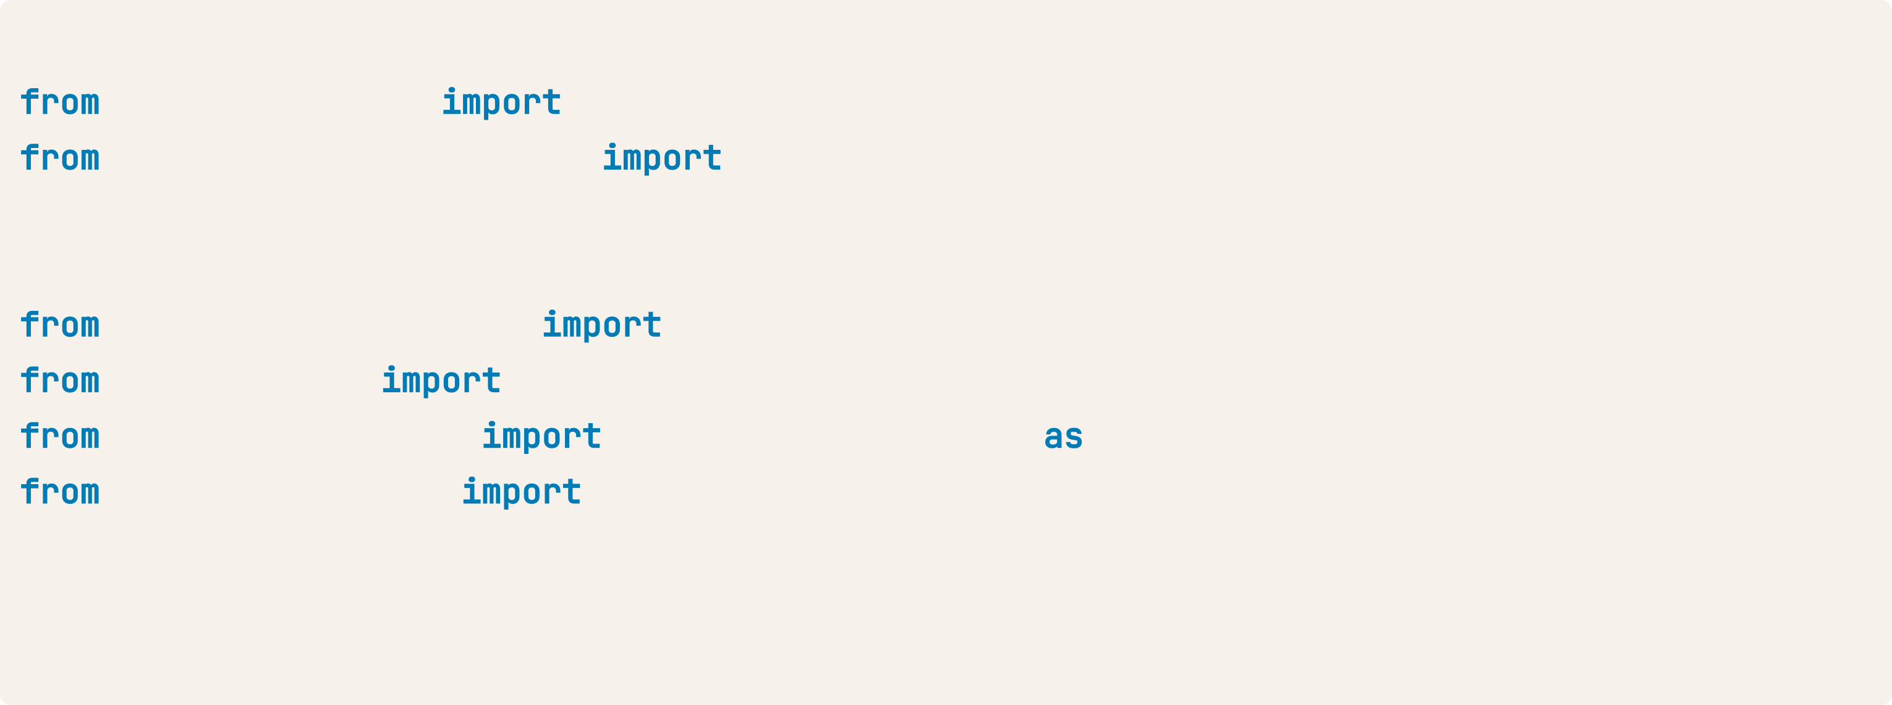
Voting Classifier in sklearn (Breast-Cancer dataset)
# Import functions to compute accuracy and split data sklearn.metrics accuracy_score sklearn.model_selection train_test_split
# Import models, including VotingClassifier meta-model sklearn.linear_model LogisticRegression
sklearn.tree sklearn.neighbors sklearn.ensemble
DecisionTreeClassifier KNeighborsClassifier
VotingClassifier
KNN
# Set seed for reproducibility SEED = 1

Slide 32
Voting Classifier in sklearn (Breast-Cancer dataset)
# Split data into 70% train and 30% test
X_train, X_test, y_train, y_test = train_test_split(X, y,
test_size= 0.3, random_state= SEED)
# Instantiate individual classifiers
lr = LogisticRegression(random_state=SEED) knn = KNN()
dt = DecisionTreeClassifier(random_state=SEED)
# Define a list called classifier that contains the tuples (classifier_name, classifier) classifiers = [('Logistic Regression', lr),
('K Nearest Neighbours', knn), ('Classification Tree', dt)]

Slide 33
# Iterate over the defined list of tuples containing the classifiers clf_name, clf classifiers:
#fit clf to the training set clf.fit(X_train, y_train)
# Predict the labels of the test set y_pred = clf.predict(X_test)
# Evaluate the accuracy of clf on the test set
print('{:s} : {:.3f}'.format(clf_name, accuracy_score(y_test, y_pred)))
Logistic Regression: 0.947 K Nearest Neighbours: 0.930 Classification Tree: 0.930

Slide 34
Voting Classifier in sklearn (Breast-Cancer dataset)
# Instantiate a VotingClassifier 'vc'
vc = VotingClassifier(estimators=classifiers)
# Fit 'vc' to the traing set and predict test set labels vc.fit(X_train, y_train)
y_pred = vc.predict(X_test)
# Evaluate the test-set accuracy of 'vc'
print('Voting Classifier: {.3f}'.format(accuracy_score(y_test, y_pred)))
Voting Classifier: 0.953

