Slide 1
Tuning a CART's hyperparameters
M AC H I N E L E A R N I N G W I T H T R E E - B A S E D M O D E L S I N P Y T H O N

Slide 2
Hyperparameters
Machine learning model:
parameters: learned from data
CART example: split-point of a node, split-feature of a node, ...
hyperparameters: not learned from data, set prior to training
CART example: max_depth , min_samples_leaf , splitting criterion ...

Slide 3
What is hyperparameter tuning?
Problem: search for a set of optimal hyperparameters for a learning algorithm.
Solution: find a set of optimal hyperparameters that results in an optimal model.
Optimal model: yields an optimal score.
Score: in sklearn defaults to accuracy (classification) and R² (regression). Cross validation is used to estimate the generalization performance.

Slide 4
Why tune hyperparameters?
In sklearn , a model's default hyperparameters are not optimal for all problems. Hyperparameters should be tuned to obtain the best model performance.

Slide 5
Approaches to hyperparameter tuning
Grid Search
Random Search Bayesian Optimization Genetic Algorithms
....

Slide 6
Grid search cross validation
Manually set a grid of discrete hyperparameter values.
Set a metric for scoring model performance. Search exhaustively through the grid.
For each set of hyperparameters, evaluate each model's CV score.
The optimal hyperparameters are those of the model achieving the best CV score.

Slide 7
Grid search cross validation: example
Hyperparameters grids:
max_depth = {2,3,4},
min_samples_leaf = {0.05, 0.1}
hyperparameter space = { (2,0.05) , (2,0.1) , (3,0.05), ... } CV scores = { score_{(2,0.05)} , ... }
optimal hyperparameters = set of hyperparameters corresponding to the best CV score.

Slide 8
Inspecting the hyperparameters of a CART in sklearn
# Import DecisionTreeClassifier
sklearn.tree DecisionTreeClassifier
# Set seed to 1 for reproducibility SEED = 1
# Instantiate a DecisionTreeClassifier 'dt'
dt = DecisionTreeClassifier(random_state=SEED)

Slide 9
Inspecting the hyperparameters of a CART in sklearn
# Print out 'dt's hyperparameters print(dt.get_params())
{'class_weight': None, 'criterion': 'gini', 'max_depth': None, 'max_features': None, 'max_leaf_nodes': None, 'min_impurity_decrease': 0.0, 'min_impurity_split': None, 'min_samples_leaf': 1,
'min_samples_split': 2,
'min_weight_fraction_leaf': 0.0, 'presort': False, 'random_state': 1,
'splitter': 'best'}

Slide 10
# Import GridSearchCV
sklearn.model_selection GridSearchCV # Define the grid of hyperparameters 'params_dt' params_dt = {
'max_depth': [3, 4,5, 6],
'min_samples_leaf': [0.04, 0.06, 0.08],
'max_features': [0.2, 0.4,0.6, 0.8]
}
# Instantiate a 10-fold CV grid search object 'grid_dt' grid_dt = GridSearchCV(estimator=dt,
param_grid=params_dt, scoring='accuracy', cv=10,
n_jobs=-1)
# Fit 'grid_dt' to the training data grid_dt.fit(X_train, y_train)

Slide 11
Extracting the best hyperparameters
# Extract best hyperparameters from 'grid_dt' best_hyperparams = grid_dt.best_params_ print('Best hyerparameters:\n', best_hyperparams)
Best hyerparameters:
{'max_depth': 3, 'max_features': 0.4, 'min_samples_leaf': 0.06}
# Extract best CV score from 'grid_dt' best_CV_score = grid_dt.best_score_ print('Best CV accuracy'.format(best_CV_score))
Best CV accuracy: 0.938

Slide 12
Extracting the best estimator
# Extract best model from 'grid_dt' best_model = grid_dt.best_estimator_
# Evaluate test set accuracy
test_acc = best_model.score(X_test,y_test)
# Print test set accuracy
print("Test set accuracy of best model: {:.3f}".format(test_acc))
Test set accuracy of best model: 0.947

Slide 13
Tuning an RF's Hyperparameters
M AC H I N E L E A R N I N G W I T H T R E E - B A S E D M O D E L S I N P Y T H O N
Random Forest (RF) is an ensemble learning algorithm based on bagging (Bootstrap Aggregating) that combines multiple decision trees to improve prediction accuracy and robustness. It can be used for both classification and regression tasks and is one of the most widely used machine learning algorithms due to its simplicity, effectiveness, and ability to handle various types of data.
Elie Kawerk
Data Scientist

Slide 14
Random Forests Hyperparameters
CART hyperparameters
number of estimators bootstrap
....

Slide 15
Tuning is expensive
Hyperparameter tuning:
computationally expensive,
sometimes leads to very slight improvement, Weight the impact of tuning on the whole project.

Slide 16
Inspecting RF Hyperparameters in sklearn
# Import RandomForestRegressor
sklearn.ensemble RandomForestRegressor
# Set seed for reproducibility SEED = 1
# Instantiate a random forests regressor 'rf' rf = RandomForestRegressor(random_state= SEED)

Slide 17
# Inspect rf' s hyperparameters rf.get_params()
{'bootstrap': True, 'criterion': 'mse', 'max_depth': None, 'max_features': 'auto', 'max_leaf_nodes': None, 'min_impurity_decrease': 0.0, 'min_impurity_split': None, 'min_samples_leaf': 1,
'min_samples_split': 2,
'min_weight_fraction_leaf': 0.0,
'n_estimators': 10,
'n_jobs': -1, 'oob_score': False, 'random_state': 1,
'verbose': 0, 'warm_start': False}

Slide 18
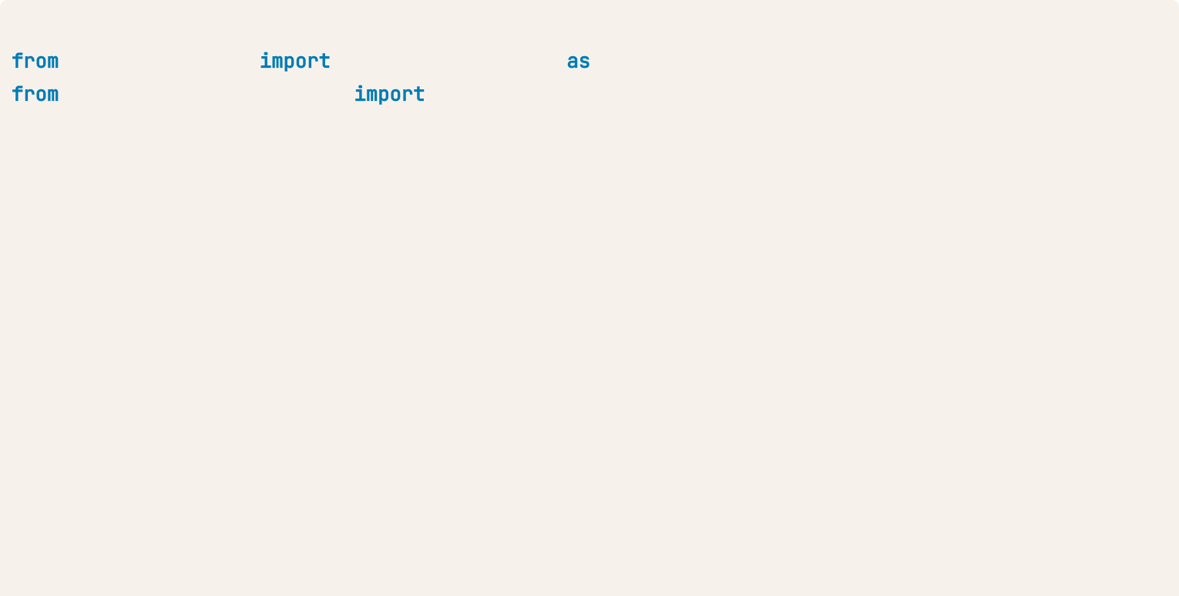
# Basic imports
sklearn.metrics
mean_squared_error MSE
sklearn.model_selection GridSearchCV # Define a grid of hyperparameter 'params_rf' params_rf = {
'n_estimators': [300, 400, 500],
'max_depth': [4, 6, 8],
'min_samples_leaf': [0.1, 0.2],
'max_features': ['log2', 'sqrt']
}
# Instantiate 'grid_rf'
grid_rf = GridSearchCV(estimator=rf,
param_grid=params_rf, cv=3,
scoring='neg_mean_squared_error', verbose=1,
n_jobs=-1)

Slide 19
Searching for the best hyperparameters
# Fit 'grid_rf' to the training set grid_rf.fit(X_train, y_train)
Fitting 3 folds for each of 36 candidates, totalling 108 fits
[Parallel(n_jobs=-1)]: Done 42 tasks | elapsed:
10.0s
24.3s finished
[Parallel(n_jobs=-1)]: Done 108 out of 108 | elapsed:
RandomForestRegressor(bootstrap=True, criterion='mse', max_depth=4, max_features='log2', max_leaf_nodes=None, min_impurity_decrease=0.0, min_impurity_split=None, min_samples_leaf=0.1, min_samples_split=2, min_weight_fraction_leaf=0.0, n_estimators=400, n_jobs=1, oob_score=False, random_state=1, verbose=0, warm_start=False)

Slide 20
Extracting the best hyperparameters
# Extract the best hyperparameters from 'grid_rf' best_hyperparams = grid_rf.best_params_
print('Best hyperparameters:\n', best_hyperparams) Best hyperparameters:
{'max_depth': 4,
'max_features': 'log2', 'min_samples_leaf': 0.1,
'n_estimators': 400}

Slide 21
Evaluating the best model performance
# Extract the best model from 'grid_rf' best_model = grid_rf.best_estimator_
# Predict the test set labels y_pred = best_model.predict(X_test) # Evaluate the test set RMSE
rmse_test = MSE(y_test, y_pred)**(1/2) # Print the test set RMSE
print('Test set RMSE of rf: {:.2f}'.format(rmse_test))
Test set RMSE of rf: 3.89

