Slide 1
Monitoring machine learning models
M LO P S C O N C E P T S
Folkert Stijnman
ML Engineer

Slide 2
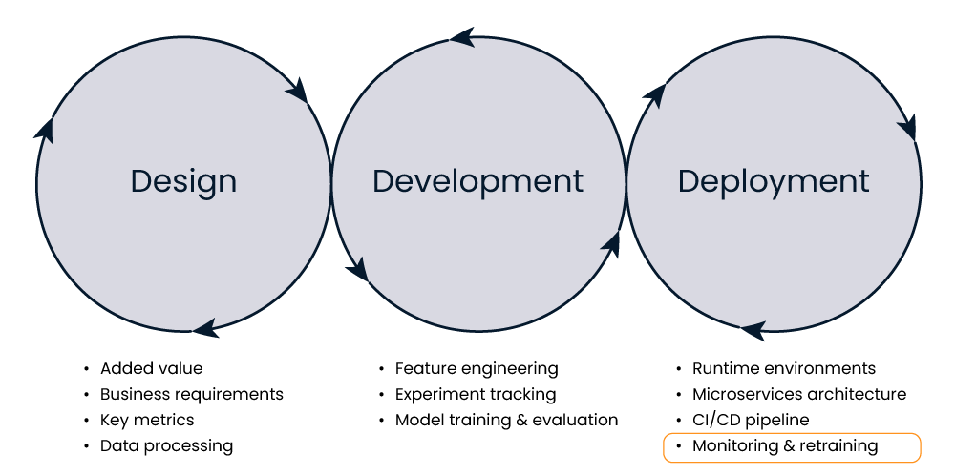
Monitoring & retraining

Slide 3
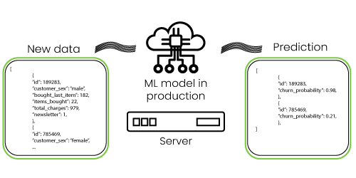
Types of monitoring
Statistical monitoring: focuses on the input and output data, including predictions
Examples: customer X has a 72% probability of churning, customer Y has a 31% probability of not churning

Slide 4
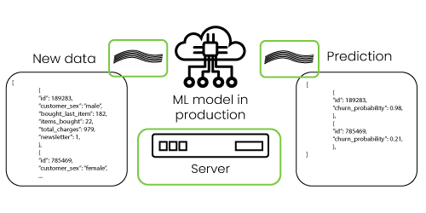
Types of monitoring
Computational monitoring: focuses on technical metrics
Examples: server CPU usage, number of incoming requests, number of predictions, downtime of server

Slide 5
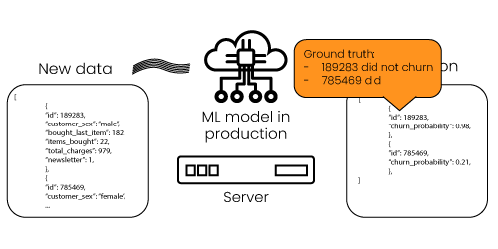
Feedback loop
Feedback loop: the process through which the ground truth is used to improve the machine learning model

Slide 6
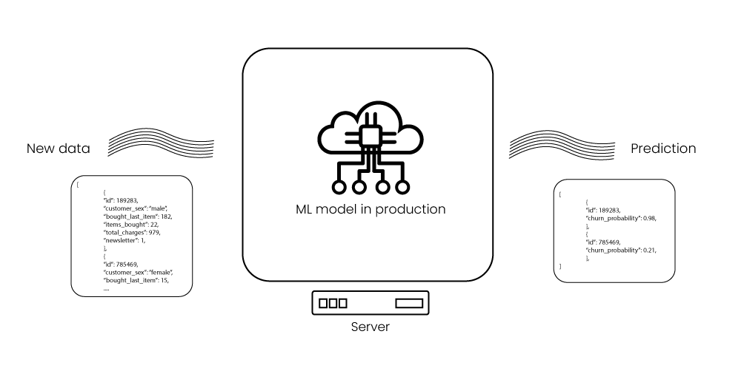
Monitoring in production

Slide 7
Retraining a machine learning model
M LO P S C O N C E P T S
Folkert Stijnman
ML Engineer

Slide 8

Retraining after changes
Retraining: use new data to develop a fresh version of the machine learning model

Slide 9
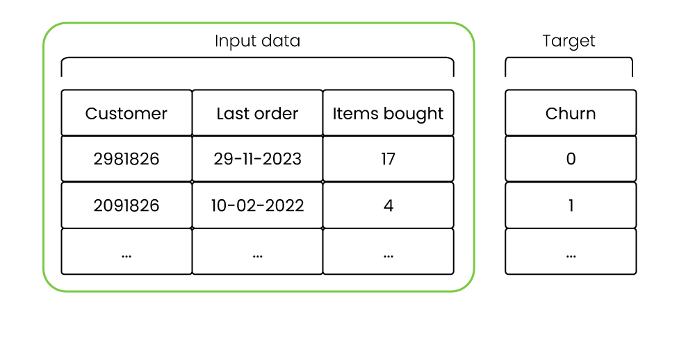
Data drift
Data drift: changes in the input data

Slide 10
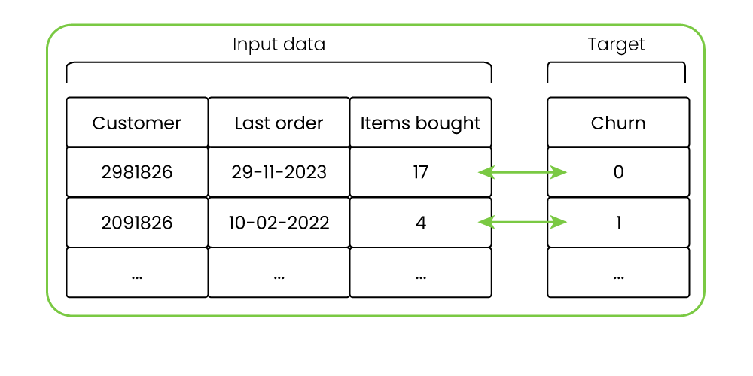
Concept drift
Concept drift: changes in the relationship between input and output data

Slide 11
How often to retrain?
Business environment: how volatile is the data?
Cost: how much does it cost to retrain?
Business requirements: what is the required model performance?

Slide 12
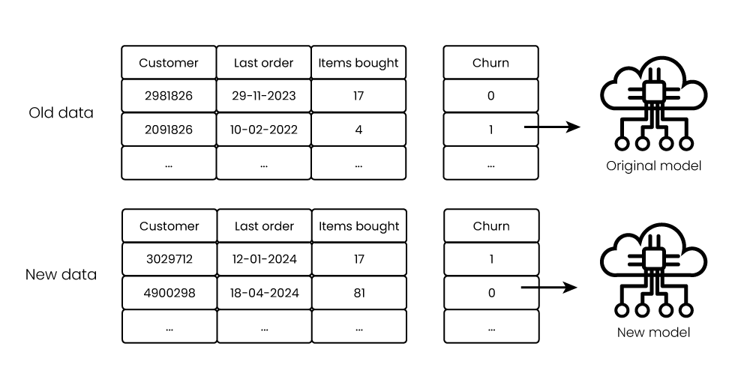
Retraining methods

Slide 13
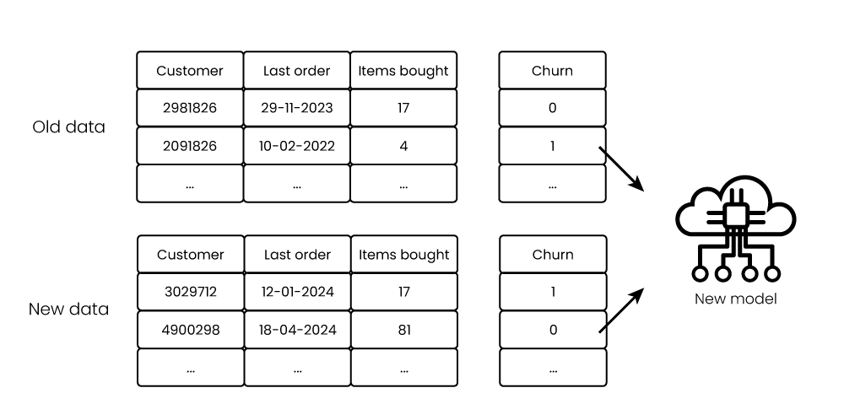
Retraining methods

Slide 14
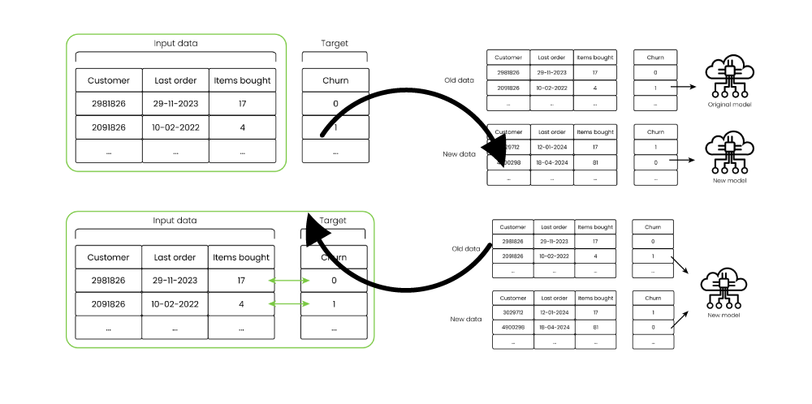
Automatic retraining

Slide 15
Levels of MLOps maturity
M LO P S C O N C E P T S
Folkert Stijnman
ML Engineer

Slide 16
MLOps maturity
Level of automation, collaboration, and monitoring within MLOps processes
Higher level is not necessarily better
Focus on development and deployment phase

Slide 17
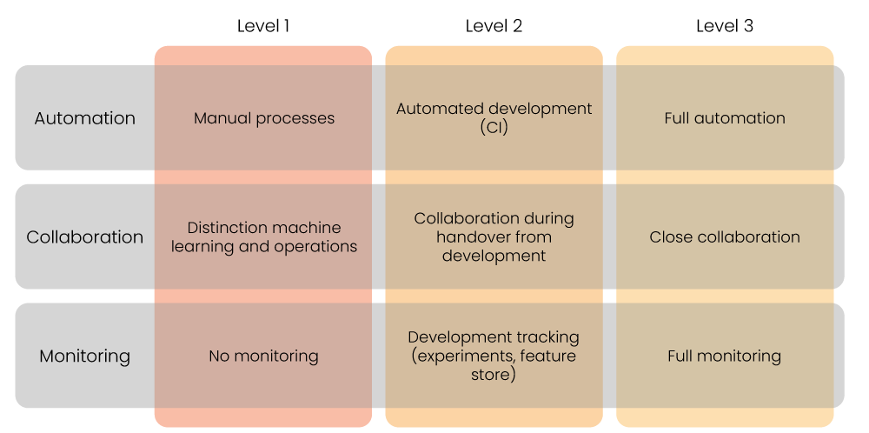
Levels of MLOps maturity

Slide 18
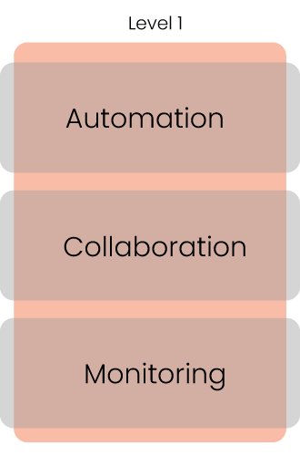
Level 1: Manual processes
Manual process for development
Manual process for deployment
No collaboration between ML and operations
Teams work in isolation
No tracking of development
No monitoring after deployment

Slide 19
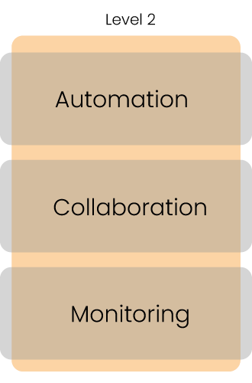
Level 2: Automated development
Automated development pipeline (Continuous integration)
Manual process for deployment
After development teams will collaborate to deploy model
Tracking of ML experiments and features Little monitoring after deployment

Slide 20
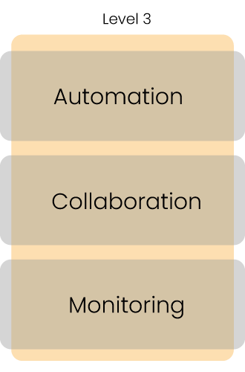
Level 3: Automated development and deployment
Automated development pipeline (CI)
Automated deployment pipeline (CD) Close collaboration between teams
Monitoring of development and deployment
Potentially automatically triggering retraining

Slide 21
MLOps tools
M LO P S C O N C E P T S
Folkert Stijnman
ML Engineer

Slide 22
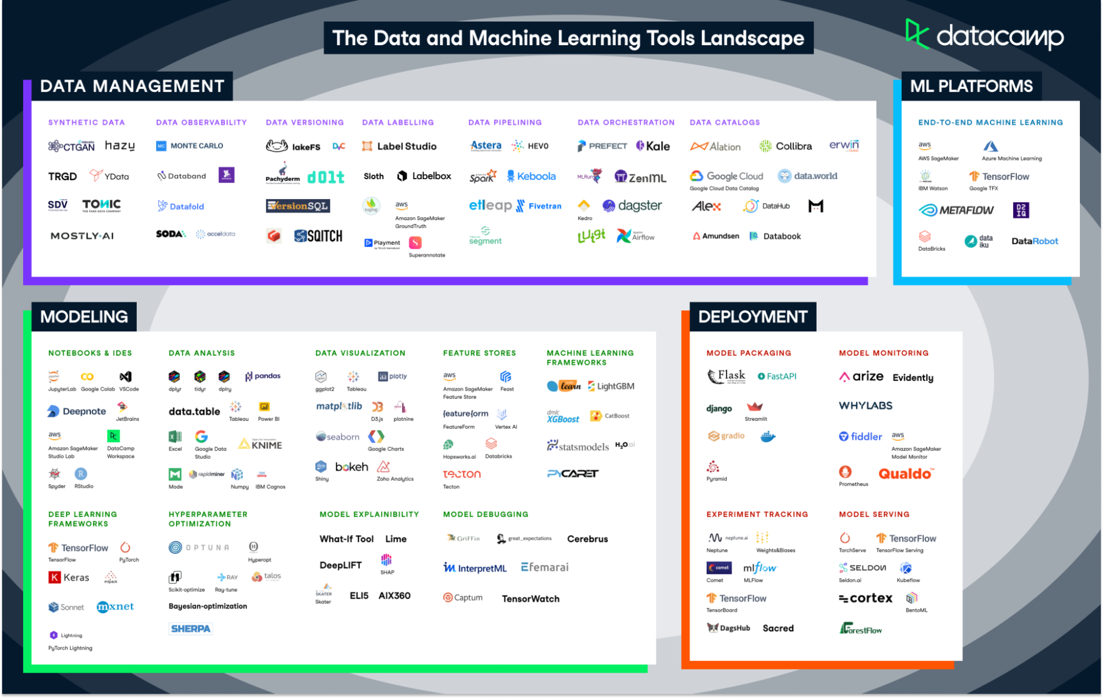
MLOps tools
¹ https://www.datacamp.com/blog/infographic-data-and-machine-learning-tools-landscape

Slide 23
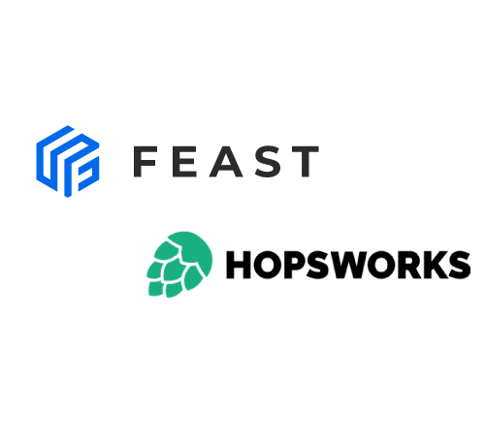
Feature store
Both open-source
Feast: self-managed
Hopsworks: part of larger platform

Slide 24
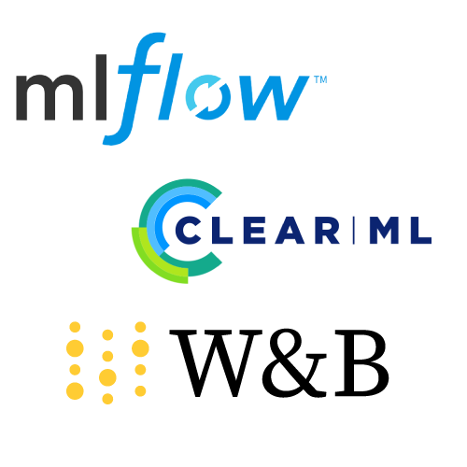
Experiment tracking
MLFlow and ClearML: full machine learning lifecycle tools
Weights and Biases: tracking and visualizing experiments

Slide 25
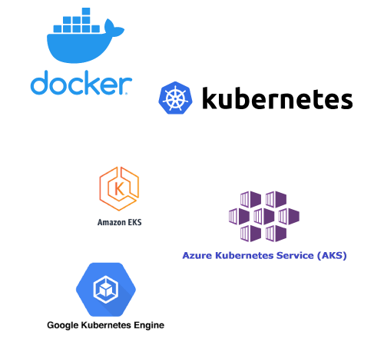
Containerization
Docker: containerizing applications
Kubernetes: running containerized applications
Cloud providers: provides Kubernetes-like services

Slide 26
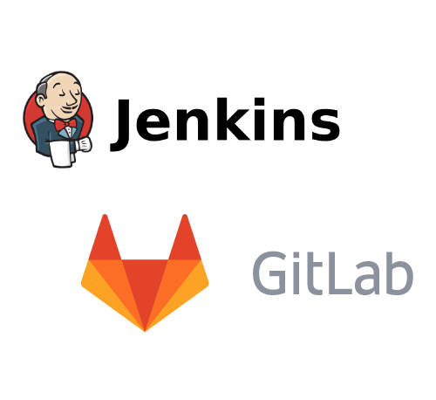
CI/CD pipeline
Jenkins: open-source continuous integration tool
GitLab: code sharing and version control through repositories

Slide 27

Monitoring
Fiddler: machine learning model monitoring
Great expectations: data monitoring

Slide 28
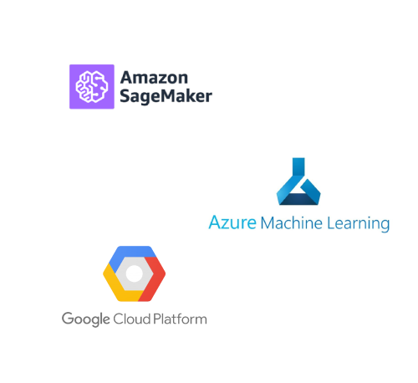
MLOps platforms
Tools for full machine learning lifecycle
AWS Sagemaker
Azure Machine Learning Google Cloud AI platform

Slide 29
Recap: MLOps concepts
M LO P S C O N C E P T S
Folkert Stijnman
ML Engineer

Slide 30
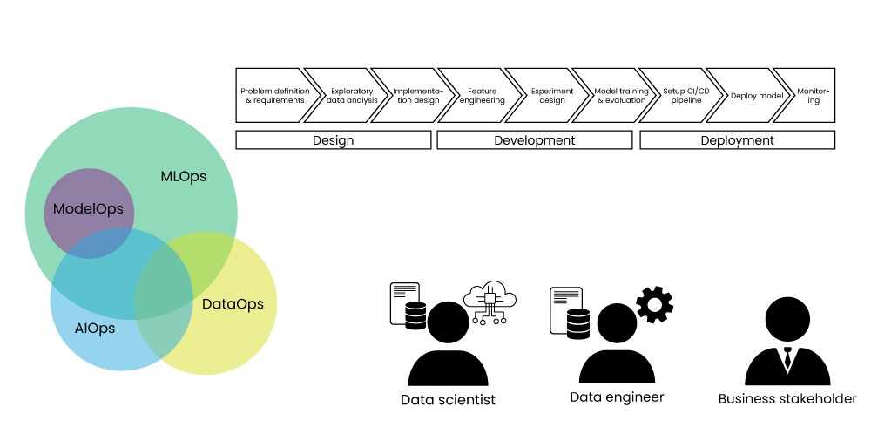
What is MLOps?

Slide 31
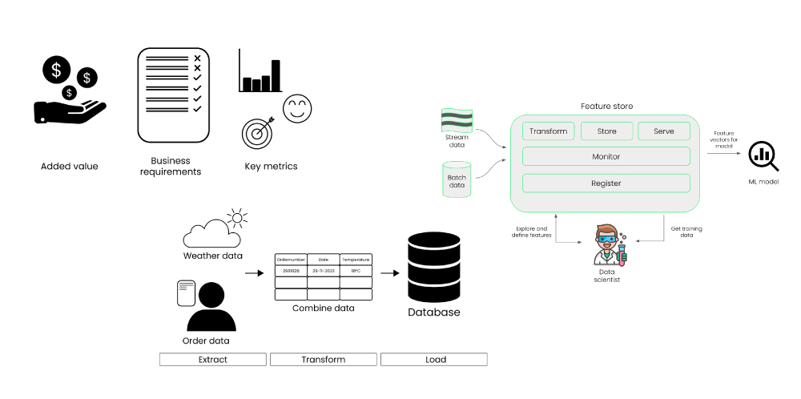
Design and development

Slide 32
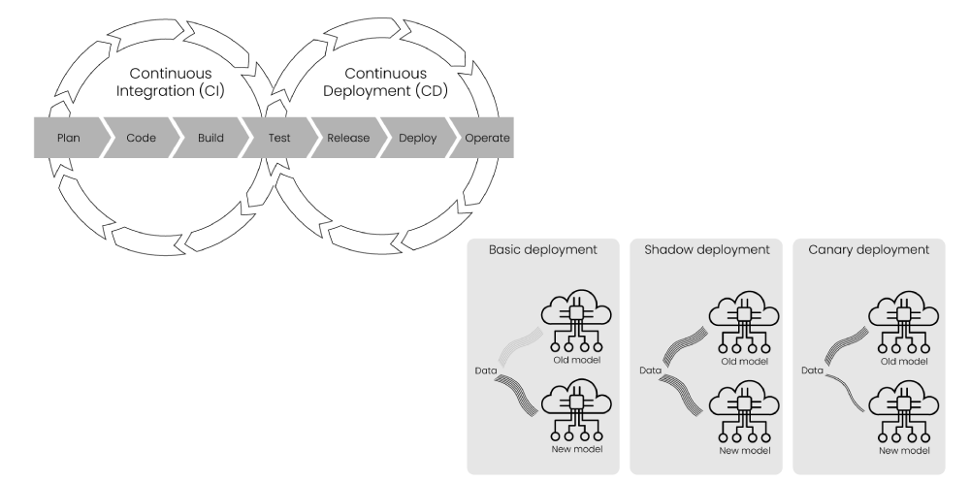
Deployment

Slide 33
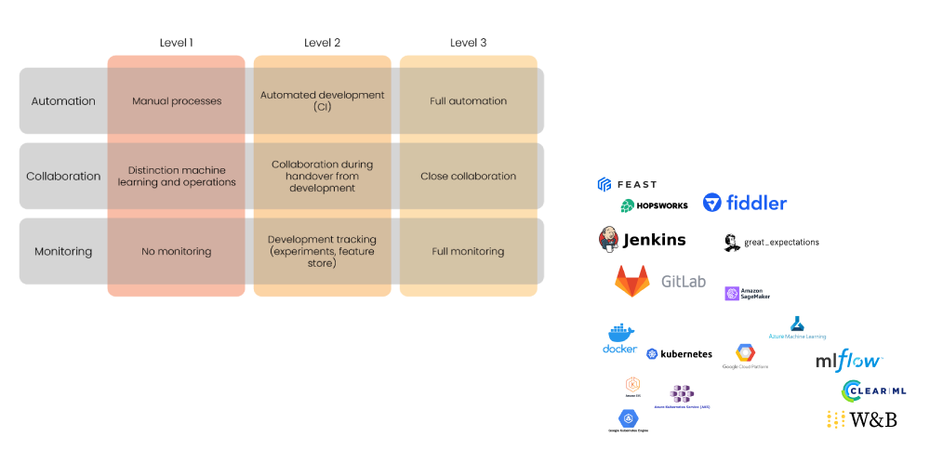
Maintaining machine learning

