Slide 1
Summary statistics
DATA M A N I P U L AT I O N W I T H PA N DA S
Maggie Matsui
Senior Content Developer at DataCamp

Slide 2
Summarizing numerical data
.median() , .mode()
.min() , .max()
.var() , .std()
.sum()
dogs["height_cm"].mean()
49.714285714285715
.quantile()

Slide 3
Summarizing dates
Oldest dog:
dogs["date_of_birth"].min()
'2011-12-11'
Youngest dog:
dogs["date_of_birth"].max()
'2018-02-27'

Slide 4
The .agg() method
(column): column.quantile(0.3)
dogs["weight_kg"].agg(pct30)
22.599999999999998

Slide 5
Summaries on multiple columns
dogs[["weight_kg", "height_cm"]].agg(pct30)
weight_kg height_cm
22.6
45.4
dtype: float64

Slide 6
Multiple summaries
(column): column.quantile(0.4)
dogs["weight_kg"].agg([pct30, pct40])
pct30 | 22.6
pct40 | 24.0
Name: | weight_kg, | dtype: | float64

Slide 7
Cumulative sum
dogs["weight_kg"]
dogs["weight_kg"].cumsum()
0 | 24 |  |  | 0 | 24
1 | 24 |  |  | 1 | 48
2 | 24 |  |  | 2 | 72
3 | 17 |  |  | 3 | 89
4 | 29 |  |  | 4 | 118
5 | 2 |  |  | 5 | 120
6 | 74 |  |  | 6 | 194
Name: | weight_kg, | dtype: | int64 | Name: | weight_kg, | dtype: | int64

Slide 8
Cumulative statistics
.cummax()
.cummin()
.cumprod()

Slide 9
Walmart
sales.head()
store | type | dept | date | weekly_sales | is_holiday | temp_c | fuel_price | unemp
0 1 | A | 1 | 2010-02-05 | 24924.50 | False | 5.73 | 0.679 | 8.106
1 1 | A | 2 | 2010-02-05 | 50605.27 | False | 5.73 | 0.679 | 8.106
2 1 | A | 3 | 2010-02-05 | 13740.12 | False | 5.73 | 0.679 | 8.106
3 1 | A | 4 | 2010-02-05 | 39954.04 | False | 5.73 | 0.679 | 8.106
4 1 | A | 5 | 2010-02-05 | 32229.38 | False | 5.73 | 0.679 | 8.106

Slide 10
Counting
DATA M A N I P U L AT I O N W I T H PA N DA S
Maggie Matsui
Senior Content Developer at DataCamp

Slide 11
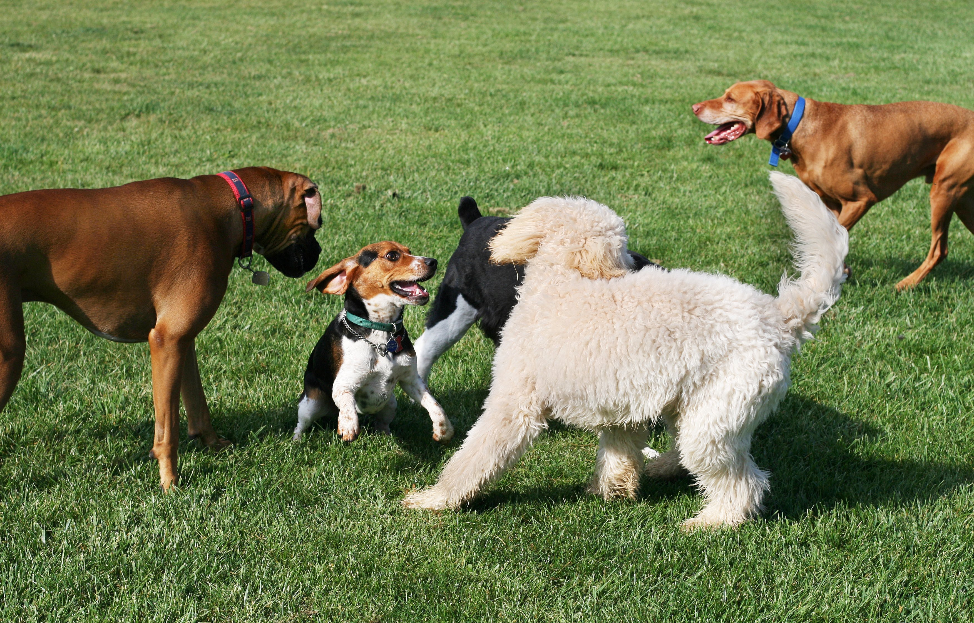
Avoiding double counting

Slide 12
Vet visits
print(vet_visits)
 | date | name | breed | weight_kg
0 | 2018-09-02 | Bella | Labrador | 24.87
1 | 2019-06-07 | Max | Labrador | 28.35
2 | 2018-01-17 | Stella | Chihuahua | 1.51
3 | 2019-10-19 | Lucy | Chow Chow | 24.07
.. | ... | ... | ... | ...
71 | 2018-01-20 | Stella | Chihuahua | 2.83
72 | 2019-06-07 | Max | Chow Chow | 24.01
73 | 2018-08-20 | Lucy | Chow Chow | 24.40
74 | 2019-04-22 | Max | Labrador | 28.54

Slide 13
Dropping duplicate names
vet_visits.drop_duplicates(subset="name")
date
0 2018-09-02
1 2019-06-07
2 2019-03-19
3 2018-01-17
4 2019-10-19
7 2019-03-30
10 2019-01-04
(6 2019-06-07
name Bella
Max Charlie Stella
Lucy Cooper Bernie
Max
breed Labrador Chow Chow
Poodle Chihuahua Chow Chow Schnauzer St. Bernard Labrador
weight_kg
24.87
24.01
24.95
1.51
24.07
16.91
74.98
28.35)

Slide 14
Dropping duplicate pairs
unique_dogs = vet_visits.drop_duplicates(subset=["name", "breed"]) print(unique_dogs)
date
0 2018-09-02
1 2019-03-13
2 2019-03-19
3 2018-01-17
4 2019-10-19
6 2019-06-07
7 2019-03-30
10 2019-01-04
name Bella
Max Charlie Stella
Lucy Max Cooper Bernie
breed Labrador Chow Chow
Poodle Chihuahua Chow Chow Labrador Schnauzer St. Bernard
weight_kg
24.87
24.13
24.95
1.51
24.07
28.35
16.91
74.98

Slide 15
Easy as 1, 2, 3
unique_dogs["breed"].value_counts()
unique_dogs["breed"].value_counts(sort=True)
Labrador | 2 |  | Labrador | 2
Schnauzer | 1 |  | Chow Chow | 2
St. Bernard | 1 |  | Schnauzer | 1
Chow Chow | 2 |  | St. Bernard | 1
Poodle | 1 |  | Poodle | 1
Chihuahua | 1 |  | Chihuahua | 1
Name: breed, | dtype: | int64 | Name: breed, | dtype: | int64

Slide 16
Proportions
unique_dogs["breed"].value_counts(normalize=True)
Labrador | 0.250
Chow Chow | 0.250
Schnauzer | 0.125
St. Bernard | 0.125
Poodle | 0.125
Chihuahua | 0.125
Name: breed, dtype: float64

Slide 17
Grouped summary statistics
DATA M A N I P U L AT I O N W I T H PA N DA S
Maggie Matsui
Senior Content Developer at DataCamp

Slide 18
Summaries by group
dogs[dogs["color"] == "Black"]["weight_kg"].mean()
dogs[dogs["color"] == "Brown"]["weight_kg"].mean()
dogs[dogs["color"] == "White"]["weight_kg"].mean()
dogs[dogs["color"] == "Gray"]["weight_kg"].mean()
dogs[dogs["color"] == "Tan"]["weight_kg"].mean()
26.0
24.0
74.0
17.0
2.0

Slide 19
Grouped summaries
dogs.groupby("color")["weight_kg"].mean()
color
Black | 26.5
Brown | 24.0
Gray | 17.0
Tan | 2.0
White | 74.0
Name: | weight_kg, | dtype: | float64

Slide 20
Multiple grouped summaries
dogs.groupby("color")["weight_kg"].agg([min, max, sum])
color | min | max | sum
Black | 24 | 29 | 53
Brown | 24 | 24 | 48
Gray | 17 | 17 | 17
Tan | 2 | 2 | 2
White | 74 | 74 | 74

Slide 21
Grouping by multiple variables
dogs.groupby(["color", "breed"])["weight_kg"].mean()
color Black
breed Chow Chow Labrador Poodle Chow Chow Labrador Schnauzer Chihuahua
St. Bernard
25
29
24
24
24
17
2
74
Brown
Gray Tan White
Name: weight_kg, dtype: int64

Slide 22
Many groups, many summaries
dogs.groupby(["color", "breed"])[["weight_kg", "height_cm"]].mean()
color | breed | weight_kg | height_cm
Black | Labrador | 29 | 59
 | Poodle | 24 | 43
Brown | Chow Chow | 24 | 46
 | Labrador | 24 | 56
Gray | Schnauzer | 17 | 49
Tan | Chihuahua | 2 | 18
White | St. Bernard | 74 | 77

Slide 23
Pivot tables
DATA M A N I P U L AT I O N W I T H PA N DA S
Maggie Matsui
Senior Content Developer at DataCamp

Slide 24
Group by to pivot table
dogs.groupby("color")["weight_kg"].mean()
dogs.pivot_table(values="weight_kg",
index="color")
color Black Brown Gray Tan White
26
24
17
2
74
weight_kg
26.5
24.0
17.0
2.0
74.0
color Black Brown Gray Tan White
Name: weight_kg, dtype: int64

Slide 25
Different statistics
numpy np
dogs.pivot_table(values="weight_kg", index="color", aggfunc=np.median)
weight_kg
color Black Brown Gray Tan White
26.5
24.0
17.0
2.0
74.0

Slide 26
Multiple statistics
dogs.pivot_table(values="weight_kg", index="color", aggfunc=[np.mean, np.median])
color | mean weight_kg | median weight_kg
Black | 26.5 | 26.5
Brown | 24.0 | 24.0
Gray | 17.0 | 17.0
Tan | 2.0 | 2.0
White | 74.0 | 74.0

Slide 27
Pivot on two variables
dogs.groupby(["color", "breed"])["weight_kg"].mean()
dogs.pivot_table(values="weight_kg", index="color", columns="breed")
breed color | Chihuahua | Chow | Chow | Labrador | Poodle | Schnauzer | St. | Bernard
Black | NaN |  | NaN | 29.0 | 24.0 | NaN |  | NaN
Brown | NaN |  | 24.0 | 24.0 | NaN | NaN |  | NaN
Gray | NaN |  | NaN | NaN | NaN | 17.0 |  | NaN
Tan | 2.0 |  | NaN | NaN | NaN | NaN |  | NaN
White | NaN |  | NaN | NaN | NaN | NaN |  | 74.0

Slide 28
Filling missing values in pivot tables
dogs.pivot_table(values="weight_kg", index="color", columns="breed", fill_value=0)
breed color | Chihuahua | Chow | Chow | Labrador | Poodle | Schnauzer | St. | Bernard
Black | 0 |  | 0 | 29 | 24 | 0 |  | 0
Brown | 0 |  | 24 | 24 | 0 | 0 |  | 0
Gray | 0 |  | 0 | 0 | 0 | 17 |  | 0
Tan | 2 |  | 0 | 0 | 0 | 0 |  | 0
White | 0 |  | 0 | 0 | 0 | 0 |  | 74

Slide 29
Summing with pivot tables
dogs.pivot_table(values="weight_kg", index="color", columns="breed", fill_value=0, margins=True)
breed color | Chihuahua | Chow | Chow | Labrador | Poodle | Schnauzer | St. | Bernard | All
Black | 0 |  | 0 | 29 | 24 | 0 |  | 0 | 26.500000
Brown | 0 |  | 24 | 24 | 0 | 0 |  | 0 | 24.000000
Gray | 0 |  | 0 | 0 | 0 | 17 |  | 0 | 17.000000
Tan | 2 |  | 0 | 0 | 0 | 0 |  | 0 | 2.000000
White | 0 |  | 0 | 0 | 0 | 0 |  | 74 | 74.000000
All | 2 |  | 24 | 26 | 24 | 17 |  | 74 | 27.714286

