Slide 1
What is statistics?
I N T R O D U C T I O N TO STAT I ST I C S
George Boorman
Curriculum Manager, DataCamp

Slide 2
What is statistics?
The field of statistics - the practice and study of collecting and analyzing data
Two main branches of statistics:
Descriptive/summary statistics - describing or summarizing our data
Inferential statistics - collect a sample of data, and apply the results to the population that the sample represents

Slide 3


Statistics is everywhere!
Sports statistics
Personal finances
¹ Image credits: https://unsplash.com/@jesusance; https://unsplash.com/@andretaissin; https://unsplash.com/@unarchive

Slide 4
What can statistics do?
Allows us to answer practical questions: What is the average salary in South Korea?
How many customer inquiries is a company likely to receive per week?
It has applications across society:
Developing safer products such as cars or airplanes
Help governments understand the needs of a population
Validates scientific breakthroughs, such as Covid-19 vaccines
¹ source: https://www.bmj.com/content/373/bmj.n1088

Slide 5

Limitations of statistics
Statistics requires specific, measurable questions:
Is rock music more popular than jazz?
On average, do women live longer than men?
We can't use statistics to find out why
relationships exist
¹ Image credit: https://unsplash.com/@mohammadmetri

Slide 6
Types of data: numeric
Continuous data: Stock prices
Interval/count data:
How many cups of coffee do people drink per day?
Stock | Opening Price ($) | Close Price {$}
Amazon.com, Inc | 2328.14 | 2329.00
Apple Inc | 156.77 | 157.04
Netflix Inc | 188.32 | 188.75
Name | Cups of coffee per day
Jessica | 4
Andrew | 2
Penny | 3
¹ Image credits: Stocks https://unsplash.com/@behy_studio

Slide 7
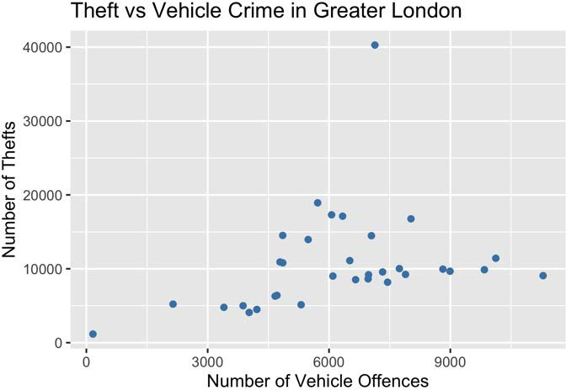
Visualizing numeric data
¹ Data source: Metropolitan Police Service, United Kingdom

Slide 8
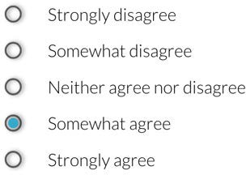
Types of data: categorical
Nominal data: Eye color
Ordinal data:
How strongly do you agree that basketball is the best sport?
Name | Eye color
Jessica | Brown
Adam | Green
Sarah | Blue
¹ Image credit: https://unsplash.com/@mango_quan

Slide 9
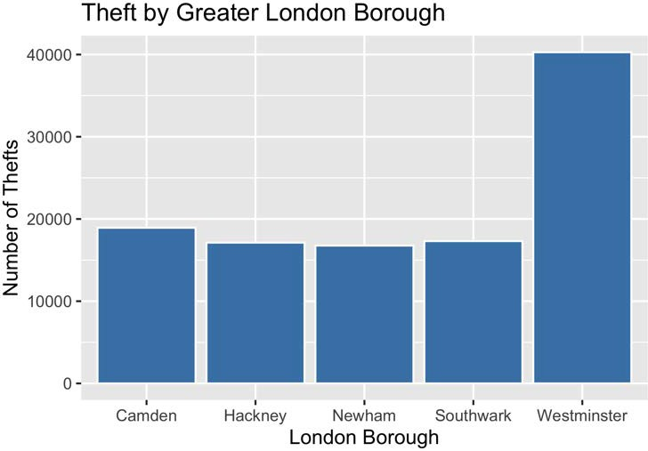
Visualizing categorical data

Slide 10
Descriptive / Summary statistics
Describe or summarize data
Borough | Number of Thefts | Percentage of Total
Westminster | 40,278 | 36.48%
Camden | 18,928 | 17.15%
Southwark | 17,309 | 15.68%
Hackney | 17,121 | 15.51%
Newham | 16,762 | 15.18%

Slide 11

Inferential statistics
Use a sample to draw conclusions about a population
How many people purchase clothing following social media advertising?
¹ source: https://unsplash.com/@pickawood

Slide 12
Measures of center
I N T R O D U C T I O N TO STAT I ST I C S
George Boorman
Curriculum Manager, DataCamp

Slide 13

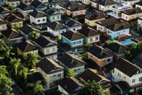

Why are measures of center useful?
Average number of sales orders per month
Typical cost of a house
Most common hair color
¹ Image credits: https://unsplash.com/@arnosenoner; https://unsplash.com/@brenoassis;

Slide 14
Crime data
Borough | Burglary | Robbery | Theft | Vehicle Crime | Total
Barking and Dagenham | 2318 | 1265 | 6300 | 4668 | 14551
Barnet | 5067 | 1369 | 9875 | 9841 | 26152
Bexley | 1583 | 444 | 4500 | 4216 | 10743
Brent | 3893 | 1650 | 10026 | 7739 | 23308
Bromley | 3053 | 844 | 8635 | 6966 | 19498
... | ... | ... | ... | ... | ...

Slide 15
Crime data
Borough | Burglary | Robbery | Theft | Vehicle Crime | Total
Barking and Dagenham | 2318 | 1265 | 6300 | 4668 | 14551
Barnet | 5067 | 1369 | 9875 | 9841 | 26152
Bexley | 1583 | 444 | 4500 | 4216 | 10743
Brent | 3893 | 1650 | 10026 | 7739 | 23308
Bromley | 3053 | 844 | 8635 | 6966 | 19498
... | ... | ... | ... | ... | ...

Slide 16
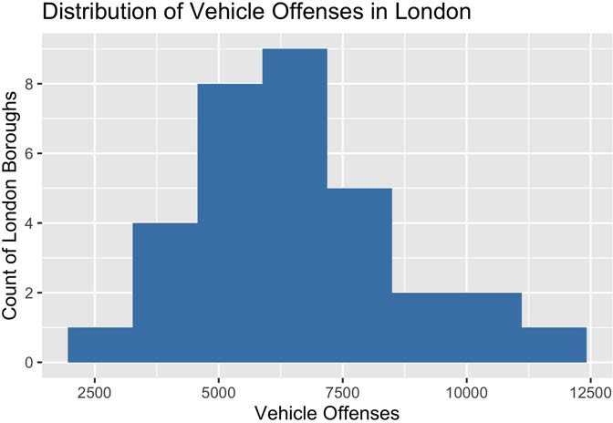
Histograms

Slide 17
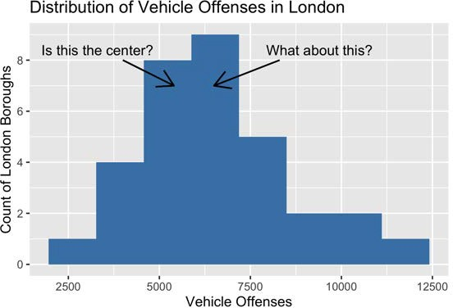
What is the typical amount of vehicle crime in London?
Where is the center of the data?
Mean Median Mode

Slide 18
Measures of center: mean
Sum of all values
mean =
Count of all values
Mean burglaries per London borough:
(2, 318 + 5, 067 + 1, 583 + 3, 893 + ...)
Mean(Burglary) =
= 3, 462.8125
32

Slide 19
Measures of center: mean
Type of Crime | Mean
Burglary | 3358.06
Robbery | 1450.85
Theft | 10642.21
Vehicle Offenses | 6227.27
Overall | 47671.62

Slide 20
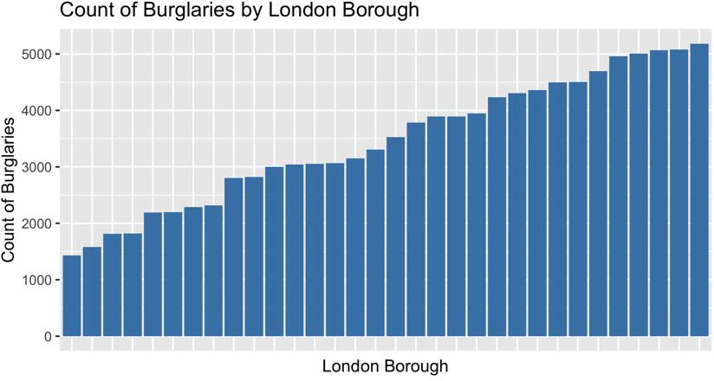
Measures of center: median
Median - middle value for a given variable

Slide 21
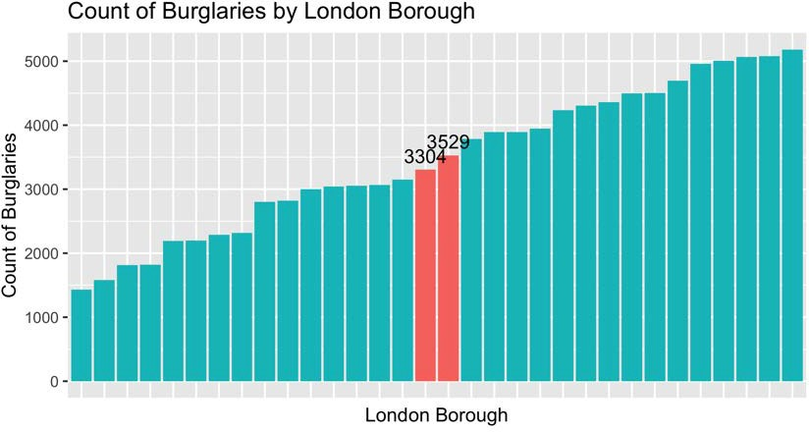
Measures of center: median

Slide 22
Measures of center: median
Median(Burglary) = ^{(3,304 +3,529)}
2
Median(Burglary) = 3, 416.5

Slide 23
Measures of center: mode
Mode - most frequent value
Type of Crime | Count
Burglary | 110,810
Robbery | 47,877
Theft | 350,025
Vehicle Offenses | 205,337

Slide 24
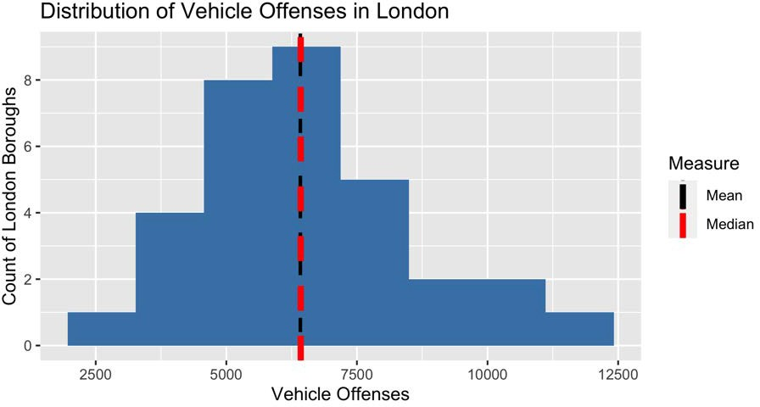
Which measure to use?

Slide 25
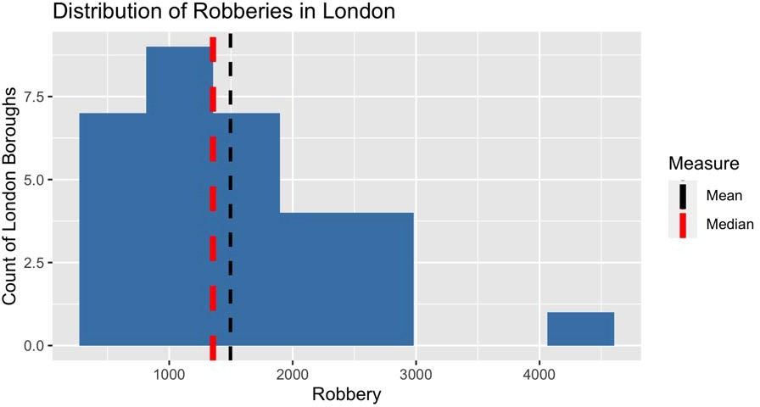
Which measure to use?

Slide 26
Measures of spread
I N T R O D U C T I O N TO STAT I ST I C S
George Boorman
Curriculum Manager, DataCamp

Slide 27

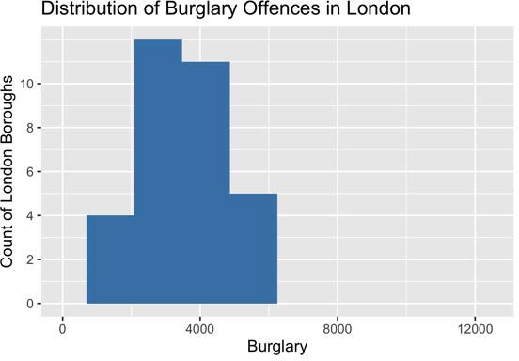
What is spread?

Slide 28

Why is spread important?
Spread measures the variety of our data
T-shirts typically cost $30 Can cost between $10-200
How likely is it one will cost $30?
If t-shirts were priced between $20-50
Does this change the likelihood of finding one for $30?
¹ Image credit: https://unsplash.com/@uyk

Slide 29
Range
Borough | Burglary
Tower Hamlets | 5,183
Hackney | 5,079
Barnet | 5,067
... | ...
Sutton | 1,815
Bexley | 1,583
Kingston upon Thames | 1,432
range = maximum − minimum
range(Burglaries) = 5, 183 − 1, 432
range(Burglaries) = 3, 751

Slide 30
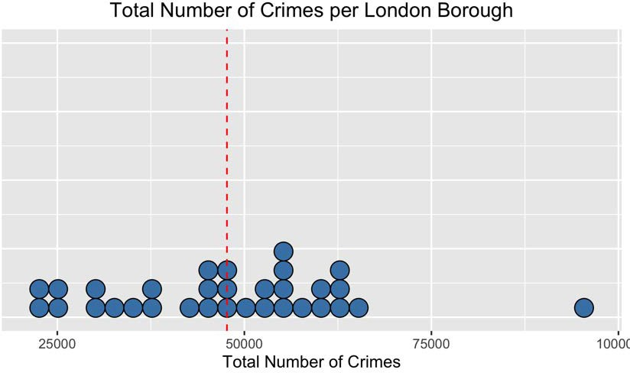
Variance

Slide 31
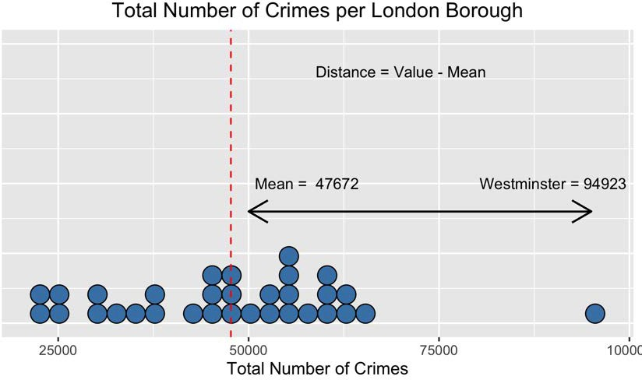
Variance

Slide 32
Variance
Borough | Total Crime | Mean | Distance
Barking and Dagenham | 37,939 | 47,672 | -9,733
Barnet | 52,421 | 47,672 | 4,749
Bexley | 29,285 | 47,672 | -18,387
Brent | 55,465 | 47,672 | 7,793
Bromley | 42,982 | 47,672 | -4,690
Camden | 54,806 | 47,672 | 7,134
... | ... | ... | ...
Total | 1,525,492 | 1,525,492 | 0

Slide 33
Variance
Borough | Total Crime | Mean | Distance | Squared Distance
Barking and Dagenham | 37,939 | 47,672 | -9,733 | 94,731,289
Barnet | 52,421 | 47,672 | 4,749 | 22,553,001
Bexley | 29,285 | 47,672 | -18,387 | 338,081,769
Brent | 55,465 | 47,672 | 7,793 | 60,730,849
Bromley | 42,982 | 47,672 | -4,690 | 21,996,100
Camden | 54,806 | 47,672 | 7,134 | 50,893,956
... | ... | ... | ... | ...
Total | 1,525,492 | 1,525,492 | 0 | 7,509,750,824

Slide 34
Variance
7, 509, 750, 824
variance(total crime) =
32
variance(total crime) = 234, 679, 713

Slide 35
Standard deviation
standard deviation(total crime) = √(variance(total crime))
standard deviation(total crime) = √(234, 679, 713)
standard deviation(total crime) = 15, 319.26
Standard deviation close to zero = data clustered around the mean

Slide 36
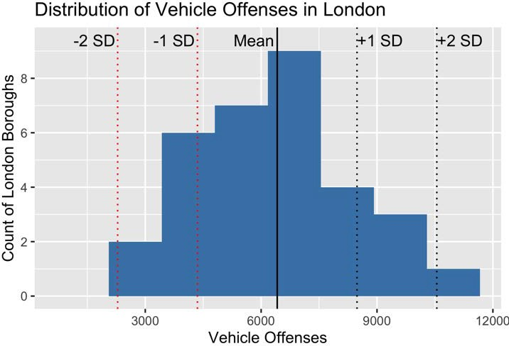
Standard deviation in a histogram

Slide 37
Quartiles
Quartiles:
splitting the data into four equal parts
Crime | 0% | 25% | 50% | 75% | 100%
Burglary | 1,432.00 | 2,681.75 | 3,416.50 | 4,392.00 | 5,183.00
Robbery | 363.00 | 895.75 | 1,354.50 | 1,976.50 | 4,156.00
Theft | 4,090.00 | 7,739.75 | 9,624.00 | 12,059.00 | 40,278.00
Vehicle Offenses | 2,143.00 | 4,838.25 | 6,424.50 | 7,520.75 | 11,292.00
Second quartile (50%) = median

Slide 38
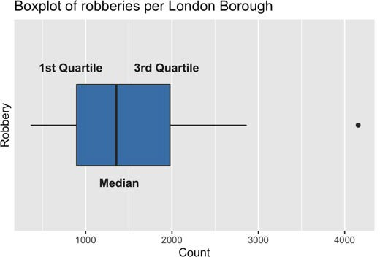
Box plots

Slide 39
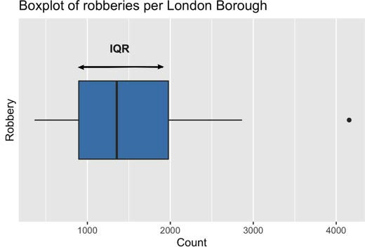
Interquartile range (IQR)
IQR = 3rd Quartile - 1st Quartile
IQR = 1976.50 - 895.75
IQR = 1080.75
IQR is less affected by extreme values

