Slide 1
Introduction to regression
S U P E R V I S E D L E A R N I N G W I T H S C I K I T- L E A R N
George Boorman
Core Curriculum Manager, DataCamp

Slide 2
Predicting blood glucose levels
pandas pd
diabetes_df = pd.read_csv("diabetes.csv") print(diabetes_df.head())
 | pregnancies | glucose | triceps | insulin | bmi | age | diabetes
0 | 6 | 148 | 35 | 0 | 33.6 | 50 | 1
1 | 1 | 85 | 29 | 0 | 26.6 | 31 | 0
2 | 8 | 183 | 0 | 0 | 23.3 | 32 | 1
3 | 1 | 89 | 23 | 94 | 28.1 | 21 | 0
4 | 0 | 137 | 35 | 168 | 43.1 | 33 | 1

Slide 3
Creating feature and target arrays
X = diabetes_df.drop("glucose", axis=1).values y = diabetes_df["glucose"].values print(type(X), type(y))
<class 'numpy.ndarray'> <class 'numpy.ndarray'>

Slide 4
Making predictions from a single feature
X_bmi = X[:, 3] print(y.shape, X_bmi.shape)
(752,) (752,)
X_bmi = X_bmi.reshape(-1, 1) print(X_bmi.shape)
(752, 1)

Slide 5
Plotting glucose vs. body mass index
matplotlib.pyplot plt plt.scatter(X_bmi, y) plt.ylabel("Blood Glucose (mg/dl)") plt.xlabel("Body Mass Index") plt.show()

Slide 6
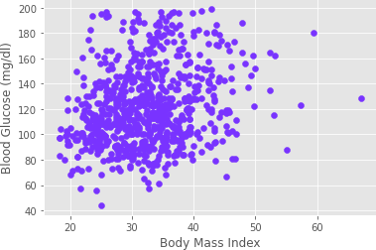
Plotting glucose vs. body mass index

Slide 7
Fitting a regression model
sklearn.linear_model reg = LinearRegression() reg.fit(X_bmi, y)
predictions = reg.predict(X_bmi) plt.scatter(X_bmi, y) plt.plot(X_bmi, predictions)
LinearRegression
plt.ylabel("Blood Glucose (mg/dl)") plt.xlabel("Body Mass Index") plt.show()

Slide 8
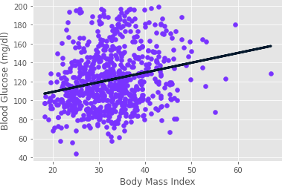
Fitting a regression model

Slide 9
The basics of linear regression
S U P E R V I S E D L E A R N I N G W I T H S C I K I T- L E A R N
George Boorman
Core Curriculum Manager, DataCamp

Slide 10
Regression mechanics
y = ax + b
Simple linear regression uses one feature
y = target
x = single feature
a, b = parameters/coefficients of the model - slope, intercept How do we choose a and b?
Define an error function for any given line
Choose the line that minimizes the error function Error function = loss function = cost function

Slide 11
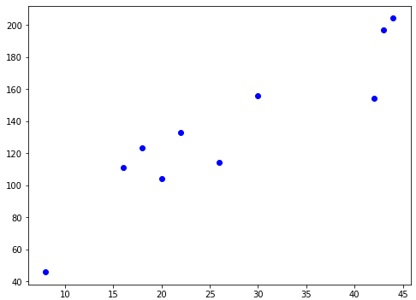
The loss function

Slide 12
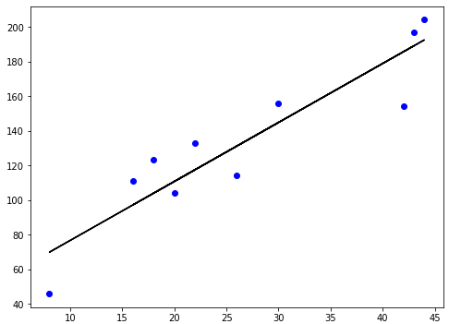
The loss function

Slide 13
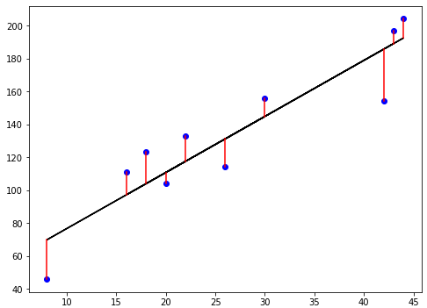
The loss function

Slide 14

The loss function

Slide 15
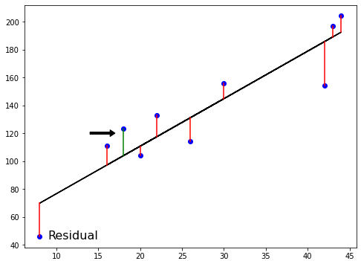
The loss function

Slide 16
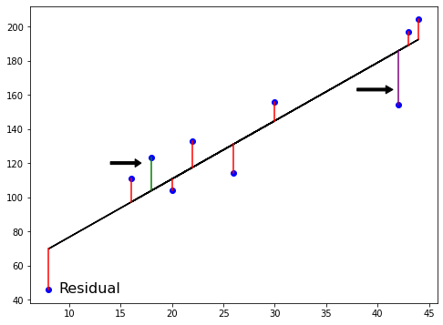
Ordinary Least Squares
n
RSS = ∑(y_{i} − y^_{i})²
i=1
Ordinary Least Squares (OLS): minimize RSS
RSS: Residual Sum of Squares

Slide 17
Linear regression in higher dimensions
y = a₁x₁ + a₂x₂ + b
To fit a linear regression model here: Need to specify 3 variables: a₁, a₂, b
In higher dimensions:
Known as multiple regression
Must specify coefficients for each feature and the variable b
y = a₁x₁ + a₂x₂ + a₃x₃ + ... + a_{n}x_{n} + b
scikit-learn works exactly the same way: Pass two arrays: features and target

Slide 18
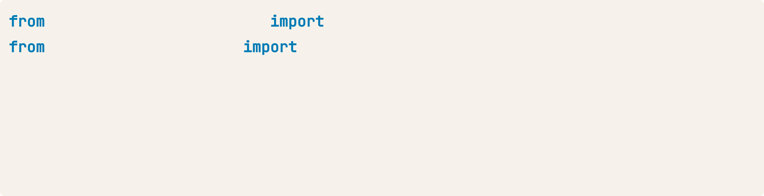
Linear regression using all features
sklearn.model_selection sklearn.linear_model
train_test_split LinearRegression
X_train, X_test, y_train, y_test = train_test_split(X, y, test_size=0.3,
random_state=42)
reg_all = LinearRegression() reg_all.fit(X_train, y_train) y_pred = reg_all.predict(X_test)

Slide 19
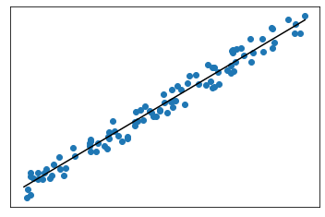
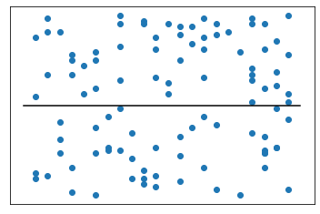
R-squared
R²: quantifies the variance in target values explained by the features
Values range from 0 to 1
High R²:
Low R²:

Slide 20
R-squared in scikit-learn
reg_all.score(X_test, y_test)
0.356302876407827

Slide 21
Mean squared error and root mean squared error
1
n
n
∑(y_{i} − y^_{i})²
i=1
MSE =
MSE is measured in target units, squared
RMSE = √MSE
Measure RMSE in the same units at the target variable

Slide 22
RMSE in scikit-learn
sklearn.metrics mean_squared_error mean_squared_error(y_test, y_pred, squared=False)
24.028109426907236
squared=False: This option specifies that the output should be the Root Mean Squared Error (RMSE) instead of the MSE.
By default, squared=True, which returns the MSE
MSE is often used during optimization since it penalizes larger errors more heavily
RMSE is used for interpretation because it is in the same scale as the target variable,
making it easier to understand how far predictions deviate from actual values.

Slide 23
Cross-validation
S U P E R V I S E D L E A R N I N G W I T H S C I K I T- L E A R N
George Boorman
Core Curriculum Manager, DataCamp

Slide 24
Cross-validation motivation
Model performance is dependent on the way we split up the data Not representative of the model's ability to generalize to unseen data Solution: Cross-validation!

Slide 25
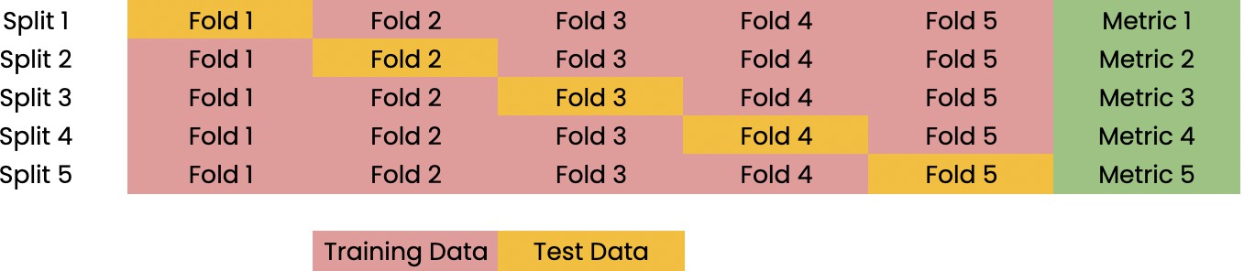
Cross-validation basics

Slide 26
Cross-validation and model performance
5 folds = 5-fold CV
10 folds = 10-fold CV k folds = k-fold CV
More folds = More computationally expensive

Slide 27
Cross-validation in scikit-learn
sklearn.model_selection cross_val_score, KFold kf = KFold(n_splits=6, shuffle=True, random_state=42)
reg = LinearRegression()
cv_results = cross_val_score(reg, X, y, cv=kf)
shuffle=True:
Randomly shuffles the data before splitting it into folds.
This ensures that the data is not divided in the same order as it appears in the dataset,
which can improve the robustness of the cross-validation process.

Slide 28
Evaluating cross-validation peformance
print(cv_results)
[0.70262578, 0.7659624, 0.75188205, 0.76914482, 0.72551151, 0.73608277]
print(np.mean(cv_results), np.std(cv_results))
0.7418682216666667 0.023330243960652888
print(np.quantile(cv_results, [0.025, 0.975]))
array([0.7054865, 0.76874702])

Slide 29
Regularized regression
S U P E R V I S E D L E A R N I N G W I T H S C I K I T- L E A R N
George Boorman
Core Curriculum Manager, DataCamp

Slide 30
Why regularize?
Recall: Linear regression minimizes a loss function
It chooses a coefficient, a, for each feature variable, plus b
Large coefficients can lead to overfitting Regularization: Penalize large coefficients

Slide 31
Ridge regression
Ridge regression is a type of linear regression that includes L2 regularization. It is used to prevent overfitting and handle multicollinearity in the data by introducing a penalty term to the loss function that shrinks the regression coefficients towards zero.
Loss function = OLS loss function +
n
α ∗ ∑ a_{i}²
i=1
Ridge penalizes large positive or negative coefficients
α: parameter we need to choose
Multicollinearity refers to a situation in regression analysis where two or more independent variables (predictors) are highly correlated with each other. This means they provide redundant information about the dependent variable, making it difficult to isolate the individual effect of each predictor.
Picking α is similar to picking k
in KNN
Hyperparameter: variable used to optimize model parameters
α controls model complexity
α = 0 = OLS (Can lead to overfitting)
Very high α: Can lead to underfitting
a_{i} Coefficients of the regression model
n Number of predictors

Slide 32
Ridge regression in scikit-learn
sklearn.linear_model Ridge scores = []
alpha [0.1, 1.0, 10.0, 100.0, 1000.0]:
ridge = Ridge(alpha=alpha) ridge.fit(X_train, y_train) y_pred = ridge.predict(X_test)
scores.append(ridge.score(X_test, y_test)) print(scores)
[0.2828466623222221, 0.28320633574804777, 0.2853000732200006,
0.26423984812668133, 0.19292424694100963]
Interpreting the Ridge Score:
High R2R^2R2 (close to 1): Indicates the model explains most of the variability in the data.
Low R2R^2R2 (close to 0): Indicates the model explains very little of the variability.
A better R2R^2R2 on test data compared to training data suggests that Ridge regression is effectively reducing overfitting.

Slide 33
Lasso regression
Loss function = OLS loss function +
n
α ∗ ∑ ∣a_{i}∣
i=1
Lasso regression (short for Least Absolute Shrinkage and Selection Operator) is a linear regression method that includes L1 regularization. It is used for both preventing overfitting and performing feature selection.
L1 Regularization: The loss function in Lasso regression adds a penalty proportional to the absolute values of the regression coefficients

Slide 34
Lasso regression in scikit-learn
sklearn.linear_model Lasso scores = []
alpha [0.01, 1.0, 10.0, 20.0, 50.0]:
lasso = Lasso(alpha=alpha) lasso.fit(X_train, y_train) lasso_pred = lasso.predict(X_test)
scores.append(lasso.score(X_test, y_test)) print(scores)
[0.99991649071123, 0.99961700284223, 0.93882227671069, 0.74855318676232, -0.05741034640016]
Interpreting Lasso Score:
High:
  Indicates the model explains a significant portion of the variance in the target variable.
  For Lasso, this means that the selected features (non-zero coefficients) are strong predictors of the target.
Low:
  Suggests that the model does not explain much of the variance in the target variable.
  For Lasso, a low R2R^2R2 may occur if the regularization parameter (α\alphaα) is too high, leading to excessive shrinkage of coefficients (or all coefficients being reduced to zero).

Slide 35
Lasso regression for feature selection
Lasso can select important features of a dataset
Shrinks the coefficients of less important features to zero Features not shrunk to zero are selected by lasso

Slide 36
Lasso for feature selection in scikit-learn
sklearn.linear_model Lasso
X = diabetes_df.drop("glucose", axis=1).values y = diabetes_df["glucose"].values
names = diabetes_df.drop("glucose", axis=1).columns lasso = Lasso(alpha=0.1)
lasso_coef = lasso.fit(X, y).coef_ plt.bar(names, lasso_coef) plt.xticks(rotation=45)
plt.show()

Slide 37
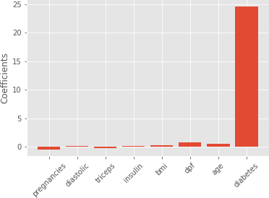
Lasso for feature selection in scikit-learn

