Slide 1
How good is your model?
S U P E R V I S E D L E A R N I N G W I T H S C I K I T- L E A R N
George Boorman
Core Curriculum Manager, DataCamp

Slide 2
Classification metrics
Measuring model performance with accuracy: Fraction of correctly classified samples
Not always a useful metric

Slide 3
Class imbalance
Classification for predicting fraudulent bank transactions 99% of transactions are legitimate; 1% are fraudulent
Could build a classifier that predicts NONE of the transactions are fraudulent 99% accurate!
But terrible at actually predicting fraudulent transactions Fails at its original purpose
Class imbalance: Uneven frequency of classes
Need a different way to assess performance

Slide 4
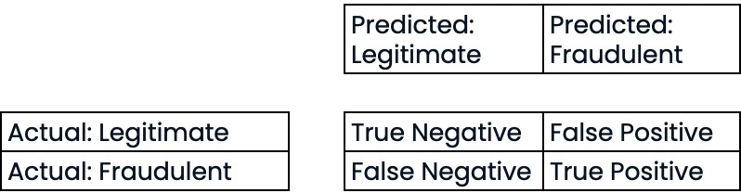
Confusion matrix for assessing classification performance
Confusion matrix

Slide 5
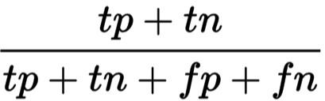
Assessing classification performance
Accuracy:

Slide 6
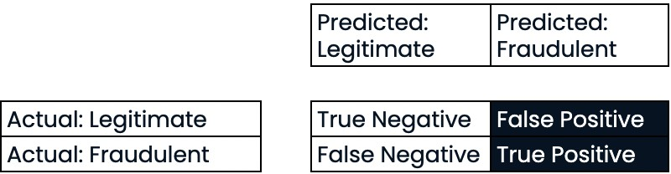

Precision
Precision
High precision = lower false positive rate
High precision: Not many legitimate transactions are predicted to be fraudulent

Slide 7
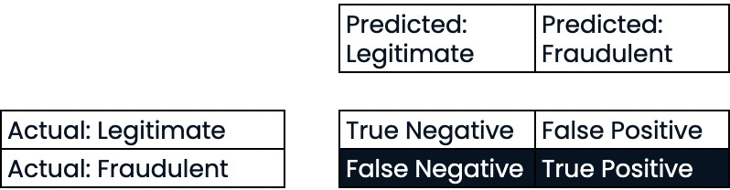

Recall
Recall
High recall = lower false negative rate
High recall: Predicted most fraudulent transactions correctly

Slide 8
F1 score
_{F1 Score: 2 ∗} precision ∗ recall
precision + recall

Slide 9
Confusion matrix in scikit-learn
sklearn.metrics classification_report, confusion_matrix knn = KNeighborsClassifier(n_neighbors=7)
X_train, X_test, y_train, y_test = train_test_split(X, y, test_size=0.4,
random_state=42)
knn.fit(X_train, y_train) y_pred = knn.predict(X_test)

Slide 10
Confusion matrix in scikit-learn
print(confusion_matrix(y_test, y_pred))
[[1106 11]
[ 183 34]]

Slide 11
Classification report in scikit-learn
print(classification_report(y_test, y_pred))
 | precision | recall | f1-score | support
0 | 0.86 | 0.99 | 0.92 | 1117
1 | 0.76 | 0.16 | 0.26 | 217
accuracy |  |  | 0.85 | 1334
macro avg | 0.81 | 0.57 | 0.59 | 1334
weighted avg | 0.84 | 0.85 | 0.81 | 1334

Slide 12
Logistic regression and the ROC curve
S U P E R V I S E D L E A R N I N G W I T H S C I K I T- L E A R N
George Boorman
Core Curriculum Manager, DataCamp

Slide 13
Logistic regression for binary classification
Logistic regression is used for classification problems
Logistic regression outputs probabilities If the probability, p > 0.5:
The data is labeled 1
If the probability, p < 0.5: The data is labeled 0

Slide 14
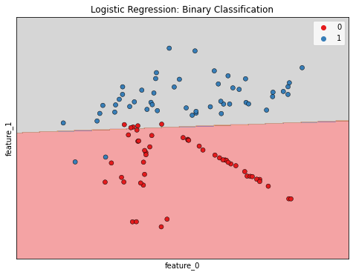
Linear decision boundary

Slide 15
Logistic regression in scikit-learn
sklearn.linear_model LogisticRegression logreg = LogisticRegression()
X_train, X_test, y_train, y_test = train_test_split(X, y, test_size=0.3,
random_state=42)
logreg.fit(X_train, y_train) y_pred = logreg.predict(X_test)

Slide 16
Predicting probabilities
y_pred_probs = logreg.predict_proba(X_test)[:, 1] print(y_pred_probs[0])
[0.08961376]

Slide 17
Probability thresholds
By default, logistic regression threshold = 0.5
Not specific to logistic regression
KNN classifiers also have thresholds
What happens if we vary the threshold?

Slide 18
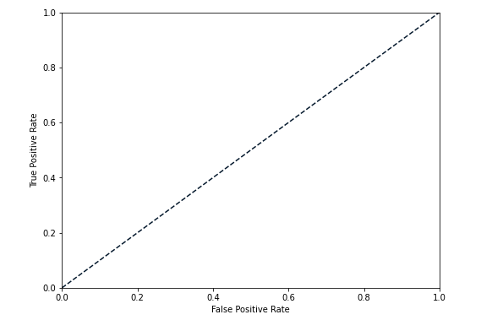
The ROC curve
The ROC Curve (Receiver Operating Characteristic Curve) is a graphical representation of a binary classifier's performance across different classification thresholds. It plots the True Positive Rate (TPR) against the False Positive Rate (FPR) for various threshold values.

Slide 19
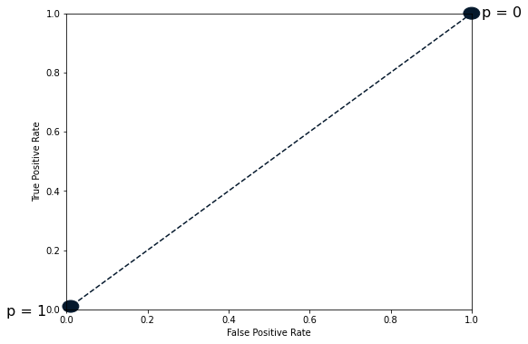
The ROC curve
Shape of the Curve:
A perfect classifier will pass through the top-left corner (TPR = 1, FPR = 0), achieving a sharp curve close to the top-left.
A random classifier (no predictive power) produces a diagonal line from (0, 0) to (1, 1).

Slide 20
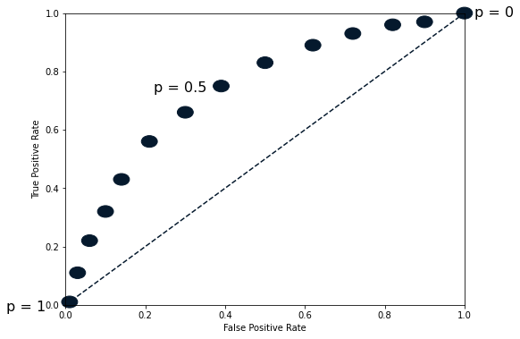
The ROC curve

Slide 21
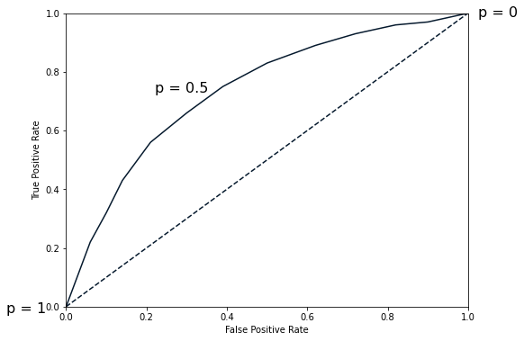
The ROC curve

Slide 22
Plotting the ROC curve
sklearn.metrics roc_curve
fpr, tpr, thresholds = roc_curve(y_test, y_pred_probs) plt.plot([0, 1], [0, 1], 'k--')
plt.plot(fpr, tpr) plt.xlabel('False Positive Rate') plt.ylabel('True Positive Rate')
plt.title('Logistic Regression ROC Curve') plt.show()

Slide 23
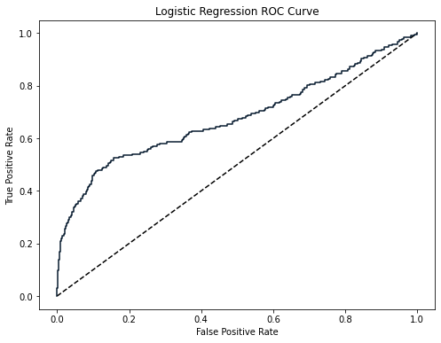
Plotting the ROC curve

Slide 24
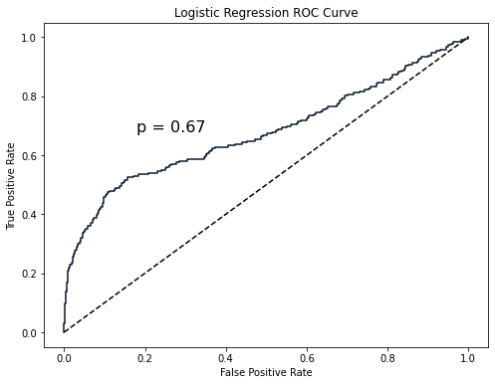
ROC AUC
ROC-AUC quantifies the overall ability of the classifier to distinguish between positive and negative classes.
AUC ranges from 0 to 1:
1: Perfect classification.
0.5: No discrimination (random chance).
< 0.5: Worse than random.

Slide 25
ROC AUC in scikit-learn
sklearn.metrics roc_auc_score print(roc_auc_score(y_test, y_pred_probs))
0.6700964152663693

Slide 26
Hyperparameter tuning
S U P E R V I S E D L E A R N I N G W I T H S C I K I T- L E A R N
George Boorman
Core Curriculum Manager

Slide 27
Hyperparameter tuning
Ridge/lasso regression: Choosing alpha
KNN: Choosing n_neighbors
Hyperparameters: Parameters we specify before fitting the model Like alpha and n_neighbors

Slide 28
Choosing the correct hyperparameters
Try lots of different hyperparameter values
Fit all of them separately
See how well they perform
Choose the best performing values
This is called hyperparameter tuning
It is essential to use cross-validation to avoid overfitting to the test set We can still split the data and perform cross-validation on the training set We withhold the test set for final evaluation

Slide 29
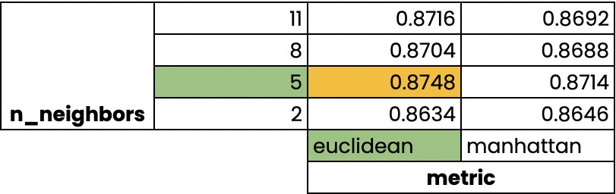
Grid search cross-validation

Slide 30
GridSearchCV in scikit-learn
sklearn.model_selection GridSearchCV
kf = KFold(n_splits=5, shuffle=True, random_state=42) param_grid = {"alpha": np.arange(0.0001, 1, 10),
"solver": ["sag", "lsqr"]} ridge = Ridge()
ridge_cv = GridSearchCV(ridge, param_grid, cv=kf) ridge_cv.fit(X_train, y_train) print(ridge_cv.best_params_, ridge_cv.best_score_)
{'alpha': 0.0001, 'solver': 'sag'} 0.7529912278705785
solver:
Specifies optimization algorithms that the model can use to minimize the loss function.
Common solvers in models like Ridge or ElasticNet:
  sag: Stochastic Average Gradient descent solver (efficient for large datasets).
  lsqr: Least Squares solver (suitable for dense data).

Slide 31
Limitations and an alternative approach
3-fold cross-validation, 1 hyperparameter, 10 total values = 30 fits
10 fold cross-validation, 3 hyperparameters, 30 total values = 900 fits

Slide 32
RandomizedSearchCV
sklearn.model_selection RandomizedSearchCV kf = KFold(n_splits=5, shuffle=True, random_state=42) param_grid = {'alpha': np.arange(0.0001, 1, 10),
"solver": ['sag', 'lsqr']} ridge = Ridge()
ridge_cv = RandomizedSearchCV(ridge, param_grid, cv=kf, n_iter=2) ridge_cv.fit(X_train, y_train)
print(ridge_cv.best_params_, ridge_cv.best_score_)
{'solver': 'sag', 'alpha': 0.0001} 0.7529912278705785

Slide 33
Evaluating on the test set
test_score = ridge_cv.score(X_test, y_test) print(test_score)
0.7564731534089224

