Slide 1
Preprocessing data
S U P E R V I S E D L E A R N I N G W I T H S C I K I T- L E A R N
George Boorman
Core Curriculum Manager, DataCamp

Slide 2
scikit-learn requirements
Numeric data
No missing values
With real-world data: This is rarely the case
We will often need to preprocess our data first

Slide 3
Dealing with categorical features
scikit-learn will not accept categorical features by default
Need to convert categorical features into numeric values Convert to binary features called dummy variables
0: Observation was NOT that category
1: Observation was that category

Slide 4
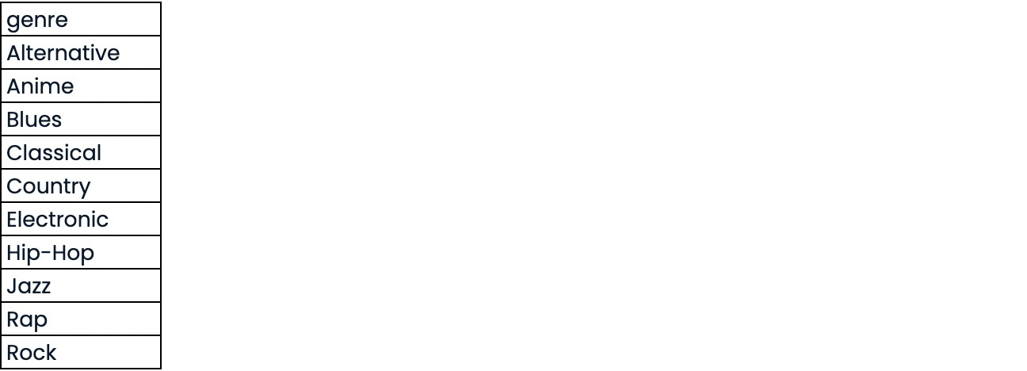
Dummy variables

Slide 5
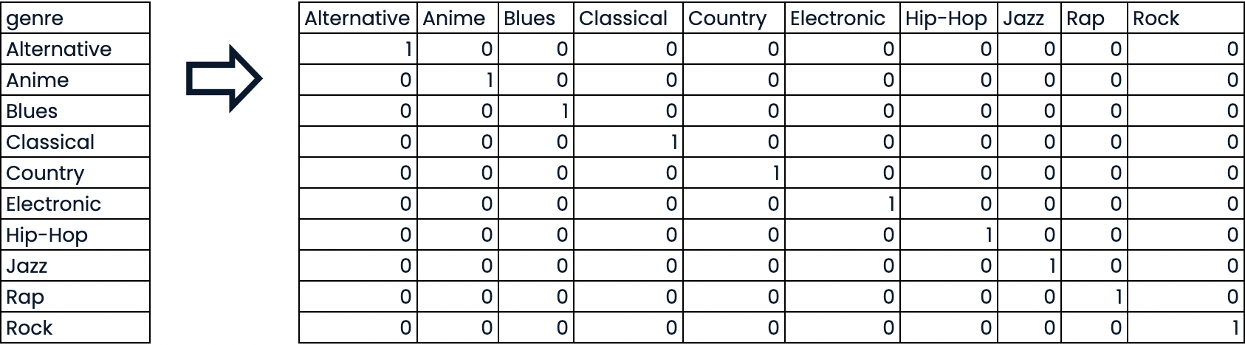
Dummy variables

Slide 6
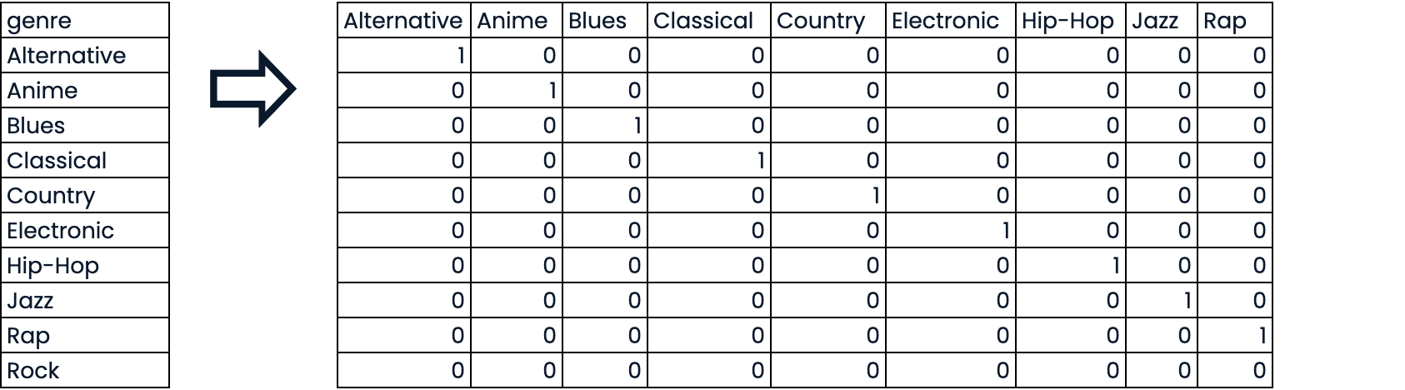
Dummy variables

Slide 7
Dealing with categorical features in Python
scikit-learn: OneHotEncoder()
pandas: get_dummies()

Slide 8
Music dataset
popularity : Target variable
genre : Categorical feature
print(music.info())
popularity 41.0
62.0
42.0
64.0
60.0
acousticness 0.6440
0.0855
0.2390
0.0125
0.1210
danceability 0.823
0.686
0.669
0.522
0.780
...
...
...
...
...
...
tempo 102.619000
173.915000
145.061000
120.406497
96.056000
valence 0.649
0.636
0.494
0.595
0.312
genre Jazz Rap
Electronic Rock
Rap
0
1
2
3
4

Slide 9
EDA w/ categorical feature

Slide 10
Encoding dummy variables
pandas pd
music_df = pd.read_csv('music.csv')
music_dummies = pd.get_dummies(music_df["genre"], drop_first=True) print(music_dummies.head())
Anime 0
0
0
0
0
Blues 0
0
0
0
0
Classical 0
0
0
0
0
Country 0
0
0
0
0
Electronic 0
0
1
0
0
Hip-Hop 0
0
0
0
0
Jazz 1
0
0
0
0
Rap 0
1
0
0
1
Rock 0
0
0
1
0
0
1
2
3
4
music_dummies | = | pd.concat([music_df, music_dummies], | axis=1)
music_dummies | = | music_dummies.drop("genre", axis=1)

Slide 11
Encoding dummy variables
music_dummies = pd.get_dummies(music_df, drop_first=True) print(music_dummies.columns)
Index(['popularity', 'acousticness', 'danceability', 'duration_ms', 'energy', 'instrumentalness', 'liveness', 'loudness', 'speechiness', 'tempo', 'valence', 'genre_Anime', 'genre_Blues', 'genre_Classical', 'genre_Country', 'genre_Electronic', 'genre_Hip-Hop', 'genre_Jazz', 'genre_Rap', 'genre_Rock'],
dtype='object')

Slide 12
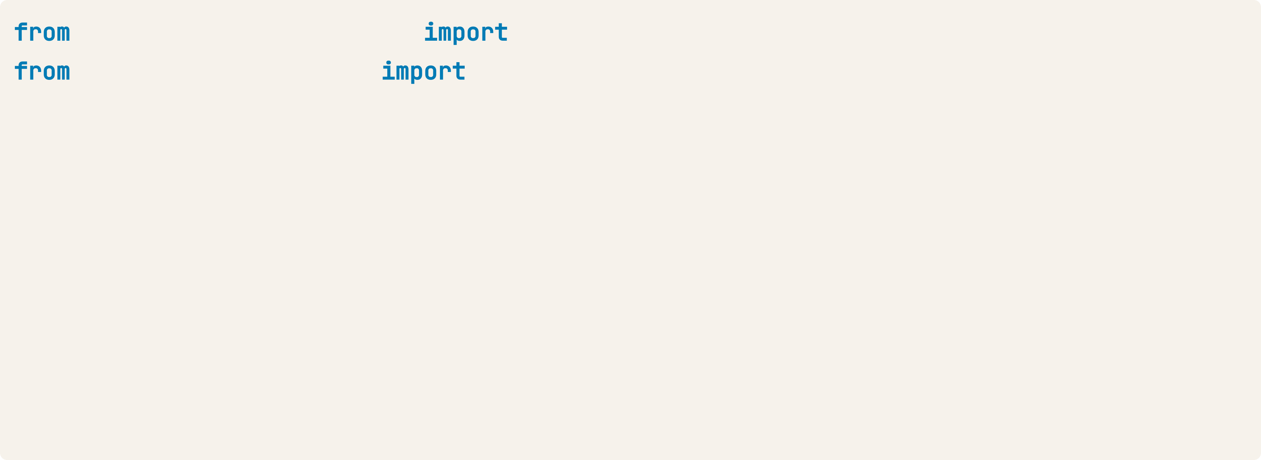
Linear regression with dummy variables
sklearn.model_selection sklearn.linear_model
cross_val_score, KFold LinearRegression
X = music_dummies.drop("popularity", axis=1).values y = music_dummies["popularity"].values
X_train, X_test, y_train, y_test = train_test_split(X, y, test_size=0.2,
random_state=42) kf = KFold(n_splits=5, shuffle=True, random_state=42)
linreg = LinearRegression()
linreg_cv = cross_val_score(linreg, X_train, y_train, cv=kf,
scoring="neg_mean_squared_error")
print(np.sqrt(-linreg_cv))
[8.15792932, 8.63117538, 7.52275279, 8.6205778, 7.91329988]

Slide 13
Handling missing data
S U P E R V I S E D L E A R N I N G W I T H S C I K I T- L E A R N
George Boorman
Core Curriculum Manager, DataCamp

Slide 14
Missing data
No value for a feature in a particular row
This can occur because:
There may have been no observation
The data might be corrupt
We need to deal with missing data

Slide 15
Music dataset
print(music_df.isna().sum().sort_values())
genre popularity loudness liveness tempo speechiness duration_ms
instrumentalness danceability valence acousticness energy
dtype: int64
8
31
44
46
46
59
91
91
143
143
200
200

Slide 16
Dropping missing data
music_df = music_df.dropna(subset=["genre", "popularity", "loudness", "liveness", "tempo"]) print(music_df.isna().sum().sort_values())
popularity liveness loudness tempo genre duration_ms
instrumentalness speechiness danceability valence acousticness energy
dtype: int64
0
0
0
0
0
29
29
53
127
127
178
178

Slide 17
Imputing values
Imputation - use subject-matter expertise to replace missing data with educated guesses
Common to use the mean
Can also use the median, or another value
For categorical values, we typically use the most frequent value - the mode Must split our data first, to avoid data leakage

Slide 18
Imputation with scikit-learn
sklearn.impute SimpleImputer
X_cat = music_df["genre"].values.reshape(-1, 1)
X_num = music_df.drop(["genre", "popularity"], axis=1).values y = music_df["popularity"].values
X_train_cat, X_test_cat, y_train, y_test = train_test_split(X_cat, y, test_size=0.2,
random_state=12) X_train_num, X_test_num, y_train, y_test = train_test_split(X_num, y, test_size=0.2,
random_state=12)
imp_cat = SimpleImputer(strategy="most_frequent") X_train_cat = imp_cat.fit_transform(X_train_cat) X_test_cat = imp_cat.transform(X_test_cat)

Slide 19
Imputation with scikit-learn
imp_num = SimpleImputer()
X_train_num = imp_num.fit_transform(X_train_num) X_test_num = imp_num.transform(X_test_num)
X_train = np.append(X_train_num, X_train_cat, axis=1) X_test = np.append(X_test_num, X_test_cat, axis=1)
Imputers are known as transformers

Slide 20
Imputing within a pipeline
sklearn.pipeline Pipeline
music_df = music_df.dropna(subset=["genre", "popularity", "loudness", "liveness", "tempo"]) music_df["genre"] = np.where(music_df["genre"] == "Rock", 1, 0)
X = music_df.drop("genre", axis=1).values y = music_df["genre"].values

Slide 21
Imputing within a pipeline
steps = [("imputation", SimpleImputer()), ("logistic_regression", LogisticRegression())]
pipeline = Pipeline(steps)
X_train, X_test, y_train, y_test = train_test_split(X, y, test_size=0.3,
random_state=42)
pipeline.fit(X_train, y_train) pipeline.score(X_test, y_test)
0.7593582887700535

Slide 22
Centering and scaling
S U P E R V I S E D L E A R N I N G W I T H S C I K I T- L E A R N
George Boorman
Core Curriculum Manager

Slide 23
Why scale our data?
print(music_df[["duration_ms", "loudness", "speechiness"]].describe())
 | duration_ms | loudness | speechiness
count | 1.000000e+03 | 1000.000000 | 1000.000000
mean | 2.176493e+05 | -8.284354 | 0.078642
std | 1.137703e+05 | 5.065447 | 0.088291
min | -1.000000e+00 | -38.718000 | 0.023400
25% | 1.831070e+05 | -9.658500 | 0.033700
50% | 2.176493e+05 | -7.033500 | 0.045000
75% | 2.564468e+05 | -5.034000 | 0.078642
max | 1.617333e+06 | -0.883000 | 0.710000

Slide 24
Why scale our data?
Many models use some form of distance to inform them
Features on larger scales can disproportionately influence the model Example: KNN uses distance explicitly when making predictions
We want features to be on a similar scale
Normalizing or standardizing (scaling and centering)

Slide 25
How to scale our data
Subtract the mean and divide by variance
All features are centered around zero and have a variance of one
This is called standardization
Can also subtract the minimum and divide by the range Minimum zero and maximum one
Can also normalize so the data ranges from -1 to +1 See scikit-learn docs for further details

Slide 26
Scaling in scikit-learn
sklearn.preprocessing StandardScaler
X = music_df.drop("genre", axis=1).values y = music_df["genre"].values
X_train, X_test, y_train, y_test = train_test_split(X, y, test_size=0.2,
random_state=42)
scaler = StandardScaler()
X_train_scaled = scaler.fit_transform(X_train) X_test_scaled = scaler.transform(X_test) print(np.mean(X), np.std(X)) print(np.mean(X_train_scaled), np.std(X_train_scaled))
19801.42536120538, 71343.52910125865
2.260817795600319e-17, 1.0

Slide 27
Scaling in a pipeline
steps = [('scaler', StandardScaler()),
('knn', KNeighborsClassifier(n_neighbors=6))] pipeline = Pipeline(steps)
X_train, X_test, y_train, y_test = train_test_split(X, y, test_size=0.2,
random_state=21)
knn_scaled = pipeline.fit(X_train, y_train) y_pred = knn_scaled.predict(X_test) print(knn_scaled.score(X_test, y_test))
0.81

Slide 28
Comparing performance using unscaled data
X_train, X_test, y_train, y_test = train_test_split(X, y, test_size=0.2,
random_state=21) knn_unscaled = KNeighborsClassifier(n_neighbors=6).fit(X_train, y_train) print(knn_unscaled.score(X_test, y_test))
0.53

Slide 29
CV and scaling in a pipeline
sklearn.model_selection GridSearchCV steps = [('scaler', StandardScaler()),
('knn', KNeighborsClassifier())] pipeline = Pipeline(steps)
parameters = {"knn n_neighbors": np.arange(1, 50)}
X_train, X_test, y_train, y_test = train_test_split(X, y, test_size=0.2,
random_state=21)
cv = GridSearchCV(pipeline, param_grid=parameters) cv.fit(X_train, y_train)
y_pred = cv.predict(X_test)

Slide 30
Checking model parameters
print(cv.best_score_)
0.8199999999999999
print(cv.best_params_)
{'knn n_neighbors': 12}

Slide 31
Evaluating multiple models
S U P E R V I S E D L E A R N I N G W I T H S C I K I T- L E A R N
George Boorman
Core Curriculum Manager, DataCamp

Slide 32
Different models for different problems
Some guiding principles
Size of the dataset
Fewer features = simpler model, faster training time
Some models require large amounts of data to perform well Interpretability
Some models are easier to explain, which can be important for stakeholders
Linear regression has high interpretability, as we can understand the coefficients Flexibility
May improve accuracy, by making fewer assumptions about data
KNN is a more flexible model, doesn't assume any linear relationships

Slide 33
It's all in the metrics
Regression model performance: RMSE
R-squared
Classification model performance: Accuracy
Confusion matrix Precision, recall, F1-score ROC AUC
Train several models and evaluate performance out of the box

Slide 34
A note on scaling
Models affected by scaling: KNN
Linear Regression (plus Ridge, Lasso) Logistic Regression
Artificial Neural Network
Best to scale our data before evaluating models

Slide 35
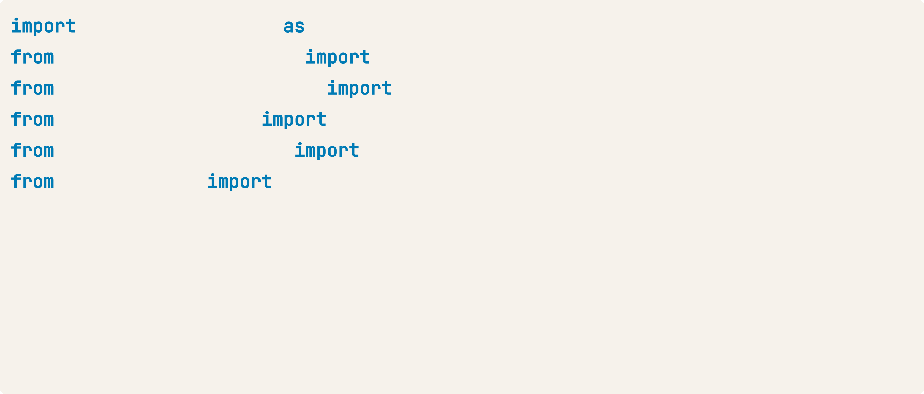
Evaluating classification models
matplotlib.pyplot plt sklearn.preprocessing
StandardScaler
cross_val_score, KFold, train_test_split KNeighborsClassifier
LogisticRegression
sklearn.model_selection sklearn.neighbors sklearn.linear_model
sklearn.tree DecisionTreeClassifier
X = music.drop("genre", axis=1).values y = music["genre"].values
X_train, X_test, y_train, y_test = train_test_split(X, y, random_state=42) scaler = StandardScaler()
X_train_scaled = scaler.fit_transform(X_train) X_test_scaled = scaler.transform(X_test)

Slide 36
Evaluating classification models
models = {"Logistic Regression": LogisticRegression(), "KNN": KNeighborsClassifier(), "Decision Tree": DecisionTreeClassifier()}
results = []
model models.values():
kf = KFold(n_splits=6, random_state=42, shuffle=True)
cv_results = cross_val_score(model, X_train_scaled, y_train, cv=kf) results.append(cv_results)
plt.boxplot(results, labels=models.keys()) plt.show()

Slide 37
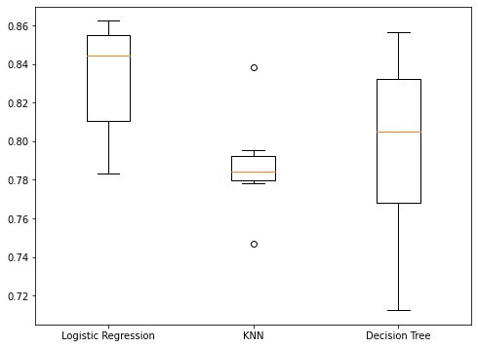
Visualizing results

Slide 38
Test set performance
name, model models.items(): model.fit(X_train_scaled, y_train)
test_score = model.score(X_test_scaled, y_test)
print("{} Test Set Accuracy: {}".format(name, test_score))
Logistic Regression Test Set Accuracy: 0.844 KNN Test Set Accuracy: 0.82
Decision Tree Test Set Accuracy: 0.832

