Slide 1
Unsupervised Learning
U N S U P E R V I S E D L E A R N I N G I N P Y T H O N
Benjamin Wilson
Director of Research at lateral.io

Slide 2
Unsupervised learning
Unsupervised learning finds patterns in data
E.g., clustering customers by their purchases
Compressing the data using purchase patterns (dimension reduction)
Purchase Patterns: In the context of purchase patterns, the data typically involves customer behaviors, such as products bought, quantities, and frequencies. Dimension reduction could help:
  Identify key factors or patterns that explain the majority of purchase behaviors (e.g., grouping similar products or customers based on purchasing habits).
  Simplify data for visualization or downstream analysis (e.g., clustering).
Why It’s Unsupervised:
No Explicit Labels: The data consists of raw purchase information without predefined labels (e.g., categories of customers or product groups).
Discovering Structure: The algorithm identifies patterns or underlying factors (e.g., principal components or clusters) without supervision or external guidance.
Examples of Unsupervised Learning for Purchase Patterns:
PCA: Reducing dimensions by identifying combinations of products frequently purchased together.
Clustering: Grouping customers or products based on similarity in purchasing behavior (e.g., k-means clustering).

Slide 3
Supervised vs unsupervised learning
Supervised learning finds patterns for a prediction task
E.g., classify tumors as benign or cancerous (labels) Unsupervised learning finds patterns in data
... but without a specific prediction task in mind

Slide 4
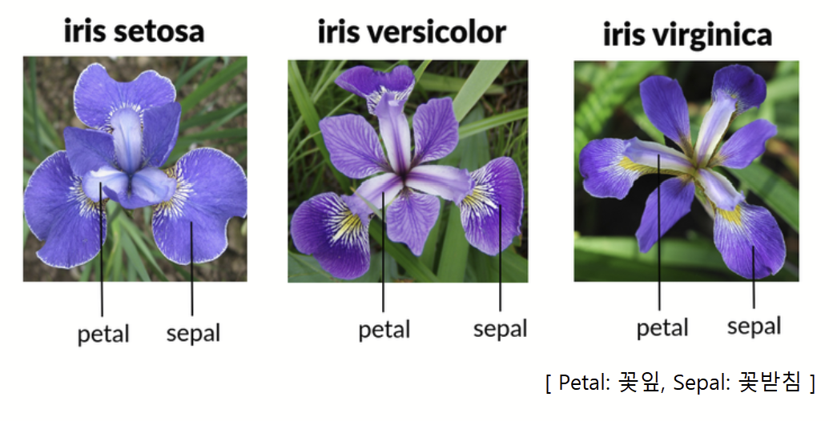
Iris (붓꽃) dataset
Measurements of many iris plants
Three species of iris:
setosa
versicolor virginica
Petal length, petal width, sepal length, sepal width (the features of the dataset)
¹ https://scikit- learn.org/stable/modules/generated/sklearn.datasets.load_iris.html

Slide 5
Arrays, features & samples
2D NumPy array
Columns are measurements (the features) Rows represent iris plants (the samples)

Slide 6
Iris data is 4-dimensional
Iris samples are points in 4 dimensional space
Dimension = number of features Dimension too high to visualize!
... but unsupervised learning gives insight

Slide 7
k-means clustering
Finds clusters of samples
Number of clusters must be specified Implemented in sklearn ("scikit-learn")
K-Means clustering is a popular unsupervised machine learning algorithm used to partition a dataset into a predefined number of groups (clusters).
Each cluster consists of data points that are more similar to each other than to those in other clusters, based on a chosen distance metric (e.g., Euclidean distance).
How K-Means Clustering Works
1. Initialization:
Choose the number of clusters, 𝑘
Randomly initialize 𝑘 cluster centroids (points representing the center of each cluster).
2. Assignment Step:
Assign each data point to the nearest cluster centroid, typically using the Euclidean distance as the similarity measure.
3. Update Step:
Recalculate the centroid of each cluster by averaging the data points assigned to it.
4. Iteration:
Repeat the assignment and update steps until the cluster assignments no longer change significantly or a maximum number of iterations is reached.

Slide 8
print(samples)
[[ 5. | 3.3 | 1.4 | 0.2]
[ 5. | 3.5 | 1.3 | 0.3]
...
[ 7.2 | 3.2 | 6. | 1.8]]
sklearn.cluster KMeans model = KMeans(n_clusters=3) model.fit(samples)
KMeans(n_clusters=3)
labels = model.predict(samples) print(labels)
[0 0 1 1 0 1 2 1 0 1 ...]

Slide 9
Cluster labels for new samples
New samples can be assigned to existing clusters
k-means remembers the mean of each cluster (the "centroids")
Finds the nearest centroid to each new sample

Slide 10
Cluster labels for new samples
print(new_samples)
[[ | 5.7 | 4.4 | 1.5 | 0.4]
[ | 6.5 | 3. | 5.5 | 1.8]
[ | 5.8 | 2.7 | 5.1 | 1.9]]
new_labels = model.predict(new_samples) print(new_labels)
[0 2 1]

Slide 11
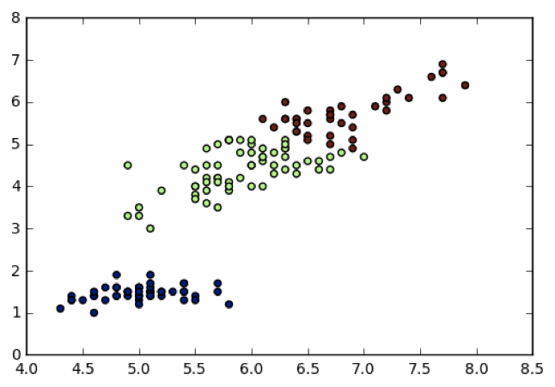
Scatter plots
Scatter plot of sepal length vs. petal length
Each point represents an iris sample
Color points by cluster labels
PyPlot ( matplotlib.pyplot
)

Slide 12
Scatter plots
matplotlib.pyplot xs = samples[:,0]
ys = samples[:,2]
plt
plt.scatter(xs, ys, c=labels) plt.show()

Slide 13
Evaluating a clustering
U N S U P E R V I S E D L E A R N I N G I N P Y T H O N
Benjamin Wilson
Director of Research at lateral.io

Slide 14
Evaluating a clustering
Can check correspondence with e.g. iris species
... but what if there are no species to check against? Measure quality of a clustering
Informs choice of how many clusters to look for

Slide 15
Iris: clusters vs species
k-means found 3 clusters amongst the iris samples Do the clusters correspond to the species?
species labels | setosa | versicolor | virginica
0 | 0 | 2 | 36
1 | 50 | 0 | 0
2 | 0 | 48 | 14

Slide 16
Cross tabulation with pandas
Clusters vs species is a "cross-tabulation"
Use the pandas library
Given the species of each sample as a list species
print(species)
['setosa', 'setosa', 'versicolor', 'virginica', ... ]

Slide 17
Aligning labels and species
pandas pd
df = pd.DataFrame({'labels': labels, 'species': species}) print(df)
 | labels | species
0 | 1 | setosa
1 | 1 | setosa
2 | 2 | versicolor
3 | 2 | virginica
4 | 1 | setosa
...

Slide 18
Crosstab of labels and species
ct = pd.crosstab(df['labels'], df['species']) print(ct)
species labels | setosa | versicolor | virginica
0 | 0 | 2 | 36
1 | 50 | 0 | 0
2 | 0 | 48 | 14
How to evaluate a clustering, if there were no species information?

Slide 19
Measuring clustering quality
Using only samples and their cluster labels A good clustering has tight clusters Samples in each cluster bunched together
In clustering, inertia measures the quality of clusters by calculating the sum of squared distances (SSD) between each data point and its assigned cluster's centroid.
It reflects how tightly the data points in a cluster are grouped around the centroid.
Lower Inertia Indicates Better Clustering:
A lower inertia value suggests that the data points within each cluster are closer to their centroids, indicating tighter and more cohesive clusters.
Minimizing Inertia: The goal of algorithms like K-Means is to minimize inertia. It adjusts the centroids and reassigns points to clusters iteratively to achieve this.

Slide 20
Inertia measures clustering quality
Measures how spread out the clusters are (lower is better)
Distance from each sample to centroid of its cluster After fit() , available as attribute inertia_
k-means attempts to minimize the inertia when choosing clusters
sklearn.cluster KMeans
model = KMeans(n_clusters=3) model.fit(samples) print(model.inertia_)
78.9408414261

Slide 21
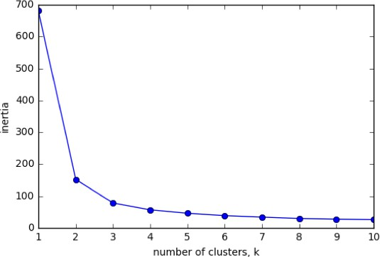
The number of clusters
Clusterings of the iris dataset with different numbers of clusters
More clusters means lower inertia
What is the best number of clusters?

Slide 22
How many clusters to choose?
A good clustering has tight clusters (so low inertia)
... but not too many clusters!
Choose an "elbow" in the inertia plot
Where inertia begins to decrease more slowly
E.g., for iris dataset, 3 is a good choice

Slide 23
Transforming features for better clusterings
U N S U P E R V I S E D L E A R N I N G I N P Y T H O N
Benjamin Wilson
Director of Research at lateral.io

Slide 24
Piedmont wines dataset
178 samples from 3 distinct varieties of red wine: Barolo, Grignolino and Barbera
Features measure chemical composition e.g. alcohol content Visual properties like "color intensity"
¹ Source: https://archive.ics.uci.edu/ml/datasets/Wine

Slide 25
Clustering the wines
sklearn.cluster KMeans model = KMeans(n_clusters=3)
labels = model.fit_predict(samples)

Slide 26
Clusters vs. varieties
df = pd.DataFrame({'labels': labels,
'varieties': varieties}) ct = pd.crosstab(df['labels'], df['varieties']) print(ct)
varieties | Barbera | Barolo | Grignolino
labels
0 | 29 | 13 | 20
1 | 0 | 46 | 1
2 | 19 | 0 | 50

Slide 27
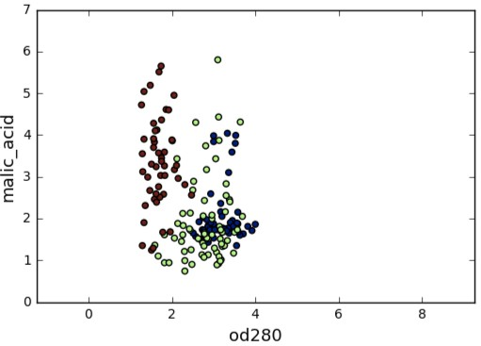
Feature variances
The wine features have very different variances!
Variance of a feature measures spread of its values
feature alcohol malic_acid
...
od280 proline
variance
0.65
1.24
0.50
99166.71
proline: 단백질생성성 아미노산(단백질의 생합성에 사용됨)으로 분류되는 유기산
od280: method for calculating protein concentration
malic acid: 말산은 모든 생물에서 만들어지고, 과일의 유쾌한 신맛에 기여하며, 식품 첨가물로 사용되는 다이카복실산

Slide 28
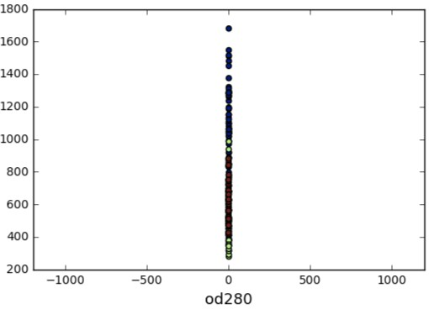
Feature variances
The wine features have very different variances!
Variance of a feature measures spread of its values
proline
feature alcohol malic_acid
...
od280 proline
variance
0.65
1.24
0.50
99166.71

Slide 29
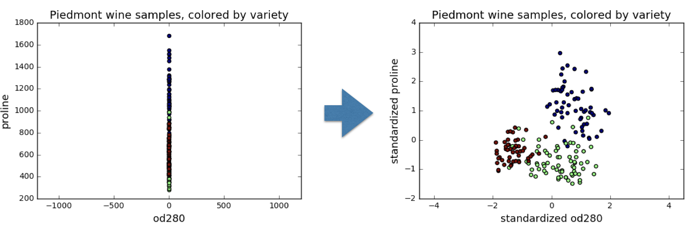
StandardScaler
In kmeans: feature variance = feature influence
StandardScaler transforms each feature to have mean 0 and variance 1
Features are said to be "standardized"

Slide 30
sklearn StandardScaler
sklearn.preprocessing scaler = StandardScaler() scaler.fit(samples)
StandardScaler
StandardScaler(copy=True, with_mean=True, with_std=True) samples_scaled = scaler.transform(samples)

Slide 31
Similar methods
StandardScaler and KMeans have similar methods
Use fit() / transform() with StandardScaler
Use fit() / predict() with KMeans

Slide 32
StandardScaler, then KMeans
Need to perform two steps: StandardScaler , then KMeans
Use sklearn pipeline to combine multiple steps Data flows from one step into the next

Slide 33
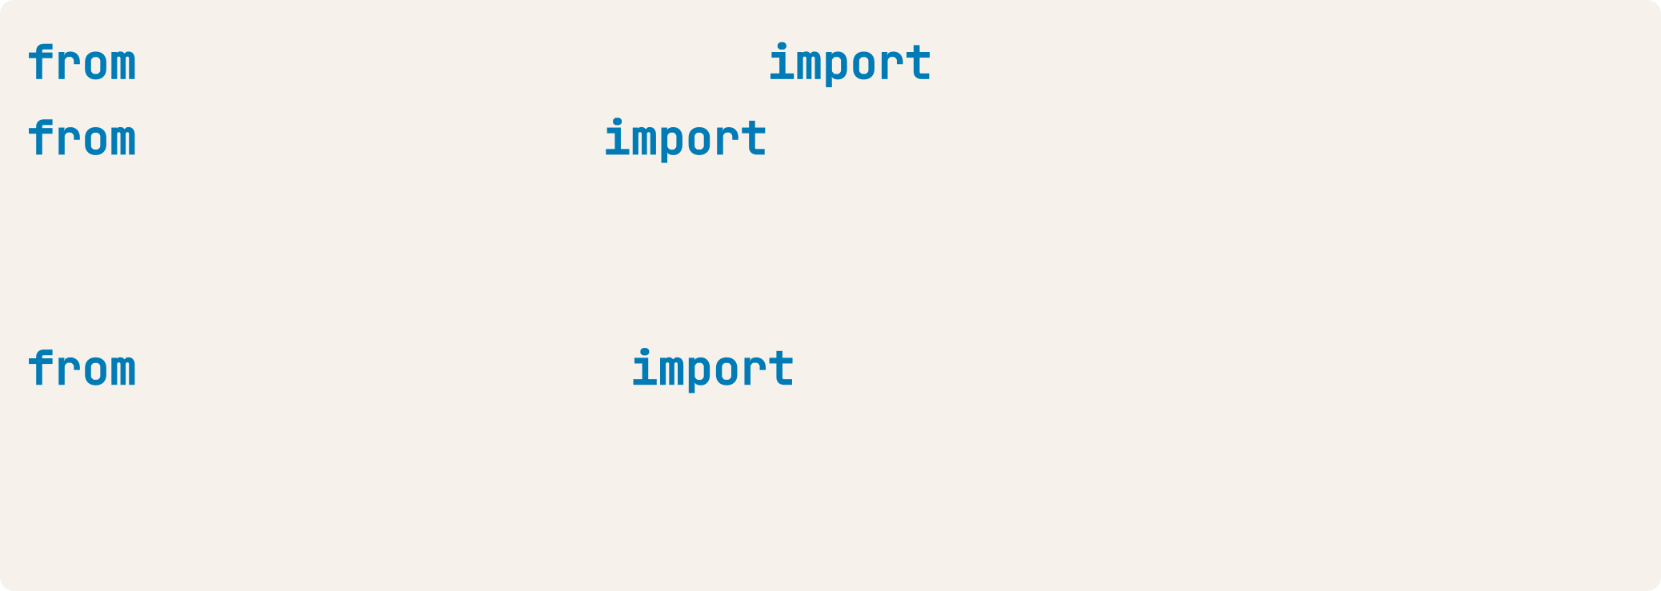
Pipelines combine multiple steps
sklearn.preprocessing sklearn.cluster
StandardScaler KMeans
scaler | = | StandardScaler()
kmeans | = | KMeans(n_clusters=3)
sklearn.pipeline make_pipeline pipeline = make_pipeline(scaler, kmeans) pipeline.fit(samples)
Pipeline(steps=...)
labels = pipeline.predict(samples)

Slide 34
Feature standardization improves clustering
With feature standardization:
varieties labels | Barbera | Barolo | Grignolino
0 | 0 | 59 | 3
1 | 48 | 0 | 3
2 | 0 | 0 | 65
Without feature standardization was very bad:
varieties labels | Barbera | Barolo | Grignolino
0 | 29 | 13 | 20
1 | 0 | 46 | 1
2 | 19 | 0 | 50

Slide 35
sklearn preprocessing steps
StandardScaler is a "preprocessing" step
MaxAbsScaler and Normalizer are other examples
MaxAbsScaler is a feature scaling technique provided by the sklearn.preprocessing module in scikit-learn.
It scales each feature individually such that the maximum absolute value of each feature becomes 1, while preserving the sparsity of the data.
It is particularly useful for data that contains both positive and negative values and does not center the data at zero.
The Normalizer in sklearn.preprocessing is a preprocessing technique that scales each data sample individually to have a unit norm.
This is done by dividing each element in a sample by the norm of the sample vector.
It is commonly used when the direction of the data is more important than its magnitude, such as in text classification, clustering, or machine learning models sensitive to cosine similarity.
The norm ∥x∥ can be calculated using one of the following:
L1 Norm
Scales the sample so that the sum of absolute values of its components equals 1.
L2 Norm:
Scales the sample so that the Euclidean norm (vector magnitude) equals 1. This is the default.
L∞ Norm:
Scales the sample so that the maximum absolute value equals 1.

