Slide 1
Visualizing hierarchies
U N S U P E R V I S E D L E A R N I N G I N P Y T H O N
Benjamin Wilson
Director of Research at lateral.io

Slide 2
Visualizations communicate insight
"t-SNE" : Creates a 2D map of a dataset "Hierarchical clustering"
t-SNE (t-Distributed Stochastic Neighbor Embedding)
t-SNE is a dimensionality reduction technique designed for visualizing high-dimensional data in a lower-dimensional space (typically 2D or 3D) while preserving the local structure of the data. It is widely used to explore patterns and clusters in complex datasets.
t-SNE is a powerful non-linear dimensionality reduction technique particularly suited for visualizing high-dimensional datasets. While computationally intensive and sensitive to hyperparameters, it remains a popular choice for uncovering clusters and patterns in complex data.
Hierarchical clustering is an unsupervised machine learning algorithm used to group similar data points into clusters. Unlike flat clustering methods (e.g., K-Means), hierarchical clustering creates a tree-like structure called a dendrogram, which shows the relationships between clusters at various levels of granularity.
Types of Hierarchical Clustering
Agglomerative Clustering (Bottom-Up):
  Starts with each data point as its own cluster.
  Iteratively merges the two closest clusters until a single cluster is formed (or a stopping criterion is met).
Divisive Clustering (Top-Down):
  Starts with all data points in one cluster.
  Iteratively splits clusters into smaller clusters until each data point is its own cluster (or a stopping criterion is met).

Slide 3
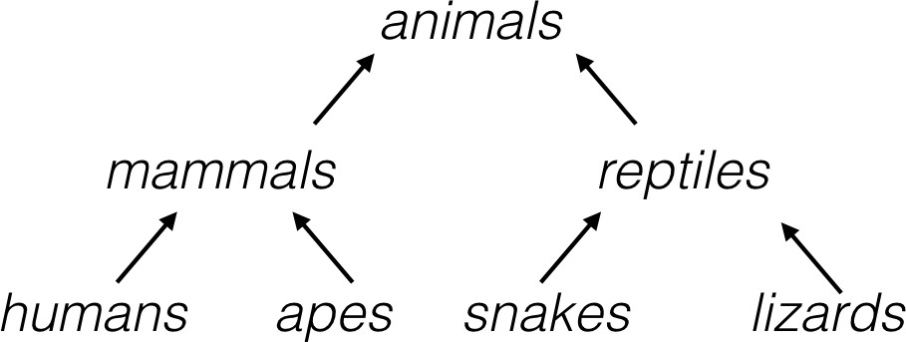
A hierarchy (계층) of groups
Groups of living things can form a hierarchy Clusters are contained in one another

Slide 4
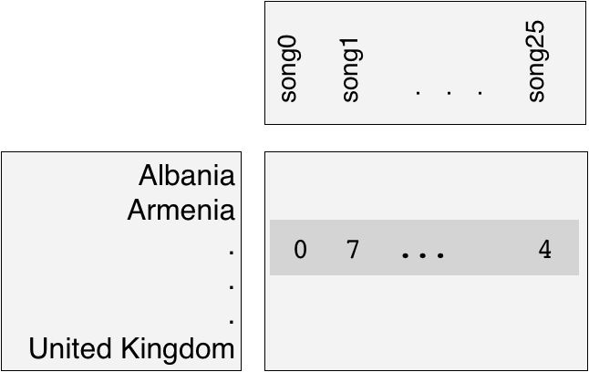
Eurovision scoring dataset
Countries gave scores to songs performed at the Eurovision 2016
2D array of scores
Rows are countries, columns are songs
유로비전 송 콘테스트(영어: Eurovision Song Contest, 프랑스어: Concours Eurovision de la Chanson)는 유럽방송연맹(European Broadcasting Union) 회원국 시청자 앞에서 노래, 춤 등 자신의 기량을 뽐낸 뒤 순위를 가리는 유럽 최대의 음악 경연 대회이다. 세계에서 가장 시청자 수가 많은 방송중 하나로 2021년에는 1억 8000만명 이상이 시청했다.
¹ https://www.eurovision.tv/page/results

Slide 5
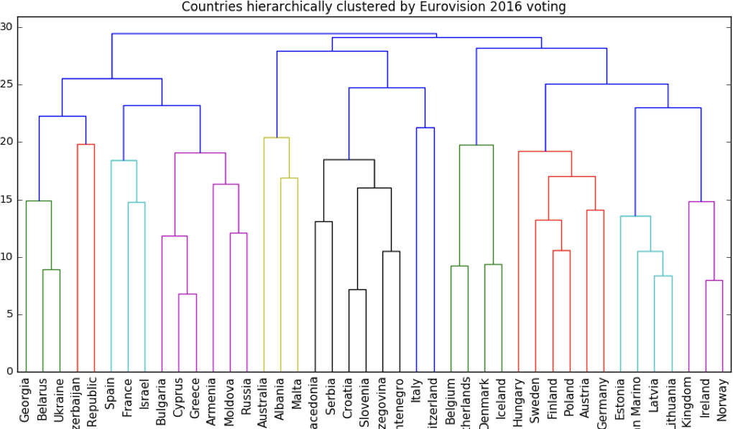
Hierarchical clustering of voting countries

Slide 6
Hierarchical clustering
Every country begins in a separate cluster
At each step, the two closest clusters are merged Continue until all countries in a single cluster
This is "agglomerative" hierarchical clustering
병합 군집^{agglomerative clustering} 알고리즘은 시작할 때 각 포인트를 하나의 클러스터로 지정하고, 그다음 종료 조건을 만족할 때까지 가장 비슷한 두 클러스터를 합침
종료조건 : 클러스터 갯수, 지정된 갯수의 클러스터가 남을 때까지 비슷한 클러스터를 합침
Linkage Methods
To define the distance between clusters, different linkage methods are used:
Single Linkage:: Distance between the closest pair of points in two clusters.
Complete Linkage: Distance between the farthest pair of points in two clusters.
Average Linkage: Average distance between all pairs of points in two clusters.
Centroid Linkage: Distance between the centroids of two clusters.
Ward’s Linkage: Minimizes the variance within clusters.

Slide 7
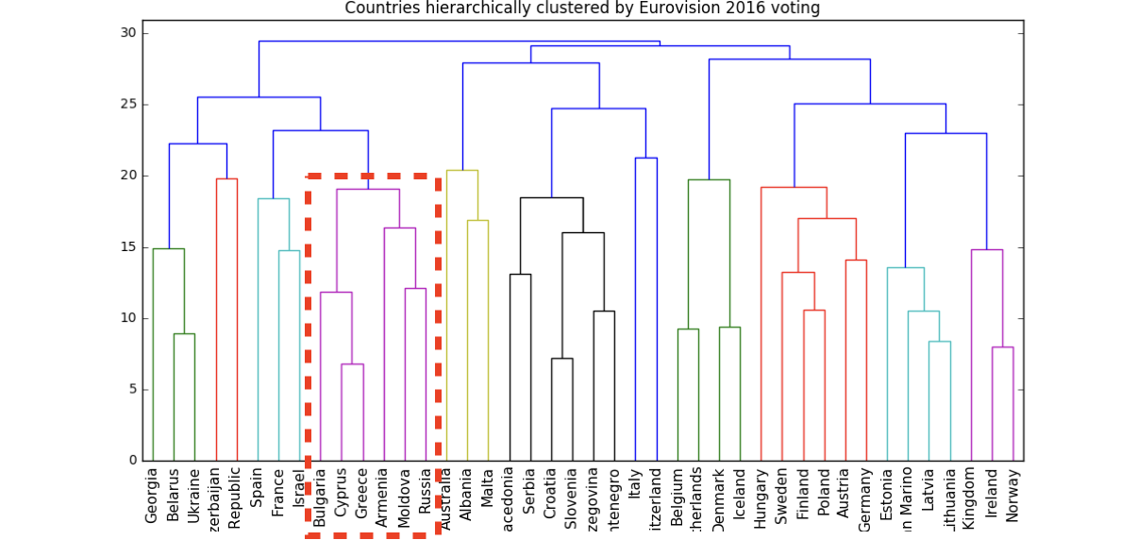
The dendrogram of a hierarchical clustering
Read from the bottom up Vertical lines represent clusters

Slide 8
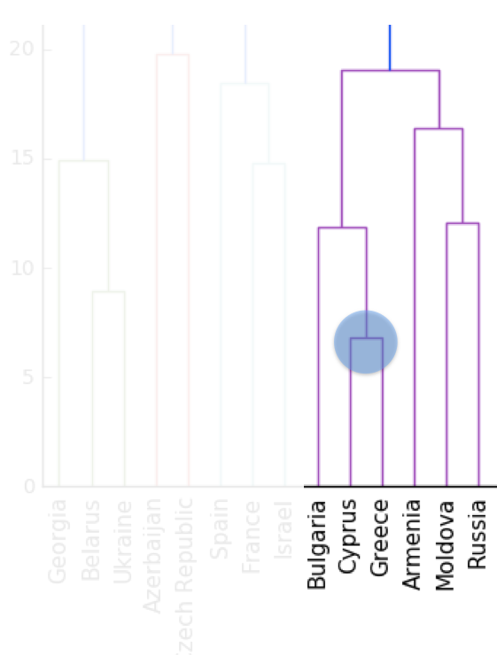
Dendrograms, step-by-step

Slide 9
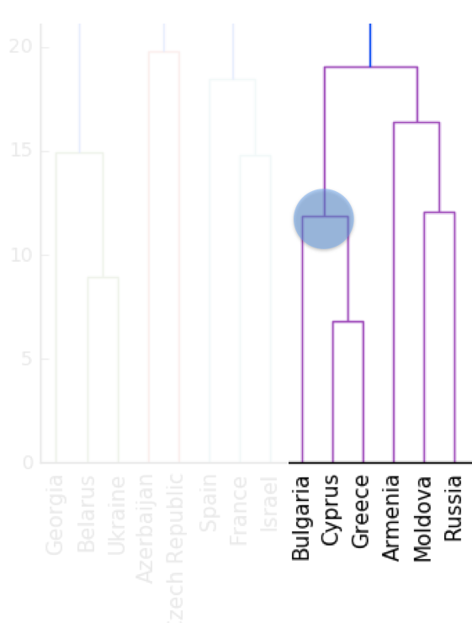
Dendrograms, step-by-step

Slide 10
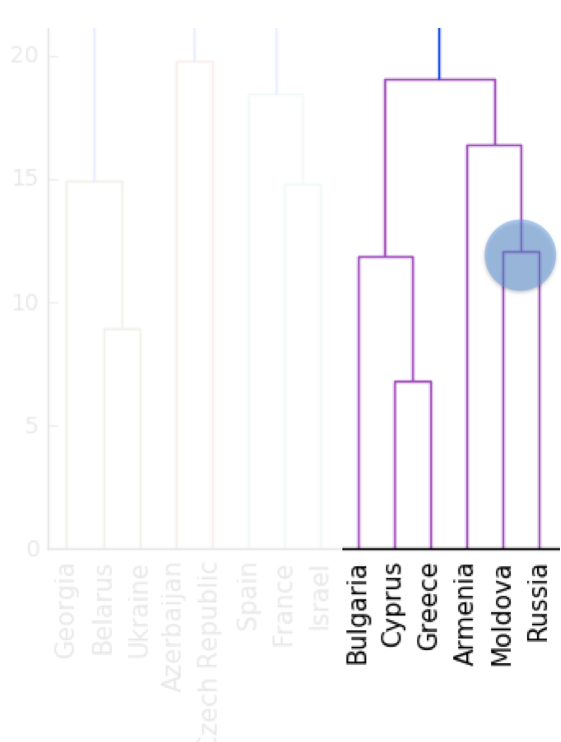
Dendrograms, step-by-step

Slide 11
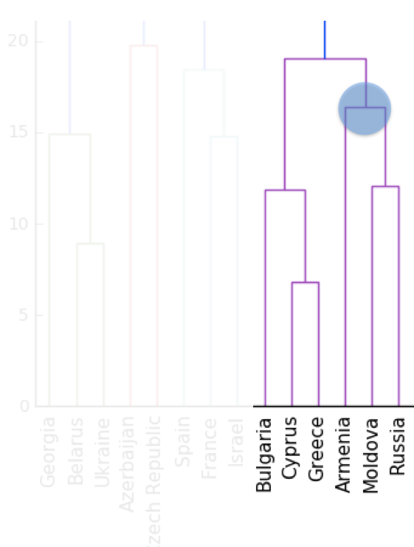
Dendrograms, step-by-step

Slide 12
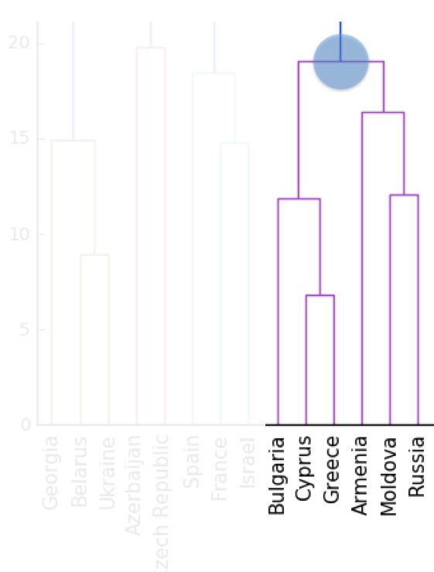
Dendrograms, step-by-step

Slide 13
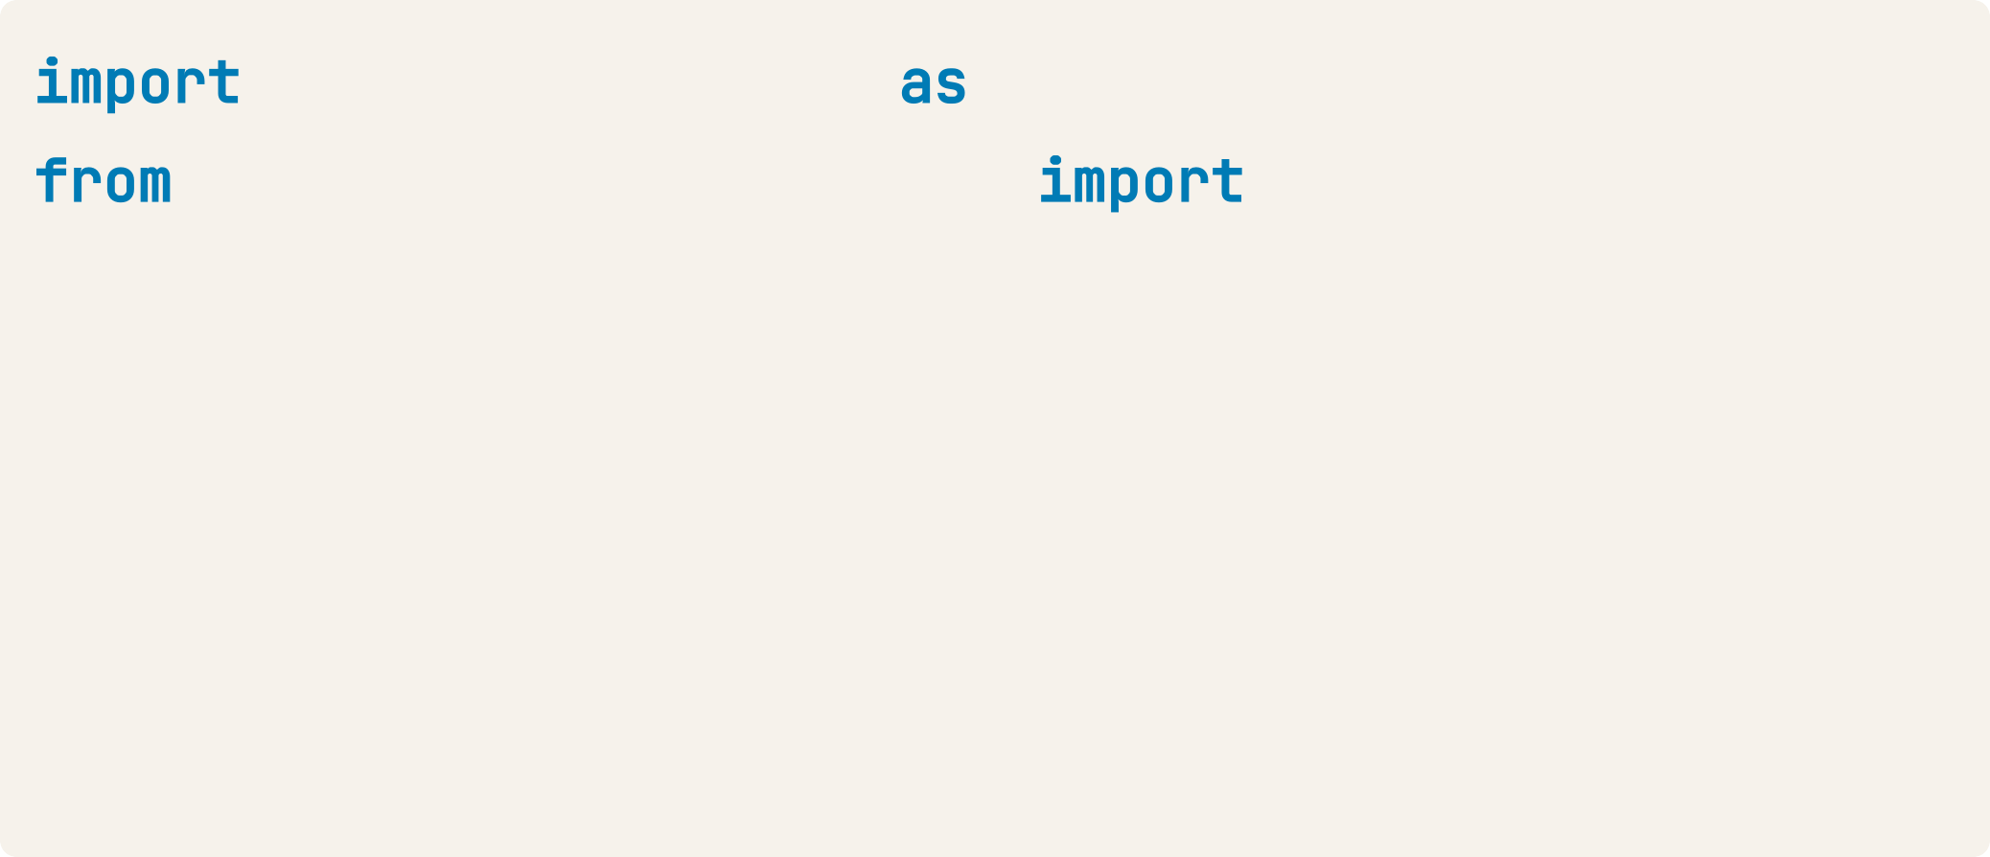
Hierarchical clustering with SciPy
Given samples (the array of scores), and country_names
matplotlib.pyplot plt scipy.cluster.hierarchy linkage, dendrogram
mergings = linkage(samples, method='complete') dendrogram(mergings,
labels=country_names, leaf_rotation=90, leaf_font_size=6)
plt.show()

Slide 14
Cluster labels in hierarchical clustering
U N S U P E R V I S E D L E A R N I N G I N P Y T H O N
Benjamin Wilson
Director of Research at lateral.io

Slide 15
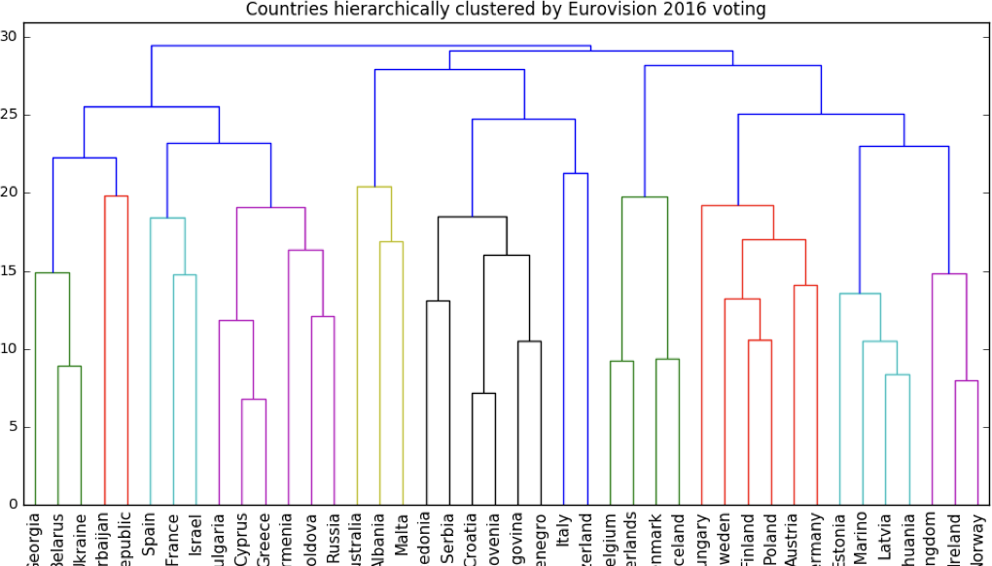
Cluster labels in hierarchical clustering
Not only a visualization tool!
Cluster labels at any intermediate stage can be recovered For use in e.g. cross-tabulations

Slide 16
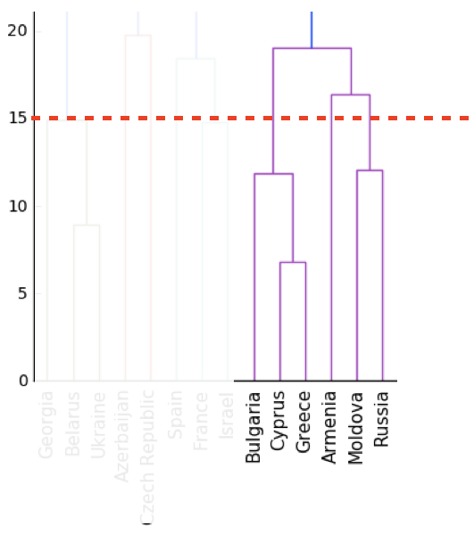
Intermediate clusterings & height on dendrogram
E.g. at height 15:
Bulgaria, Cyprus, Greece are one cluster
Russia and Moldova are another
Armenia in a cluster on its own
덴드로그램(Dendrogram)은 나무를 나타내는 다이어그램이다.
계층적 군집화에서는 해당 분석에 의해 생성된 클러스터의 배열을 보여준다.

Slide 17
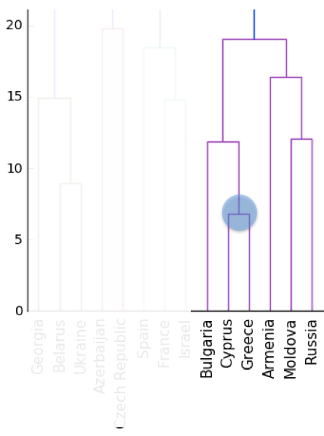
Dendrograms show cluster distances
Height on dendrogram = distance between merging clusters
E.g. clusters with only Cyprus and Greece had distance approx. 6

Slide 18
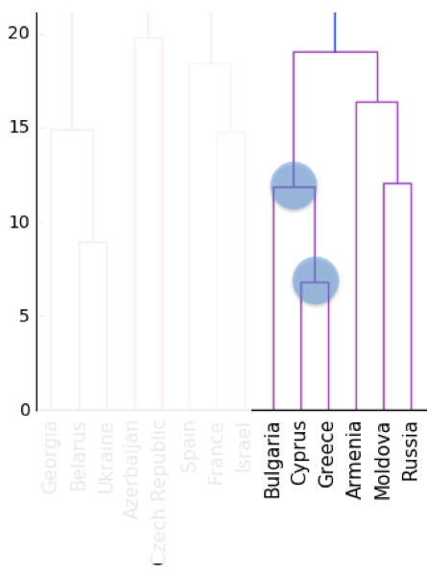
Dendrograms show cluster distances
Height on dendrogram = distance between merging clusters
E.g. clusters with only Cyprus and Greece had distance approx. 6
This new cluster distance approx. 12 from cluster with only Bulgaria

Slide 19
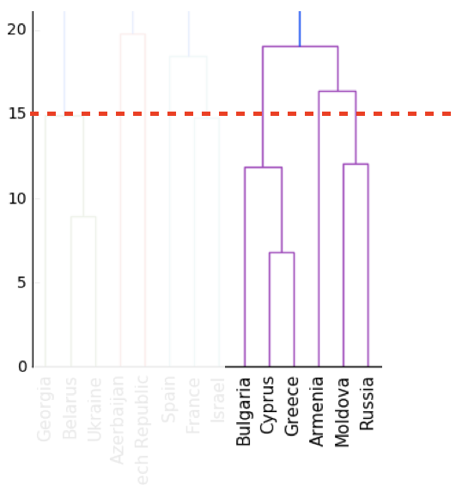
Intermediate clusterings & height on dendrogram
Height on dendrogram specifies max. distance between merging clusters
Don't merge clusters further apart than this (e.g. 15)

Slide 20
Distance between clusters
Defined by a "linkage method"
In "complete" linkage: distance between clusters is max. distance between their samples
Specified via method parameter, e.g. linkage(samples, method="complete")
Different linkage method, different hierarchical clustering!
Complete Linkage: Distance between the farthest pair of points in two clusters.

Slide 21
Extracting cluster labels
Use the fcluster() function
Returns a NumPy array of cluster labels

Slide 22
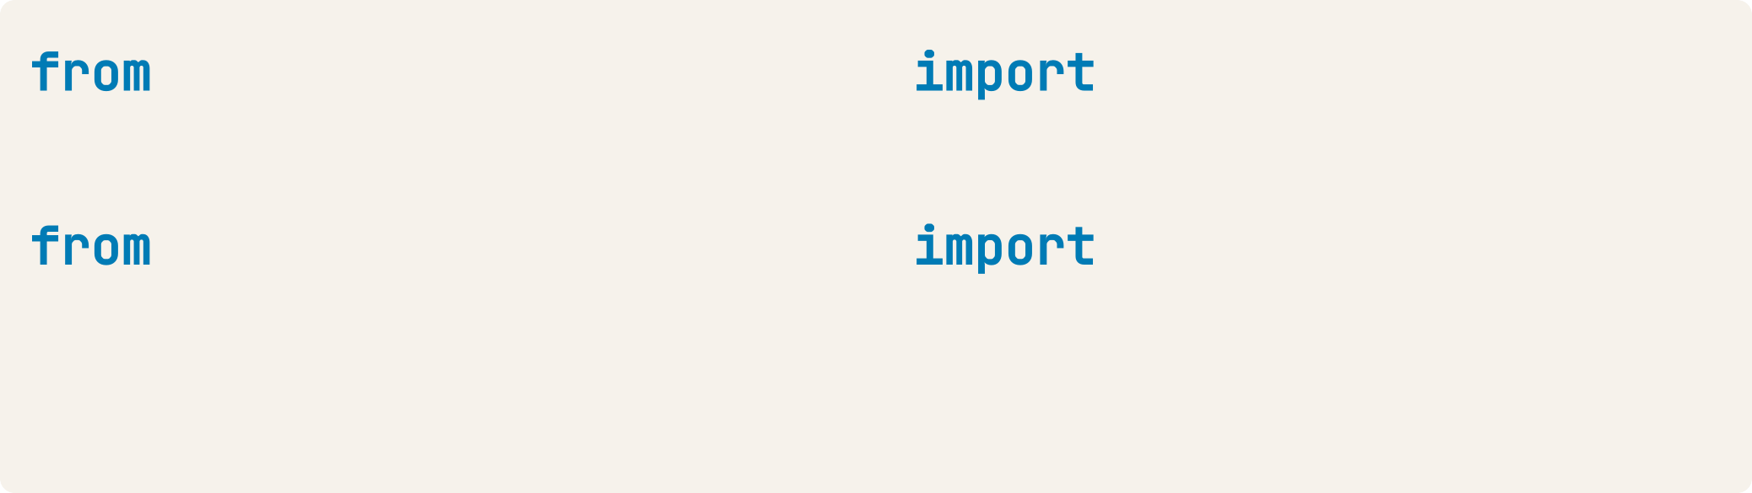
Extracting cluster labels using fcluster
scipy.cluster.hierarchy linkage mergings = linkage(samples, method='complete')
scipy.cluster.hierarchy fcluster
labels = fcluster(mergings, 15, criterion='distance') print(labels)
[ 9 8 11 20 2 1 17 14 ... ]

Slide 23
Aligning cluster labels with country names
Given a list of strings country_names :
pandas pd
pairs = pd.DataFrame({'labels': labels, 'countries': country_names}) print(pairs.sort_values('labels'))
 | countries | labels
5 | Belarus | 1
40 | Ukraine | 1
...
36 | Spain | 5
8 | Bulgaria | 6
19 | Greece | 6
10 | Cyprus | 6
28 | Moldova | 7
...

Slide 24
t-SNE for 2- dimensional maps
U N S U P E R V I S E D L E A R N I N G I N P Y T H O N
Benjamin Wilson
Director of Research at lateral.io

Slide 25
t-SNE for 2-dimensional maps
t-SNE = "t-distributed stochastic neighbor embedding"
Maps samples to 2D space (or 3D)
Map approximately preserves nearness of samples Great for inspecting datasets

Slide 26
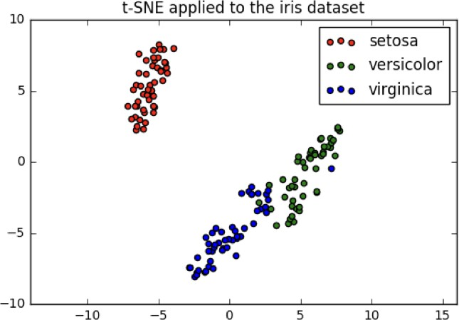
t-SNE on the iris dataset
Iris dataset has 4 measurements, so samples are 4- dimensional
t-SNE maps samples to 2D space
t-SNE didn't know that there were different species
... yet kept the species mostly separate

Slide 27
Interpreting t-SNE scatter plots
"versicolor" and "virginica" harder to distinguish from one another
Consistent with k-means inertia plot: could argue for 2 clusters, or for 3

Slide 28
t-SNE in sklearn
2D NumPy array samples
print(samples)
[[ | 5. | 3.3 | 1.4 | 0.2]
[ | 5. | 3.5 | 1.3 | 0.3]
[ | 4.9 | 2.4 | 3.3 | 1. ]
[ | 6.3 | 2.8 | 5.1 | 1.5]
...
[ 4.9 |  | 3.1 | 1.5 | 0.1]]
List species
giving species of labels as number (0, 1, or 2)
print(species)
[0, 0, 1, 2, ..., 0]

Slide 29
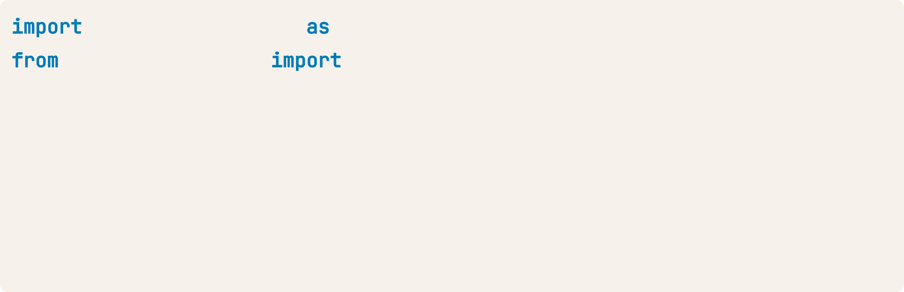
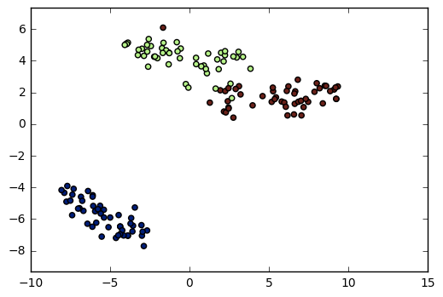
t-SNE in sklearn
The learning rate determines how fast or slow the t-SNE algorithm adjusts the positions of points in the lower-dimensional space during optimization. A learning rate that is too low or too high may lead to suboptimal results.
transformed[:, 0]:The first column of the transformed array, representing the x-coordinates of the 2D projection.
transformed[:, 1]:The second column of the transformed array, representing the y-coordinates of the 2D projection.
matplotlib.pyplot sklearn.manifold
plt
TSNE
model = TSNE(learning_rate=100) transformed = model.fit_transform(samples) xs = transformed[:,0]
ys = transformed[:,1] plt.scatter(xs, ys, c=species) plt.show()

Slide 30
t-SNE has only fit_transform()
Has a fit_transform() method
Simultaneously fits the model and transforms the data Has no separate fit() or transform() methods Can't extend the map to include new data samples Must start over each time!

Slide 31
t-SNE learning rate
Choose learning rate for the dataset Wrong choice: points bunch together Try values between 50 and 200

Slide 32
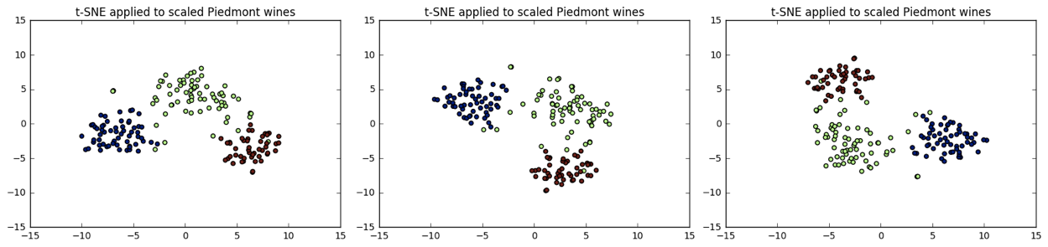
Different every time
t-SNE features are different every time
Piedmont wines, 3 runs, 3 different scatter plots!
... however: The wine varieties (=colors) have same position relative to one another

