Slide 1
Non-negative matrix factorization (NMF)
U N S U P E R V I S E D L E A R N I N G I N P Y T H O N
Benjamin Wilson
Director of Research at lateral.io

Slide 2
Non-negative matrix factorization
NMF = "non-negative matrix factorization"
Dimension reduction technique
NMF models are interpretable (unlike PCA) Easy to interpret means easy to explain!
However, all sample features must be non-negative (>= 0)
Non-Negative Matrix Factorization (NMF) is a dimensionality reduction and matrix decomposition technique that factors a non-negative matrix V into two lower-dimensional non-negative matrices, W and H.
It is widely used in data analysis and machine learning tasks where the data is inherently non-negative, such as text mining, image processing, and bioinformatics.
NMF is a powerful and interpretable dimensionality reduction technique that is well-suited for applications involving non-negative data.
It excels in uncovering latent structures and patterns, making it a popular choice for tasks like topic modeling, image analysis, and recommendation systems.
Its simplicity and ability to handle sparse data further enhance its utility in real-world scenarios.

Slide 3
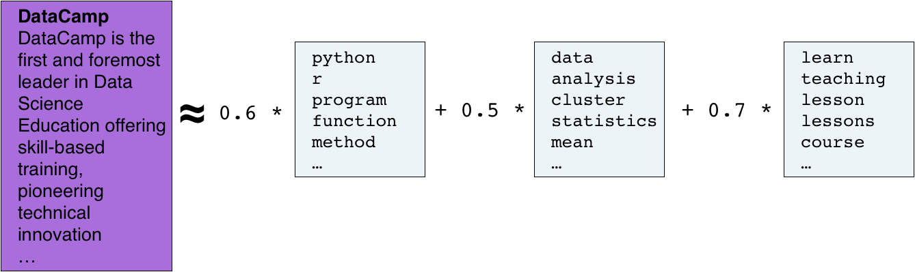
Interpretable parts
NMF expresses documents as combinations of topics (or "themes")

Slide 4
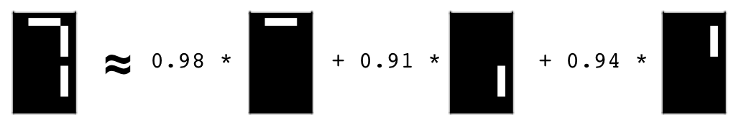
Interpretable parts
NMF expresses images as combinations of patterns

Slide 5
Using scikit-learn NMF
Follows fit() / transform() pattern
Must specify number of components e.g.
NMF(n_components=2)
Works with NumPy arrays and with csr_matrix
csr_matrix (Compressed Sparse Row matrix) is a data structure used in numerical and scientific computing to store sparse matrices efficiently.

Slide 6
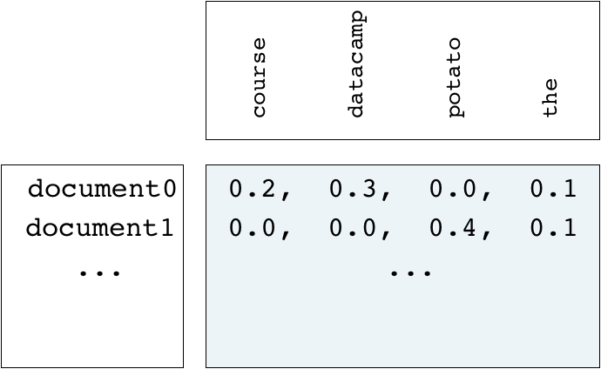
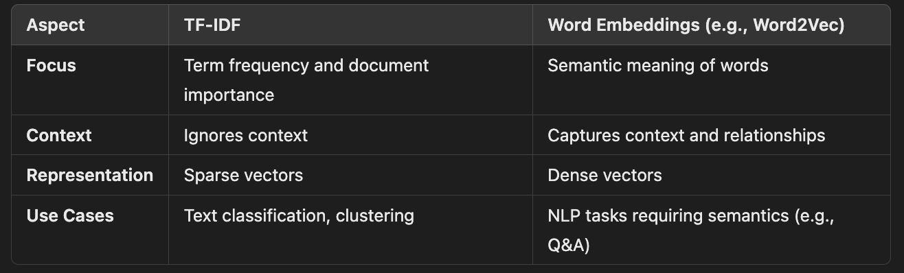
Example word-frequency array
Word frequency array, 4 words, many documents
Measure presence of words in each document using "tf-idf" "tf" = frequency of word in document
"idf" reduces influence of frequent words

Slide 7
Example usage of NMF
samples is the word-frequency array
sklearn.decomposition model = NMF(n_components=2) model.fit(samples)
NMF
n_components=2: Specifies that the matrix will be reduced to 2 components (or topics in text processing).
model.fit(samples): Decomposes the samples matrix into two matrices WWW (basis) and HHH (components).
NMF(n_components=2)
nmf_features = model.transform(samples)
nmf_features:A matrix where each row corresponds to a sample, and each column represents its weight for one of the components.
model.transform(samples):Computes the feature matrix W, which represents the input data in terms of the new components.

Slide 8
NMF components
NMF has components
... just like PCA has principal components Dimension of components = dimension of samples Entries are non-negative
print(model.components_)
model.components_: Retrieves the matrix HHH, where each row represents one of the 2 components, and each column corresponds to the importance of a feature (e.g., a word) for that component.
[[ 0.01
[ 0.99
0. 2.13 0.54]
1.47 0. 0.5 ]]

Slide 9
NMF features
NMF feature values are non-negative
Can be used to reconstruct the samples
... combine feature values with components
print(nmf_features)
[[ | 0. | 0.2 | ]
[ | 0.19 | 0. | ]
...
[ 0.15
0.12]]

Slide 10
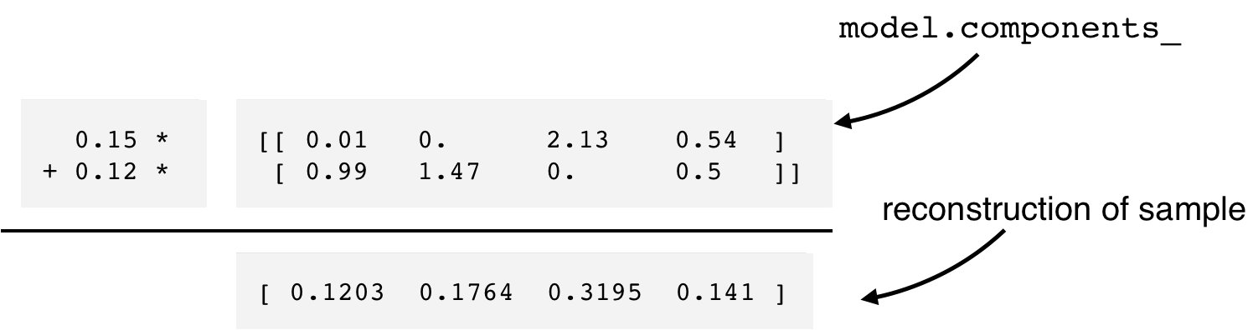
Reconstruction of a sample
print(samples[i,:])
Outputs the original word-frequency data for the ith sample for comparison.
[ 0.12 0.18 0.32 0.14]
Displays the weights of the ith sample for the 2 components.Each value in this array indicates how much the sample contributes to each component.
print(nmf_features[i,:])
[ 0.15
0.12]

Slide 11
Sample reconstruction
Multiply components by feature values, and add up Can also be expressed as a product of matrices This is the "Matrix Factorization" in "NMF"
Matrix Factorization in Non-Negative Matrix Factorization (NMF) refers to the process of decomposing a given non-negative matrix V into two lower-dimensional non-negative matrices W (basis matrix) and H (coefficient matrix) such that:
V≈W⋅H
This decomposition is achieved while ensuring that all elements in W and H are non-negative, preserving the non-negative nature of V.
Key Components in Matrix Factorization
Input Matrix (V):
  A non-negative matrix of size m×n
  Rows often represent features (e.g., words in text data).
  Columns often represent samples (e.g., documents or items).
Basis Matrix (W):
  A non-negative matrix of size m×k, where k is the number of components or latent factors.
  Each column in W represents a latent feature, such as a topic in text or a feature in image data.
Coefficient Matrix (H):
  A non-negative matrix of size k×n, where each column represents how much the corresponding latent feature contributes to the sample.

Slide 12
NMF fits to non-negative data only
Word frequencies in each document
Images encoded as arrays Audio spectrograms
Purchase histories on e-commerce sites
... and many more!

Slide 13
Non-negative matrix factorization (NMF) learns interpretable parts
U N S U P E R V I S E D L E A R N I N G I N P Y T H O N
Benjamin Wilson
Director of Research at lateral.io

Slide 14
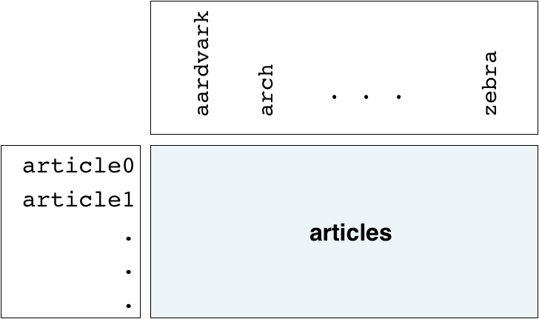
Example: NMF learns interpretable parts
Word-frequency array articles (tf-idf)
20,000 scientific articles (rows) 800 words (columns)

Slide 15
Applying NMF to the articles
print(articles.shape)
(20000, 800)
sklearn.decomposition nmf = NMF(n_components=10) nmf.fit(articles)
NMF
NMF(n_components=10)
print(nmf.components_.shape)
(10, 800)

Slide 16
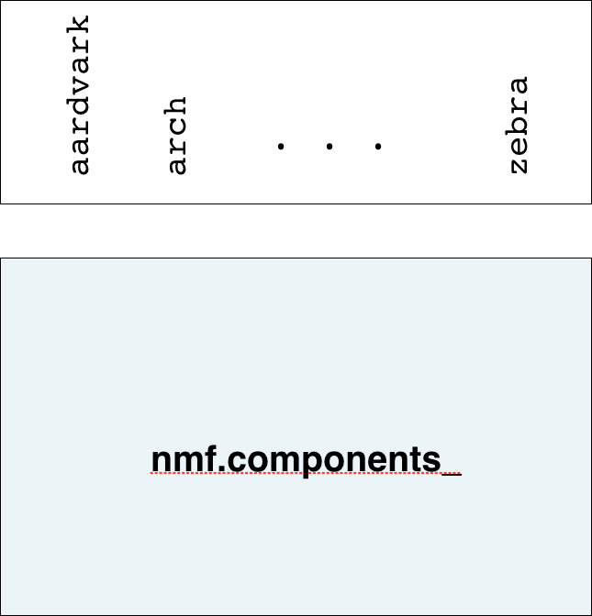
NMF components are topics

Slide 17
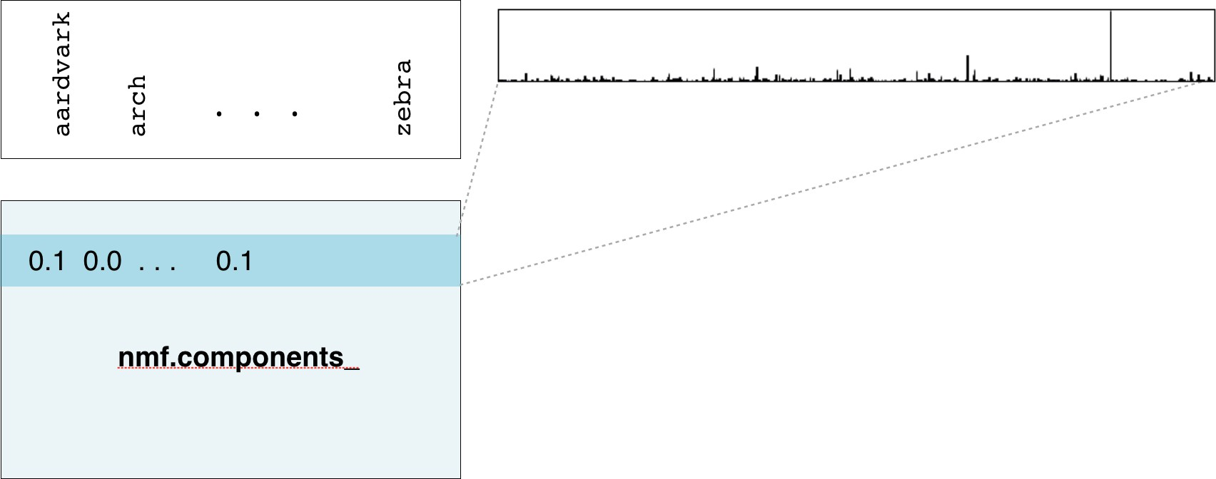
NMF components are topics

Slide 18
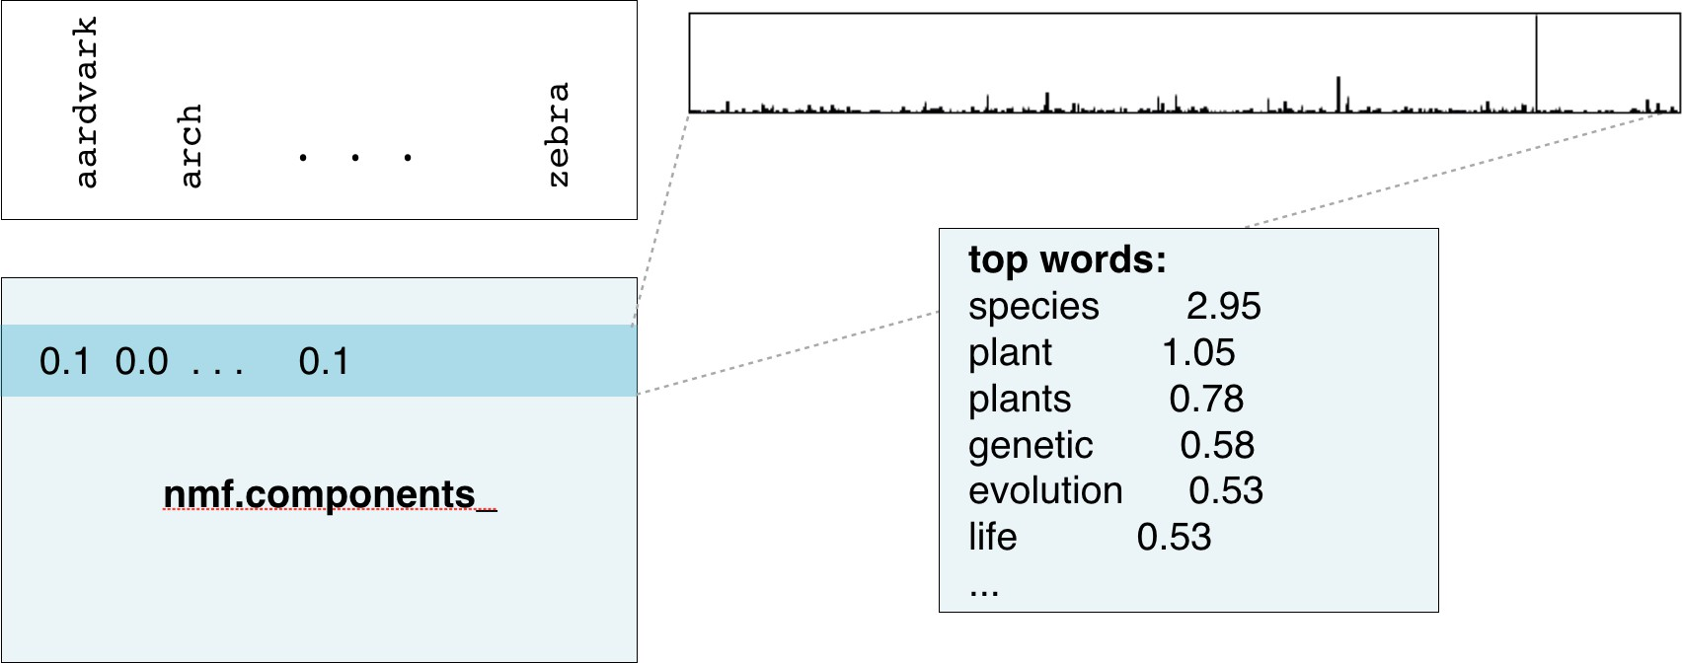
NMF components are topics

Slide 19
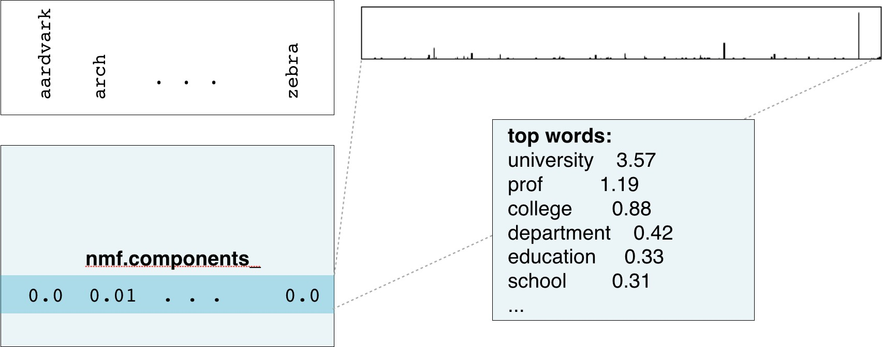
NMF components are topics

Slide 20
NMF components
For documents:
NMF components represent topics
NMF features combine topics into documents For images, NMF components are parts of images

Slide 21
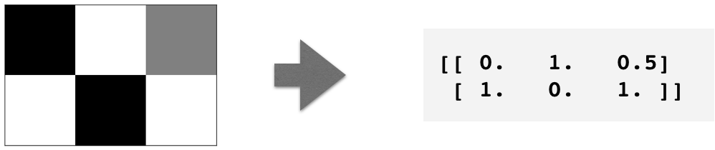
Grayscale images
"Grayscale" image = no colors, only shades of gray
Measure pixel brightness
Represent with value between 0 and 1 (0 is black) Convert to 2D array

Slide 22
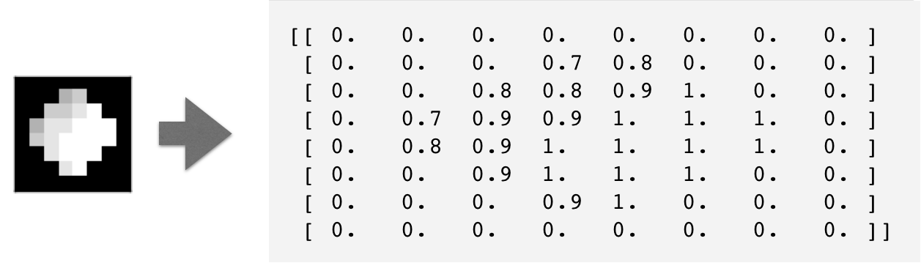
Grayscale image example
An 8×8 grayscale image of the moon, written as an array

Slide 23
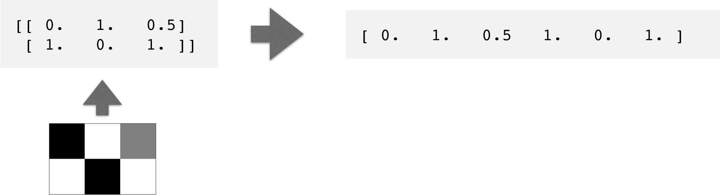
Grayscale images as flat arrays
Enumerate the entries
Row-by-row
From left to right, top to bottom

Slide 24
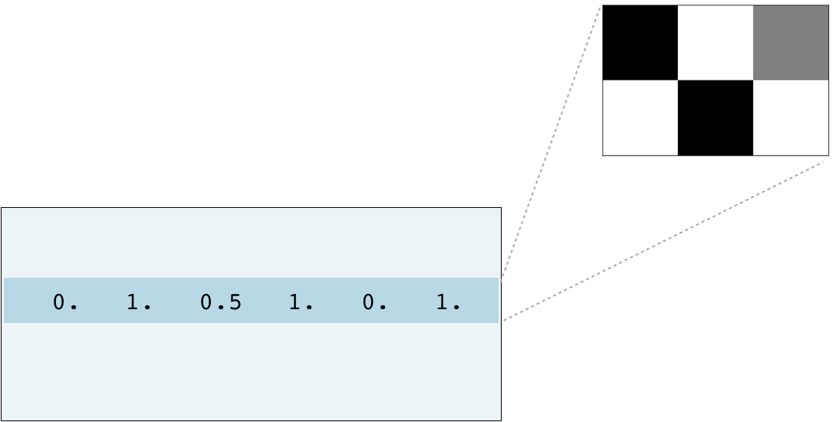
Encoding a collection of images
Collection of images of the same size
Encode as 2D array
Each row corresponds to an image Each column corresponds to a pixel
... can apply NMF!

Slide 25
Visualizing samples
print(sample)
[ 0. 1. 0.5 1. 0. 1. ]
bitmap = sample.reshape((2, 3)) print(bitmap)
[[ 0. | 1. | 0.5]
[ 1. | 0. | 1. ]]
matplotlib pyplot plt
plt.imshow(bitmap, cmap='gray', interpolation='nearest') plt.show()

Slide 26
Building recommender systems using Non-negative matrix factorization (NMF)
U N S U P E R V I S E D L E A R N I N G I N P Y T H O N
Benjamin Wilson
Director of Research at lateral.io

Slide 27
Finding similar articles
Engineer at a large online newspaper
Task: recommend articles similar to article being read by customer
Similar articles should have similar topics

Slide 28
Strategy
Apply NMF to the word-frequency array
NMF feature values describe the topics
... so similar documents have similar NMF feature values Compare NMF feature values?

Slide 29
Apply NMF to the word-frequency array
articles is a word frequency array
sklearn.decomposition NMF nmf = NMF(n_components=6)
nmf_features = nmf.fit_transform(articles)

Slide 30
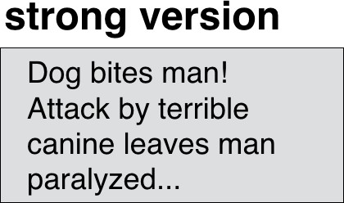
Versions of articles
Different versions of the same document have same topic proportions
... exact feature values may be different!

Slide 31
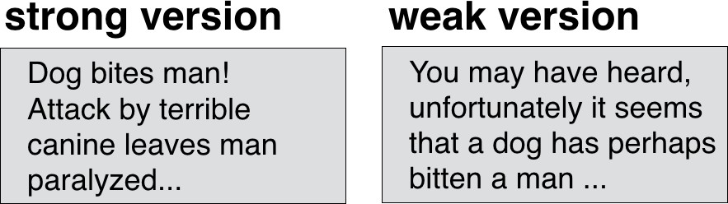
Versions of articles
Different versions of the same document have same topic proportions
... exact feature values may be different!
E.g. because one version uses many meaningless words

Slide 32
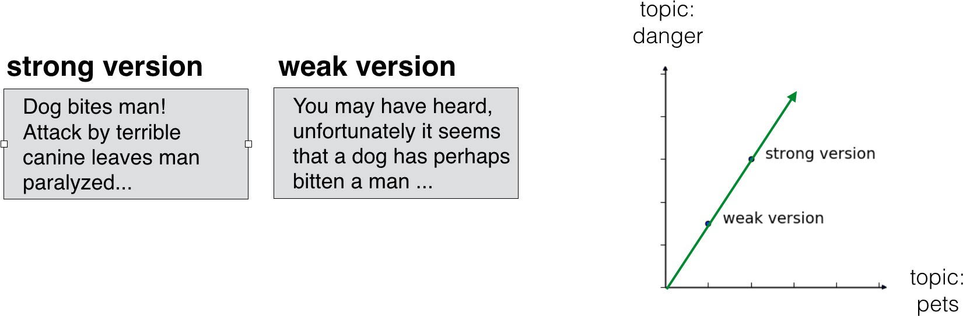
Versions of articles
Different versions of the same document have same topic proportions
... exact feature values may be different!
E.g. because one version uses many meaningless words But all versions lie on the same line through the origin

Slide 33
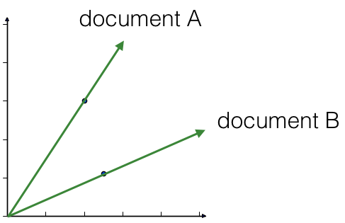
Cosine similarity
Uses the angle between the lines
Higher values means more similar
Maximum value is 1, when angle is 0 degrees
Cosine similarity is a metric used to measure the similarity between two non-zero vectors based on the cosine of the angle between them. It is widely used in applications like text analysis, information retrieval, and machine learning to determine how similar two pieces of data are in terms of their direction in a high-dimensional space.
Cosine similarity is a versatile and widely-used metric to compare vectors based on their orientation in space. Its emphasis on direction rather than magnitude makes it particularly useful for text similarity, clustering, and high-dimensional data analysis.

Slide 34
Calculating the cosine similarities
normalize(nmf_features): The normalize function from sklearn.preprocessing scales the rows of the input matrix (nmf_features) so that each row has a unit norm (length of 1).
Purpose:
  Ensures that the magnitudes of the feature vectors do not affect the cosine similarity calculation.
  When vectors are normalized, cosine similarity becomes equivalent to the dot product of the vectors.
After normalization:
  Each row of norm features is a unit vector.
current_article = norm_features[23, :]
This extracts the 23rd row of the normalized feature matrix norm_features, representing the features of the target article.
Shape: current_article is a 1D vector corresponding to the 23rd article in the dataset.
sklearn.preprocessing normalize norm_features = normalize(nmf_features)
# if has index 23
current_article = norm_features[23,:] similarities = norm_features.dot(current_article) print(similarities)
[ 0.7150569
0.26349967 ..., 0.20323616
0.05047817]
norm_features.dot(current_article):
  Computes the cosine similarity between the current_article vector and all other vectors in norm_features.
  Since the rows of norm_features are normalized, the dot product directly gives the cosine similarity.
Output:
  similarities is a 1D array, where each entry corresponds to the similarity score between the current_article and another article.
  Values range between −1-1−1 and 111:
    1: Perfectly similar (identical direction).
    0: Orthogonal (no similarity).
    -1: Completely opposite direction (rare in normalized positive data like NMF).

Slide 35
DataFrames and labels
Label similarities with the article titles, using a DataFrame Titles given as a list: titles
normalize(nmf_features):
  Scales each row (representing an article) of the NMF feature matrix nmf_features to unit norm (length 1).
  Normalization ensures that the magnitude of the vectors does not influence the cosine similarity calculation.
  After normalization:
    The rows of norm_features are unit vectors.
    Cosine similarity becomes equivalent to the dot product of the vectors.
pd.DataFrame():
  Converts the normalized feature matrix into a pandas DataFrame for easier handling and visualization.
  index=titles:
    Assigns the titles of the articles as row indices.
    Each row in df corresponds to an article, and each column corresponds to a normalized feature.
df.loc['Dog bites man']:Retrieves the row corresponding to the article titled "Dog bites man".
current_article:
  A 1D pandas Series containing the normalized feature vector for the article.
pandas pd
norm_features = normalize(nmf_features)
df = pd.DataFrame(norm_features, index=titles) current_article = df.loc['Dog bites man'] similarities = df.dot(current_article)
df.dot(current_article):Computes the dot product between the feature vectors of all articles (rows of df) and the feature vector of the current article.
Since all rows are normalized, the dot product directly computes the cosine similarity.
similarities:
  A pandas Series where:
    Index: Article titles.
    Values: Cosine similarity scores between the corresponding article and "Dog bites man".

Slide 36
DataFrames and labels
print(similarities.nlargest())
Dog bites man |  | 1.000000
Hound mauls cat |  | 0.979946
Pets go wild! |  | 0.979708
Dachshunds are dangerous |  | 0.949641
Our streets are no longer | safe | 0.900474
dtype: float64

