Slide 1
An Introduction to WEKA
SEEM 4630
10-2012

Slide 2
Content
What is WEKA?
The Explorer:
  Preprocess data
  Classification
  Clustering
  Association Rules
  Attribute Selection
  Data Visualization
References and Resources

Slide 3

What is WEKA?
Waikato Environment for Knowledge Analysis
  It’s a data mining/machine learning tool developed by Department of Computer Science, University of Waikato, New Zealand.
  Weka is also a bird found only on the islands of New Zealand.

Slide 4
Download and Install WEKA
Website: http://www.cs.waikato.ac.nz/~ml/weka/index.html
Support multiple platforms (written in java):
  Windows, Mac OS X and Linux
WEKA has been installed in the teaching labs in SEEM

Slide 5
Main Features
49 data preprocessing tools
76 classification/regression algorithms
8 clustering algorithms
3 algorithms for finding association rules
15 attribute/subset evaluators + 10 search algorithms for feature selection

Slide 6
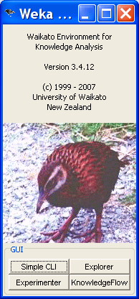
Main GUI
Three graphical user interfaces
  “The Explorer” (exploratory data analysis)
  “The Experimenter” (experimental environment)
  “The KnowledgeFlow” (new process model inspired interface)

Slide 7
Content
What is WEKA?
The Explorer:
  Preprocess data
  Classification
  Clustering
  Association Rules
  Attribute Selection
  Data Visualization
References and Resources

Slide 8
Explorer: pre-processing the data
Data can be imported from a file in various formats: ARFF, CSV, C4.5, binary
Data can also be read from a URL or from an SQL database (using JDBC)
Pre-processing tools in WEKA are called “filters”
WEKA contains filters for:
  Discretization, normalization, resampling, attribute selection, transforming and combining attributes, …

Slide 9
WEKA only deals with “flat” files
@relation heart-disease-simplified
@attribute age numeric
@attribute sex { female, male}
@attribute chest_pain_type { typ_angina, asympt, non_anginal, atyp_angina}
@attribute cholesterol numeric
@attribute exercise_induced_angina { no, yes}
@attribute class { present, not_present}
@data
63,male,typ_angina,233,no,not_present
67,male,asympt,286,yes,present
67,male,asympt,229,yes,present
38,female,non_anginal,?,no,not_present
...
Flat file in ARFF
(Attribute-Relation
File Format) format

Slide 10
WEKA only deals with “flat” files
@relation heart-disease-simplified
@attribute age numeric
@attribute sex { female, male}
@attribute chest_pain_type { typ_angina, asympt, non_anginal, atyp_angina}
@attribute cholesterol numeric
@attribute exercise_induced_angina { no, yes}
@attribute class { present, not_present}
@data
63,male,typ_angina,233,no,not_present
67,male,asympt,286,yes,present
67,male,asympt,229,yes,present
38,female,non_anginal,?,no,not_present
...
numeric attribute
nominal attribute

Slide 11
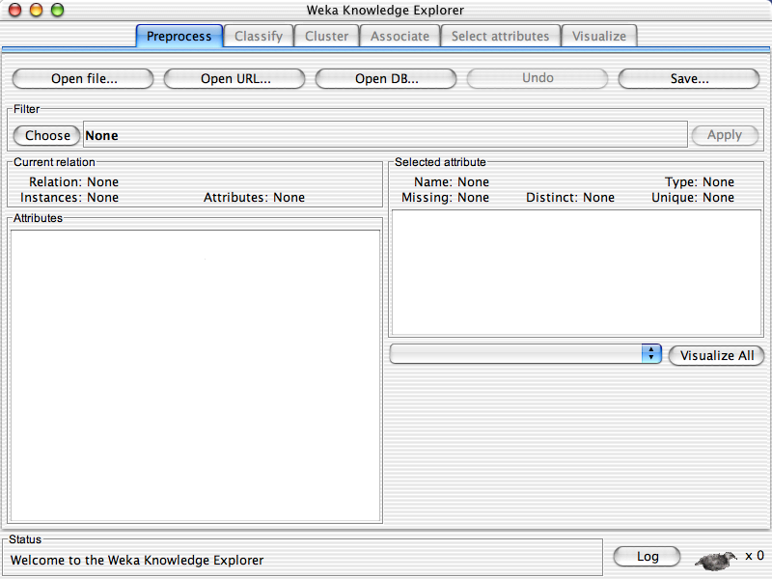
University of Waikato

Slide 12
University of Waikato

Slide 13
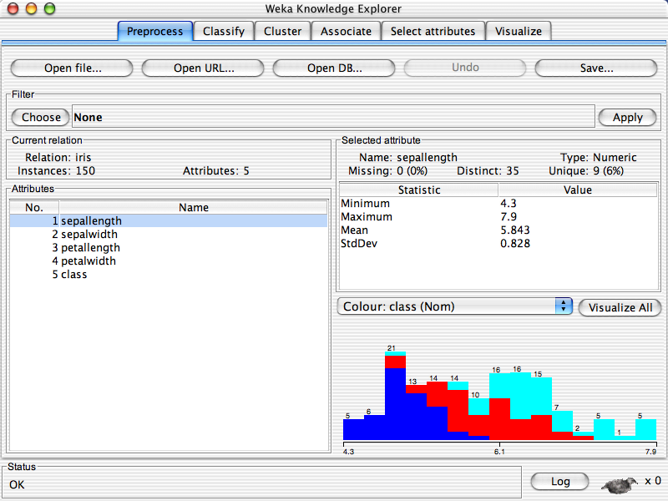
University of Waikato

Slide 14
University of Waikato

Slide 15
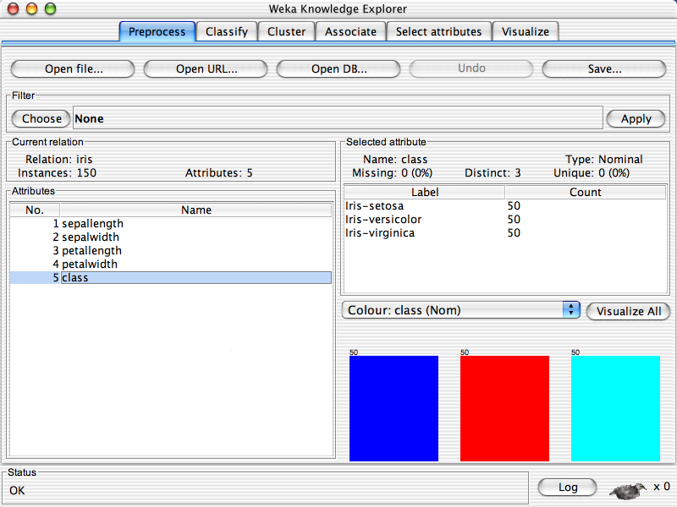
University of Waikato

Slide 16
University of Waikato

Slide 17
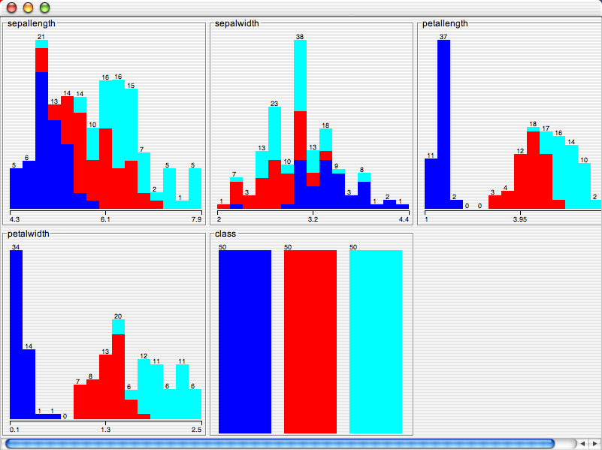
University of Waikato

Slide 18
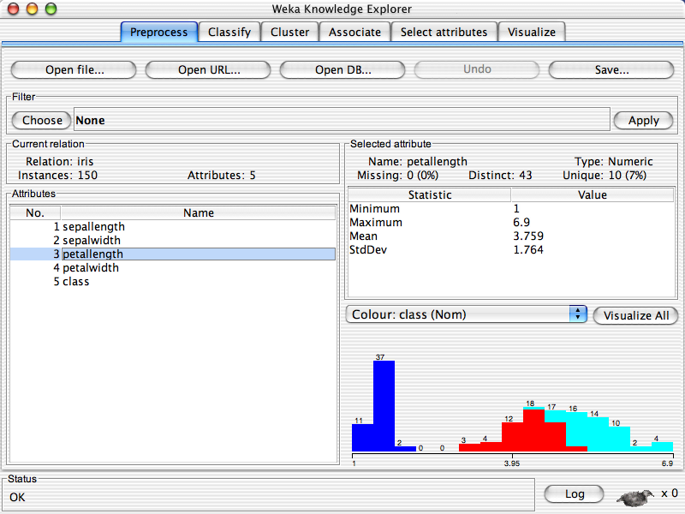
University of Waikato

Slide 19
University of Waikato

Slide 20
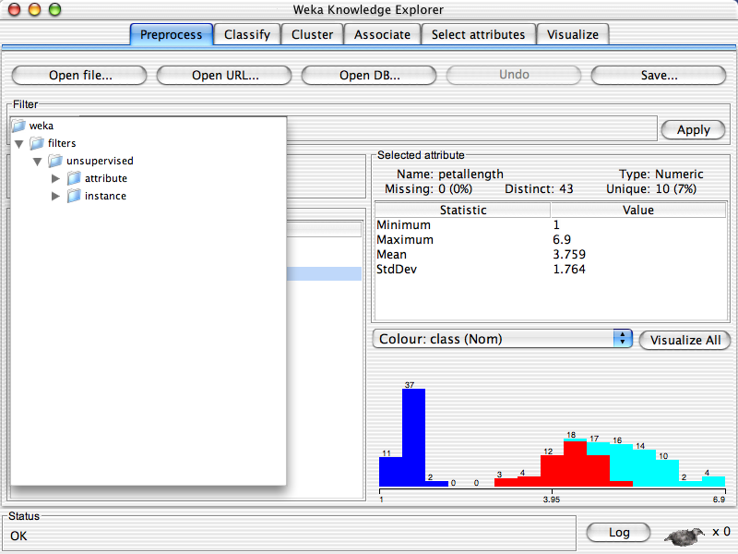
University of Waikato

Slide 21
University of Waikato

Slide 22
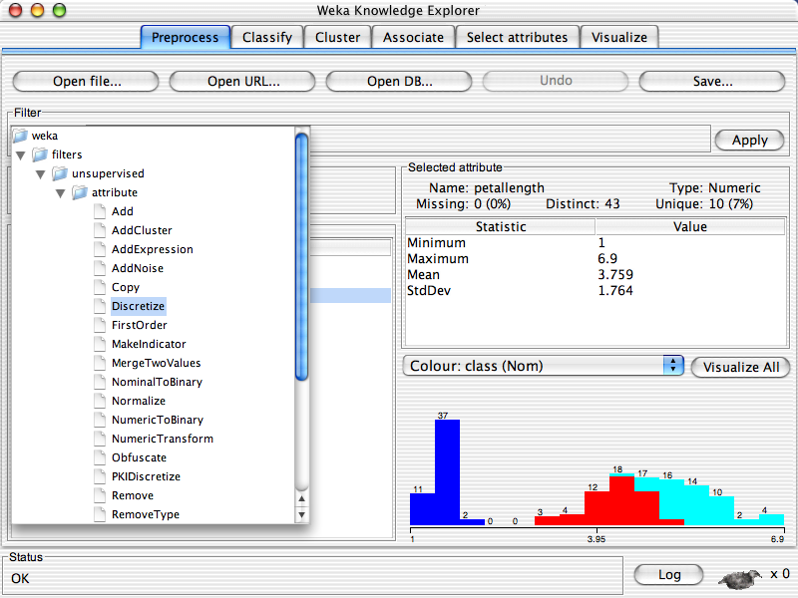
University of Waikato

Slide 23
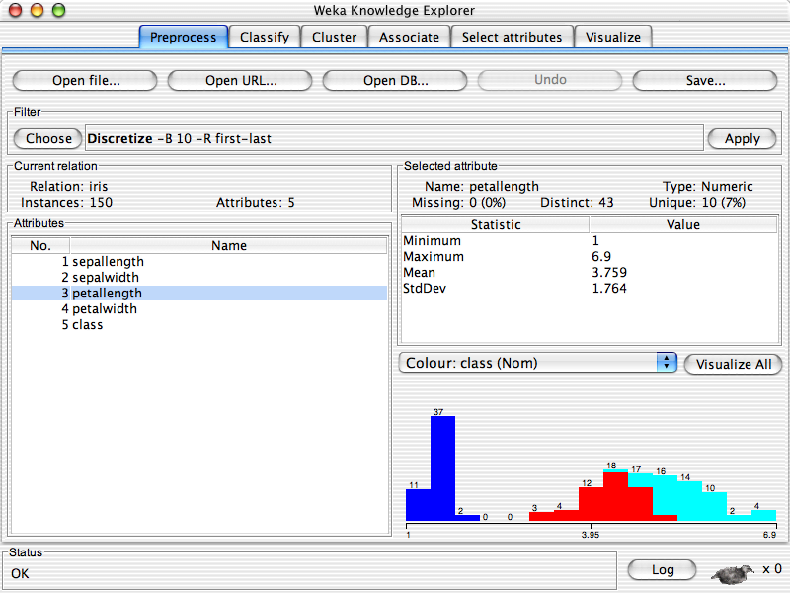
University of Waikato

Slide 24
University of Waikato

Slide 25
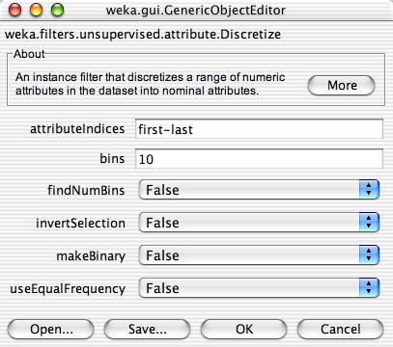
University of Waikato

Slide 26
University of Waikato

Slide 27
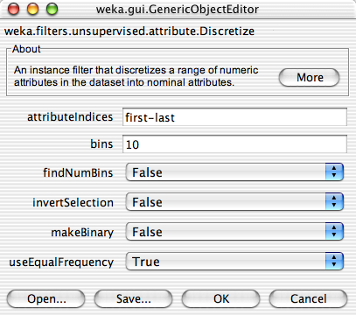
University of Waikato

Slide 28
University of Waikato

Slide 29

University of Waikato

Slide 30
University of Waikato

Slide 31
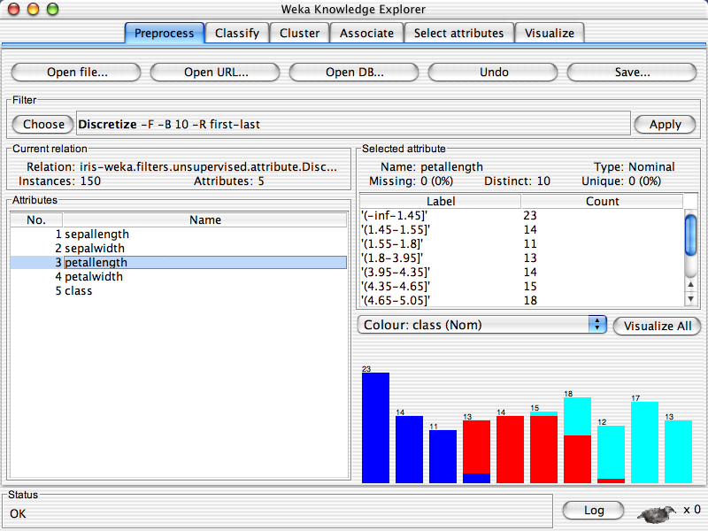
University of Waikato

Slide 32
Explorer: building “classifiers”
Classifiers in WEKA are models for predicting nominal or numeric quantities
Implemented learning schemes include:
  Decision trees and lists, instance-based classifiers, support vector machines, multi-layer perceptrons, logistic regression, Bayes’ nets, …

Slide 33
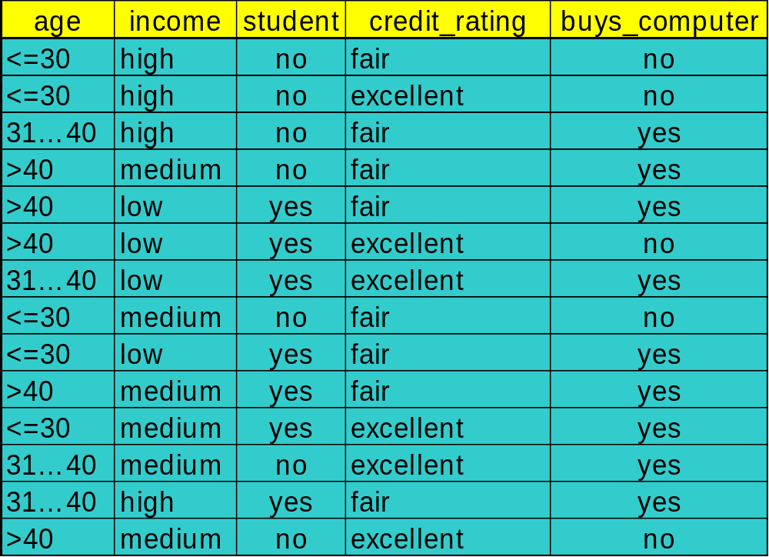
Decision Tree Induction: Training Dataset
This follows an example of Quinlan’s ID3 (Playing Tennis)

Slide 34
Output: A Decision Tree for “buys_computer”
age?
<=30
overcast
>40
31..40
student?
yes
credit rating?
no
yes
excellent
fair
no
yes
no
yes

Slide 35
Algorithm for Decision Tree Induction
Basic algorithm (a greedy algorithm)
  Tree is constructed in a top-down recursive divide-and-conquer manner
  At start, all the training examples are at the root
  Attributes are categorical (if continuous-valued, they are discretized in advance)
  Examples are partitioned recursively based on selected attributes
  Test attributes are selected on the basis of a heuristic or statistical measure (e.g., information gain)

Slide 36
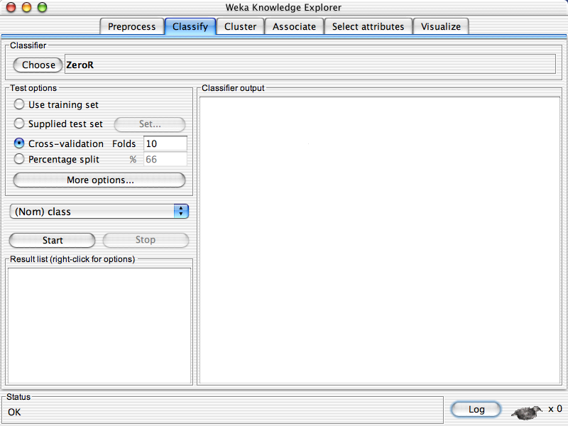
University of Waikato

Slide 37
University of Waikato

Slide 38
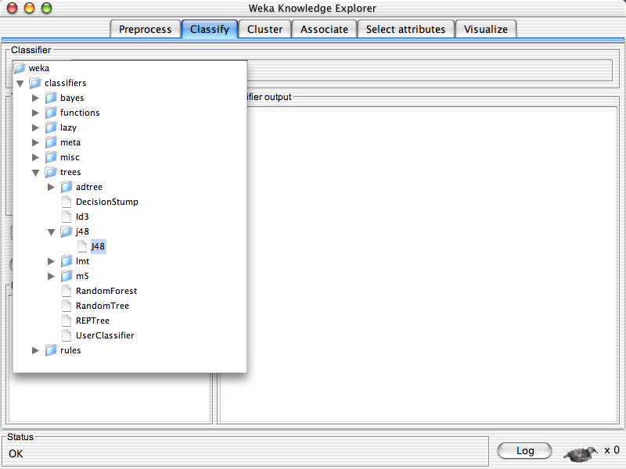
University of Waikato

Slide 39
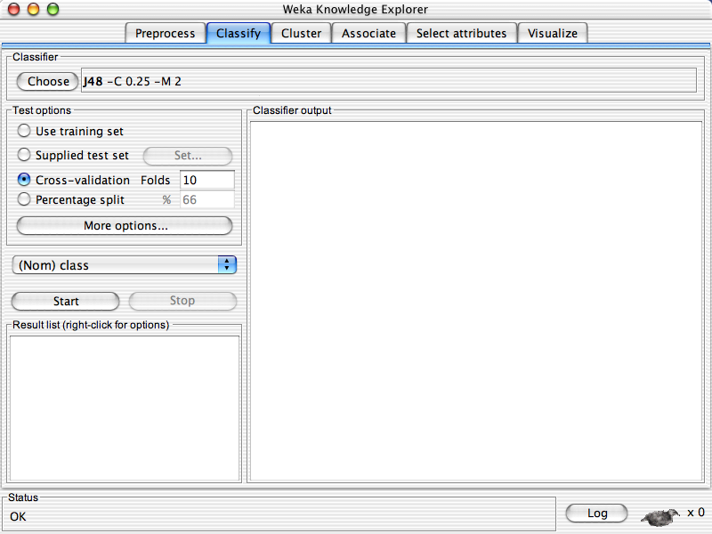
University of Waikato

Slide 40
University of Waikato

Slide 41
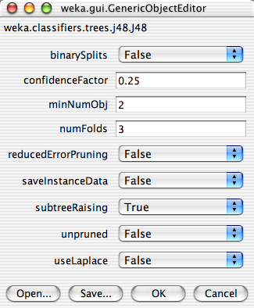
University of Waikato

Slide 42
University of Waikato

Slide 43
University of Waikato

Slide 44
University of Waikato

Slide 45
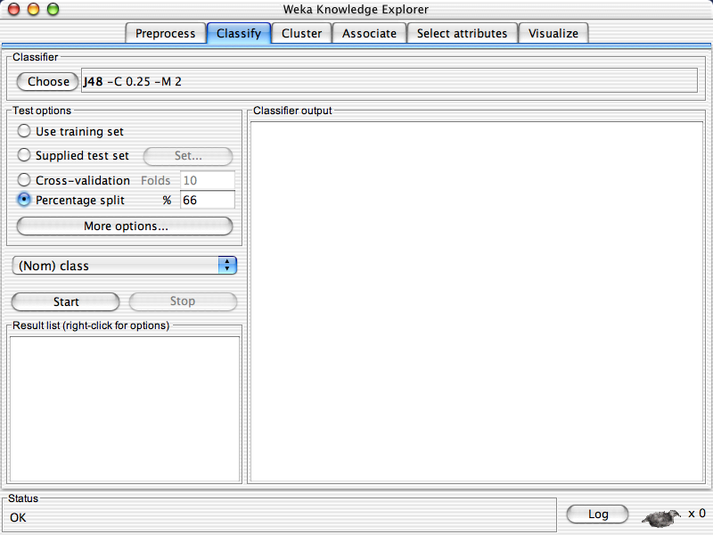
University of Waikato

Slide 46
University of Waikato

Slide 47
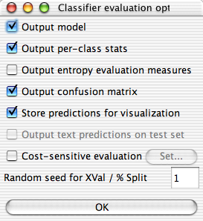
University of Waikato

Slide 48
University of Waikato

Slide 49
University of Waikato

Slide 50
University of Waikato

Slide 51
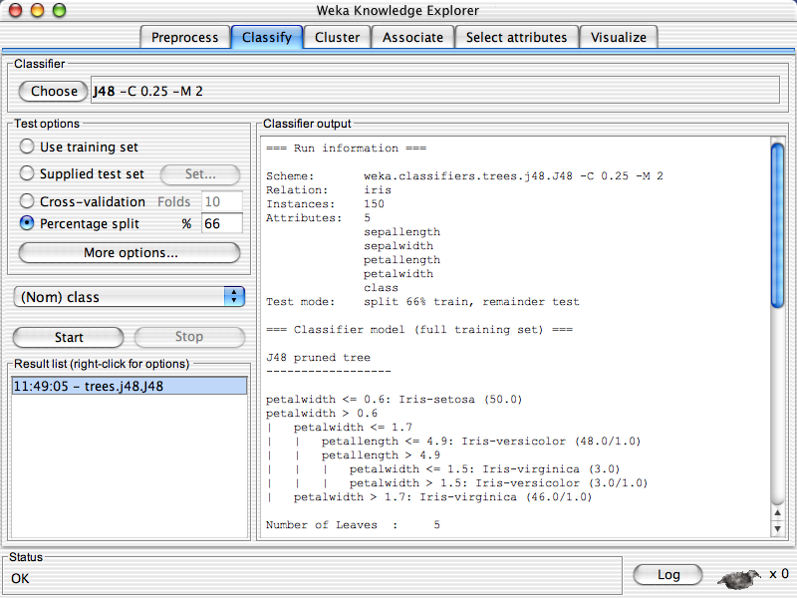
University of Waikato

Slide 52
University of Waikato

Slide 53
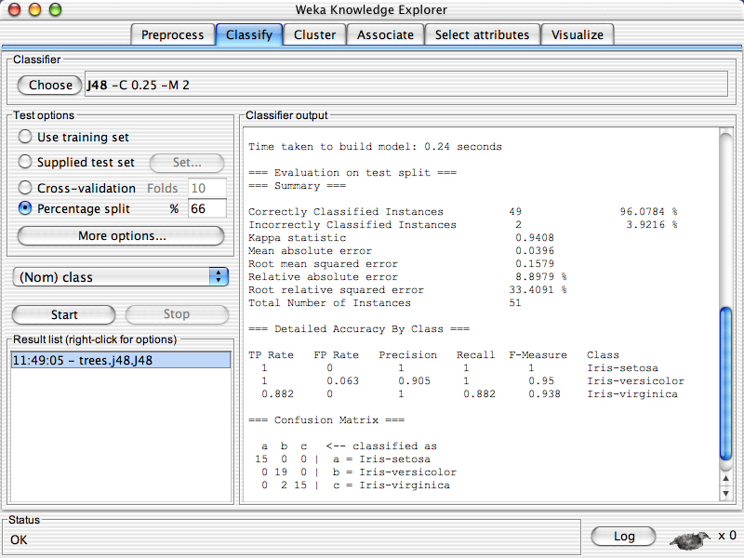
University of Waikato

Slide 54
University of Waikato

Slide 55
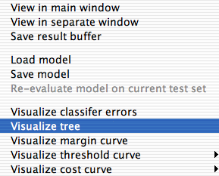
University of Waikato

Slide 56
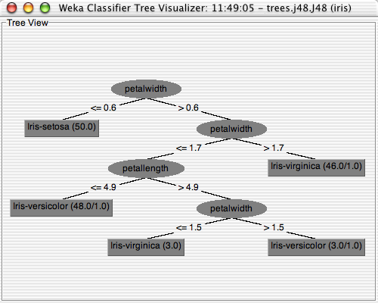
University of Waikato

Slide 57
University of Waikato

Slide 58
Explorer: clustering data
WEKA contains “clusterers” for finding groups of similar instances in a dataset
Implemented schemes are:
  k-Means, EM, Cobweb, X-means, FarthestFirst
Clusters can be visualized and compared to “true” clusters (if given)
Evaluation based on loglikelihood if clustering scheme produces a probability distribution

Slide 59
The K-Means Clustering Method
Given k, the k-means algorithm is implemented in four steps:
  Partition objects into k nonempty subsets
  Compute seed points as the centroids of the clusters of the current partition (the centroid is the center, i.e., mean point, of the cluster)
  Assign each object to the cluster with the nearest seed point
  Go back to Step 2, stop when no more new assignment

Slide 60
Demo Now. (Demo Online)

Slide 61
Explorer: finding associations
WEKA contains an implementation of the Apriori algorithm for learning association rules
  Works only with discrete data
Can identify statistical dependencies between groups of attributes:
  milk, butter ⇒ bread, eggs (with confidence 0.9 and support 2000)
Apriori can compute all rules that have a given minimum support and exceed a given confidence

Slide 62
Basic Concepts: Frequent Patterns
Tid | Items bought
10 | Beer, Nuts, Diaper
20 | Beer, Coffee, Diaper
30 | Beer, Diaper, Eggs
40 | Nuts, Eggs, Milk
50 | Nuts, Coffee, Diaper, Eggs, Milk
itemset: A set of one or more items
k-itemset X = {x₁, …, x_{k}}
(absolute) support, or, support count of X: Frequency or occurrence of an itemset X
(relative) support, s, is the fraction of transactions that contains X (i.e., the probability that a transaction contains X)
An itemset X is frequent if X’s support is no less than a minsup threshold
Customer
buys both
Customer
buys diaper
Customer
buys beer

Slide 63
Basic Concepts: Association Rules
Tid
Items bought
Find all the rules X → Y with minimum support and confidence
  support, s, probability that a transaction contains X ∪ Y
  confidence, c, conditional probability that a transaction having X also contains Y
Let minsup = 50%, minconf = 50%
Freq. Pat.: Beer:3, Nuts:3, Diaper:4, Eggs:3, {Beer, Diaper}:3
10
Beer, Nuts, Diaper
20
Beer, Coffee, Diaper
30
Beer, Diaper, Eggs
40
Nuts, Eggs, Milk
50
Nuts, Coffee, Diaper, Eggs, Milk
Customer
buys both
Customer
buys diaper
Customer
buys beer
Association rules: (many more!)
  Beer → Diaper (60%, 100%)
  Diaper → Beer (60%, 75%)

Slide 64
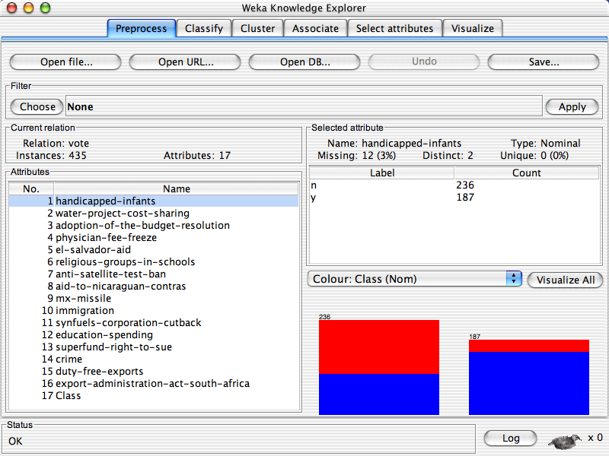
University of Waikato

Slide 65
University of Waikato

Slide 66
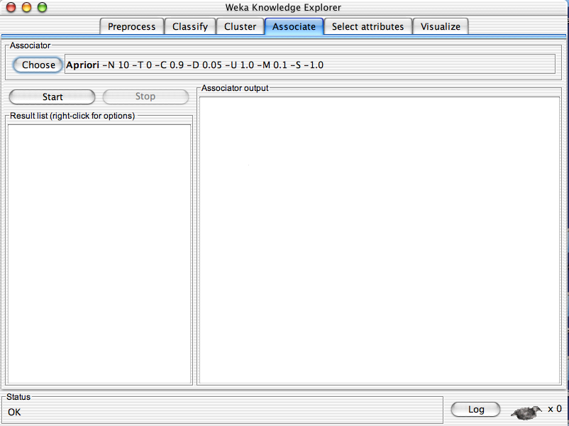
University of Waikato

Slide 67
University of Waikato

Slide 68
University of Waikato

Slide 69
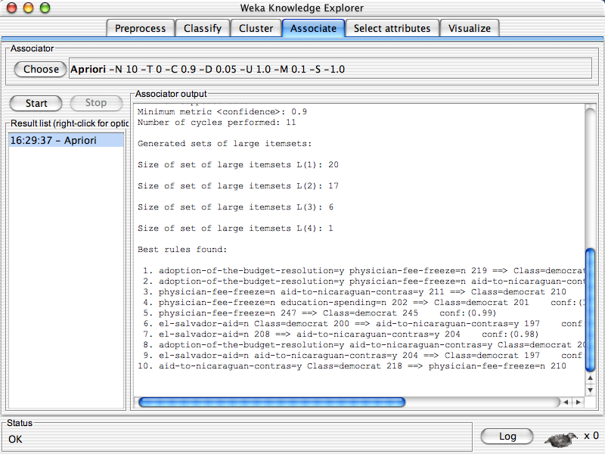
University of Waikato

Slide 70
Explorer: attribute selection
Panel that can be used to investigate which (subsets of) attributes are the most predictive ones
Attribute selection methods contain two parts:
  A search method: best-first, forward selection, random, exhaustive, genetic algorithm, ranking
  An evaluation method: correlation-based, wrapper, information gain, chi-squared, …
Very flexible: WEKA allows (almost) arbitrary combinations of these two

Slide 71
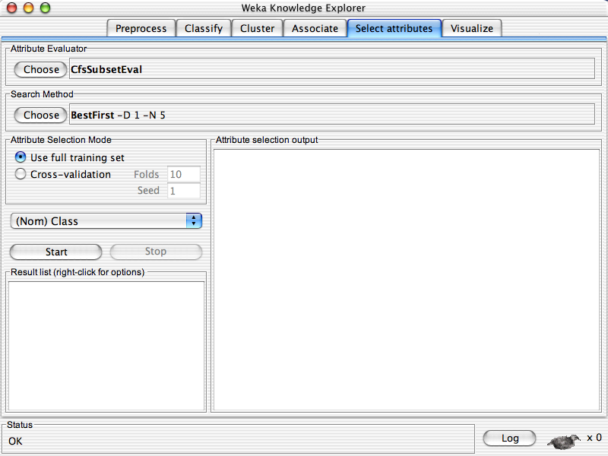
University of Waikato

Slide 72
University of Waikato

Slide 73
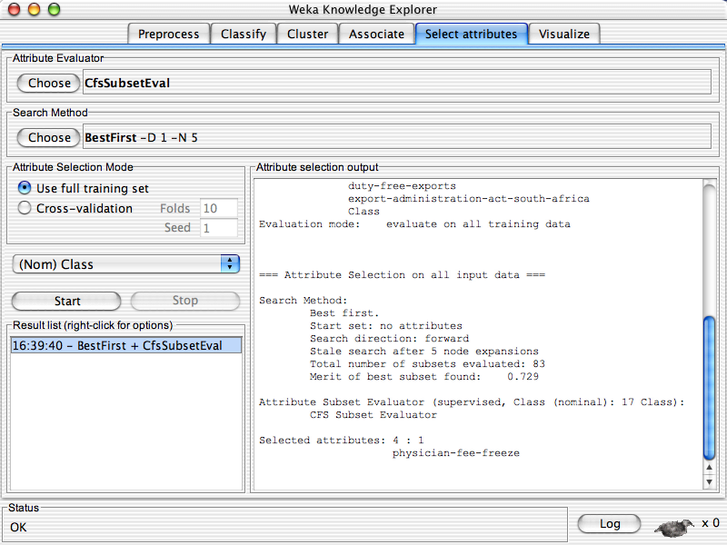
University of Waikato

Slide 74
University of Waikato

Slide 75
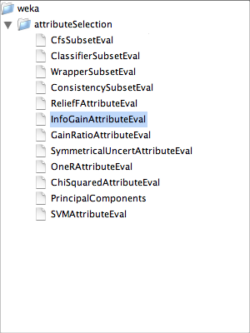
University of Waikato

Slide 76
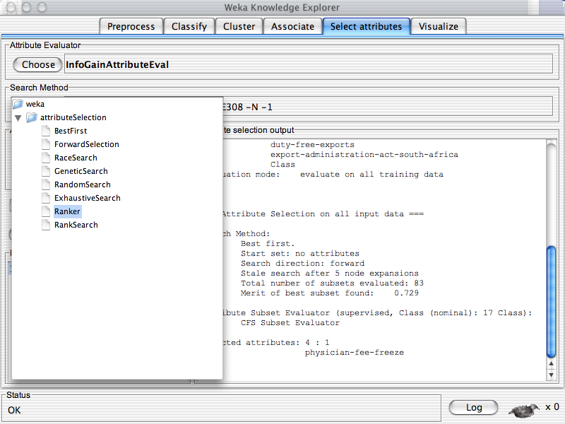
University of Waikato

Slide 77
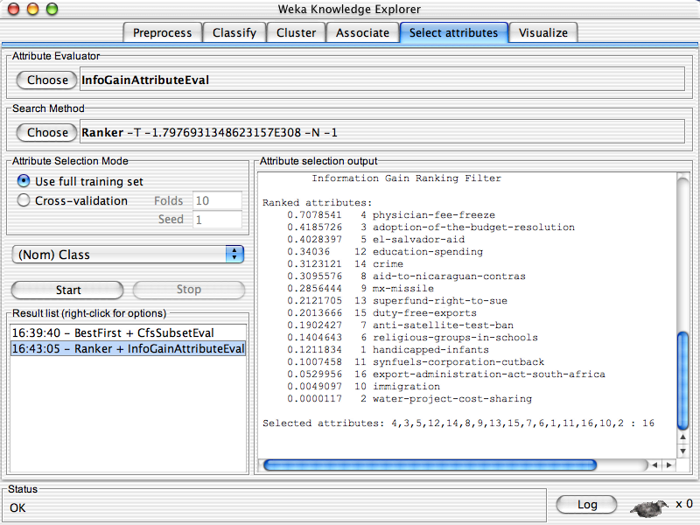
University of Waikato

Slide 78
University of Waikato

Slide 79
Explorer: data visualization
Visualization very useful in practice: e.g. helps to determine difficulty of the learning problem
WEKA can visualize single attributes (1-d) and pairs of attributes (2-d)
  To do: rotating 3-d visualizations (Xgobi-style)
Color-coded class values
“Jitter” option to deal with nominal attributes (and to detect “hidden” data points)
“Zoom-in” function

Slide 80
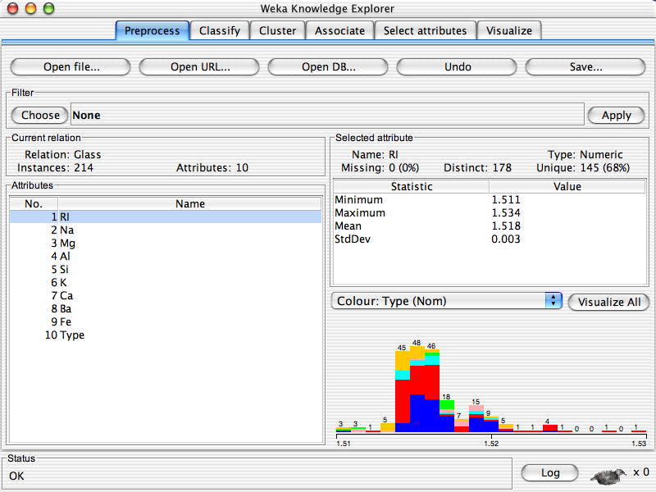
University of Waikato

Slide 81
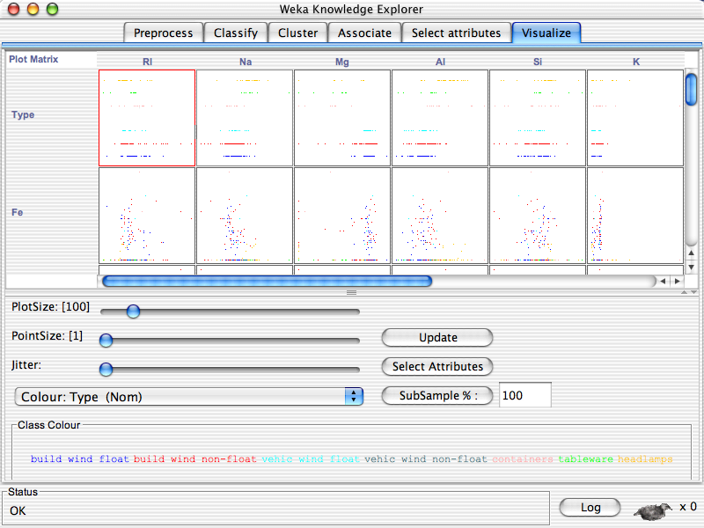
University of Waikato

Slide 82
University of Waikato

Slide 83
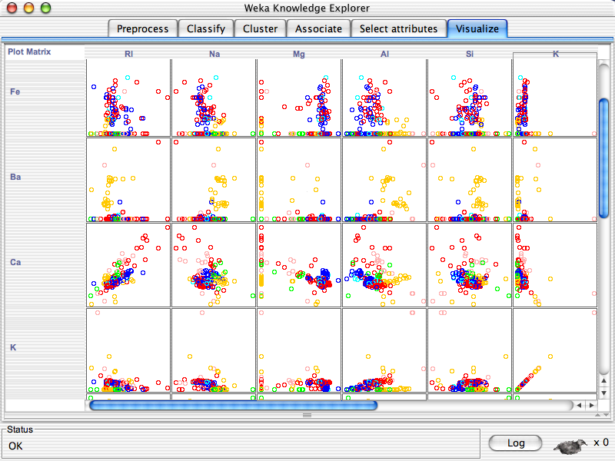
University of Waikato

Slide 84
University of Waikato

Slide 85
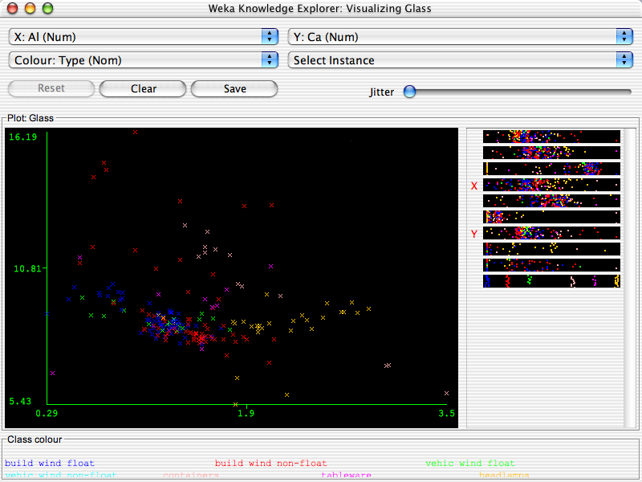
University of Waikato

Slide 86
University of Waikato

Slide 87
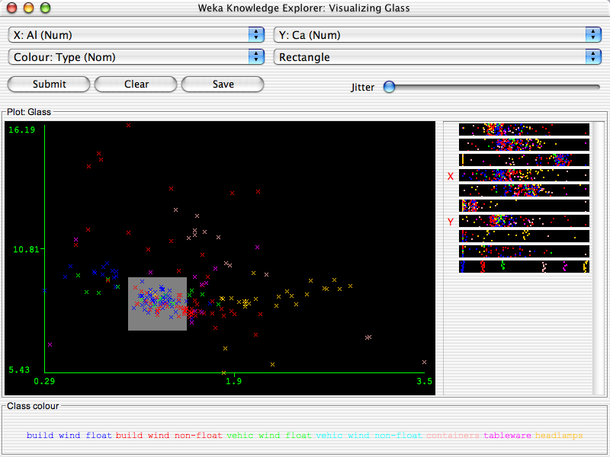
University of Waikato

Slide 88
University of Waikato

Slide 89
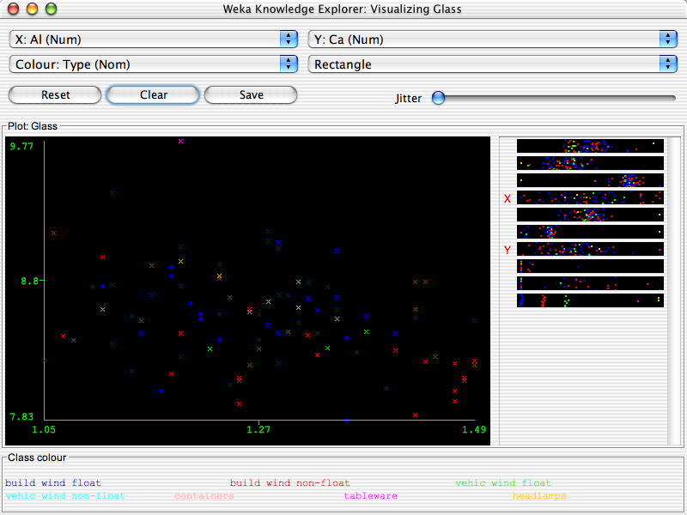
University of Waikato

Slide 90
References and Resources
References:
  WEKA website: http://www.cs.waikato.ac.nz/~ml/weka/index.html
  WEKA Tutorial:
    Machine Learning with WEKA: A presentation demonstrating all graphical user interfaces (GUI) in Weka.
    A presentation which explains how to use Weka for exploratory data mining.
  WEKA Data Mining Book:
    Ian H. Witten and Eibe Frank, Data Mining: Practical Machine Learning Tools and Techniques (Second Edition)
  WEKA Wiki: http://weka.sourceforge.net/wiki/index.php/Main_Page
  Others:
    Jiawei Han and Micheline Kamber, Data Mining: Concepts and Techniques, 2nd ed.

